Slide 1
A Review of GPUOpen Effects
Takahiro Harada & Jason lacroix

Slide 2

An initiative designed to help developers make better content by “opening up” the GPU
Contains a variety of software modules across various GPU needs:
  Effects and render features
  Tools, SDKs, and libraries
  Patches and drivers
Software hosted on GitHub with no “black box” implementations or licensing fees
Website provides:
  The latest news and information on all GPUOpen software​
  Tutorials and samples to help you optimise your game​
  A central location for up-to-date GPU and CPU documentation​
  Information about upcoming events and previous presentations​

Slide 3
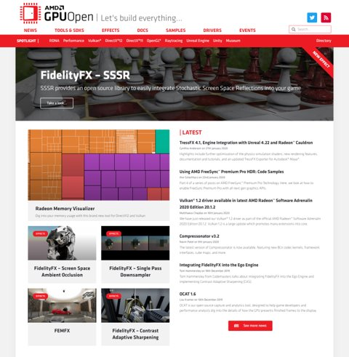

Let’s build a new gpuopen…
Brand new, modern, dynamic website
Easy to find the information you need quickly
Read the latest news and see what’s popular
Learn new tips and techniques from our engineers
Looks good on mobile platforms too!
New social media presence
  @GPUOpen

Slide 4
effects
A look at recently released samples

Slide 5

Tressfx 4.1
Self-contained solution for hair simulation
Implementation into Radeon® Cauldron framework
  DirectX® 12 and Vulkan® with full source
Optimized physics simulation
  Faster velocity shock propagation
  Simplified local shape constraints
  Reorganization of dispatches
StrandUV support
New LOD system
New and improved Autodesk® Maya® exporter

Slide 6
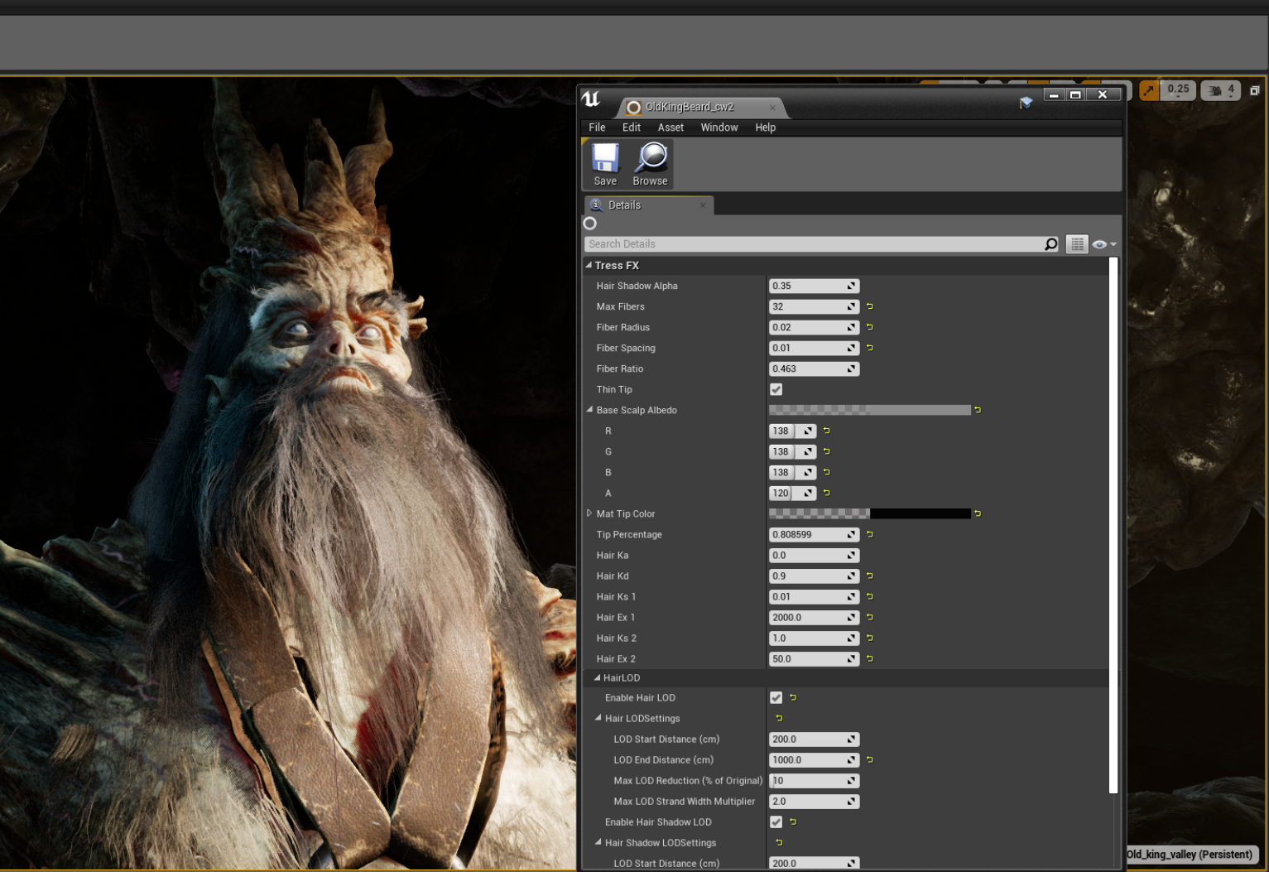
Tressfx 4.1 – ue4 ®
External code module requiring minimal hooks
Reference renderer for hair
Provides a starting point for developers to integrate TressFX into their Unreal ® -based games
Features
  Unreal ® shadow system support*
    *Dynamic lights only
  Parameter blending via blend maps
  TressFX component
  .uasset support for TressFX data files
    Can be drag and dropped into Unreal ®

Slide 7
Demo
Tressfx 4.1 UE4

Slide 8
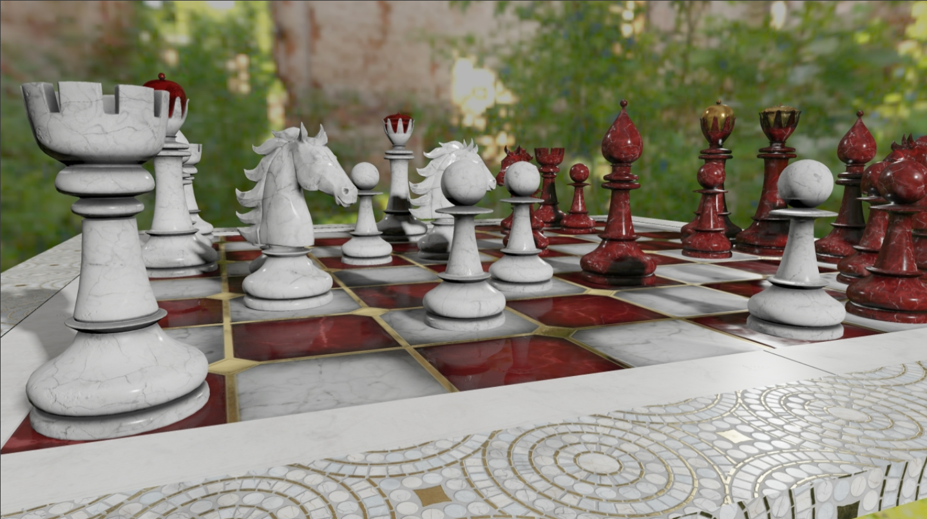
Fidelityfx – SSSR
Stochastic screen space reflections (SSSR)
Based on industry leading algorithm
Hierarchical depth buffer traversal kernel
Glossy reflections via Ray Jittering
High performant spatio-temporal denoisers
Tile classifier that allows skipping non-reflective areas
HLSL SM 6.0 with wave-level optimizations
D3D12
Vulkan (coming soon)

Slide 9


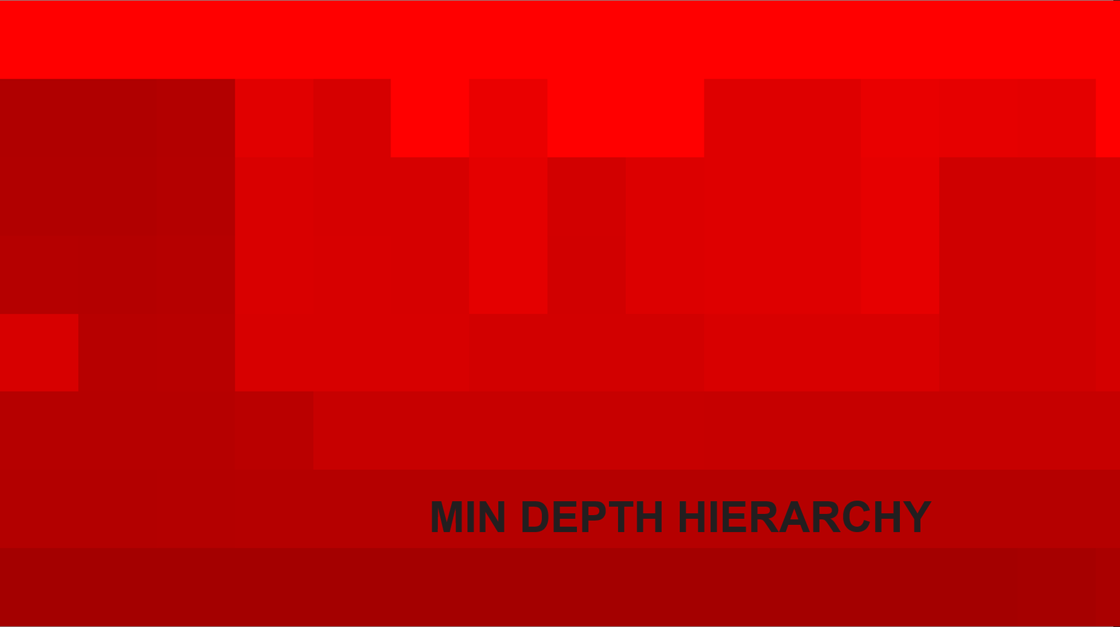
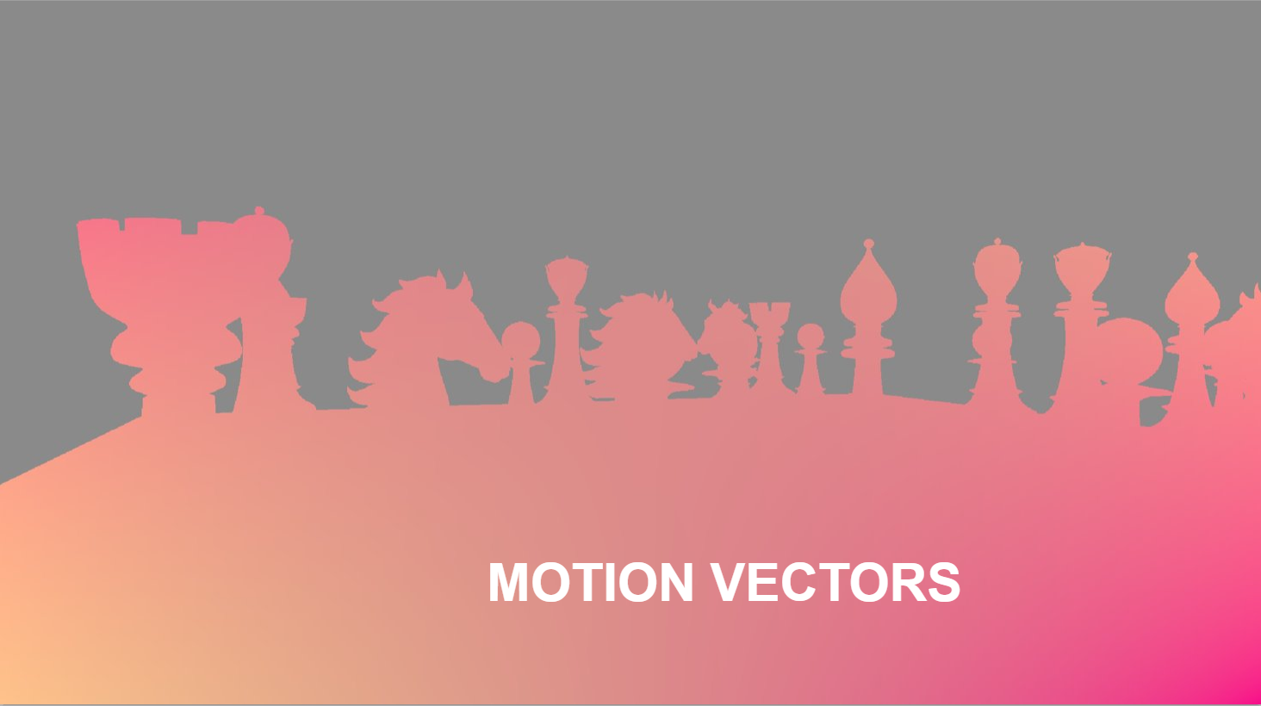
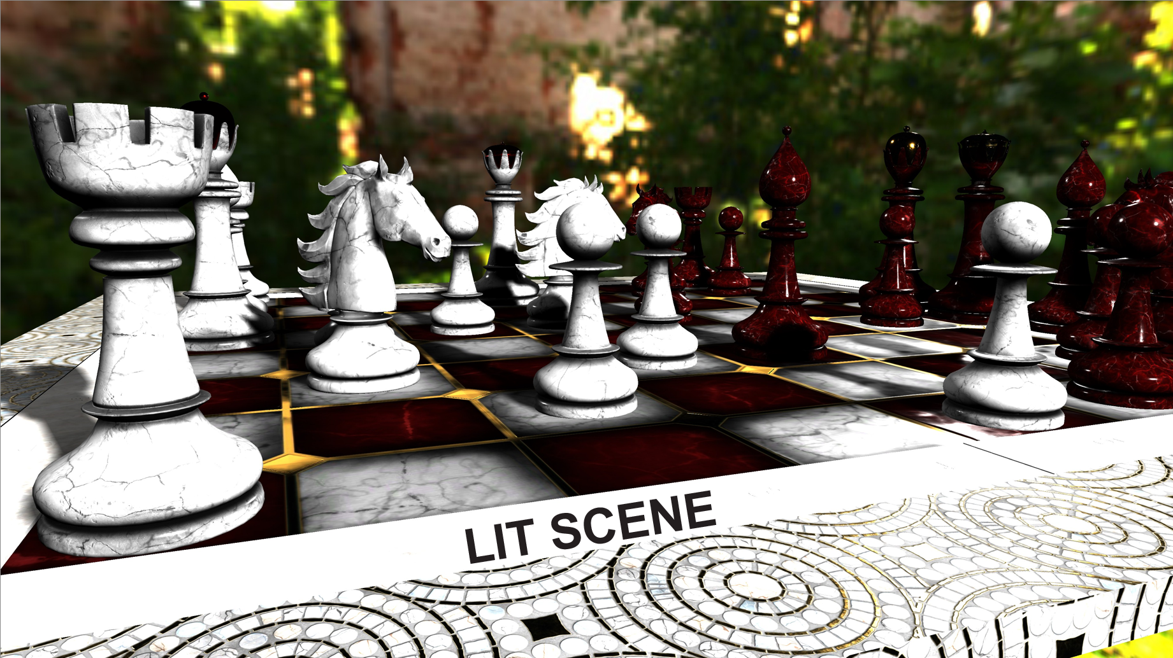
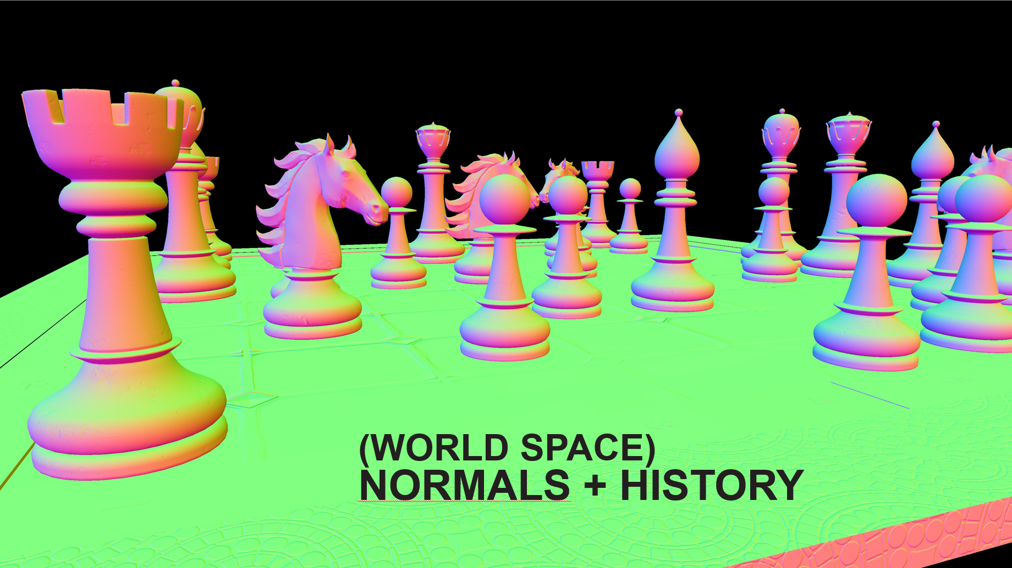
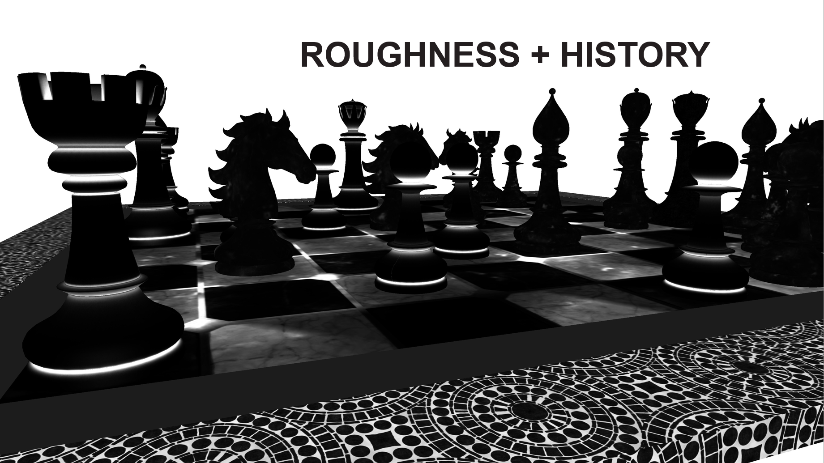
Fidelityfx – SSSR
Surface requirements
  Depth Hierarchy (2x2 minimum)
  Per pixel motion vectors
  Resolved scene
  Normals for current and last frame
  Roughness for current and last frame

Slide 10
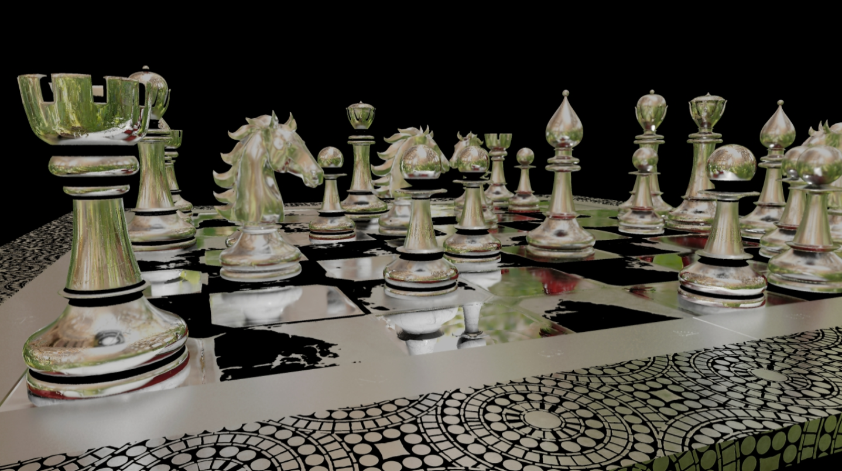
Fidelityfx – SSSR
Tile Classification Pass
  Which pixel needs a ray
  Which tile needs a denoiser
Intersection Pass
  Hierarchical trace through the depth buffer to find first intersection
  Looks up environment map as fallback
  Variable rate traversal
    1 ray per pixel for mirror surfaces
    1 ray per 4 pixels for rough surfaces
Denoiser Passes

Slide 11
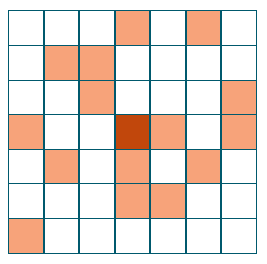
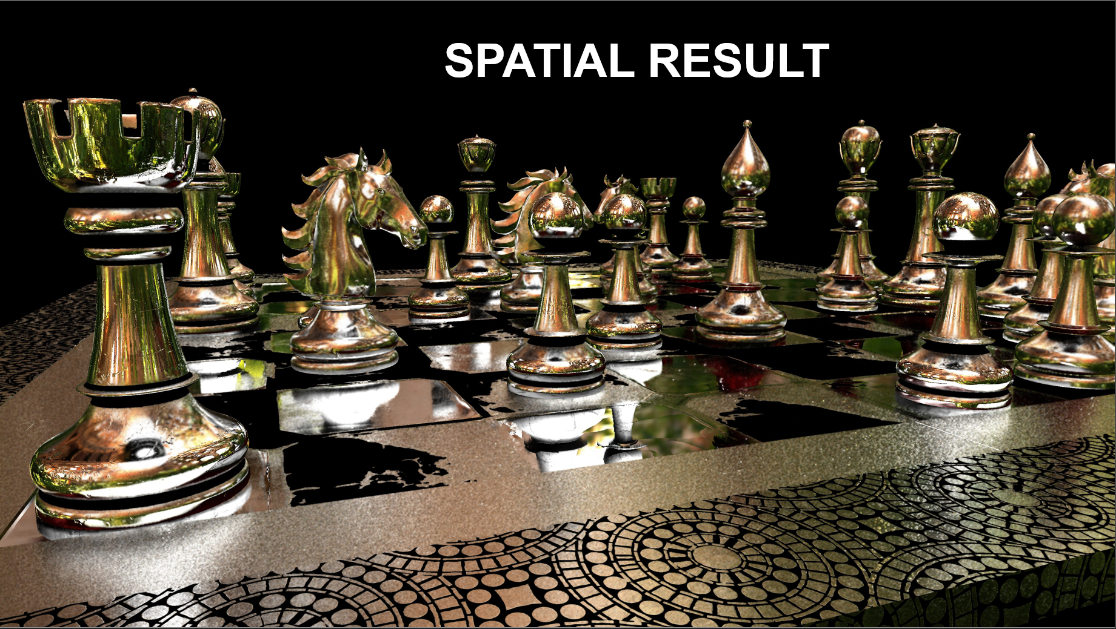
Fidelityfx – SSSR
Spatial Denoiser Pass
  16 samples of Halton Sequence (2,3) discretized to 7x7 region
  Edge stopping weight based on normal
  Gaussian weight based on depth difference
  Accumulate all radiance values
  Normalize using accumulated weights
Temporal Denoiser Pass
  Temporal reprojection based on surface position
  Temporal reprojection based on hit position
  Picks the best result between the two
Edge-Aware À-Trous Wavelet Filter (EAW)
  Get rid of remaining spatial noise

Slide 12
Demo
FidelityFX: SSSR

Slide 13
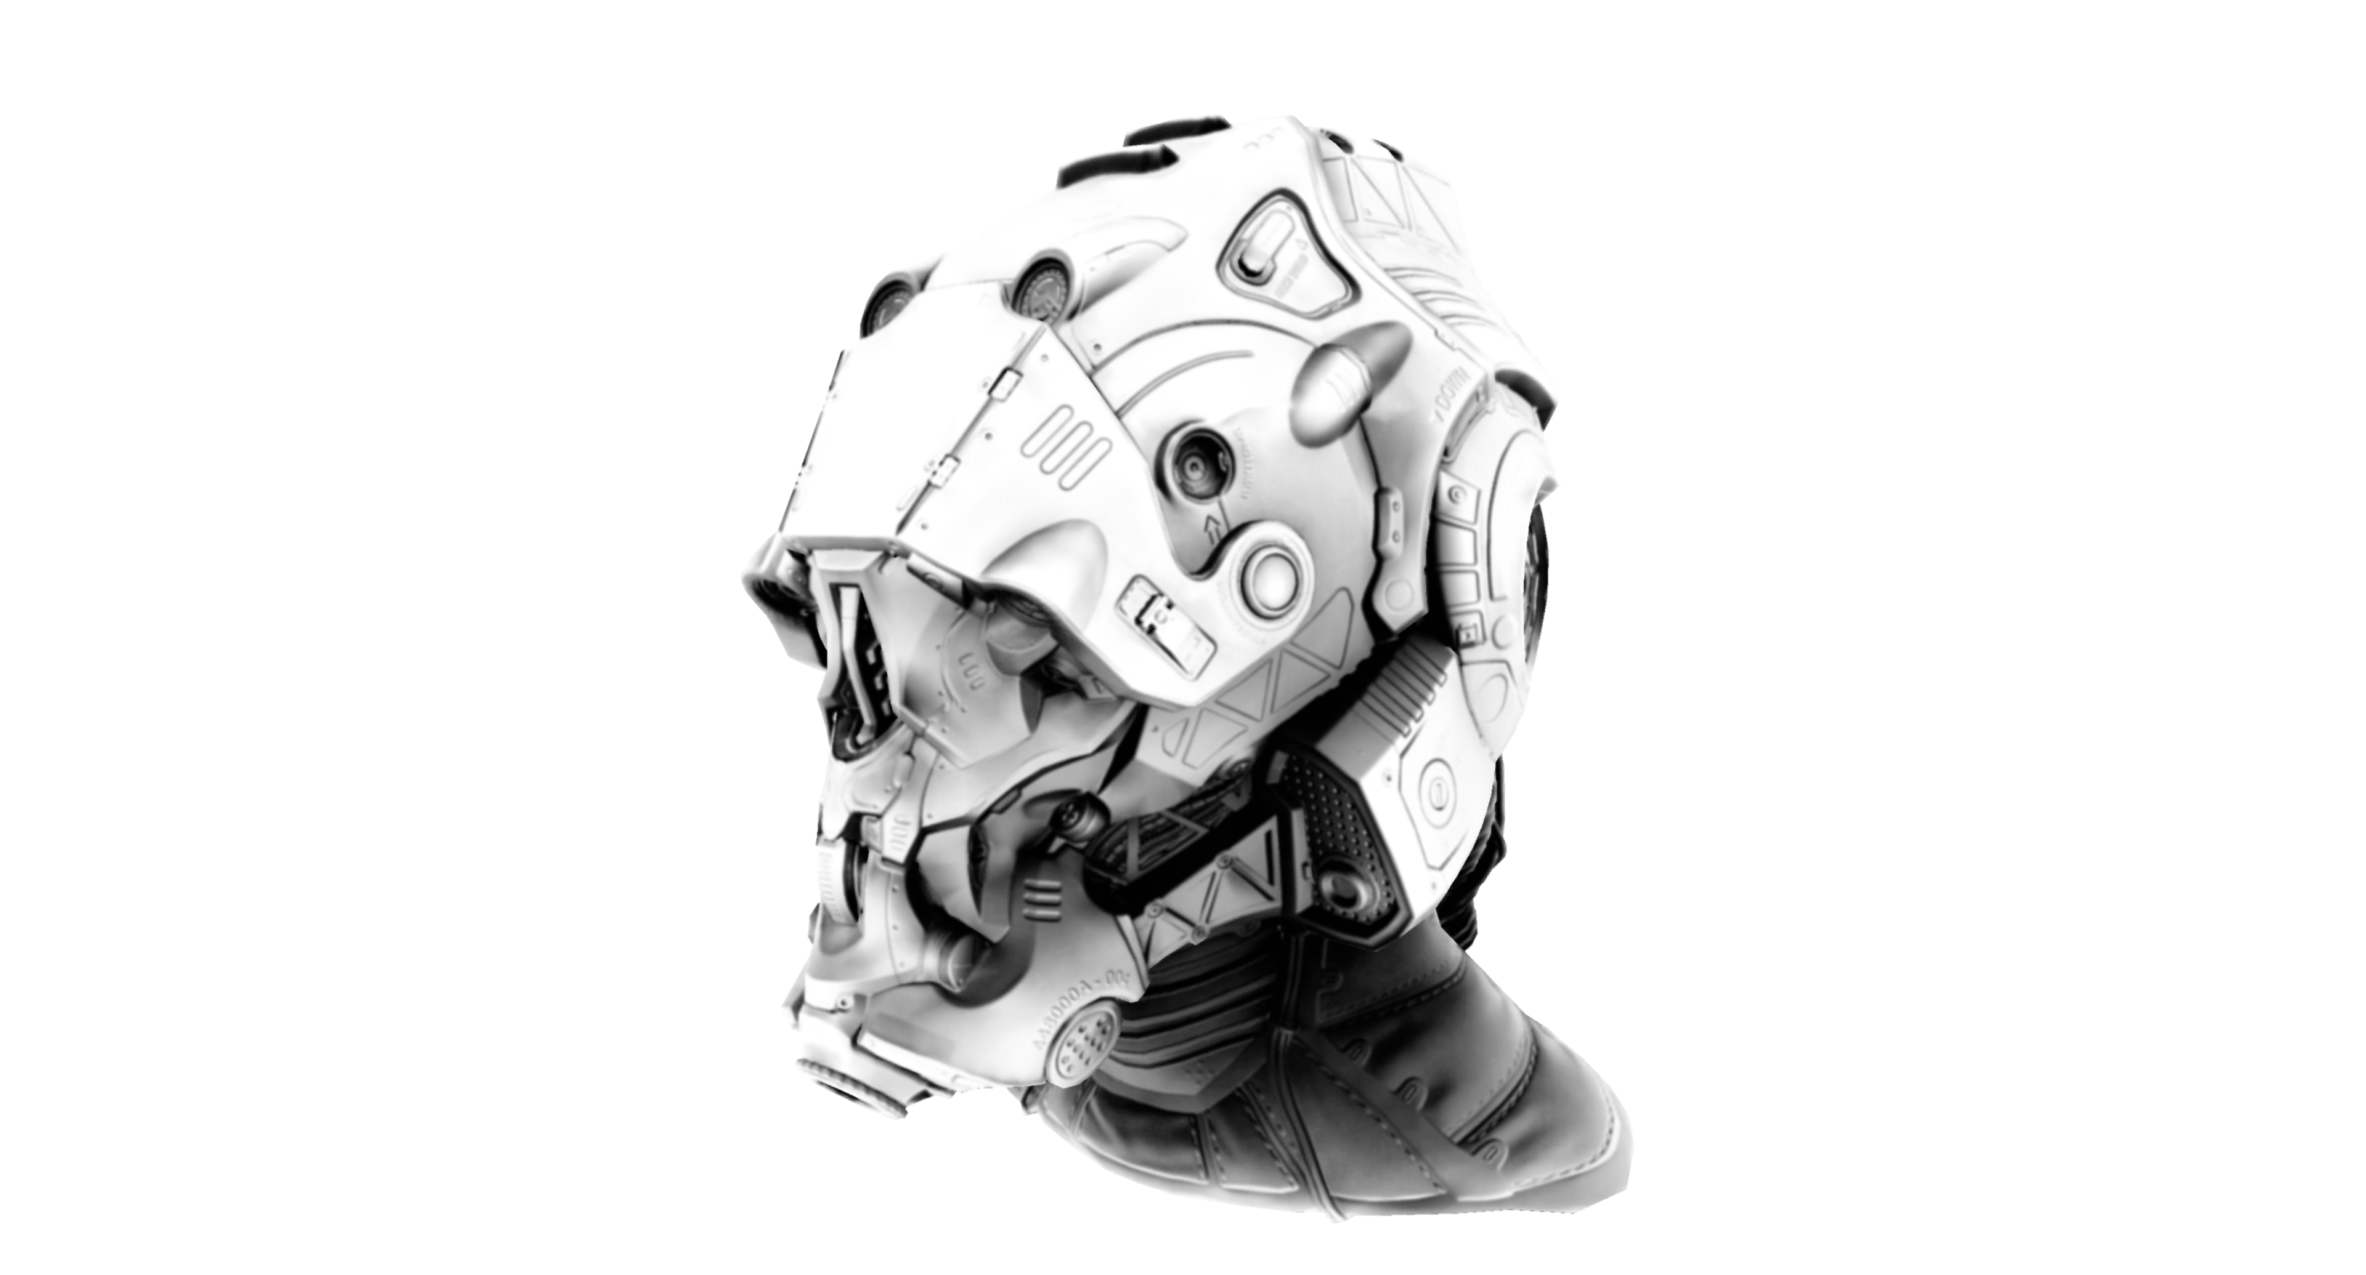
FidelityFX – CACAO
Combined Adaptive Compute Ambient Occlusion (CACAO)
A highly optimized implementation of SSAO
Multiple settings which balance performance and quality
Requirements
  Depth buffer
  Normal buffer (optional)
Supports
  DX12
  Vulkan (coming soon)

Slide 14
Demo
FidelityFX: CACAO

Slide 15
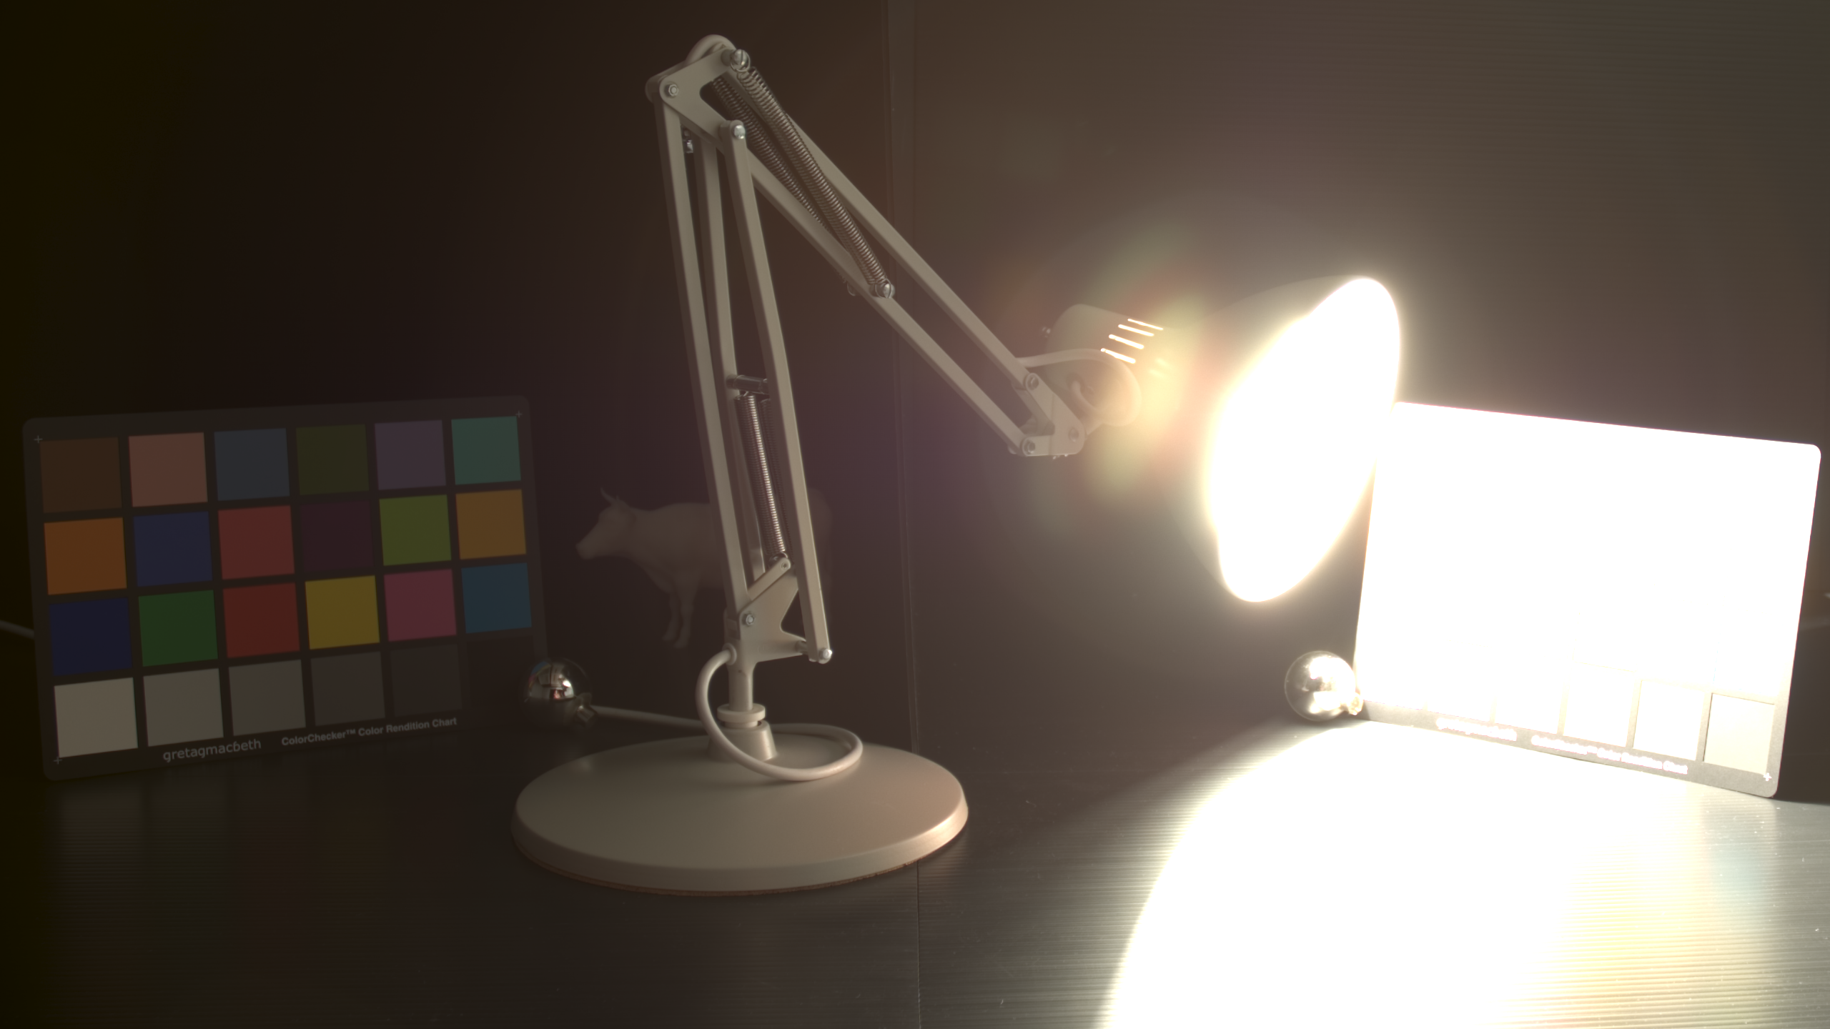
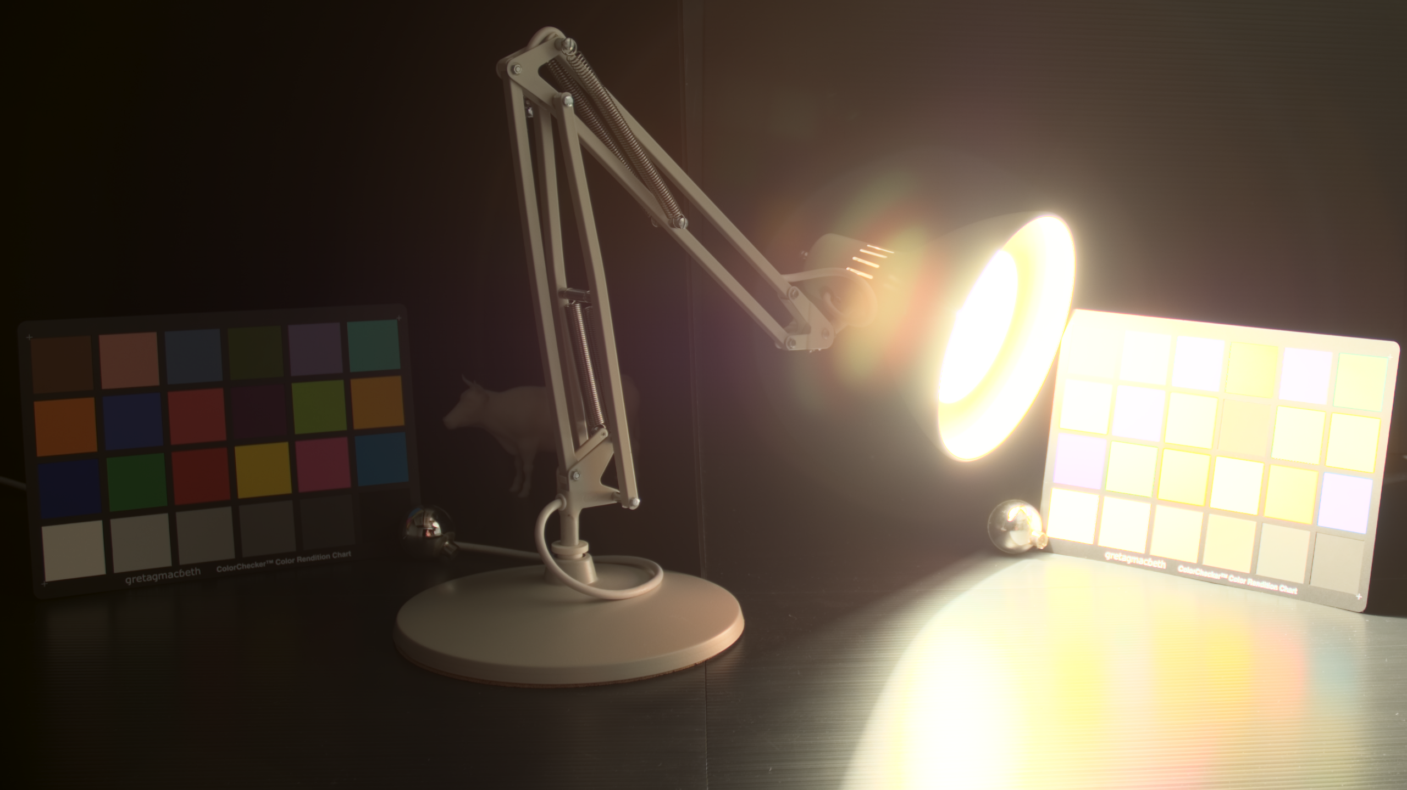
FidelityFX – LPM
Luma Preserving Mapper
  Help balance content for HDR and wide gamut
  Tonemap(Luma(RGB)) rather than Luma(Tonemap(RGB))
Key Takeaways:
  Works with any positive RGB input
  Targets any RGB output
    Presets for available for common colorspaces
      REC709, P3, REC2020, HDR10, FS2
  Completely ALU based solution without LUT
    Can be easily decoupled to run to async compute queue
  Supports FP16
    Better perf on Vulkan
Available for Vulkan and D3D12

Slide 16
Demo
FidelityFX: Luma Preserving Mapper

Slide 17
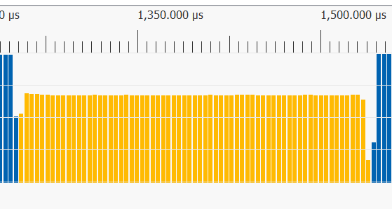
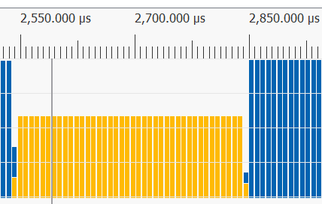
FidelityFX – CAS
Contrast Adaptive Sharpening (CAS)
First effect in the FidelityFX library
For sharpening and optional upsampling
  Enhances sharpness and local high-frequency contrast lost due to TAA
  Created to provide natural sharpness without artifacts with low overhead
  Upsampling designed for Dynamic Resolution Scaling (DRS)
Single compute dispatch call
CAS Upsample & Sharpen 1440p to 4K: 0.287ms RX 5700 XT
CAS Sharpen Only 4K: 0.301ms RX 5700 XT

Slide 18
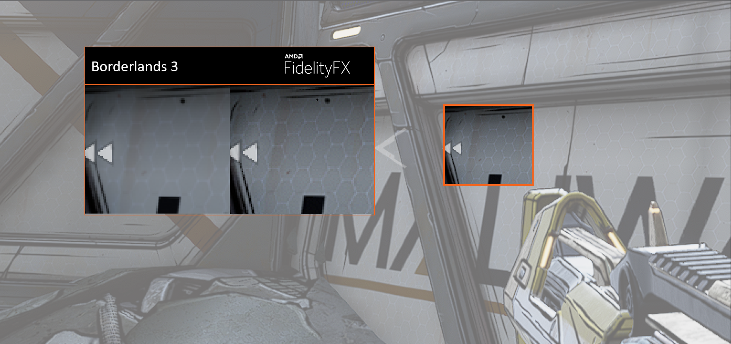
FidelityFX – CAS

Slide 19
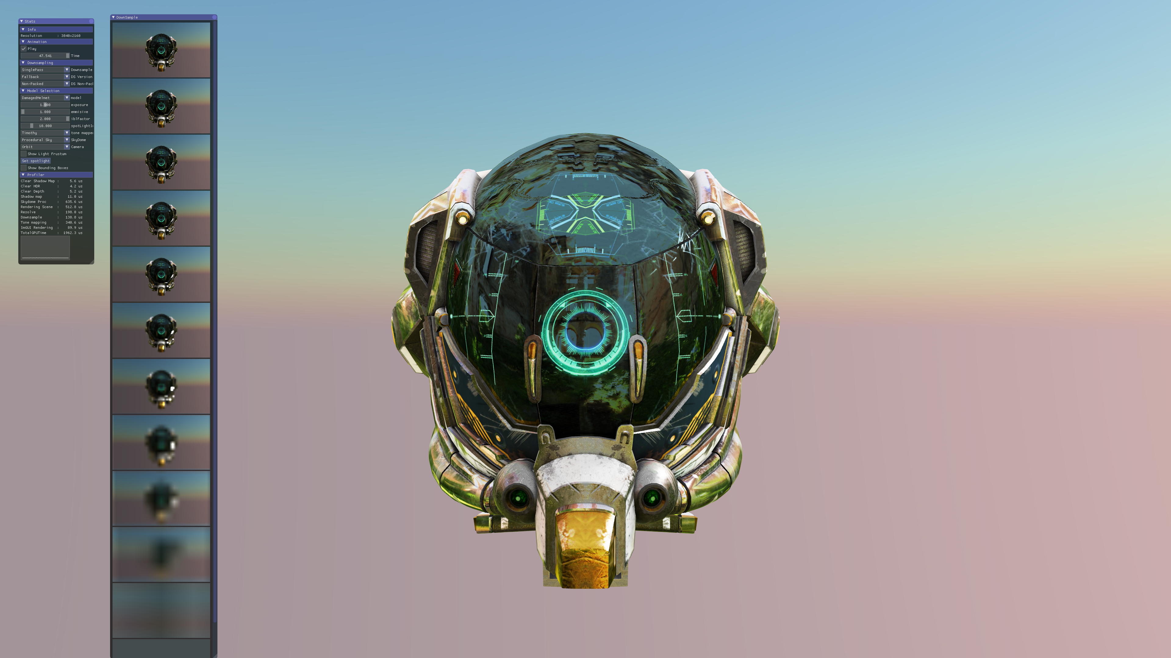
Fidelityfx – SPD
Single Pass Downsampler (SPD)
Downsamples texture from 4kx4k down to 1x1
User configurable 2x2 reduction operation
GLSL and HLSL code available
Compute shader based solution
Suitable for async compute
2 modes of execution
  Using wave operations and LDS
  Using LDS without wave operations
FP16 support

Slide 20
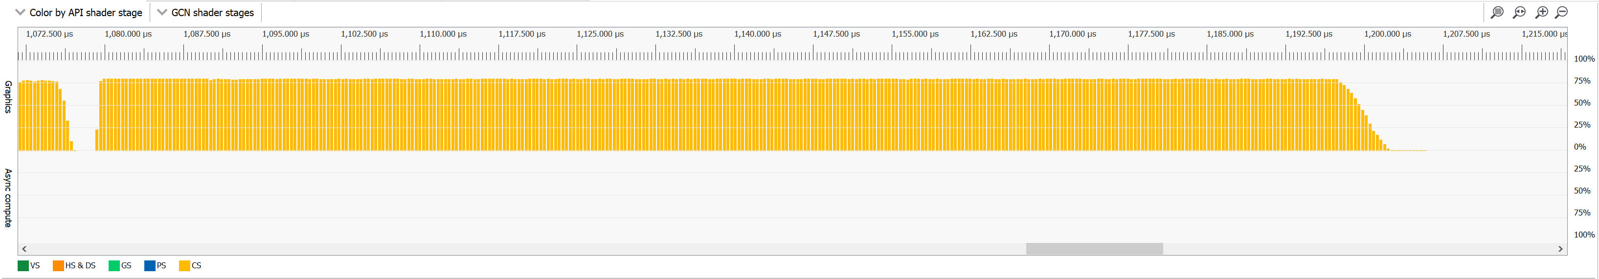
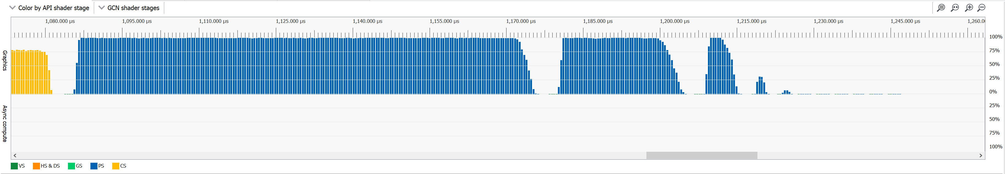
Fidelityfx – SPD
SPD vs.
traditional multipass pixel shader
4k source image
11 mip levels generated
SPD: 0.127 ms
Multi-pass Pixel Shader: 0.166 ms
SPD - 0.127 ms on Radeon RX 5700 XT
Multi-pass Pixel Shader - 0.166 ms on Radeon RX 5700 XT

Slide 21
FEMFX

Slide 22
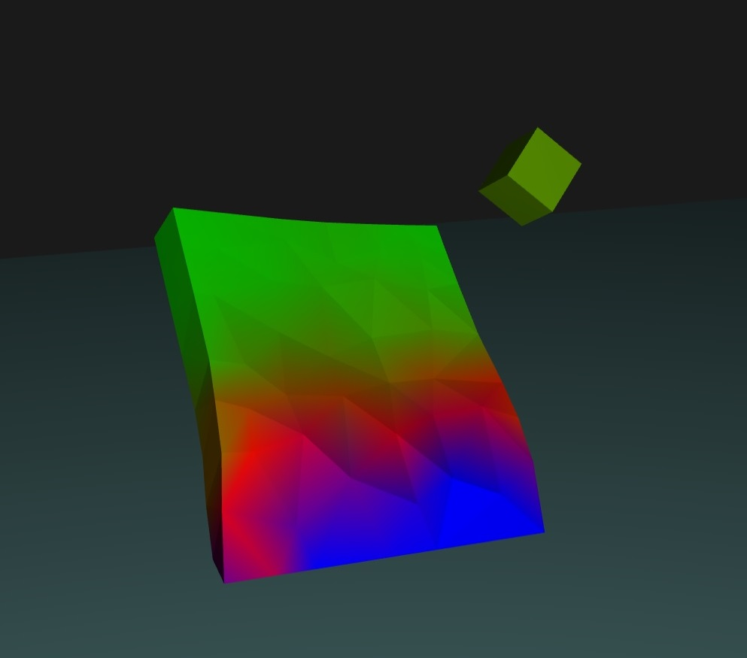
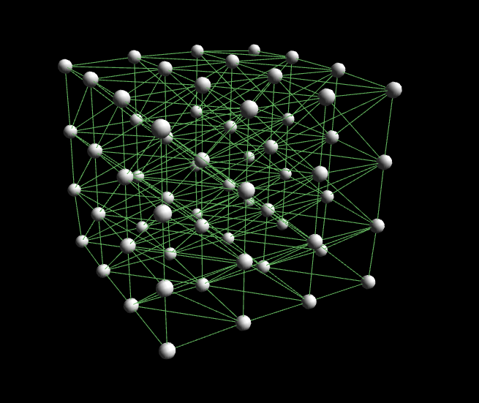
FEM Fundamentals
Physics method for deformable materials
Models a solid as a mesh of elements (tetrahedra)
Each element has material parameters
  Stiffness
  Volume preservation
  Stress limit before permanent (plastic) deformation
  Stress limit before fracture

Slide 23
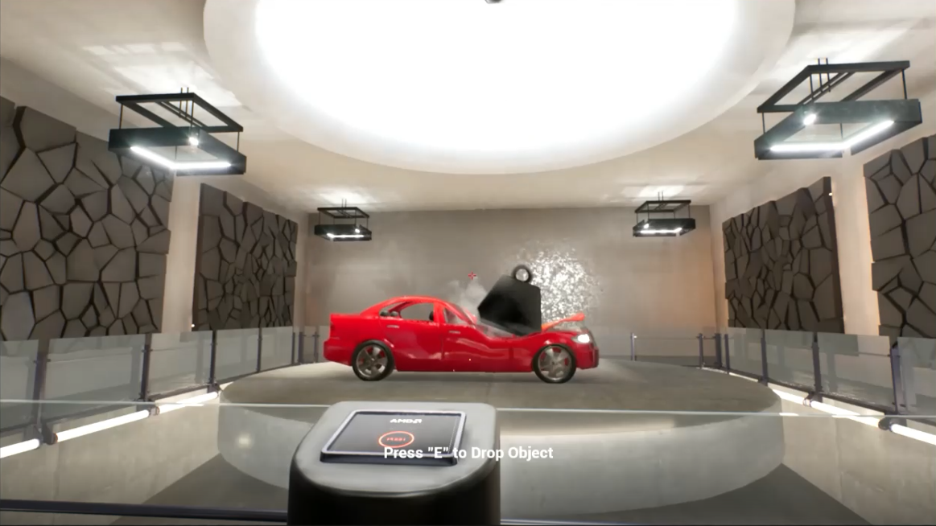
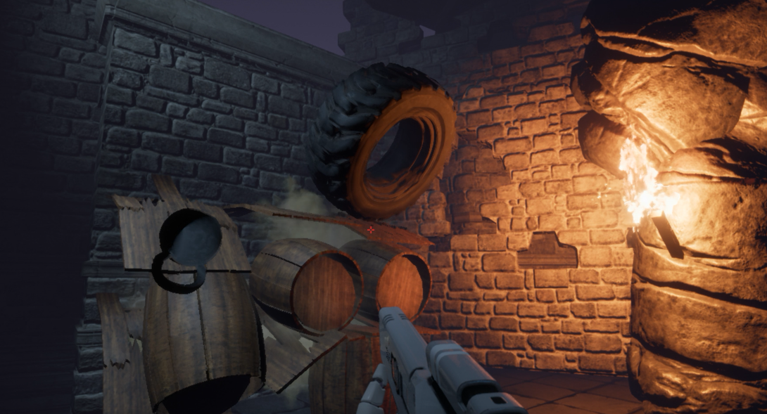
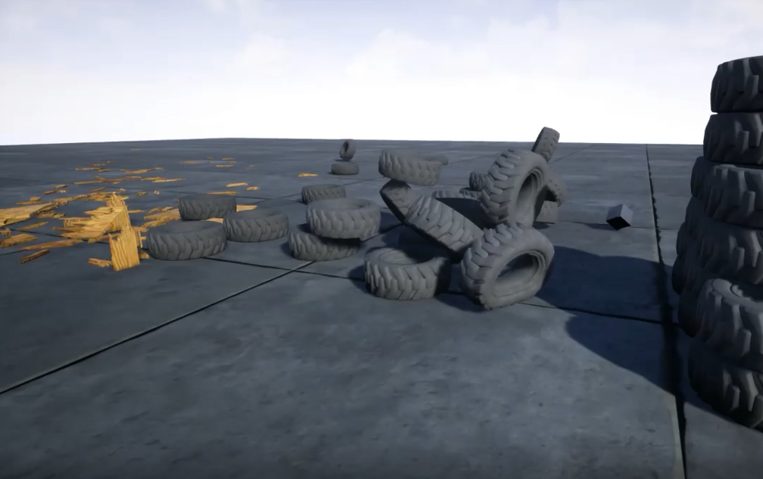
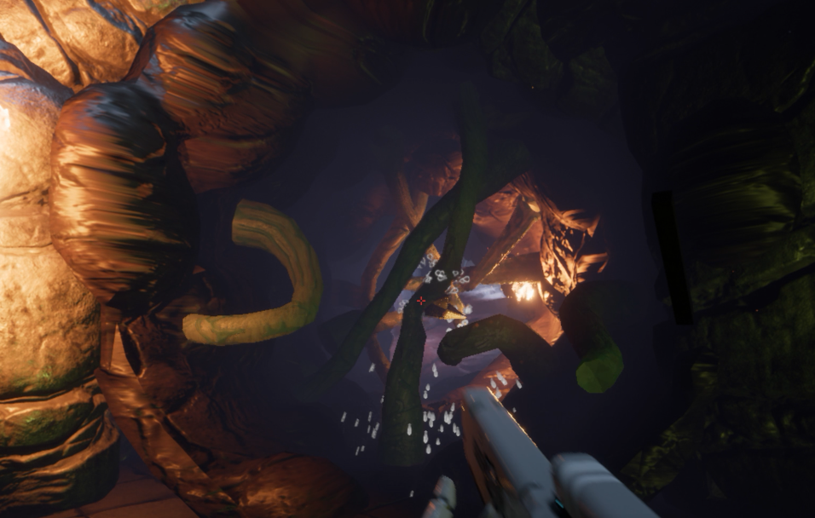
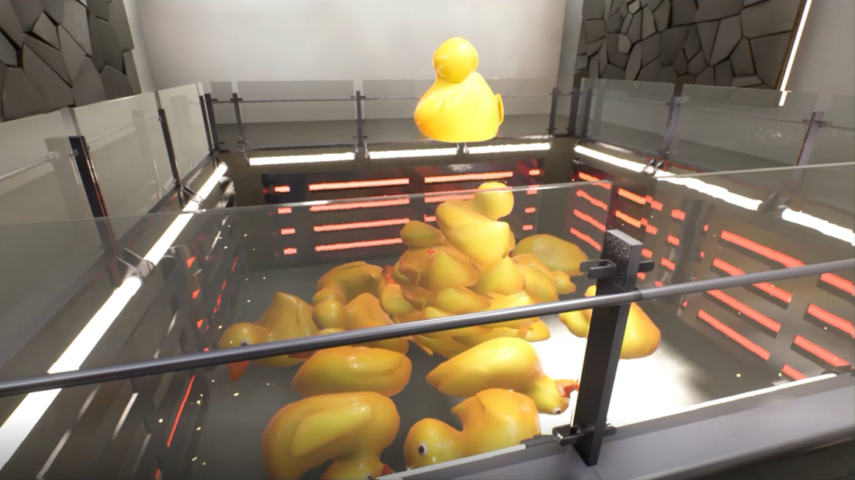
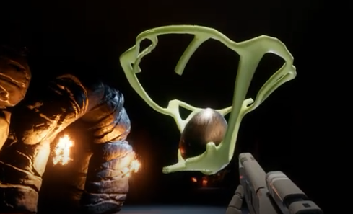
Benefits
A different kind of physics for different effects
Simulates deformable materials
  Bending metal
  Wood that flexes and breaks
  Compressing, bouncing tires
  Melting objects
  “Alien” materials
Improves fidelity
  Realistic flexing
  Storing and release of energy
  Snap when breaking
  Less brittle-looking fracture
New interaction possibilities

Slide 24
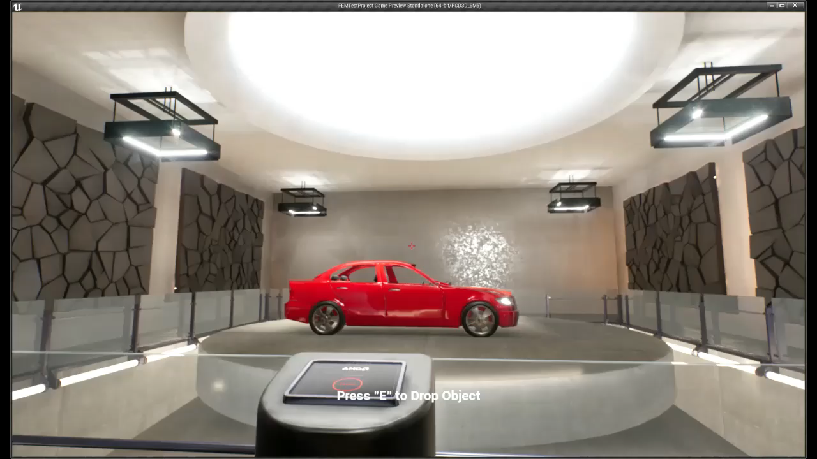
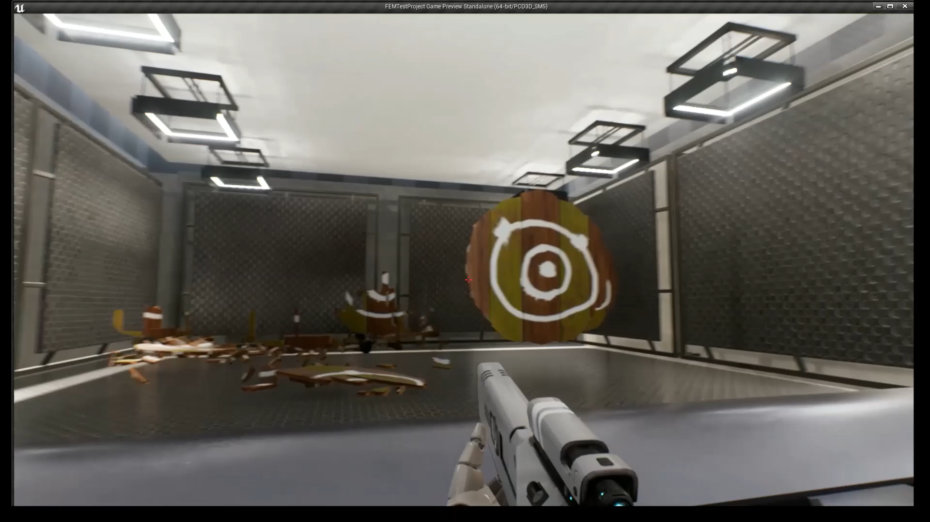
Demo

Slide 25
FEMFX Library
Open source with GPUOpen license
Multithreaded CPU implementation
  For interaction with gameplay and other systems
  Following trend of increasing CPU cores
  SIMD optimizations
Release includes
  Houdini authoring tools
  UE4 Plugin as example engine integration

Slide 26
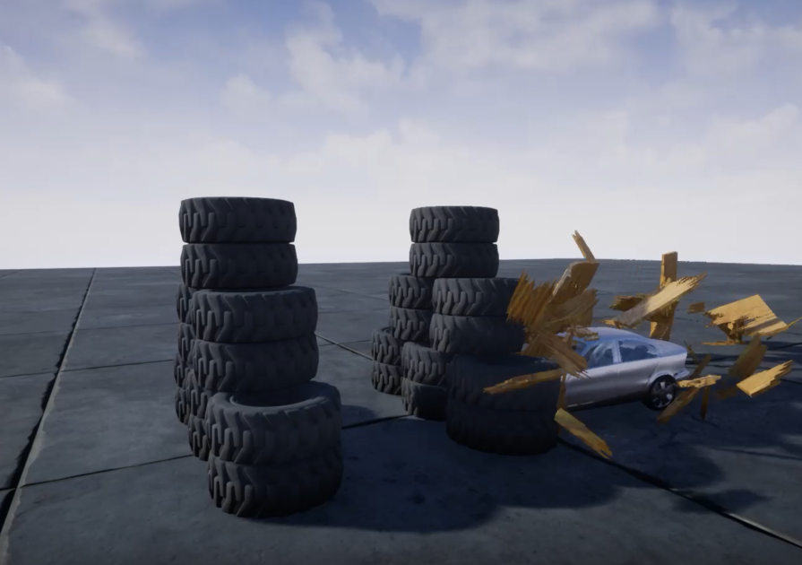
Implementation Highlights
Implicit integration for stiff materials
  Benefits stability and convergence
Constraint-based contact between objects
  Supports stacking
  Compatibility with rigid-body solvers
Continuous collision detection
  Reduces missed collisions, tunneling
  Using approximate method
Multiplicative plasticity
  Found behavior better than additive
  Intuitive limits
Sleeping feature to freeze slow-moving objects
Disabling feature to remove object from simulation
Non-fracture groups

Slide 27
Threading Approach
Library uses all async threading
  Dispatched tasks detect completion of work
  One of these tasks submits a task to continue
  Handles all the task synchronization
High level threading features implemented in the library
  Parallel for
  Task graph
Has a callback interface to support external task systems
  Mostly just async task submit

Slide 28
Rendering
Demonstrated in UE4 Plugin
Render mesh is separate from tetrahedral mesh
  Allows more visual detail than simulation detail
Preprocessing finds correspondence between them
  Attaches each render vertex to closest tetrahedron
  Finds barycentric coords of vertex in tetrahedron (four weights)
At run-time vertices driven by tetrahedral mesh and weights
  Like skinning
  Can be done in a vertex shader
Render meshes authored in pieces
  Which break up with fractures in the tetrahedral mesh
After fracture, may re-assign vertex to another tetrahedron
  To keep vertices of the same render mesh piece together

Slide 29
Radeon™ ProRender

Slide 30
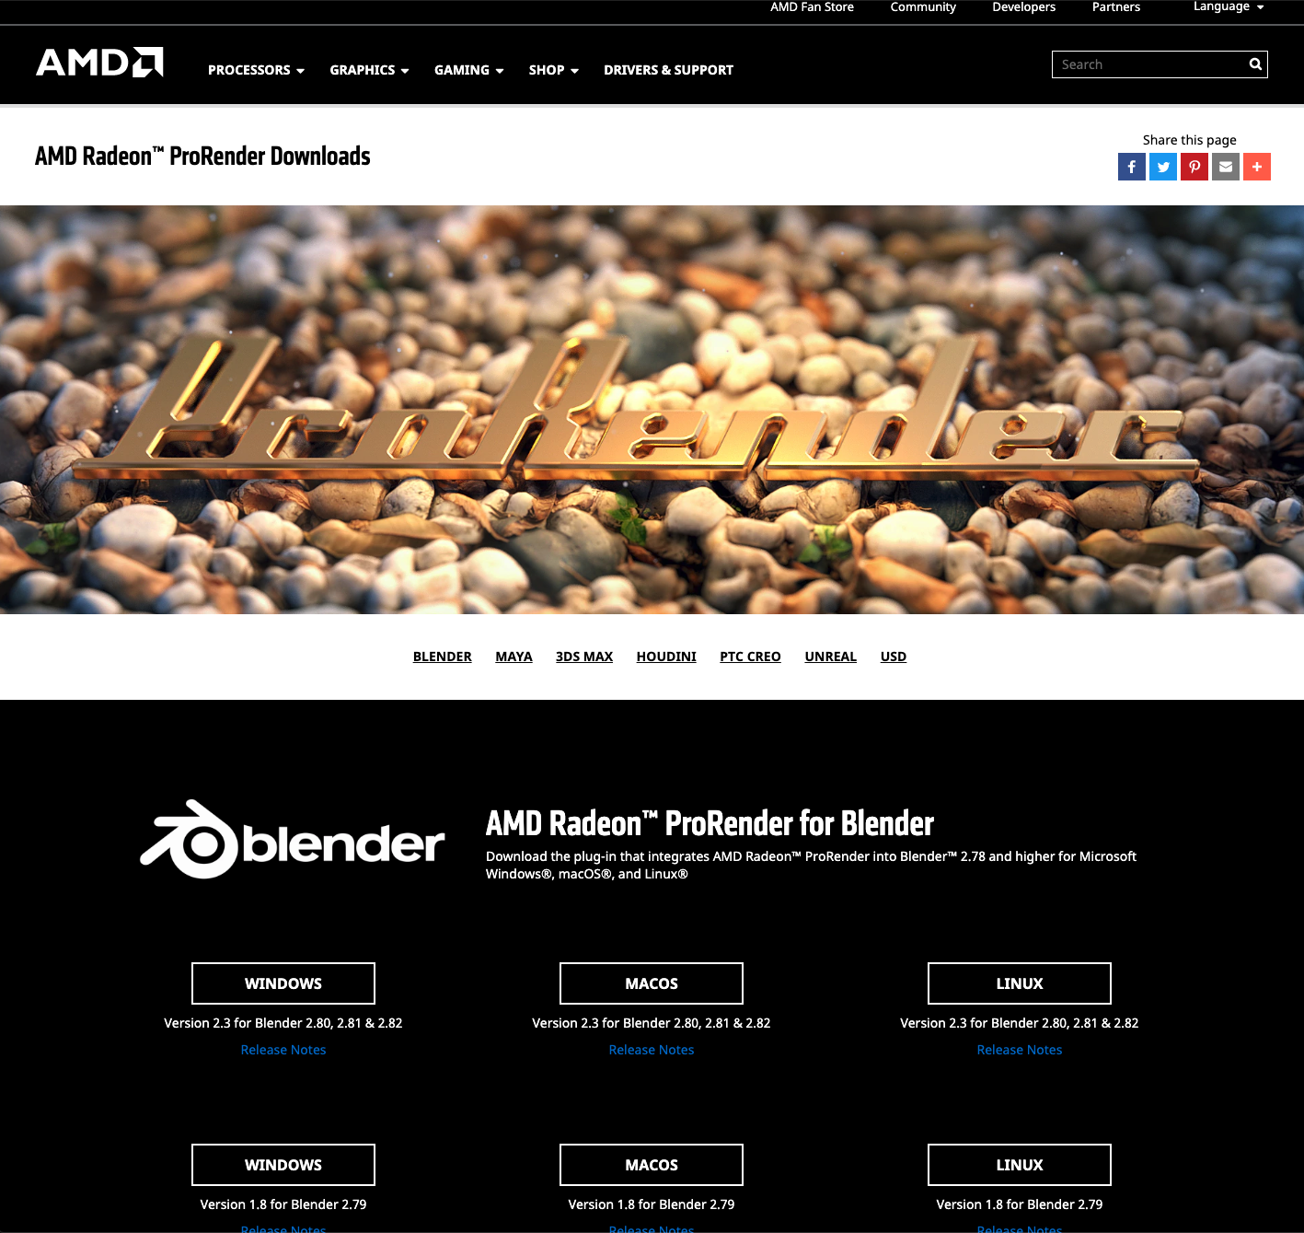
Radeon™ ProRender
A powerful physically-based path traced rendering engine
Supports GPUs and CPUs (OpenCL™ or Apple® Metal®)
Works across Windows®, Linux®, and macOS®
Plugins, integrations for artists
  Maya, Max, Blender plugins
  Integrations from our partners
  USD Hydra delegate (Houdini)
https://www.amd.com/en/technologies/radeon-prorender-downloads

Slide 31
Radeon™ ProRender
SDK for developers
Open access to the SDK at GDC2020
Radeon ProRender 2.0
  Re architected for better experience
  Improvements
    Rendering speed
    GPU memory reduction
    MaterialX support
Created by Nick Nikiforov

Slide 32
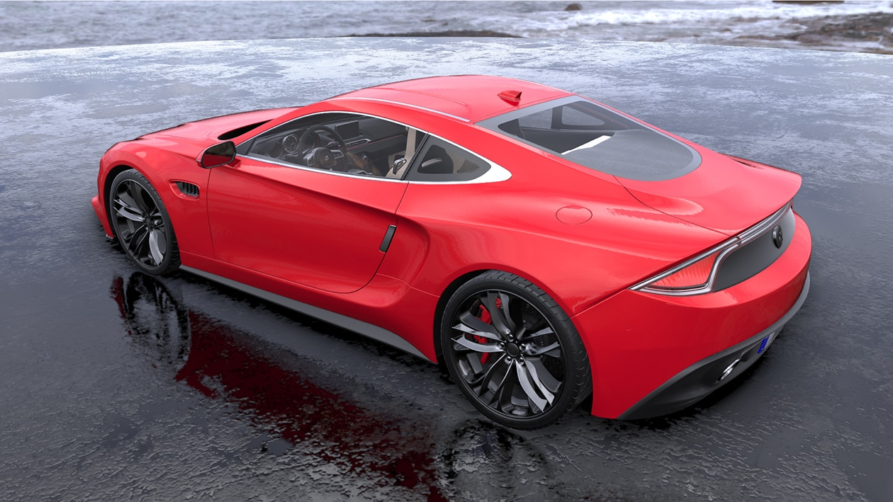
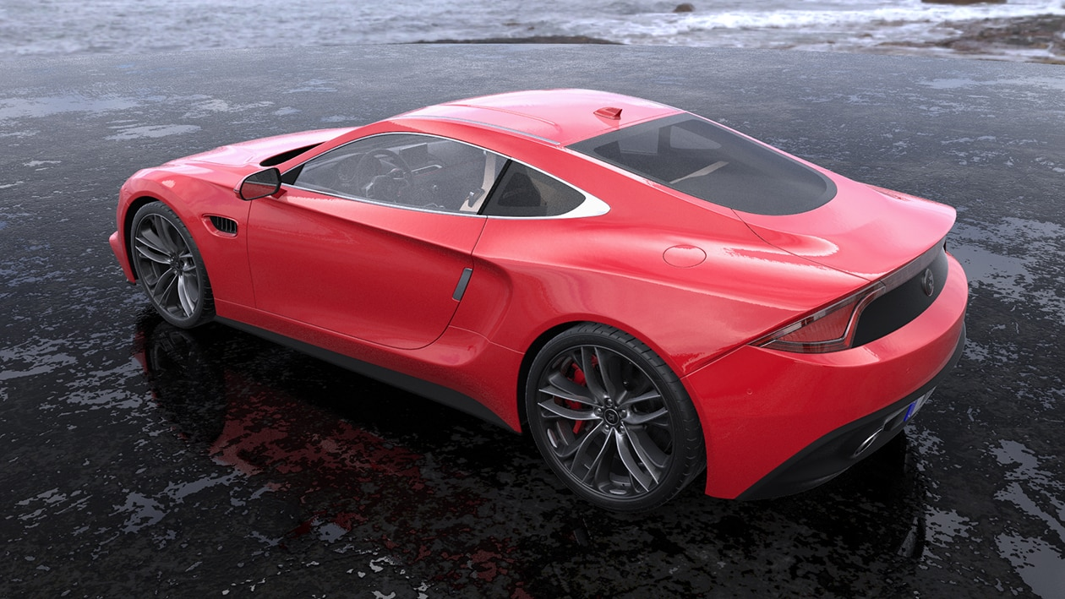
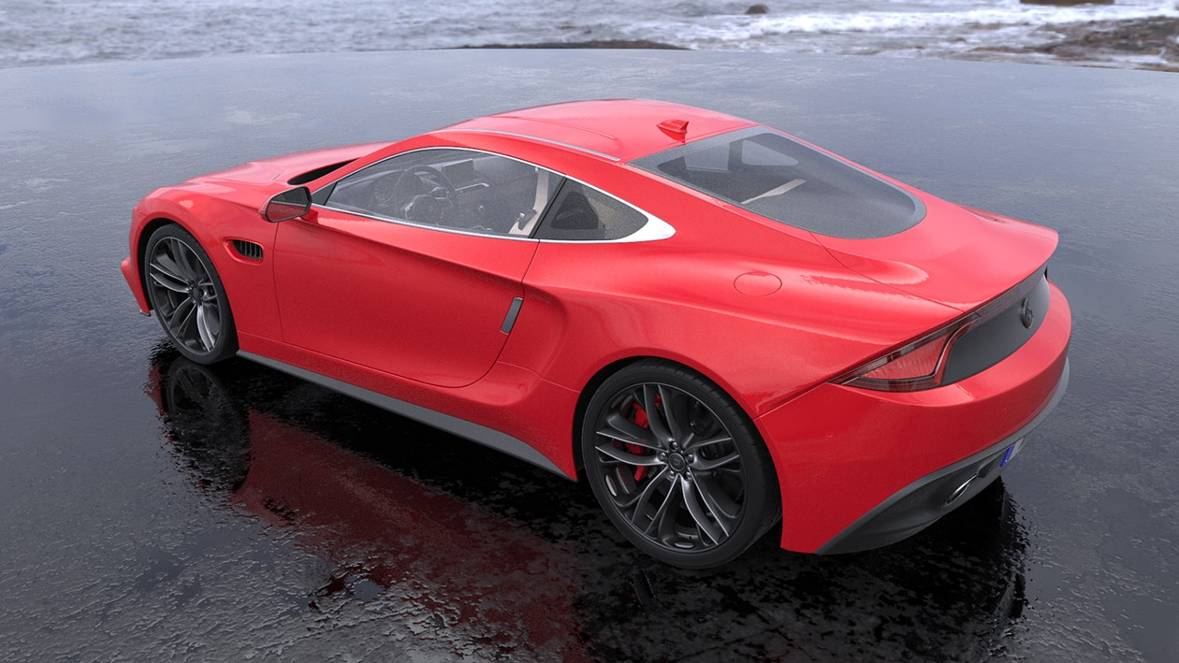
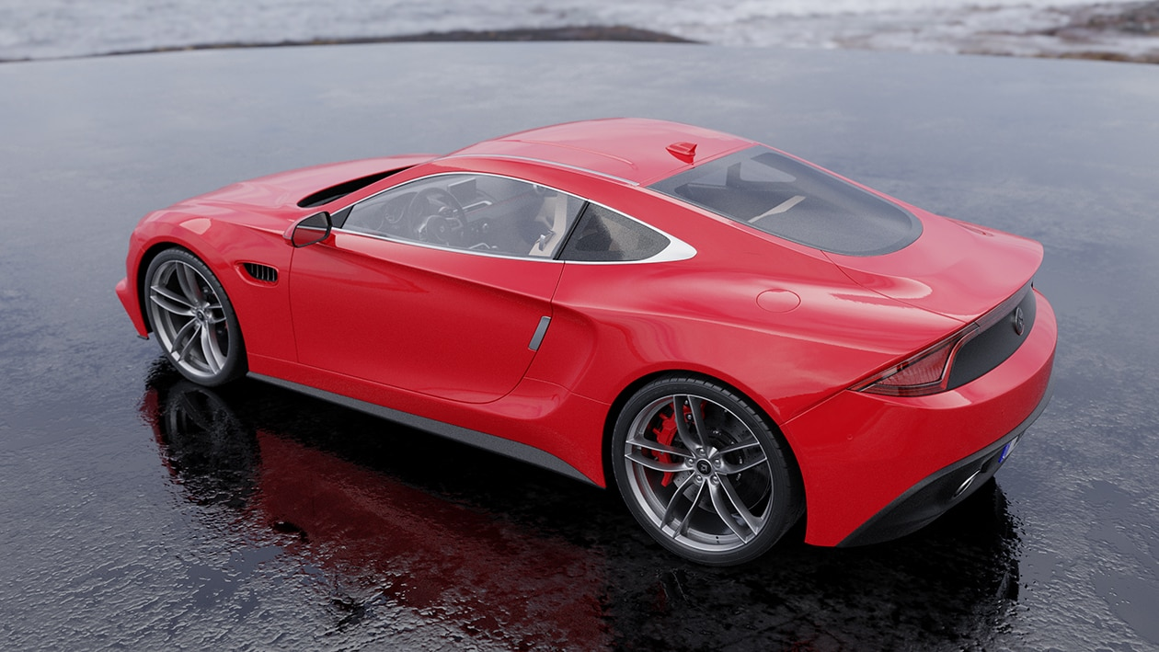
Radeon™ ProRender
Full Spectrum Rendering
Approximated faster render modes
Cross-platform, cross-vendor
Implemented using
  Vulkan, RadeonRays 3.0
  DX12, RadeonRays 4.0
Render modes:
  Raster
  Hybrid
  Biased path tracer
Dynamic lightmap GI
Voxel GI
Rasterized
Hybrid
Biased
Full path traced

Slide 33
Radeon Rays
Radeon Rays 4.0
  Releasing at GDC 2020
Radeon Rays 3.0
  Implemented in Vulkan®
  Supports both AMD GPUs and CPUs
  Feature highlight
    GPU-accelerated Bounding Volume Hierarchy (BVH) building
    Half-precision (FP16) computation support
  Works across Windows® and Linux®
Radeon Rays 2.0
  Implemented in OpenCL™
  Supports both GPUs and CPUs
  Works across Windows® and Linux®

Slide 34
Radeon Rays 4.0
Unifies the zoo of SW/HW raytracing APIs
Today, we have A LOT of APIs
  Windows: DX12 Compute/DXR, Vulkan Compute/RT
  Linux: Vulkan Compute/RT
  MacOS: Metal Performance Shader
Makes it platform / API independent
Different level of intersection APIs depending on your needs
Supports more intersection primitives

Slide 35
Radeon Rays 4.0
Batch intersection
  Good for pro apps
  No graphics / compute API interop required
  Cross-vendor
DXR1.1 compute shader intrinsic (via interop)
  AMD only
  For performance critical workflows / gaming
Fully customizable BVH traversal from compute shader
  AMD only
  For ultimate performance on AMD
  Enables algorithms not available with DXR
    Flexible LOD, early traversal stop, mixed nodes, on-the-fly BVH generation, etc.

Slide 36
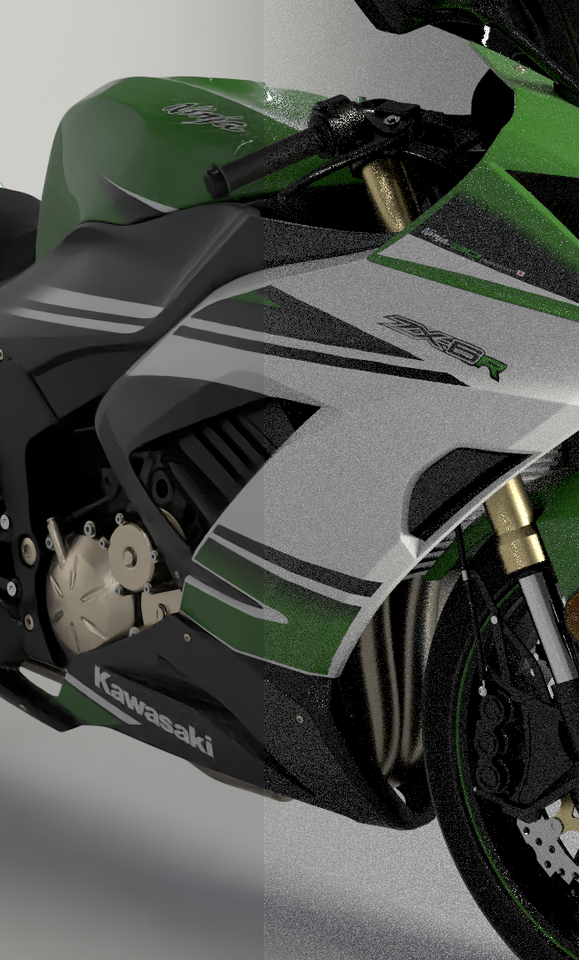
Radeon™ Image Filter Library
Collection of image post processing filters
Started to provide post processing effect for Radeon™ ProRender
  Tone mapping
  Denoising
  Bloom
  etc…
Now includes our AI effects for denoising and upsampling.
Based on OpenCL™, Metal, DX12 (new for GDC) and DML for AI
  Interop with OpenCL™, Metal, DX12 but also OpenGL & DX11
Part of RPR SDK
https://www.amd.com/en/technologies/radeon-prorender-developers
https://radeon-pro.github.io/RadeonProRenderDocs/rif/about.html

Slide 37
Tools
The right tools for building great effects

Slide 38
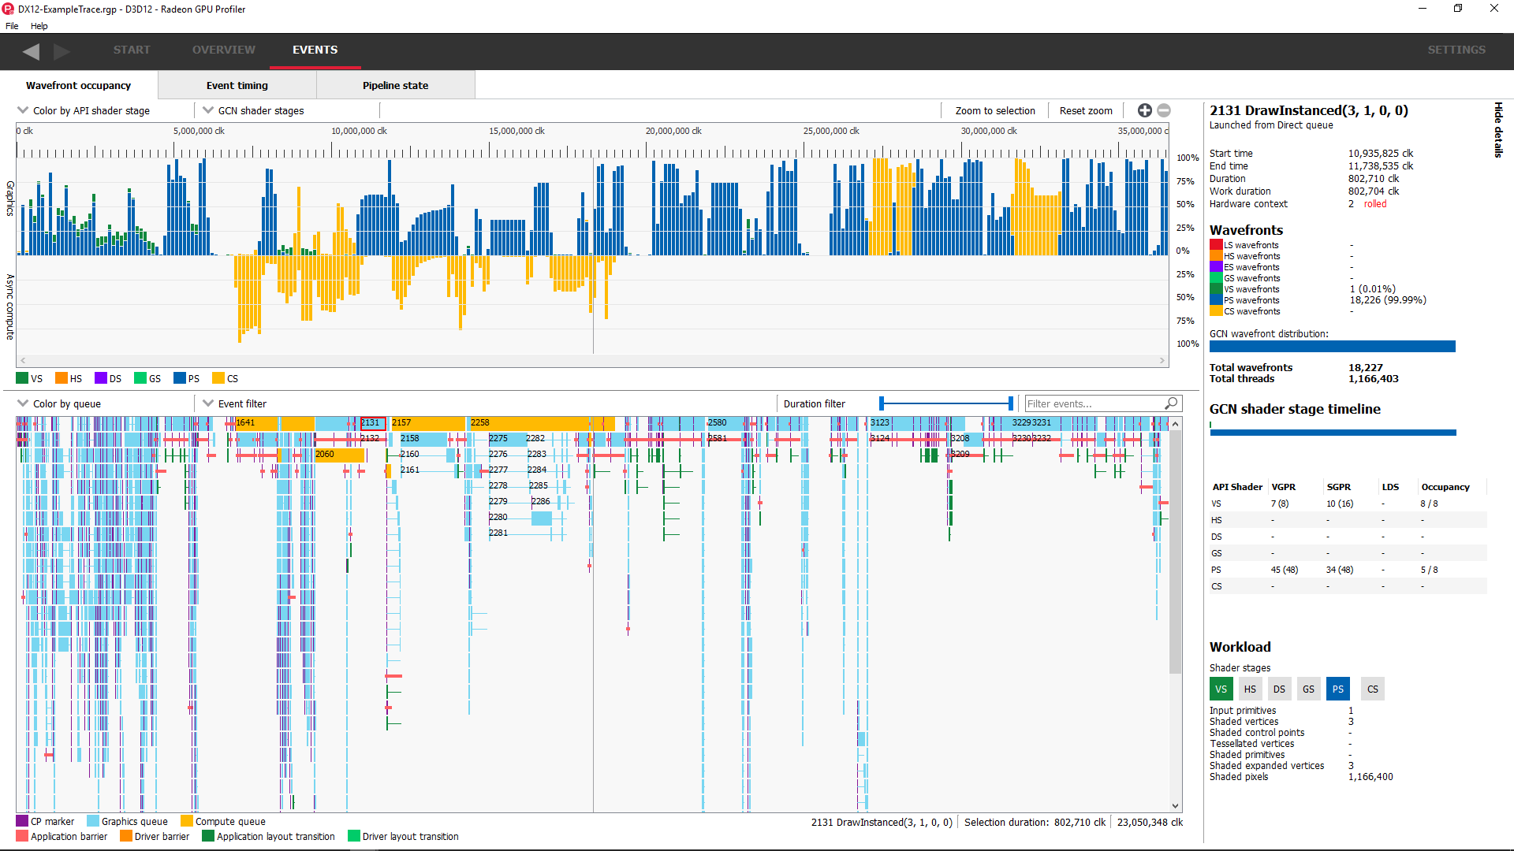
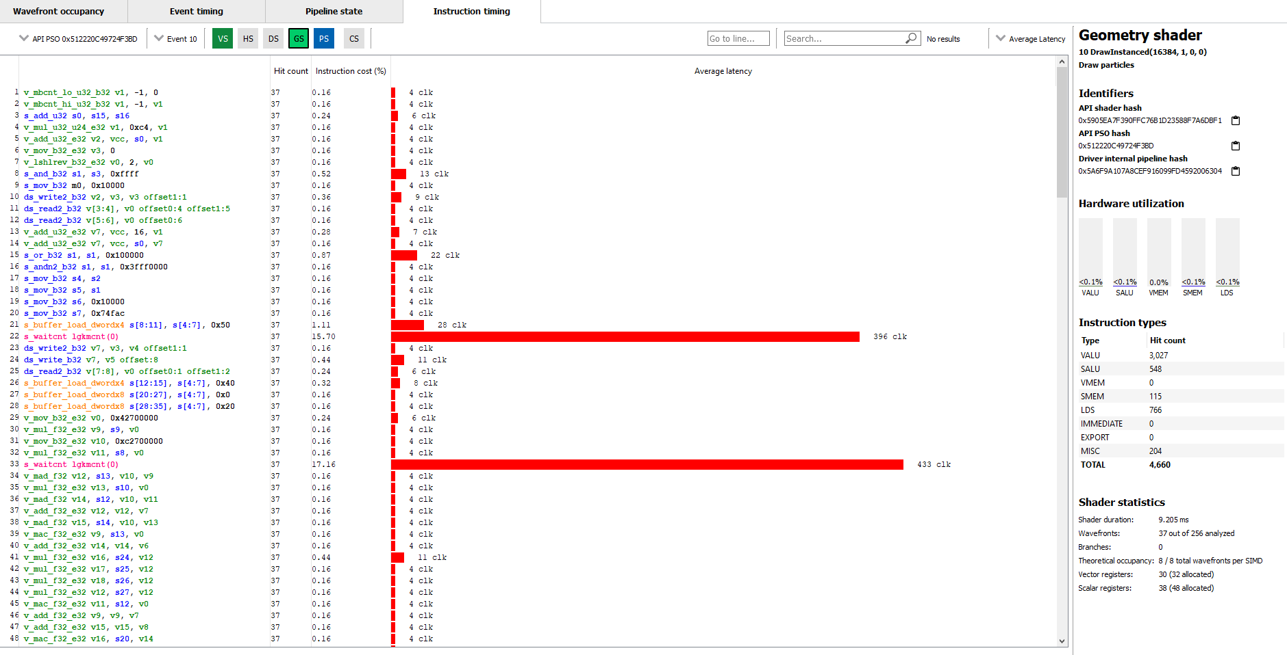
Radeon GPU profiler
Draw, compute, and barrier visualization
Pipeline state inspection
WGP occupancy
Instruction timings & RDNA ISA

Slide 39
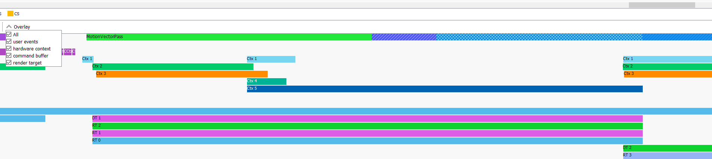
Radeon gpu profiler
RGP 1.7
  Support for Radeon RX 5500 and Radeon RX 5300
  New pipelines overview pane
  New flag to show wave32 vs wave64 on RDNA hardware
  New overlays:
    User events
    Hardware contexts
    Command buffers
    Render targets
https://gpuopen.com/gaming-product/radeon-gpu-profiler-rgp/

Slide 40
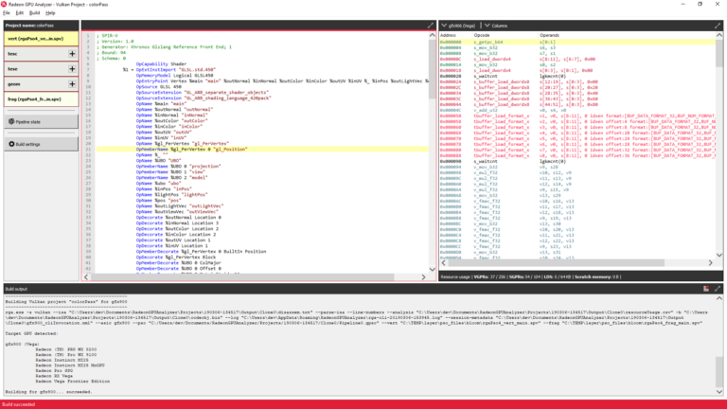
Radeon gpu analyzer
Offline compilation of shaders to AMD GCN ISA / RDNA ISA
Shader register liveness analysis
Support for DX11, OpenCL & Vulkan (SPIR-V)
Full support for D3D12 Pipeline Compilation as of v2.3

Slide 41
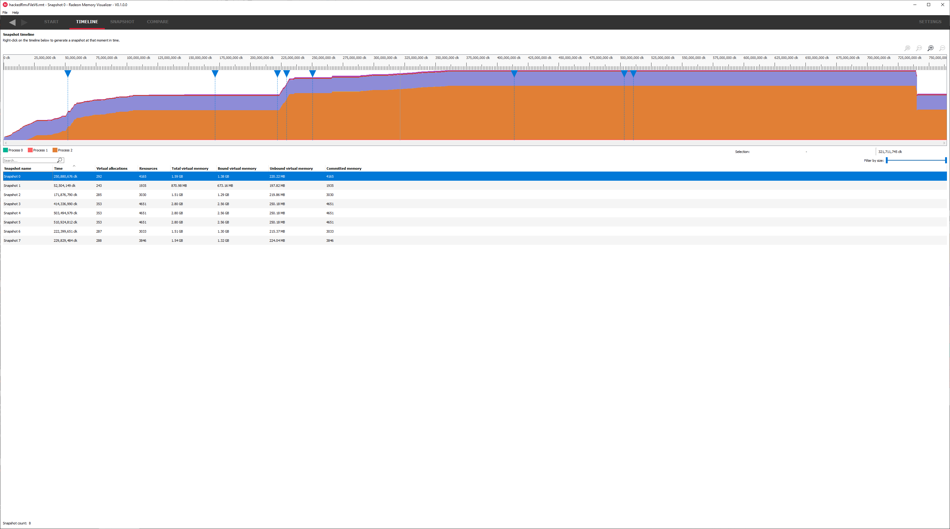
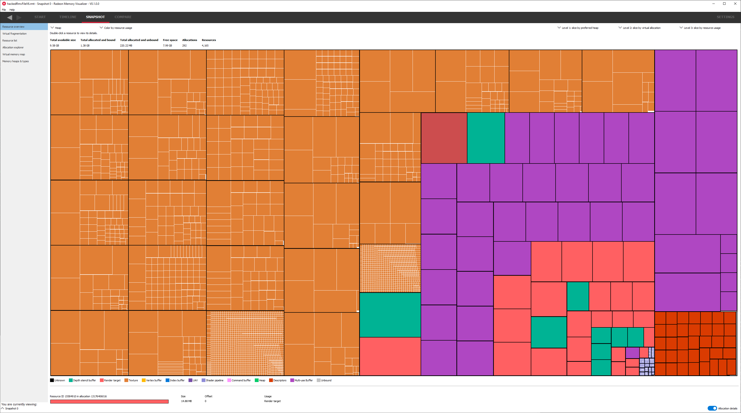
Radeon memory viewer
Create deep-dive snapshots at any point in time (even after the fact)
Track memory-related events over time
  Resource creation (render target, buffer, etc.)
  Full virtual & physical memory map
  Memory paging
  Generate full history of any resource
  Understand when resources were last accessed
Snapshot comparisons
  Detect memory leaks

Slide 42
Disclaimer:
The information presented in this document is for informational purposes only and may contain technical inaccuracies, omissions, and typographical errors. The information contained herein is subject to change and may be rendered inaccurate for many reasons, including but not limited to product and roadmap changes, component and motherboard version changes, new model and/or product releases, product differences between differing manufacturers, software changes, BIOS flashes, firmware upgrades, or the like. Any computer system has risks of security vulnerabilities that cannot be completely prevented or mitigated. AMD assumes no obligation to update or otherwise correct or revise this information. However, AMD reserves the right to revise this information and to make changes from time to time to the content hereof without obligation of AMD to notify any person of such revisions or changes.
THIS INFORMATION IS PROVIDED ‘AS IS.” AMD MAKES NO REPRESENTATIONS OR WARRANTIES WITH RESPECT TO THE CONTENTS HEREOF AND ASSUMES NO RESPONSIBILITY FOR ANY INACCURACIES, ERRORS, OR OMISSIONS THAT MAY APPEAR IN THIS INFORMATION. AMD SPECIFICALLY DISCLAIMS ANY IMPLIED WARRANTIES OF NON-INFRINGEMENT, MERCHANTABILITY, OR FITNESS FOR ANY PARTICULAR PURPOSE. IN NO EVENT WILL AMD BE LIABLE TO ANY PERSON FOR ANY RELIANCE, DIRECT, INDIRECT, SPECIAL, OR OTHER CONSEQUENTIAL DAMAGES ARISING FROM THE USE OF ANY INFORMATION CONTAINED HEREIN, EVEN IF AMD IS EXPRESSLY ADVISED OF THE POSSIBILITY OF SUCH DAMAGES.
Use of third-party marks / products is for informational purposes only and no endorsement of or by AMD is intended or implied. GD-83
© 2020 Advanced Micro Devices, Inc. All rights reserved. AMD, the AMD Arrow logo, Radeon and combinations thereof are trademarks of Advanced Micro Devices, Inc. in the United States and/or other jurisdictions. Windows and DirectX are registered trademarks of Microsoft Corporation in the US and other jurisdictions. Vulkan and the Vulkan logo are trademarks of Khronos Group Inc. Unreal and its logo are registered trademarks of Epic Games in the US and elsewhere. Autodesk, the Autodesk logo, and Maya are registered trademarks of Autodesk, Inc., and/or its subsidiaries and/or affiliates in the USA and/or other countries. Houdini is a registered trademark of SideFX in the US and elsewhere. Twitter Logo is a registered trademark of Twitter in the US and elsewhere. MacOS is a trademark of Apple Inc. in the US and elsewhere. Other names are for informational purposes only and may be trademarks of their respective owners.

