Slide 2
Denoising Raytraced Soft Shadows on Xbox Series X|S and Windows with FidelityFX
Dominik Baumeister, AMD

Slide 3
Agenda
Building blocks of the denoiser
Performance improvements

Slide 4
10,000 foot view
Simulate area lights by choosing a random point on the light and tracing a ray towards it
This inherently introduces noise that is tightly coupled with the sampling pattern
We average over multiple rays (samples) to converge, but this may become prohibitively costly
Reuse neighboring samples instead and accumulate samples over multiple frames
For a small number of lights, it is feasible to drop the lights color and instead sample a mask
Based on NVIDIAs paper on Spatiotemporal Variance-Guided Filtering: Real-Time Reconstruction for Path-Traced Global Illumination https://research.nvidia.com/publication/2017-07_Spatiotemporal-Variance-Guided-Filtering%3A
Disclaimer: I merely jumped in and made it faster. All credit goes to Guillaume Boissé for making it work in the first place

Slide 6
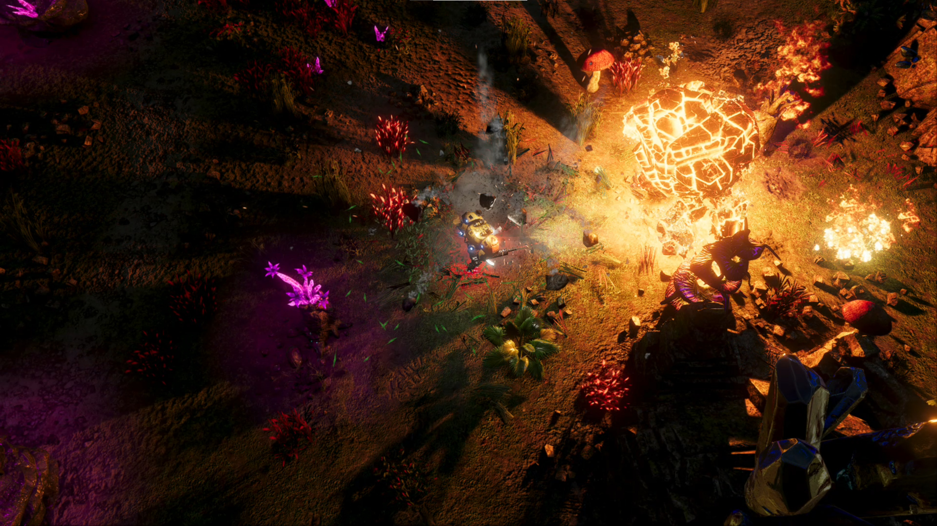

Slide 7
Building blocks

Slide 8
Building blocks
Create Shadow Mask
Local Neighborhood
Disocclusion
Reprojection
Spatial Filter 0
Spatial Filter 1
Spatial Filter 2

Slide 9
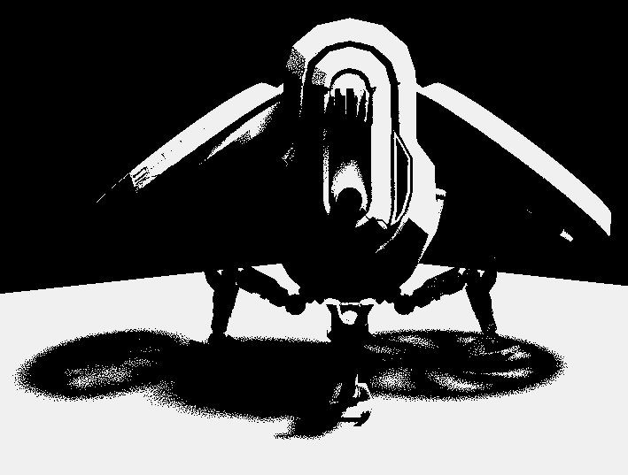
Building blocks
Create Shadow Mask
Initialize a counter to 0
Choose a fixed number of random points on the light source
Shoot ray with offset along the normal to avoid self-intersections
Increment the counter by 1 for every miss That means we missed geometry and thus, hit the light
Store counter value in our shadow mask target
Noisy shadow mask

Slide 10
Building blocks
Estimate Local Neighborhood
Estimate mean and variance in a neighborhood
Variance tells how noisy the data is
This can be used to create a window in which we would expect additional rays to lie in
We settled with a 17x17 kernel. Usually, the larger the region, the better the results
Important observation: We can separate horizontal and vertical filter kernels
$$mean+=value ∗weight$$
$$variance+={value}^{2} ∗weight$$
5x5 kernel
17x17 kernel
29x29 kernel

Slide 11
Building blocks
Create Disocclusion Mask
Identify regions of the screen without history data
Calculate the expected depth in the previous frame using a reprojection matrix (intermediate matrix calculations should be ideally performed using double precision): $Reprojection = {ViewProjection}^{−1}∗ PreviousViewProjection$
Compare that with the depth buffer value from last frame, reprojected using per pixel motion vectors
Check if the reprojection to the last frame belongs to the same surface by comparing the depth values

Slide 12
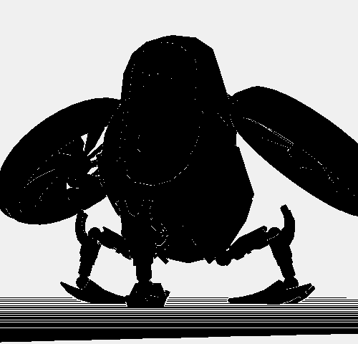
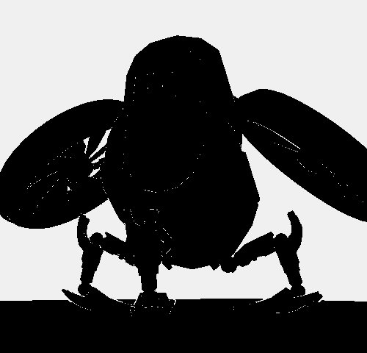
Building blocks
Create Disocclusion Mask
Mismatching depth values are treated as a disocclusion
Use adaptive depth thresholds to counter false disocclusion at grazing angles
Constant depth threshold
Adaptive depth threshold
Disocclusion Mask

Slide 13
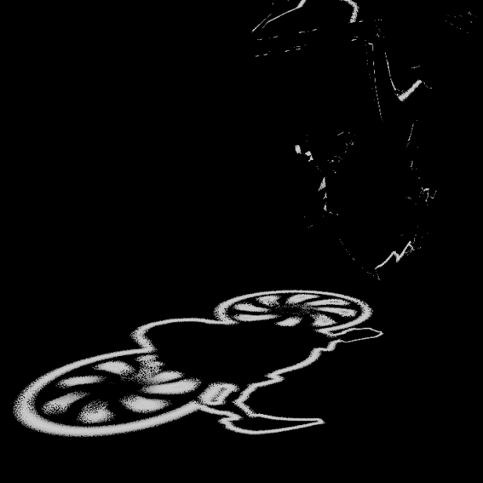
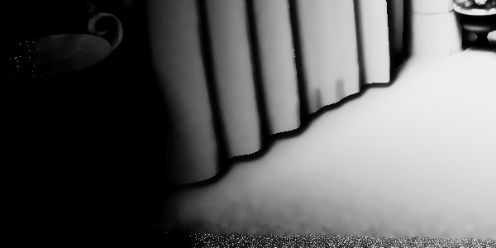
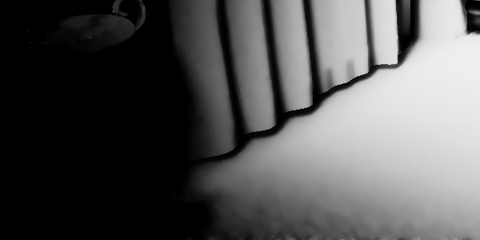
Building blocks
Reprojection
Use disocclusion information to determine if we can reuse the history moments
Reproject using per pixel motion vectors and sample the history moments
Use those to update the current temporal variance which is used to guide the spatial filtering
Additional variance boost for more aggressive spatial filtering when dealing with low temporal sample counts
Temporal Variance
Without variance boost
With variance boost

Slide 14
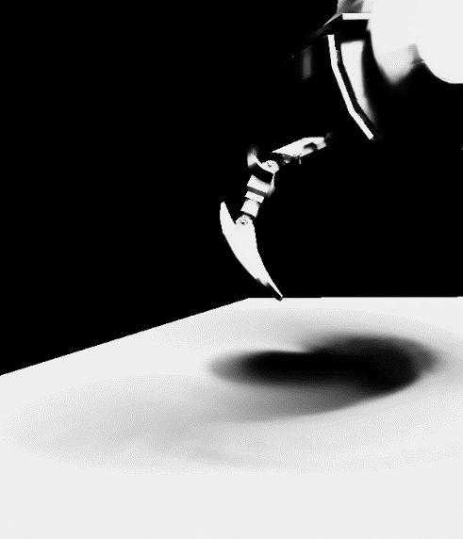
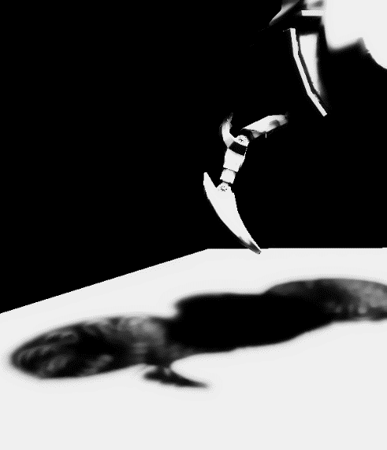
Building blocks
Reprojection
Moving shadows are a challenging problem
Notice how the shadow pretty much disappears as many temporal samples get incorrectly blended
Neighborhood clamping the history values helps with obtaining a much more responsive filter and preserves the shadow details under motion
Naïve blending
Neighborhood clamping

Slide 15
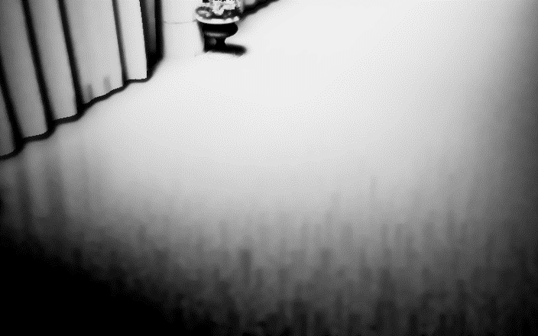
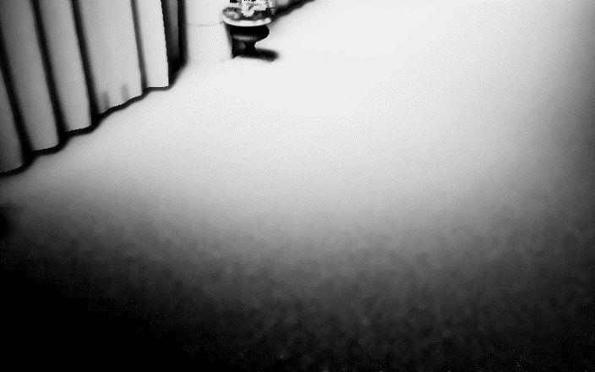
Building blocks
Reprojection
The clamped history information is merged with the current frame using an exponential moving average blend
A low blend factor heavily weights the current frame value resulting in a responsive but unstable filter,
A high blend factor heavily weights the clamped history value resulting in a stable but unresponsive filter
Our implementation adjusts the blend factor based on the number of accumulated history samples
Constant blend factor
Adaptive blend factor

Slide 16
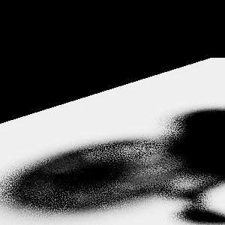
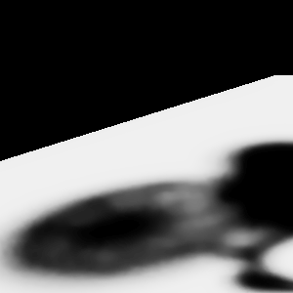
Building blocks
Spatial Filter
We’re left with a (mostly) temporally stable image
Use consecutive spatial filters—edge aware á-trous wavelet (EAW) filters—to remove the remaining spatial noise
Spatial Filter 0: EAW with 1-pixel stride
Spatial Filter 1: EAW with 2-pixel stride
Spatial Filter 2: EAW with 4-pixel stride
The results of Spatial Filter 0 are reused as history input for the next frame
No EAW pass
Single EAW pass
3 EAW passes

Slide 17
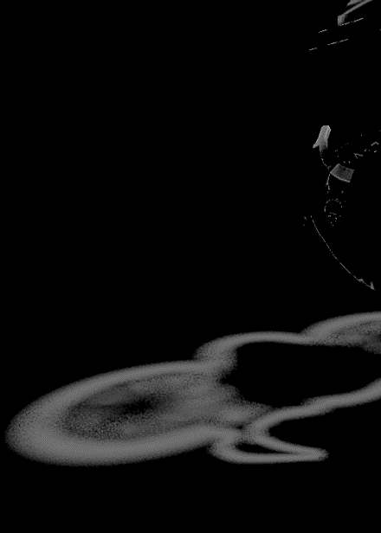
Building blocks
Spatial Filter
Track variance to avoid over blurring in regions where variance is already low enough
With each successive pass the variance cools off
Variance after 1 blur pass
Variance after 2 blur passes
Variance after 3 blur passes

Slide 18
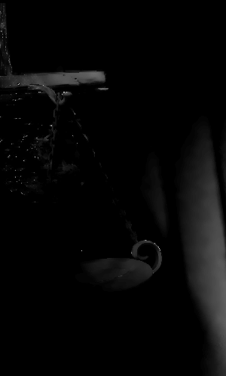
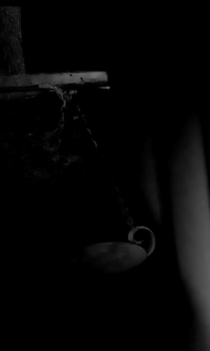
Building blocks
TAA
TAA is an important step to finish stabilizing and cleaning up the image after the denoiser has run and is recommended to get the best results both in terms of image quality and stability
Notice how the render without TAA exhibits artifacts at the edges where the spatial blur fails to find matching samples
TAA helps eliminate those artifacts and overall improves the image stability
Without TAA
With TAA

Slide 19
Performance improvements

Slide 20
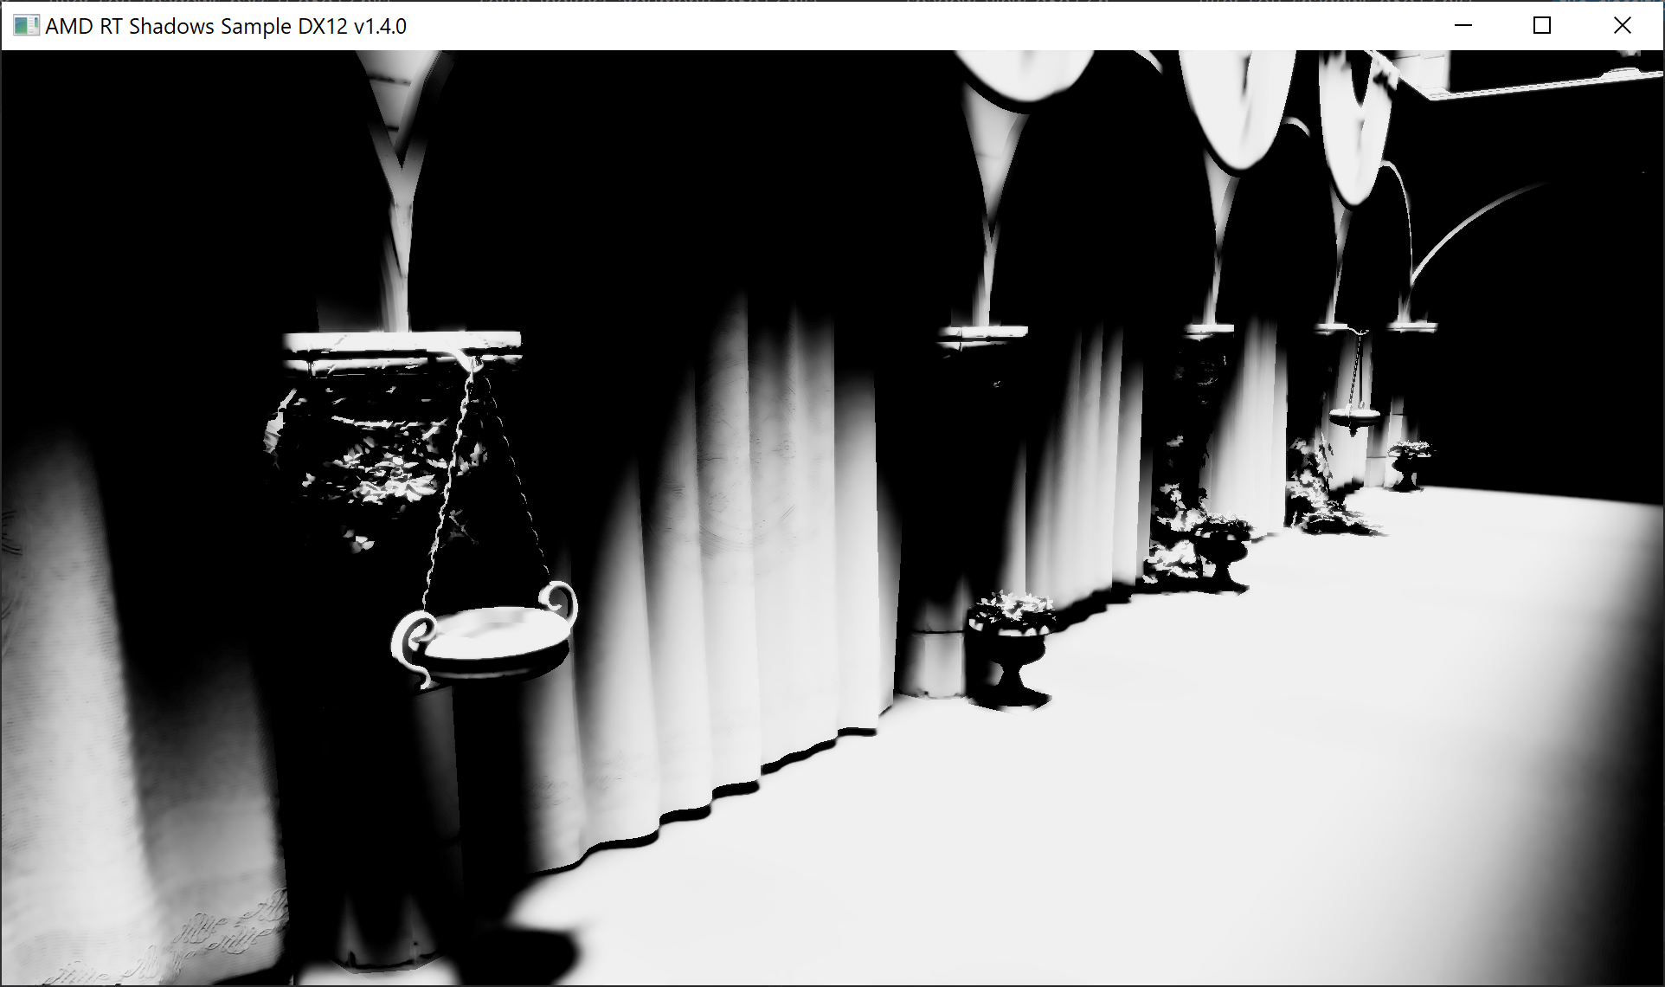
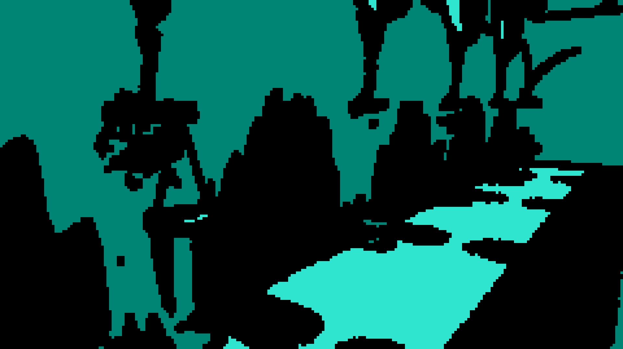
Key observations
For performance reasons we likely only ever shoot one ray per pixel anyway
There may be large areas of the screen where the denoiser does not perform any work

Slide 21
Single ray per pixel
At 1 sample per pixel the shadow values become either 0 or 1
Thus, calculating the second order moment (used for variance) becomes indifferent from calculating the first order moment (mean)
As a result, we can drop half of the calculations in the local neighborhood pass
$$mean+=value ∗weight$$
$$variance+={value}^{2} ∗weight$$
becomes:
$$moments+=value ∗weight$$

Slide 22
Single ray per pixel
Create Shadow Mask
Compress the occlusion data to 1 bit per pixel
A single 32-bit unit can store the data of an entire 8x4 region of pixels
This nicely matches the native SIMD size of 32 on RDNA
The ray traversal shader creates a single bool for “in light” or “in shadow”
Naturally, that flag is kept in a scalar 32bit uint anyway
In theory, this idea may be extended to multiple rays per pixel and just use one bit per sample. But this makes some of the later optimizations more complex
0
1
2
3
4
5
6
7
8
9
10
11
12
13
14
15
16
17
18
19
20
21
22
23
24
25
26
27
28
29
30
31
index in bitmask

Slide 23
Single ray per pixel
Create Shadow Mask
uint GetBitMaskFromPixelPosition(uint2 pixel_pos) {
int lane_index = (pixel_pos.y % 4) * 8 + (pixel_pos.x % 8);
return (1u << lane_index);
}
const uint lane_mask = hit_light ? GetBitMaskFromPixelPosition(dispatch_thread_id) : 0;
ShadowMask[tile_index] = WaveActiveBitOr(lane_mask);
Creating the mask:
All that would be left to do is writing that uint into a buffer
Can not guarantee this on PC, as the mapping from WaveGetLaneIndex() to SV_DispatchThreadID is not enforced
So, we must manually calculate the bit location on PC and use a WaveActiveBitOr()
The thread group size of a RayGen shader is not defined on DXR1.0. Thus, we write to a R8 target and compress the mask in a separate pass

Slide 24
Single ray per pixel
Local Neighborhood
Compute the horizontal neighborhood from that bit mask
Brief example on how this is done around the pixel at bit position 19 colored in orange, which is part of the center bit mask
0
1
2
3
4
5
6
7
0
1
2
3
4
5
6
7
0
1
2
3
4
5
6
7
8
9
10
11
12
13
14
15
8
9
10
11
12
13
14
15
8
9
10
11
12
13
14
15
16
17
18
19
20
21
22
23
16
17
18
19
20
21
22
23
16
17
18
19
20
21
22
23
24
25
26
27
28
29
30
31
24
25
26
27
28
29
30
31
24
25
26
27
28
29
30
31
left
center
right

Slide 25
Single ray per pixel
Local Neighborhood
// First extract the 8 bits of our row // in each of the neighboring tiles
const uint row_base_index = (did.y % 4) * 8;
const uint left = (left_tile >> row_base_index) & 0xFF;
const uint center = (center_tile >> row_base_index) & 0xFF;
const uint right = (right_tile >> row_base_index) & 0xFF;
// Combine them into a single mask containing // [left, center, right] from least significant // to most significant bit
const uint combined = left | (center << 8) | (right << 16);
// Make sure our pixel is at bit position 9 // to get the highest contribution from the filter kernel
const uint bit_index_in_row = (did.x % 8); // Shift out bits to the right, // so the center bit ends up at bit 9.
const uint neighborhood = combined >> bit_index_in_row;
moment += (mask & neighborhood) ? KernelWeight(i) : 0;
left
…
23
22
21
20
19
18
17
16
15
14
13
12
11
10
9
8
7
6
5
4
3
2
1
0
center
…
23
22
21
20
19
18
17
16
15
14
13
12
11
10
9
8
7
6
5
4
3
2
1
0
right
…
23
22
21
20
19
18
17
16
15
14
13
12
11
10
9
8
7
6
5
4
3
2
1
0
right
center
left
combined
23
22
21
20
19
18
17
16
23
22
21
20
19
18
17
16
23
22
21
20
19
18
17
16
neighborhood
19
18
17
16
23
22
21
20
19
18
17
16
23
22
21
20
19
Iterate over these 17 bits to combine the horizontal local neighborhood
Utilizes scalar loads and requires relatively low VGPR usage for some high ALU counts

Slide 26
Tile classification
Idea: quickly identify regions that we may skip in the denoiser
Seeing gains in the 25–30% range, highly dependent on the scene
The denoisers run on 8x8 tiles
The neighborhood stretches another 8 in each direction
Thus, we check a 24x24 region if it is entirely in light or entirely in shadow using 18 scalar loads:
32-bit bitmask covering 8x4 pixel tile
8x8 pixel center tile = target of the classification

Slide 27
Tile classification
Tile Classification
int2 tile_dimensions = int2(
RoundedDivide(BufferDimensions.x, 8), RoundedDivide(BufferDimensions.y, 4));
// Load the entire region of masks in a scalar fashion
uint combined_or_mask = 0;
uint combined_and_mask = 0xFFFFFFFF;
for (int j = -2; j <= 3; ++j) {
for (int i = -1; i <= 1; ++i) {
int2 tile_index = base_tile + int2(i, j); tile_index = clamp(tile_index, 0, tile_dimensions- 1);
const uint linear_tile_index = Flatten(tile_index);
const uint shadow_mask = RaytracerResult[linear_tile_index];
combined_or_mask = combined_or_mask | shadow_mask;
combined_and_mask = combined_and_mask & shadow_mask;
}
}
all_in_light = combined_and_mask == 0xFFFFFFFFu;
all_in_shadow = combined_or_mask == 0u;
label_01F8:
s_add_i32 s59, s51, s0
s_add_i32 s51, s51, 3
s_max_i32 s57, s59, 0
s_min_i32 s14, s57, s1
s_add_i32 s57, s59, 1
s_add_i32 s59, s59, 2
s_mul_i32 s60, s27, s14
s_max_i32 s57, s57, 0
s_max_i32 s59, s59, 0
s_add_i32 s58, s60, s74
s_add_i32 s62, s60, s75
s_min_i32 s61, s57, s1
s_lshl_b32 s57, s58, 2
s_lshl_b32 s58, s62, 2
s_min_i32 s62, s59, s1
s_add_i32 s59, s60, s90
s_mul_i32 s63, s27, s61
s_buffer_load_dword s57, s[20:23], s57
s_mul_i32 s60, s27, s62
s_lshl_b32 s59, s59, 2
s_add_i32 s61, s63, s74
s_add_i32 s62, s63, s75
s_add_i32 s63, s63, s90
s_add_i32 s66, s60, s90
s_add_i32 s64, s60, s74
s_add_i32 s65, s60, s75
s_buffer_load_dword s60, s[20:23], s58
s_buffer_load_dword s59, s[20:23], s59
s_lshl_b32 s58, s61, 2
s_lshl_b32 s61, s62, 2
s_lshl_b32 s67, s64, 2
s_lshl_b32 s78, s65, 2
s_lshl_b32 s62, s63, 2
s_buffer_load_dword s65, s[20:23], s58
s_buffer_load_dword s64, s[20:23], s61
s_lshl_b32 s66, s66, 2
s_waitcnt lgkmcnt(0)
s_or_b32 s56, s57, s56
s_and_b32 s15, s57, s15
s_buffer_load_dword s63, s[20:23], s62
s_buffer_load_dword s62, s[20:23], s67
s_buffer_load_dword s61, s[20:23], s78
s_buffer_load_dword s58, s[20:23], s66
s_or_b32 s56, s60, s56
s_and_b32 s15, s60, s15
s_or_b32 s56, s59, s56
s_and_b32 s15, s59, s15
s_or_b32 s56, s65, s56
s_and_b32 s15, s65, s15
s_or_b32 s56, s64, s56
s_and_b32 s12, s64, s15
s_waitcnt lgkmcnt(0)
s_or_b32 s56, s63, s56
s_and_b32 s12, s63, s12
s_or_b32 s56, s62, s56
s_and_b32 s57, s62, s12
s_or_b32 s15, s61, s56
s_and_b32 s57, s61, s57
s_or_b32 s56, s58, s15
s_and_b32 s15, s58, s57
s_cmp_eq_u32 s51, 4
s_cbranch_scc0 label_01F8

Slide 28
Tile classification
Spatial Filter
bool is_cleared;
bool all_in_light;
ReadTileMetaData(group_id, is_cleared, all_in_light);
[branch]
if (is_cleared) {
Clear(all_in_light, …)
}
else {
ApplyFilter(…);
}
The three Spatial Filter passes now run off a tile meta data mask
Scalar loads for clears
Scalar branch for clear/not clear
s_buffer_load_dword s0, s[32:35], s14
s_waitcnt lgkmcnt(0)
s_and_b32 s1, s0, 1
s_cmp_eq_u32 s1, 0
s_cbranch_scc0 label_0914

Slide 29
Merge passes
Classify Tiles
Local Neighborhood
Create Shadow Mask
Spatial Filter 0
Spatial Filter 1
Spatial Filter 2
Using the bit mask makes this feasible for local neighborhood—store the intermediate values in groupshared memory
Allows to remove a few transient resources, including a depth buffer copy, the local neighborhood and the tile classification target
Resulted in around 10% performance improvement
Disocclusion
Reprojection

Slide 30
Groupshared memory
Spatial Filter
int2 offset[4] = { int2(0, 0), int2(8, 0), int2(0, 8), int2(8, 8) };
min16float3 normals[4];
min16float2 input[4];
float depth[4];
did -= 4;
for (int i = 0; i < 4; ++i) { LoadWithOffset(dispatch_thread_id, offset[i], normals[i], input[i], depth[i]); }
for (int j = 0; j < 4; ++j) { StoreWithOffset(group_thread_id, offset[j], normals[j], input[j], depth[j]); }
// Center threads in groupshared memory
group_thread_id += 4;
DenoiseFromGroupSharedMemory(…);
Need 16x16 region in groupshared memory
Requires 4 loads in total
Each loads an 8x8 region for best cache utilization
Load #0
Load #1
Center in groupshared memory
Load #2
Load #3
Load 8x8 pixels into groupshared memory
Offset indices by 4 to center the work tile in groupshared memory

Slide 31
Packed math
Spatial Filter
Texture2D<float16_t2> InputBuffer; // first and second order moments
uint PackFloat16(float16_t2 v) {
uint2 p = f32tof16(float2(v));
return p.x | (p.y << 16);
}
groupshared uint g_shared_input[16][16];
… g_shared_input[idx.y][idx.x] = PackFloat16(input);
Two 16-bit values from the same texture fetch will share a register (if the image_load uses the d16 flag)
v_pk_ instructions can work on both values in that register at once
That register will be written to groupshared memory directly → PackFloat16 will be a no-op

Slide 32
Packed math
Spatial Filter
image_load v[8:9], v[4:5], s[24:31] dmask:0x7 dim:SQ_RSRC_IMG_2D unorm d16 // normals - 4x FP16
image_load v[10:11], [v6, v5], s[24:31] dmask:0x7 dim:SQ_RSRC_IMG_2D unorm d16
image_load v[12:13], [v4, v7], s[24:31] dmask:0x7 dim:SQ_RSRC_IMG_2D unorm d16
image_load v[14:15], v[6:7], s[24:31] dmask:0x7 dim:SQ_RSRC_IMG_2D unorm d16
image_load v16, v[4:5], s[32:39] dmask:0x3 dim:SQ_RSRC_IMG_2D unorm d16 // input moments - 2x FP16
image_load v17, [v6, v5], s[32:39] dmask:0x3 dim:SQ_RSRC_IMG_2D unorm d16
image_load v19, [v4, v7], s[32:39] dmask:0x3 dim:SQ_RSRC_IMG_2D unorm d16
image_load v18, v[6:7], s[32:39] dmask:0x3 dim:SQ_RSRC_IMG_2D unorm d16
image_load v23, v[4:5], s[24:31] dmask:0x1 dim:SQ_RSRC_IMG_2D unorm // depths - FP32
image_load v22, [v6, v5], s[24:31] dmask:0x1 dim:SQ_RSRC_IMG_2D unorm
image_load v26, [v4, v7], s[24:31] dmask:0x1 dim:SQ_RSRC_IMG_2D unorm
image_load v7, v[6:7], s[24:31] dmask:0x1 dim:SQ_RSRC_IMG_2D unorm
image_load v4, v[2:3], s[24:31] dmask:0x1 dim:SQ_RSRC_IMG_2D unorm
s_waitcnt vmcnt(0)
v_pk_fma_f16 v6, v8, 2.0, -1.0 op_sel_hi:[1,0,0]
v_pk_fma_f16 v8, v8, 2.0, -1.0 op_sel_hi:[1,0,0]
v_pk_fma_f16 v5, v10, 2.0, -1.0 op_sel_hi:[1,0,0]
v_pk_fma_f16 v10, v10, 2.0, -1.0 op_sel_hi:[1,0,0]
v_pk_fma_f16 v21, v14, 2.0, -1.0 op_sel_hi:[1,0,0]
v_pk_fma_f16 v14, v14, 2.0, -1.0 op_sel_hi:[1,0,0]
v_pk_fma_f16 v20, v12, 2.0, -1.0 op_sel_hi:[1,0,0]
v_pack_b32_f16 v24, v5, v6
v_pack_b32_f16 v6, v5, v6 op_sel:[1,1,0]
v_pack_b32_f16 v5, v15, v13
v_pk_fma_f16 v13, v12, 2.0, -1.0 op_sel_hi:[1,0,0]
v_pack_b32_f16 v25, v21, v20
v_pack_b32_f16 v30, v21, v20 op_sel:[1,1,0]
v_pack_b32_f16 v9, v11, v9
v_pk_mul_f16 v11, v24, v24
v_pk_mul_f16 v27, v25, v25
v_pk_fma_f16 v24, v9, 2.0, -1.0 op_sel_hi:[1,0,0]
v_pk_fmac_f16 v11, v6, v6
v_pk_fma_f16 v6, v5, 2.0, -1.0 op_sel_hi:[1,0,0]
v_pk_fmac_f16 v27, v30, v30
v_pk_fmac_f16 v11, v24, v24
v_pk_fmac_f16 v27, v6, v6
v_rsq_f16 v5, v11
v_rsq_f16 v9, v27
v_rsq_f16_sdwa v5, v11 dst_sel:WORD_1 dst_unused:UNUSED_PRESERVE src0_sel:WORD_1
v_rsq_f16_sdwa v9, v27 dst_sel:WORD_1 dst_unused:UNUSED_PRESERVE src0_sel:WORD_1
v_pk_mul_f16 v11, v24, v5
v_pk_mul_f16 v10, v10, v5 op_sel_hi:[1,0]
v_pk_mul_f16 v8, v8, v5 op_sel:[0,1]
v_pk_mul_f16 v6, v6, v9
v_pk_mul_f16 v15, v14, v9 op_sel_hi:[1,0]
v_mov_b32_sdwa v21, v11 dst_sel:DWORD dst_unused:UNUSED_PAD src0_sel:WORD_0
v_mov_b32_sdwa v11, v11 dst_sel:DWORD dst_unused:UNUSED_PAD src0_sel:WORD_1
v_pk_mul_f16 v27, v13, v9 op_sel:[0,1]
v_mov_b32_sdwa v14, v6 dst_sel:DWORD dst_unused:UNUSED_PAD src0_sel:WORD_0
v_mov_b32_sdwa v6, v6 dst_sel:DWORD dst_unused:UNUSED_PAD src0_sel:WORD_1
ds_write2st64_b32 v1, v16, v23 offset1:4 // depth and input moments
ds_write2st64_b32 v0, v17, v22 offset1:4
ds_write2st64_b32 v0, v18, v7 offset0:2 offset1:6
ds_write2st64_b32 v1, v19, v26 offset0:2 offset1:6
ds_write2st64_b32 v1, v8, v11 offset0:8 offset1:12 // normals
ds_write2st64_b32 v0, v10, v21 offset0:8 offset1:12
ds_write2st64_b32 v1, v27, v6 offset0:10 offset1:14
ds_write2st64_b32 v0, v15, v14 offset0:10 offset1:14

Slide 33
Miscellaneous
tile_classification.hlsl
image_load v0, v[34:35], s[16:23] dmask:0x1 dim:SQ_RSRC_IMG_2D unorm
s_waitcnt vmcnt(0) // this can stall for hundreds of cycles
v_mov_b32 v1, v0
v_mov_b32 v2, v0
v_mov_b32 v3, v0
image_store v[0:3], v[34:35], s[0:7] dmask:0xf dim:SQ_RSRC_IMG_2D unorm glc
v_mov_b32 v54, v57
v_mov_b32 v55, v57
v_mov_b32 v56, v57
image_store v[54:57], v[34:35], s[16:23] dmask:0xf dim:SQ_RSRC_IMG_2D unorm glc
Use single channel mask per light instead of a combined 4-channel format for 4 lights
Avoids a read-modify-write when writing the final output (unused channels would still be fetched)
Yielded roughly another 5%

Slide 34
Closing notes

Slide 35
Future ideas
Trace and denoise at half resolution then upsample
Guide raytracing
Include information from a VRS image to reduce number of rays
Compare history frames, shoot fewer rays where denoiser converged
Reuse tile meta data
Denoiser may as well be applied to AO

Slide 36
Acknowledgements
Guillaume Boissé
Marcus Rogowsky
Matthäus Chajdas
Rys Sommefeldt
Colin Riley
Kenneth Mitchell
Marco Weber
Gareth Thomas
Jonas Gustavsson
Nicolas Thibieroz
Soon to be found here—next to our reflection denoiser: https://gpuopen.com/fidelityfx-denoiser/

Slide 37
Disclaimer and attribution
The information presented in this document is for informational purposes only and may contain technical inaccuracies, omissions and typographical errors.
The information contained herein is subject to change and may be rendered inaccurate for many reasons, including but not limited to product and roadmap changes, component and motherboard version changes, new model and/or product releases, product differences between differing manufacturers, software changes, BIOS flashes, firmware upgrades, or the like. AMD assumes no obligation to update or otherwise correct or revise this information. However, AMD reserves the right to revise this information and to make changes from time to time to the content hereof without obligation of AMD to notify any person of such revisions or changes.
AMD MAKES NO REPRESENTATIONS OR WARRANTIES WITH RESPECT TO THE CONTENTS HEREOF AND ASSUMES NO RESPONSIBILITY FOR ANY INACCURACIES, ERRORS OR OMISSIONS THAT MAY APPEAR IN THIS INFORMATION.
AMD SPECIFICALLY DISCLAIMS ANY IMPLIED WARRANTIES OF MERCHANTABILITY OR FITNESS FOR ANY PARTICULAR PURPOSE. IN NO EVENT WILL AMD BE LIABLE TO ANY PERSON FOR ANY DIRECT, INDIRECT, SPECIAL OR OTHER CONSEQUENTIAL DAMAGES ARISING FROM THE USE OF ANY INFORMATION CONTAINED HEREIN, EVEN IF AMD IS EXPRESSLY ADVISED OF THE POSSIBILITY OF SUCH DAMAGES.
ATTRIBUTION
© 2021 Advanced Micro Devices, Inc. All rights reserved. AMD, Ryzen™, and the AMD Arrow logo and combinations thereof are trademarks of Advanced Micro Devices, Inc. in the United States and/or other jurisdictions. Microsoft and Windows are registered trademarks of Microsoft Corporation. Other names are for informational purposes only and may be trademarks of their respective owners.
© 2021 The Codemasters Software Company Limited ("Codemasters"). All rights reserved. "Codemasters"®, “EGO”®, the Codemasters logo, and “DIRT”® are registered trademarks owned by Codemasters. “DIRT 5”™ and “RaceNet”™ are trademarks of Codemasters. All rights reserved. All other copyrights or trademarks are the property of their respective owners and are being used under license. Developed and published by Codemasters.
© 2021 Counterplay Games Inc. All rights reserved. GODFALL™ published and distributed by Gearbox Publishing. Gearbox and the Gearbox Software logo are registered trademarks, and the Gearbox Publishing logo is a trademark, of Gearbox Enterprises, LLC.
© 2021 EXOR Studios, the EXOR Studios logo, “The Riftbreaker”, and the Riftbreaker logo are trademarks or registered trademarks in the United States, European Union, and other countries.

