Slide 1
Optimization with Radeon GPU Profiler
A Vulkan Case Study
Gregory Mitrano
gregory.mitrano@amd.com

Slide 2

About Me
Previous:
Subatomic Studios - Game Developer / Graphics Programmer
Demoscene - Youth Uprising
Current:
AMD
  DirectX Driver Engineer
  Developer Driver
  Radeon GPU Profiler
Demoscene - Catalyst
Catalyst Logo By Pepi Simeonov (https://www.pepisimeonov.com/)

Slide 3
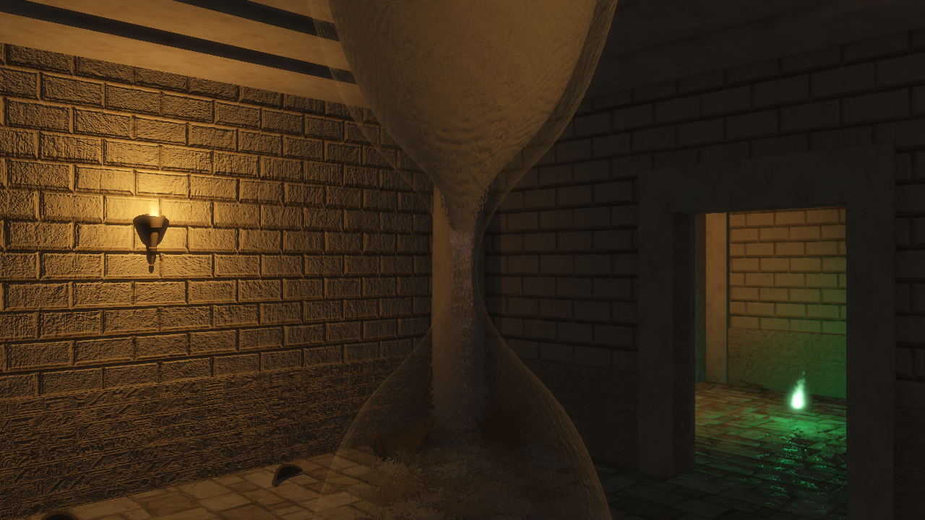
Sands of Time - Catalyst

Slide 4

Vulkan
Why?
  Consistency
  Performance
  Control
Challenging
Learning curve
Performance is not free
Vulkan and the Vulkan logo are registered trademarks of the Khronos Group Inc.
Notes:
Open source Linux driver from AMD! (https://github.com/GPUOpen-Drivers/AMDVLK)
Gives some nice insight into what each Vulkan feature / function will do.

Slide 5
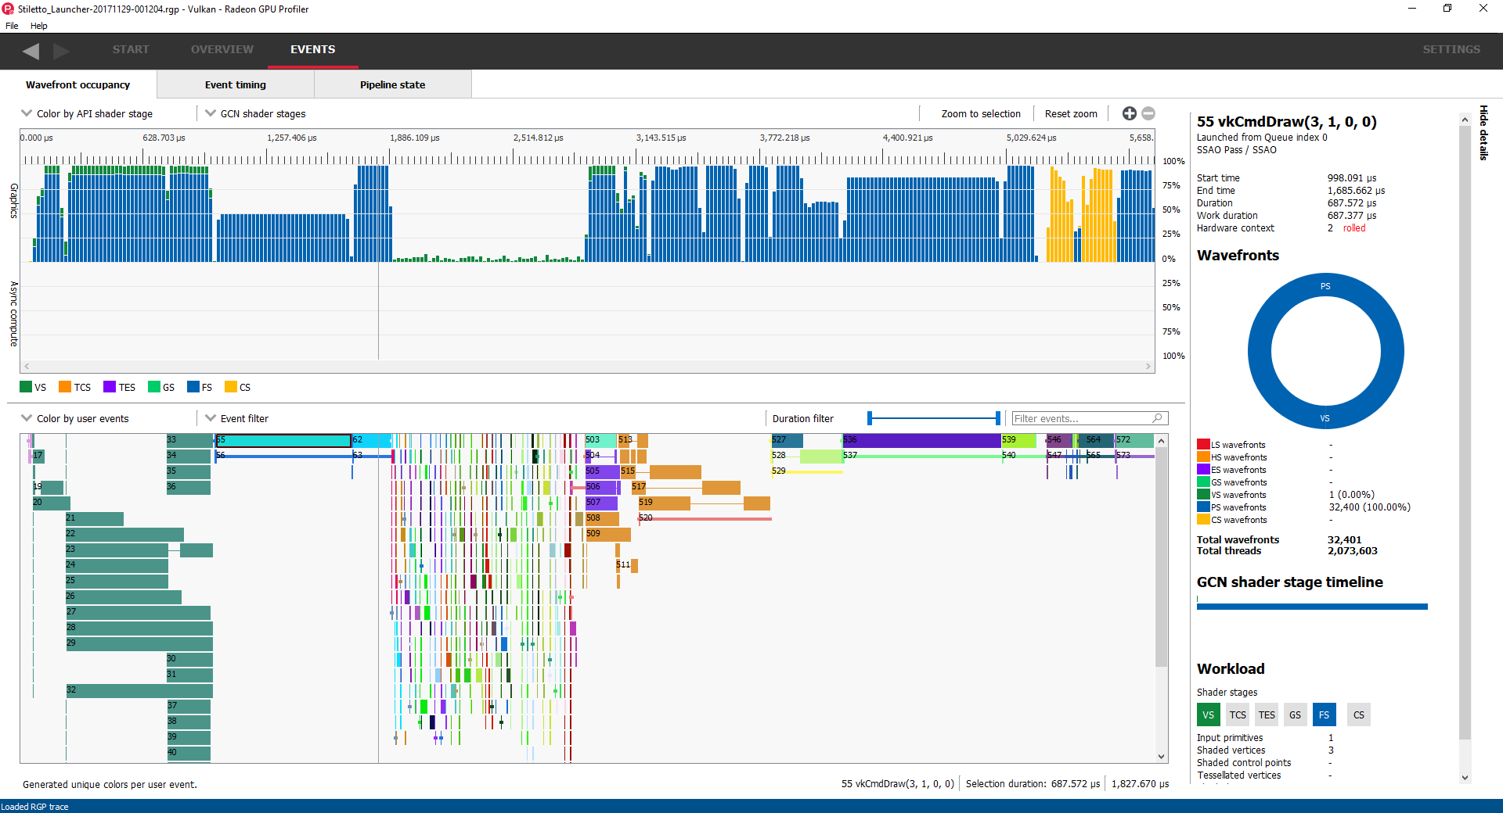
What is Radeon GPU Profiler?
Detailed workload information
DX12 and Vulkan support
Hardware level profiling features

Slide 6
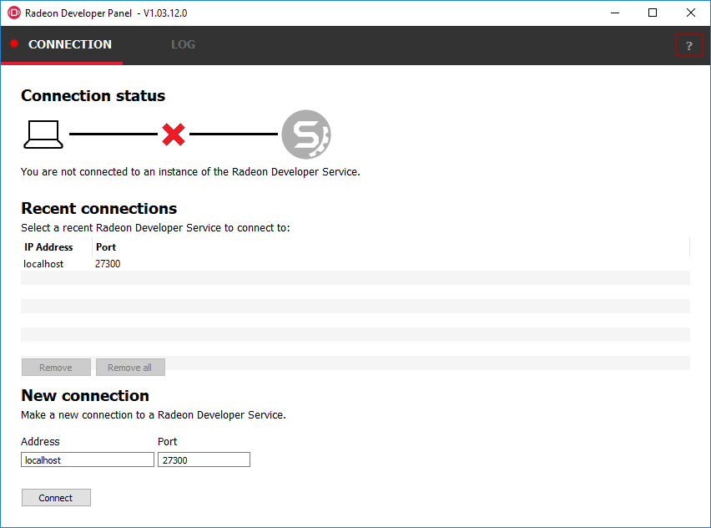
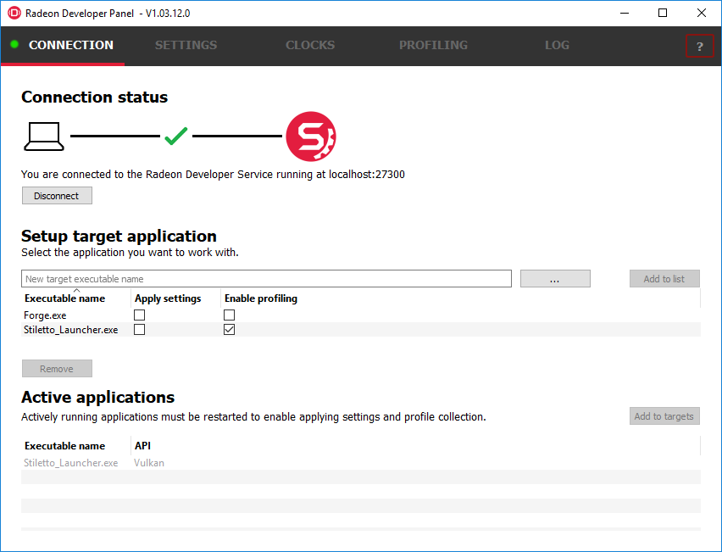
How does it work?
Connect Radeon Developer Panel
to Radeon Developer Service
Connect
Set up the target application

Slide 7
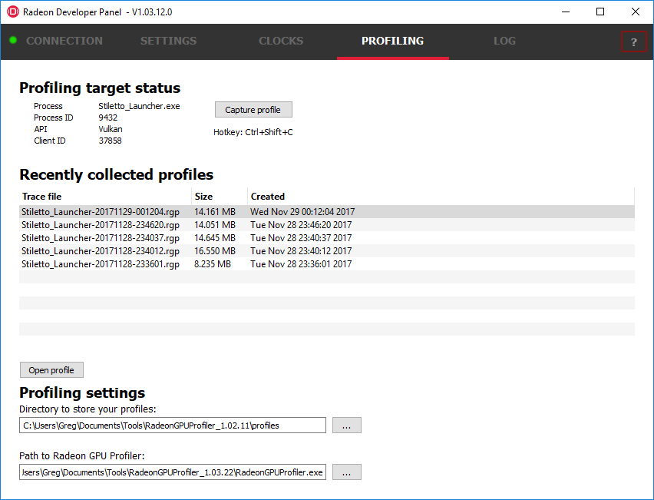
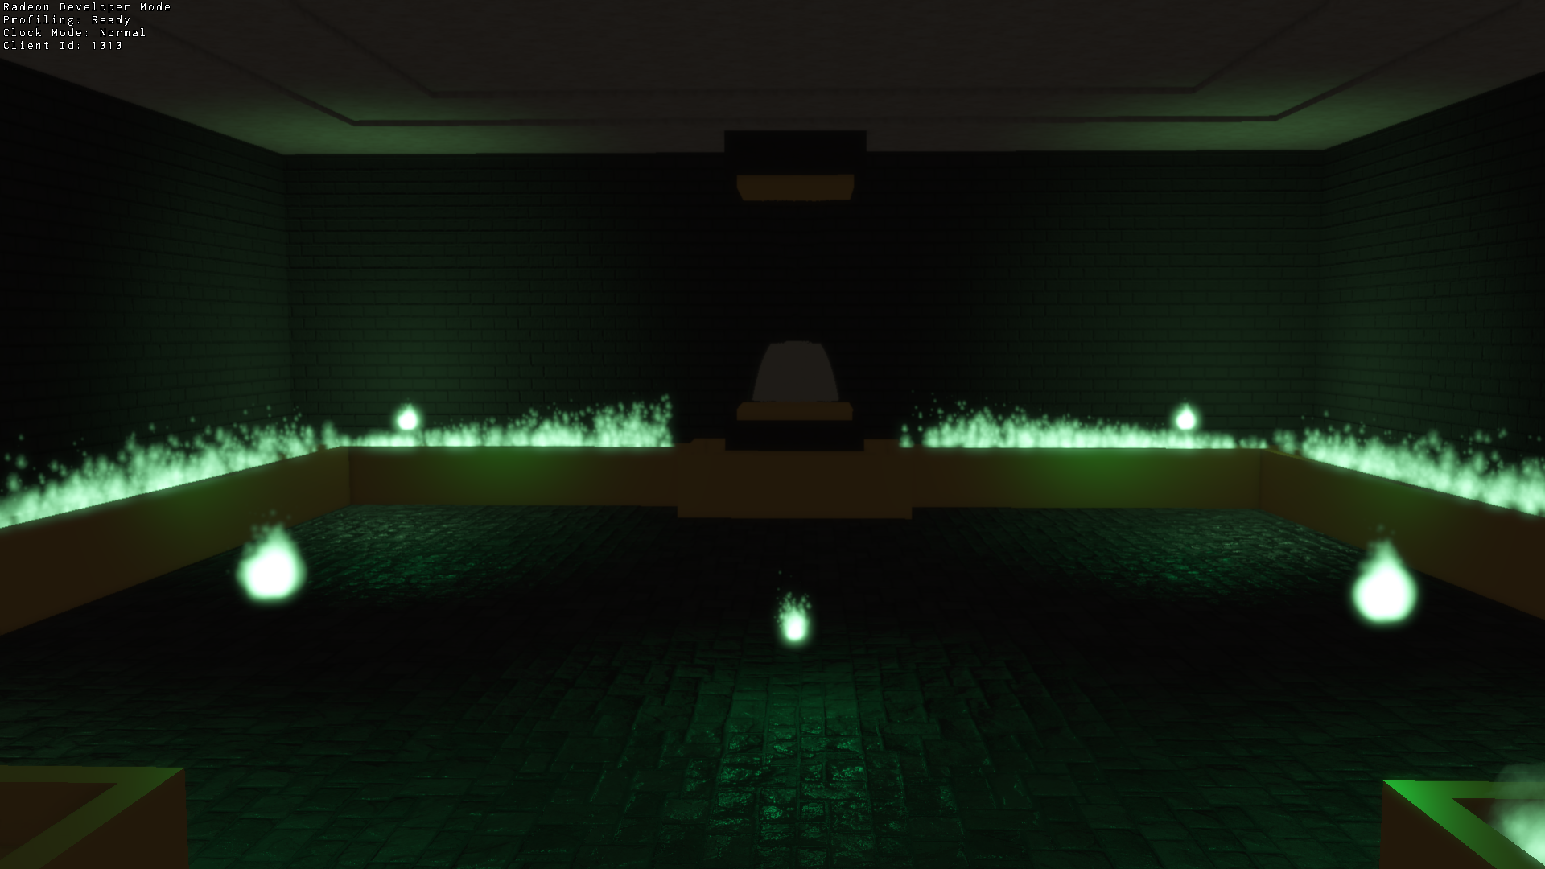
How does it work?
Capture
Capture a trace
Double click to open in RGP
Launch the target application
(RGP support is built directly into the production driver)

Slide 8
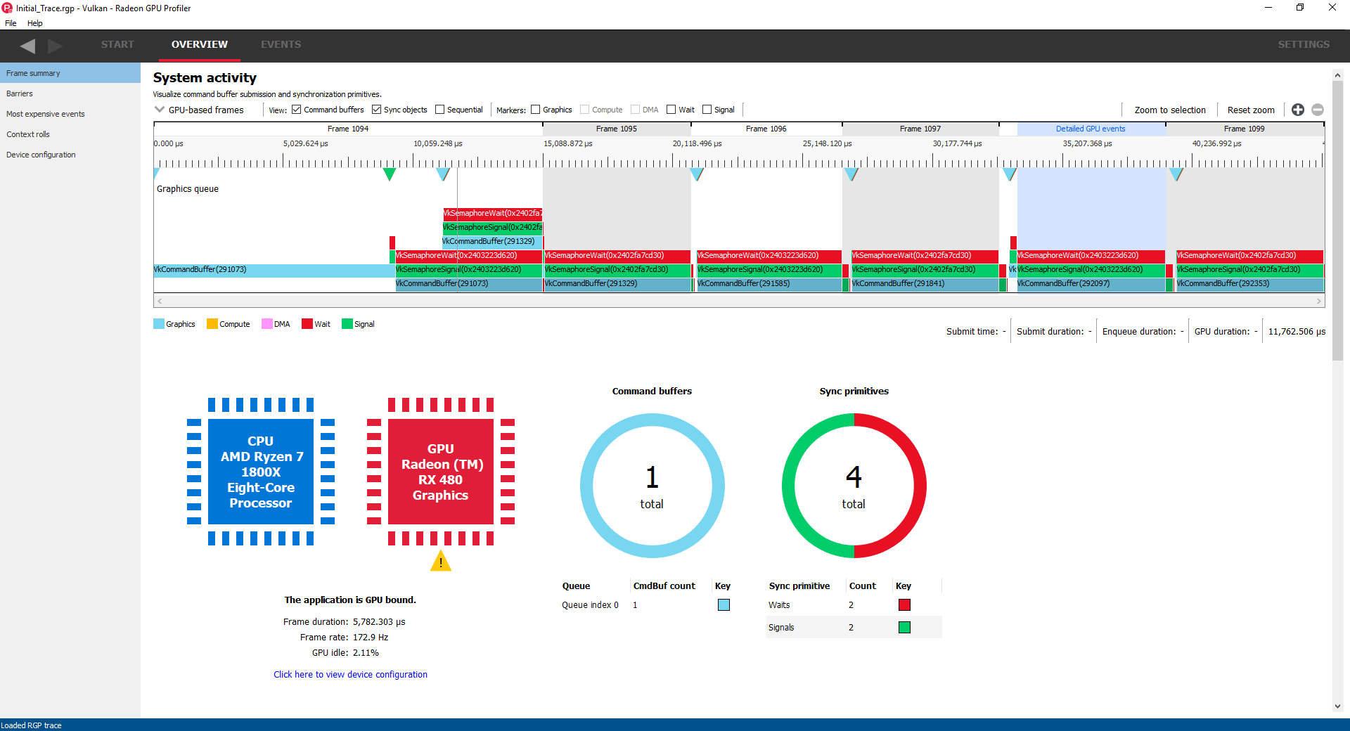
Using RGP - Where do I start?

Slide 9
Using RGP - Where do I start?
Notes:
Check for CPU Bound cases. Make sure the command buffers are filling the whole frame and there are no large gaps in between which would cause the gpu to idle.
Make sure we don’t have a huge amount of command buffers submitted in a frame. Try to submit command buffers together in the same queue submission. There’s a slight speed penalty for switching between command buffers that are submitted from different submit calls.

Slide 10
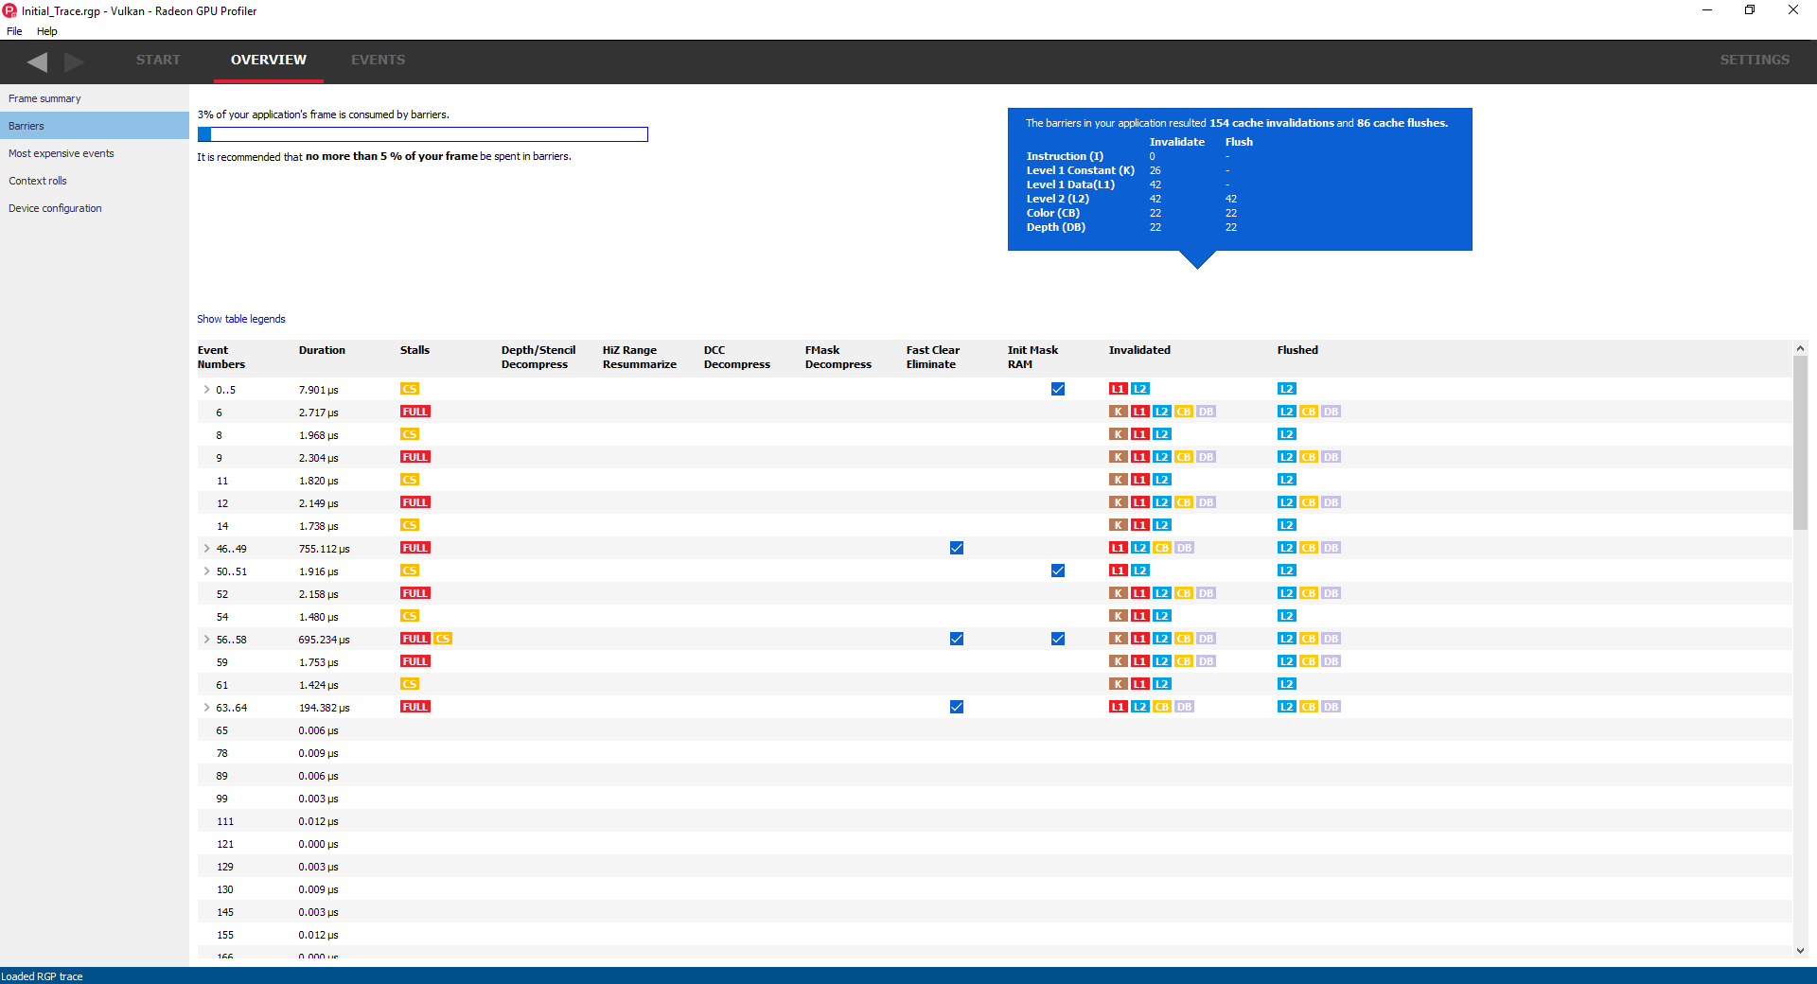
Using RGP - Barriers
Notes:
Check the percentage of the frame consumed by barriers. Should be no more than 5% (Ideally).
Check for any slow-path barriers.
Fast clear eliminates and init mask ram blits are expected in optimal cases.

Slide 11
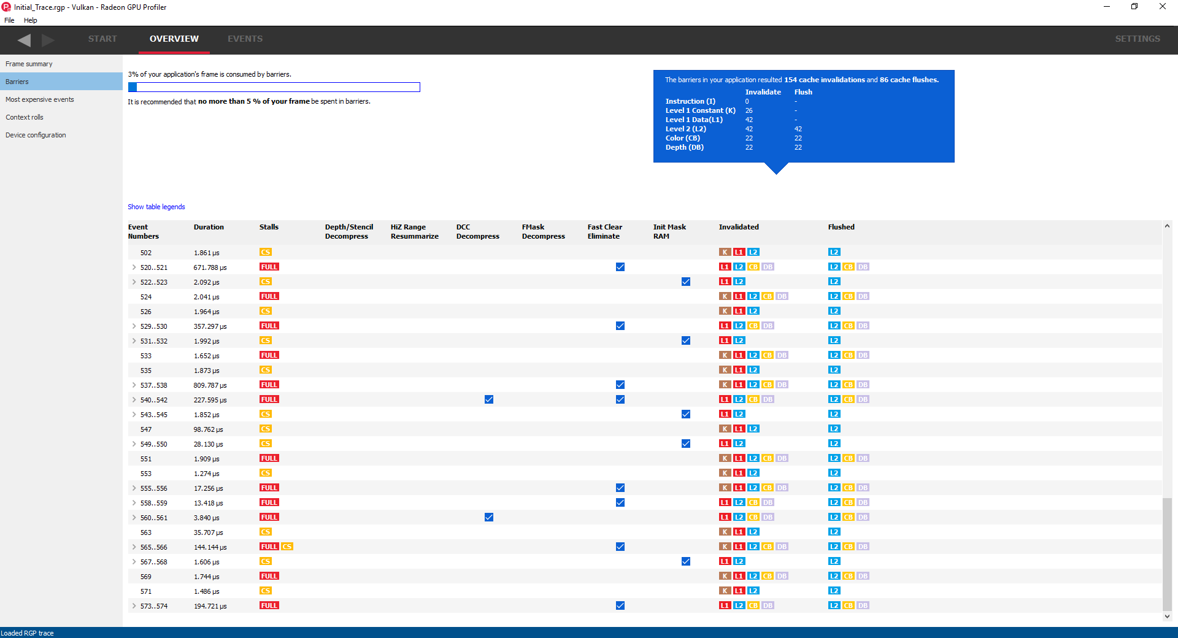
Using RGP - Barriers
Notes:
Looks like this frame has a couple of DCC decompress blits. We’ll investigate those later.

Slide 12
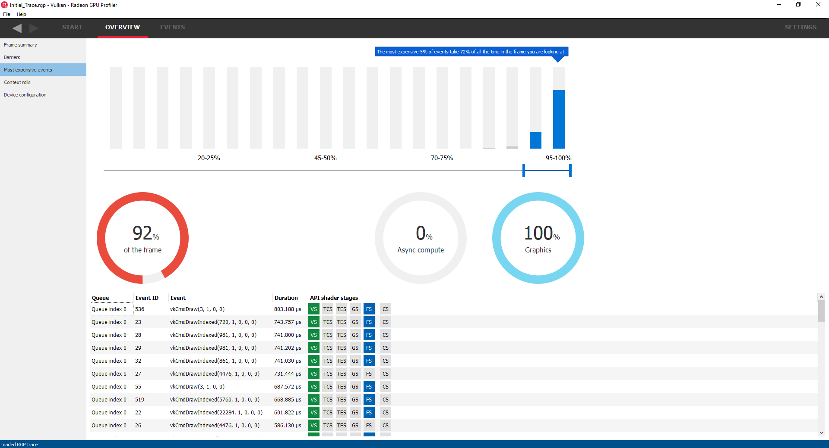
Using RGP - Most Expensive Events
Notes:
Nothing too interesting here, lots of very expensive vs/ps draws though.
Good place to figure out if there’s a specific type of work that’s dominating the frame.

Slide 13
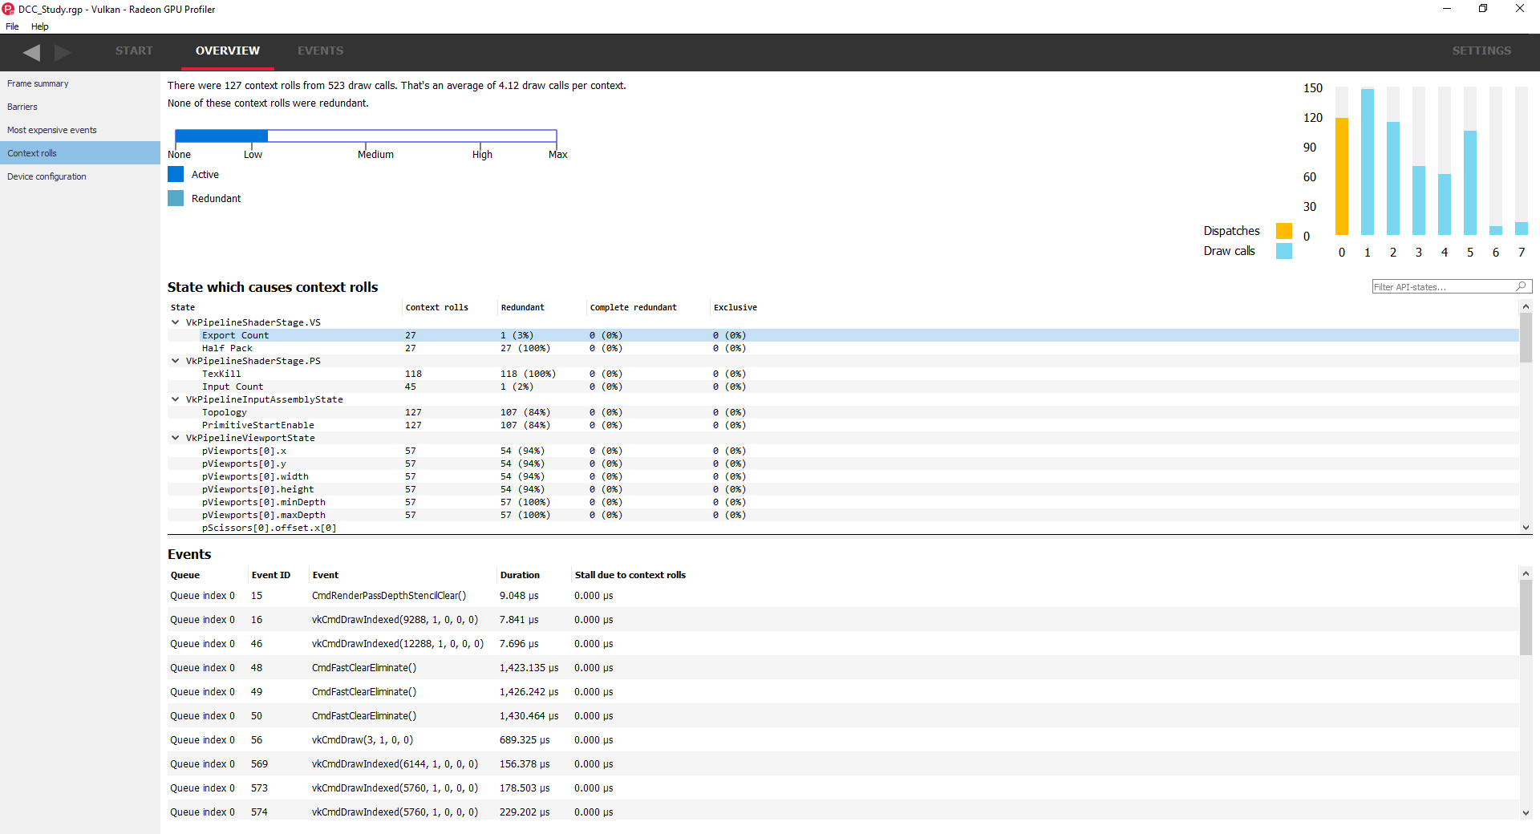
Using RGP - Context Rolls
Notes:
Yay! No stalls due to context rolls!
Good place to look to find out if the application is changing graphics state too frequently.

Slide 14
Using RGP - Wavefront View
Occupancy
Graph
GPU
Events
Notes:
Top is the wavefront occupancy graph
Bottom displays the gpu events associated with the waves above

Slide 15
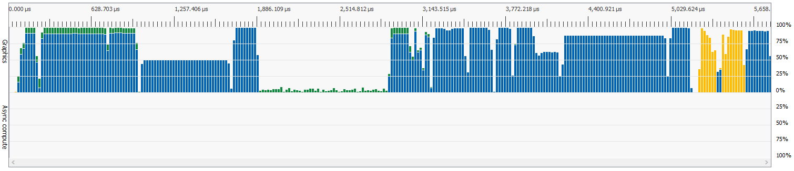
What’s a wavefront?
What’s wavefront occupancy?
?
Notes:
You may have a few questions at this point if you aren’t familiar with low level gpu operation…
Probably questions like “What’s a wavefront?”, or “What’s wavefront occupancy”?
The graph won’t be very useful for you unless you understand the answers to these questions.

Slide 16
What’s a wavefront?
AMD Graphics Core Next (GCN)
Wavefront
64 threads
Smallest unit of GPU work
Also called a “wave”
0 | 1 | 2 | 3 | 4 | 5 | 6 | 7
8 | 9 | 10 | 11 | 12 | 13 | 14 | 15
16 | 17 | 18 | 19 | 20 | 21 | 22 | 23
24 | 25 | 26 | 27 | 28 | 29 | 30 | 31
32 | 33 | 34 | 35 | 36 | 37 | 38 | 39
40 | 41 | 42 | 43 | 44 | 45 | 46 | 47
48 | 49 | 50 | 51 | 52 | 53 | 54 | 55
56 | 57 | 58 | 59 | 60 | 61 | 62 | 63
Notes:
Let’s start with the first one. What’s a wavefront?
3 threads was used as the example since it’s how many vertex shader threads you’d need to draw a fullscreen triangle. Doing this will still issue a 64 thread vertex shader wavefront and waste 61 threads.
So that’s what a wavefront is. Before we answer the next question though, we need to fill in a little background information about AMD GCN Architecture.

Slide 17
GCN Architecture
N SEs per chip
N CUs per SE
4 SIMDs per CU
N waves per SIMD
SE 0
CU 0 | CU 1 | CU 2 | CU 3 | CU 4 | CU 5 | CU 6 | CU 7 | CU 8
CU 0
SIMD 0 | SIMD 1 | SIMD 2 | SIMD 3
SIMD 0
Wave0 | Wave1 | Wave2 | Wave3 | Wave4 | Wave5 | Wave6 | Wave7
Notes:
This is how a typical GCN GPU is structured
A variable amount of shader engines per chip
A variable amount of compute units per shader engine
Always 4 SIMDs per compute unit
And a variable amount of waves per SIMD

Slide 18
What’s wavefront occupancy?
8 Wave Slots Per SIMD on RX480
8 Waves Per SIMD
100%
4 Waves Per SIMD
50%
2 Waves Per SIMD
25%
1 Wave Per SIMD
12.5%
A measure of how close a SIMD is to its maximum wavefront capacity
SIMD
Wave | Wave | Wave | Wave | Wave | Wave | Wave | Wave
SIMD
Wave | Wave | Wave | Wave | Empty | Empty | Empty | Empty
SIMD
Wave | Wave | Empty | Empty | Empty | Empty | Empty | Empty
SIMD
Wave | Empty | Empty | Empty | Empty | Empty | Empty | Empty
Notes:
In most cases, the higher occupancy the better.
Why is this important?
It’s all about hiding memory latency!

Slide 19
Latency Hiding - Definition
ALUs -> Fast
Memory -> Slow
Memory latency prevents us from fully utilizing the ALUs.
Notes:
ALUs are much faster than memory. A few clocks per op vs hundreds.
Hiding latency allows you to keep your ALUs fully utilized while the GPU is waiting for memory requests to complete.
Higher ALU utilization means more work in less time.

Slide 20
Latency Hiding - Example
Available Wave
Executing Wave
Stalled Wave
SIMD
SIMD executes wave 0
0 Wave | 1 Wave | 2 Wave | 3 Wave | 4 Wave | 5 Wave | 6 Wave | 7 Wave
SIMD
Wave 0 stalls,
SIMD moves to Wave 1
0 Wave | 1 Wave | 2 Wave | 3 Wave | 4 Wave | 5 Wave | 6 Wave | 7 Wave
SIMD
Wave 1 stalls,
SIMD moves to Wave 2
0 Wave | 1 Wave | 2 Wave | 3 Wave | 4 Wave | 5 Wave | 6 Wave | 7 Wave
SIMD
Wave 2 stalls,
Wave 0 unblocks,
SIMD moves to Wave 0
0 Wave | 1 Wave | 2 Wave | 3 Wave | 4 Wave | 5 Wave | 6 Wave | 7 Wave
Notes:
Here’s an example of how wavefront occupancy allows the GPU to hide memory fetch latency.
Having multiple waves occupying a SIMD allows the GPU to hop between them when a memory fetch stalls a shader program.
Hopping between waves allows the GPU to keep the ALUs running at max speed so it can get more done in less time.

Slide 21
Wavefront occupancy in RGP - Global
Notes:
In RGP, wavefront occupancy is displayed at a global / whole chip granularity through the wavefront occupancy graph.
The percentages on the graph represent 0% - 100% wavefront occupancy for the entire chip.
Top section is graphics, bottom section is asynchronous compute

Slide 22
Using RGP - Wavefront View
Occupancy
Graph
GPU
Events
Notes:
Now that we understand what we’re looking at, let’s look at the application.
Overall the occupancy looks pretty good over most of the frame.

Slide 23
Using RGP - Wavefront View
Occupancy
Graph
GPU
Events
Notes:
There’s a couple of areas that stick out though…
(L->R) Low Occupancy, Very Low Occupancy, Pipeline Bubble
(Bottom) No async compute usage

Slide 24
Using RGP - Wavefront View
Occupancy
Graph
GPU
Events
Notes:
Let’s start with this one here.

Slide 25
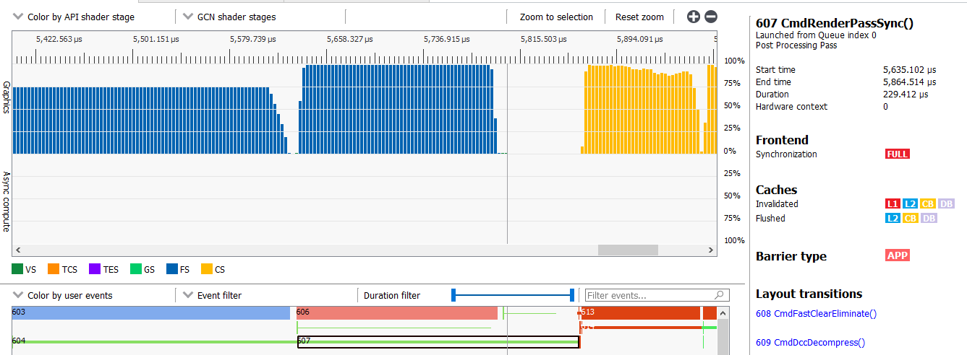
Pipeline Bubble - Zoomed In
Notes:
Looks like the second layout transition which is a DCC (Delta Color Compression) decompress is causing a pipeline bubble! (https://gpuopen.com/dcc-overview/)
Let’s look at the event timeline to figure out what’s going on here.

Slide 26
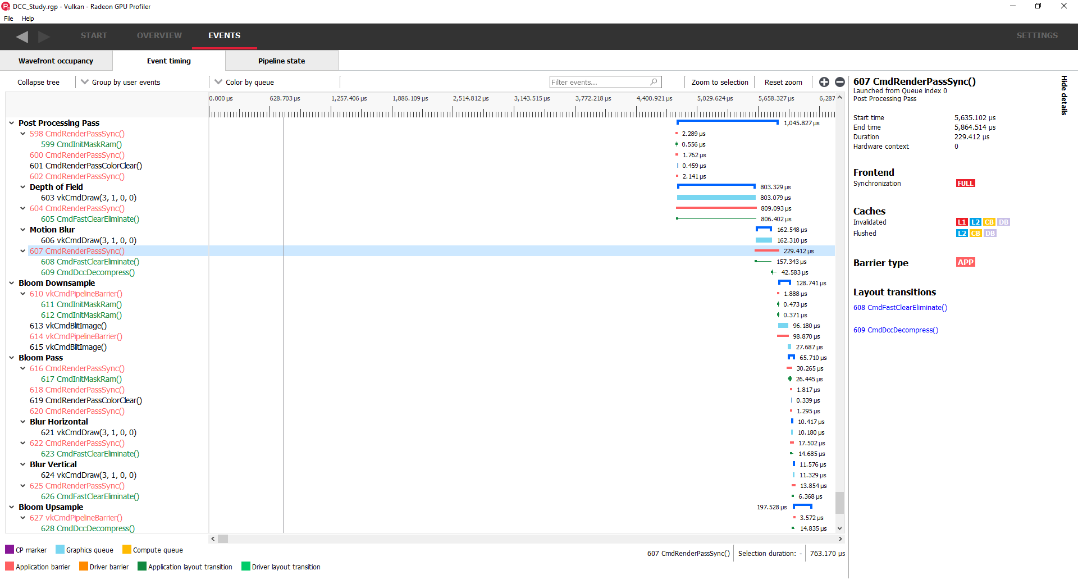
Pipeline Bubble - Event Timeline
Notes:
The event timeline view shows the entire frame as a vertical list. It’s a good way to see a lot of detail about the frame all at once.
If user markers are provided by the application (via the VK_EXT_debug_marker extension), this window will automatically group by user markers which is quite nice.

Slide 27
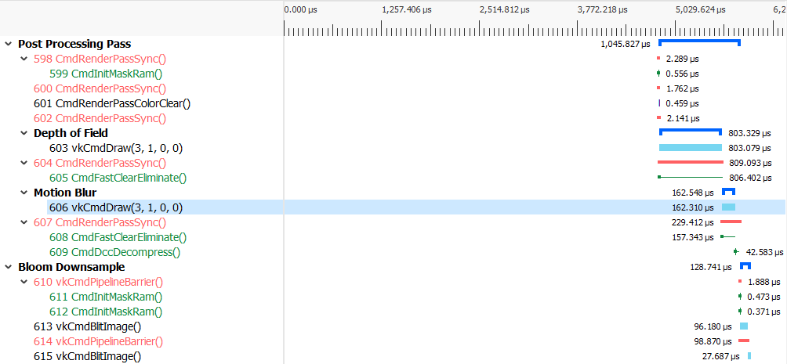
Pipeline Bubble - Event Timeline
Notes:
Here’s the group of events we were looking at before.
Looks like the decompress is coming from a render pass sync at the end of the post processing pass.

Slide 28
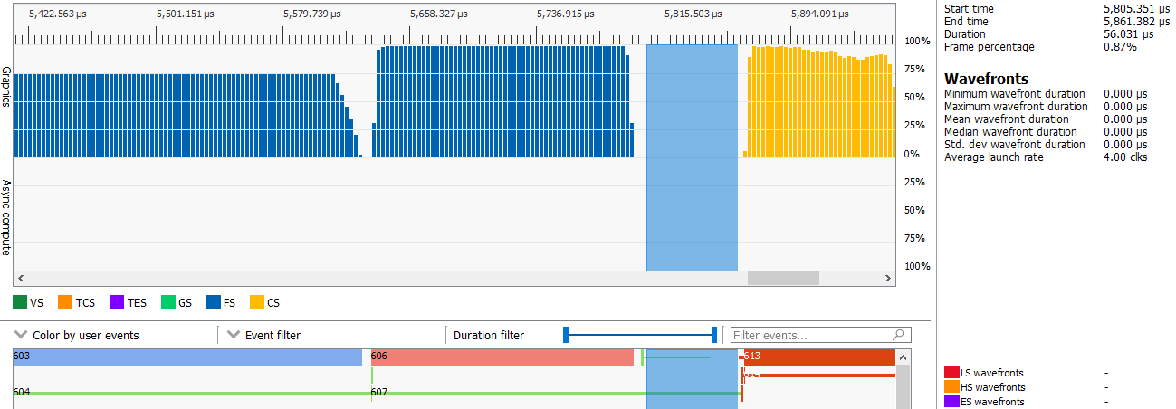
Pipeline Bubble - DCC Decompress
161us
56us~
DCC
Decompress
Depth Of Field
Motion Blur
Bloom
Downsample
Post Processing Render Pass
Notes:
If you drag select in RGP, you can measure the duration of the selection.
In total, that decompress costs us about 56us which is not as small as it sounds when you realize that the motion blur pass next to it only costs about 161us.
Why is this happening? Is there anything we can do about it? Let’s take a look at post processing render pass.

Slide 29
The Post Processing Render Pass
Subpasses
Attachments
Which layout transition is causing the decompress?
 | Initial | Depth of Field | Motion Blur | Final
Color | Shader Read | Shader Read | Color Write | Transfer Src
Depth | D/S Read | D/S Read | Preserve | D/S Read
Composite | Undefined | Color Write | Shader Read | Transfer Dst
Velocity | Shader Read | Preserve | Shader Read | Shader Read
Notes:
The post processing render pass is made up of two different subpasses.
We know the decompress happens at the end of the renderpass so it has to be caused by the last transitions that occur.

Slide 30
The Post Processing Render Pass
Subpasses
Attachments
 | Motion Blur | Final
Color | Color Write | Transfer Src
Depth | Preserve | D/S Read
Composite | Shader Read | Transfer Dst
Velocity | Shader Read | Shader Read
Notes:
So we’ve got 4 options here.
Can’t be depth because DCC is for color targets only. (https://gpuopen.com/dcc-overview/) Depth uses HTILE.
Can’t be velocity because it’s doing a read -> read transition so there shouldn’t be any state changes occuring.
So it’s either a write -> read in color, or a read -> write in composite.

Slide 31
The Post Processing Render Pass
Subpasses
Attachments
 | Motion Blur | Final | Operation
Color | Color Write | Transfer Src | Fast Clear Eliminate
Depth | Preserve | D/S Read
Composite | Shader Read | Transfer Dst | DCC Decompress
Velocity | Shader Read | Shader Read
Notes:
A write -> read should just cause a fast clear eliminate. This is an expected transition for applications and it shouldn’t have any significant overhead.
The read -> write transition on the other hand is responsible for the decompress. Unfortunately I can’t tell you exactly why without going into lots of driver details, but my best guess is that it’s because the driver uses compute for most of its copies and compute can’t write DCC so it needs to decompress since we’re going to be copying to it next.
How can we get around this?

Slide 32
The Post Processing Render Pass
Subpasses
Attachments
 | Motion Blur | Final | Operation
Composite | Shader Read | Transfer Dst | DCC Decompress
 | Motion Blur | Final
Composite | Shader Read | Shader Read
VkCmdPipelineBarrier : Image Layout [Undefined -> Transfer Dst]
Notes:
Turns out we can get around this completely by using Vulkan’s Undefined -> Anything barrier feature which allows the driver to drop the contents of the previous image since we’re just copying over it anyways!
See section 6.1.1 of the Vulkan spec where it mentions the VK_IMAGE_LAYOUT_UNDEFINED image layout.

Slide 33
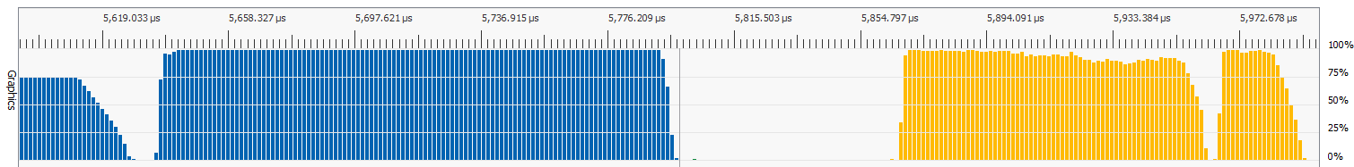
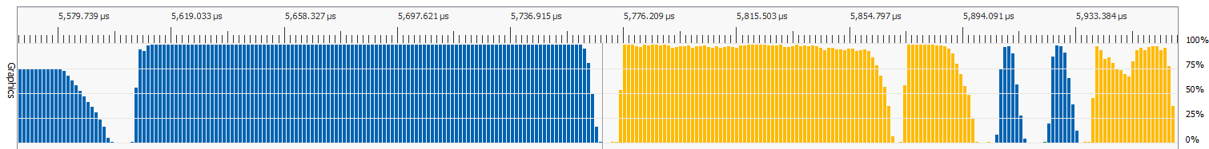
The Post Processing Render Pass
90us~ Gain
Notes:
No more DCC decompress!
Gained about 90us. Better than the original estimation due to other gpu pipeline factors.
Before we get back to the other issues, let’s take a quick peek at RGP’s pipeline view.

Slide 34
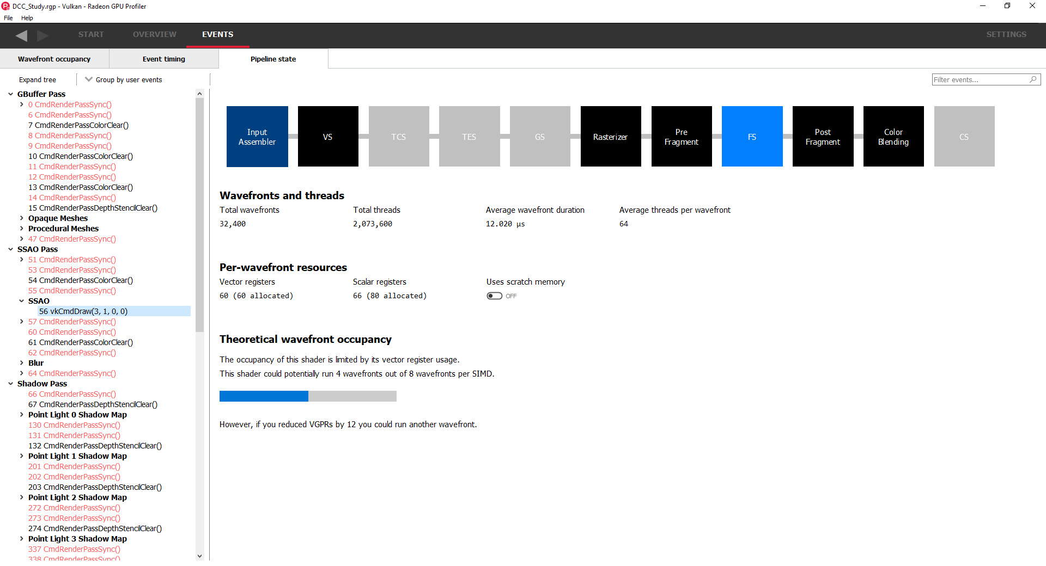
Using RGP - Pipeline State View
Notes:
This view shows the full pipeline state for a given gpu event.
All sorts of good information about what a particular draw is doing. Stuff like vertex re-use, MSAA usage, DCC status, hardware z culling mode, etc.
Allows shows you shader occupancy at an individual pipeline level.

Slide 35
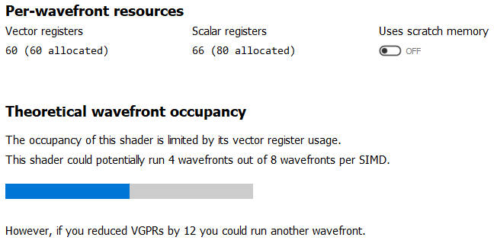
Using RGP - Pipeline State View
SIMD
PS Wave | PS Wave | PS Wave | PS Wave | Empty | Empty | Empty | Empty
Notes:
You can use the information in this view to verify how changes to your shader code will affect occupancy and performance characteristics.
At the individual shader level, occupancy is limited based on how many resources a shader requires to run.
If a shader uses a lot of resources, you won’t be able to run many copies of it on a SIMD to hide latency.
RGP will give you hints about how close you are to running another wave for a specific pipeline.
That draw might look something like the SIMD below in actual execution if you filled the entire gpu with work from this particular pipeline.

Slide 36
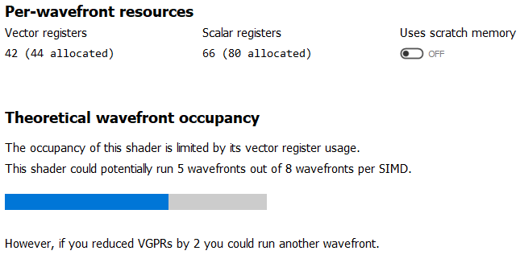
Using RGP - Pipeline State View
SIMD
VS Wave | VS Wave | VS Wave | VS Wave | VS Wave | VS Wave | Empty | Empty
Notes:
Scrolling through the shaders in the pipeline view can help you identify easy targets like this one where you only have to do a small amount of work to get another wave out of the shader.
This shader only needs to drop the vector register count by 2 in order to get another wave.
Optimizing register usage inside a shader is a big enough topic by itself so I’ll leave the details for another time! :)

Slide 37
Using RGP - Wavefront View
Notes:
Anyways, back to the wavefront view. What else do we have left?
Well it turns out that all three of these spots are related in a way… Let’s take a look.

Slide 38
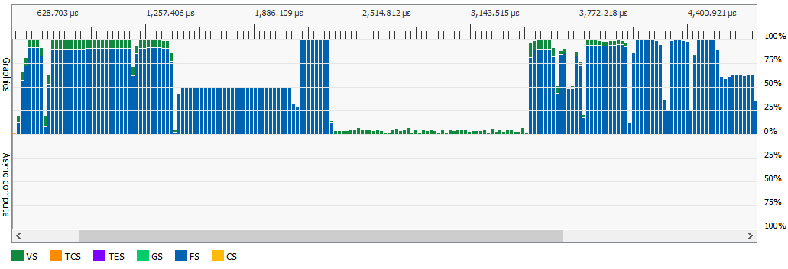
Low Occupancy - Zoomed In
Low-ish Occupancy
Very Low Occupancy
GBuffer Pass
SSAO Pass
Shadow Pass
Lighting Pass
No Async Compute Usage
Notes:
So we’ve got a few issues here, let’s try solving the occupancy issue first.
What can we do about the shadow pass? It takes forever and barely uses the shader cores since it’s mostly fixed function work.
The SSAO pass also takes a long time, and it uses a decent amount of ALU.
If only we could mix them somehow...

Slide 39
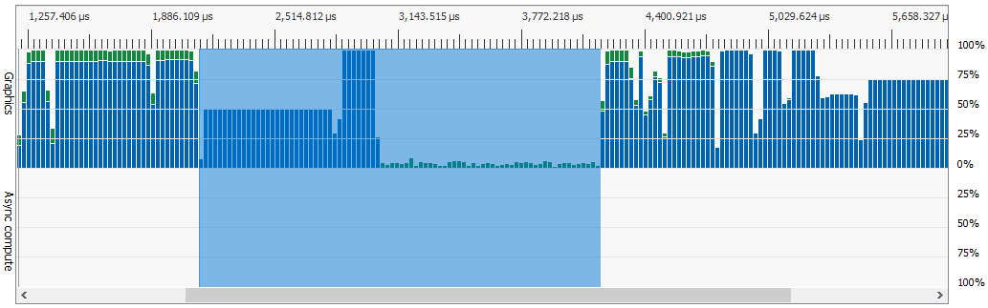
Original - 2046us
1080p

Slide 40
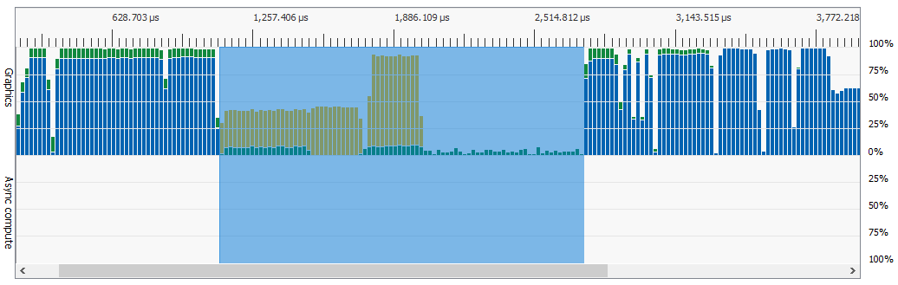
Graphics Queue Overlap - 1627us
1080p

Slide 41
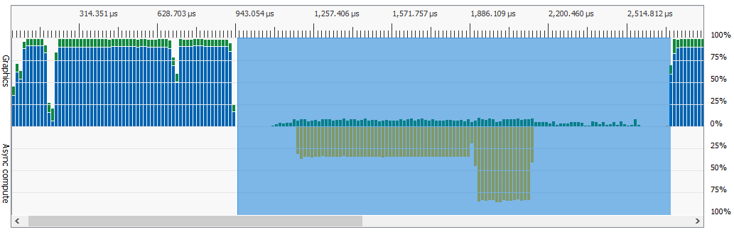
Asynchronous Compute Queue - 1738us
1080p

Slide 42
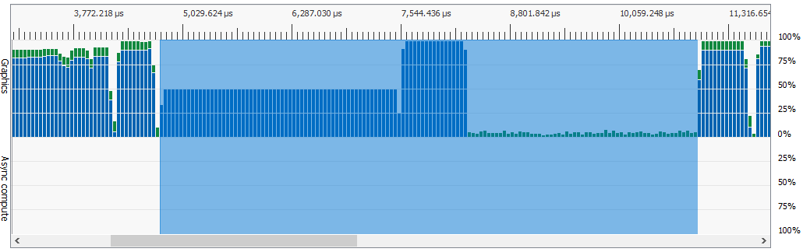
Original - 6183us
4k

Slide 43
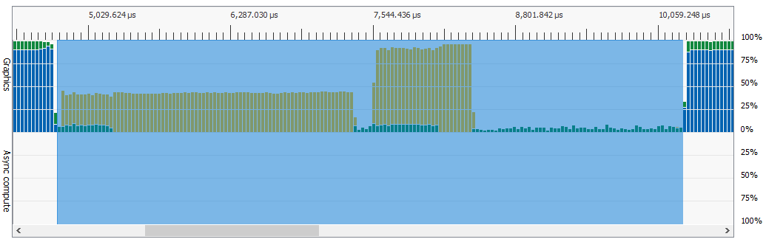
Graphics Queue Overlap - 5519us
4k

Slide 44
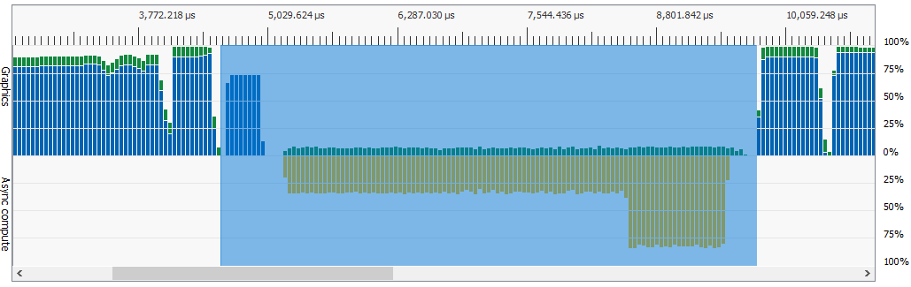
Asynchronous Compute Queue - 5203us
4k

Slide 45
SSAO Overlap Results - AMD Radeon RX480
1080p : GFX Overlap (419us Gain)
5,896us Total Original Frametime
4k : Async Compute (980us Gain)
25,830us Total Original Frametime
Notes:
Interestingly enough, the results depend on the resolution.
At lower resolutions, GFX overlap is faster due to the fixed overhead related to queue semaphores and separate command buffers that’s involved with async compute.
At higher resolutions, async compute is faster because it actually runs faster / better than the graphics overlap and the fixed costs are small enough to be covered by the increased cost of 4k.

Slide 46
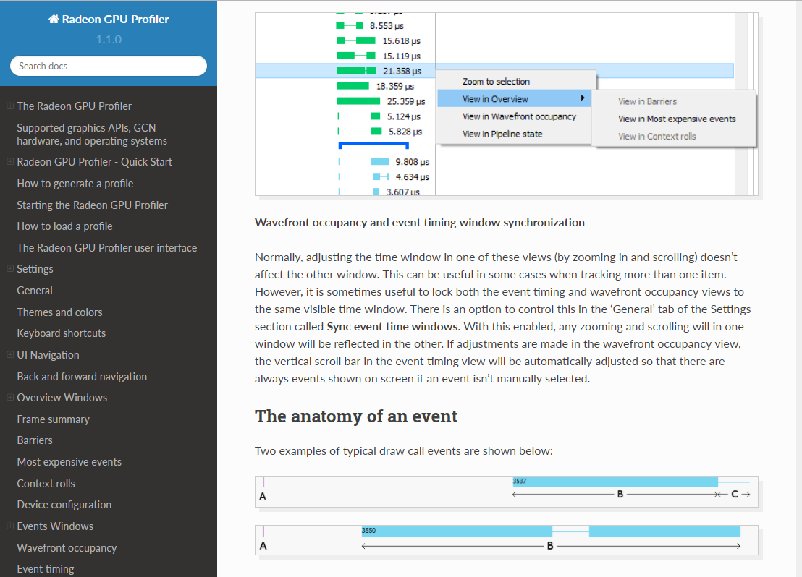
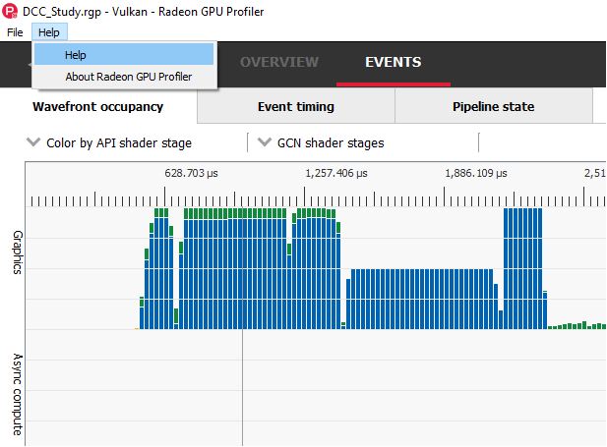
RGP Built-in Help
Notes:
One last thing, make sure you check out the built in help in RGP!
It’s really nice! I don’t typically bother with built in help CHM/HTML pages but this one is definitely worth a look!

Slide 47
Links
GPUOpen RGP Product Page
  https://gpuopen.com/gaming-product/radeon-gpu-profiler-rgp/
AMD Open Source Vulkan Driver (AMDVLK)
  https://github.com/GPUOpen-Drivers/AMDVLK
Sands of Time - Catalyst
  Youtube : https://www.youtube.com/watch?v=fS8MQhbnrvQ
  Pouet : http://www.pouet.net/prod.php?which=72282

Slide 48
Questions?

Slide 49
Backup

Slide 50
Compute -> Graphics -> Compute
Notes:
Didn’t have time to get to this one here, but it’d be nice to convert the pixel shaders in between those compute shaders into compute shaders as well.
This would allow the gpu to avoid switching between graphics and compute pipelines and it might result in some small gains.

