Slide 2
AMD Ryzen™ Processor Software Optimization
Ken Mitchell (AMD)

Slide 3
Agenda
Abstract
Speaker biography
“Zen 2” architecture processors
“Zen 3” architecture processors
Best practices

Slide 4
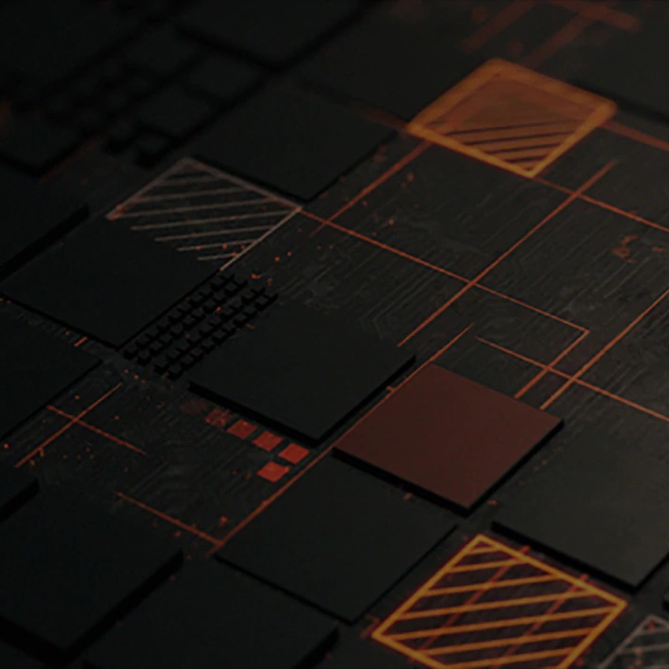

Abstract
Join AMD on an adventure thru “Zen 2” and “Zen 3” processors which power today’s game consoles and PCs. Dive into instruction sets, cache hierarchies, resource sharing, and simultaneous multi-threading. Journey across the sands of silicon to master microarchitecture and uncover best practices!

Slide 5

Player One
Ken Mitchell is a Principal Member of Technical Staff in the AMD Game Engineering team where he focuses on helping game developers utilize AMD processors efficiently.

Slide 6
“Zen 2” architecture processors

Slide 7
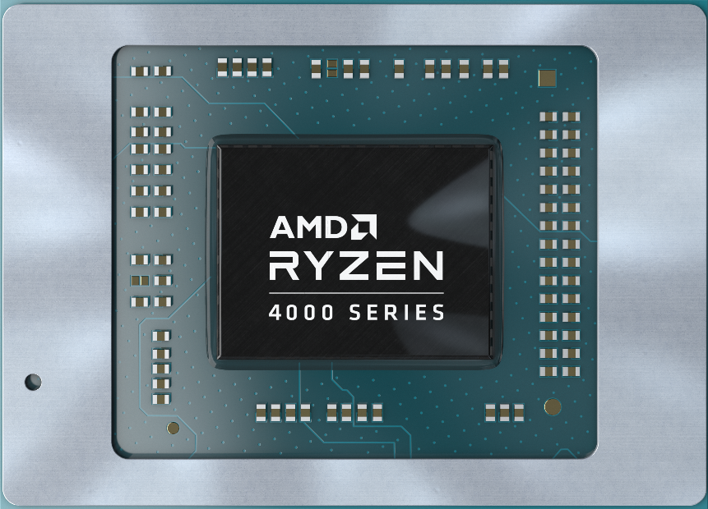
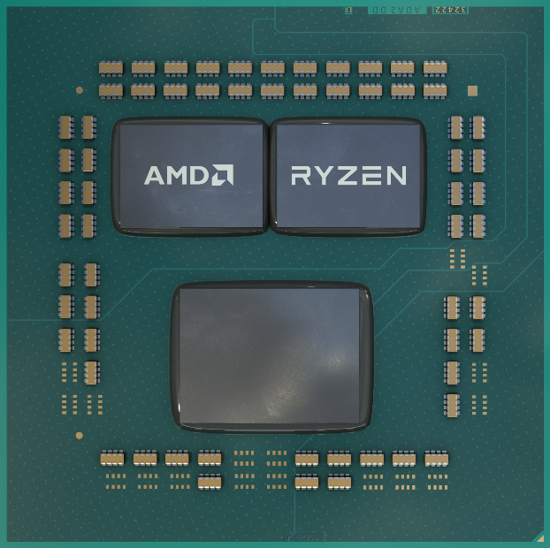
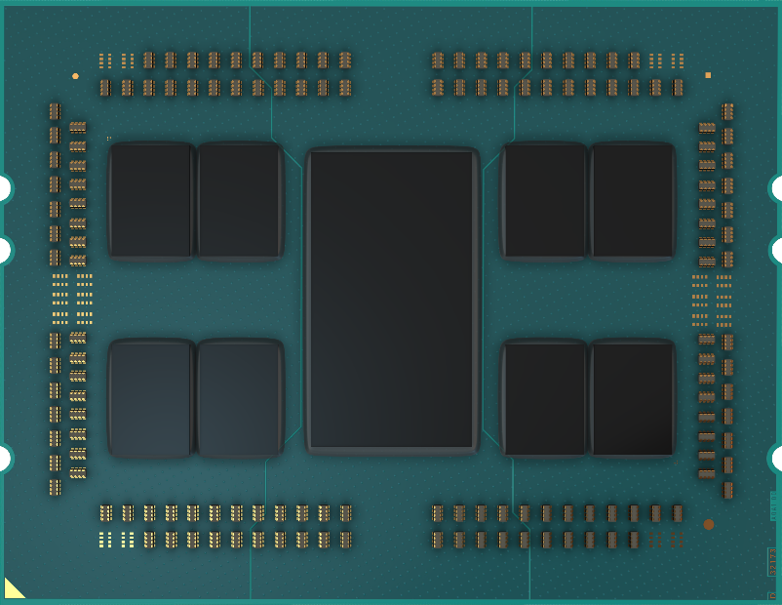
“Zen 2” PC product examples
“Renoir”
AMD Ryzen™ 7 4800U 8-Cores, 16 Logical Processors
“Matisse”
AMD Ryzen™ 9 3950X 16-Cores, 32 Logical Processors
“Castle Peak”
AMD Ryzen™ Threadripper™ 3990X 64-Cores, 128 Logical Processors

Slide 8
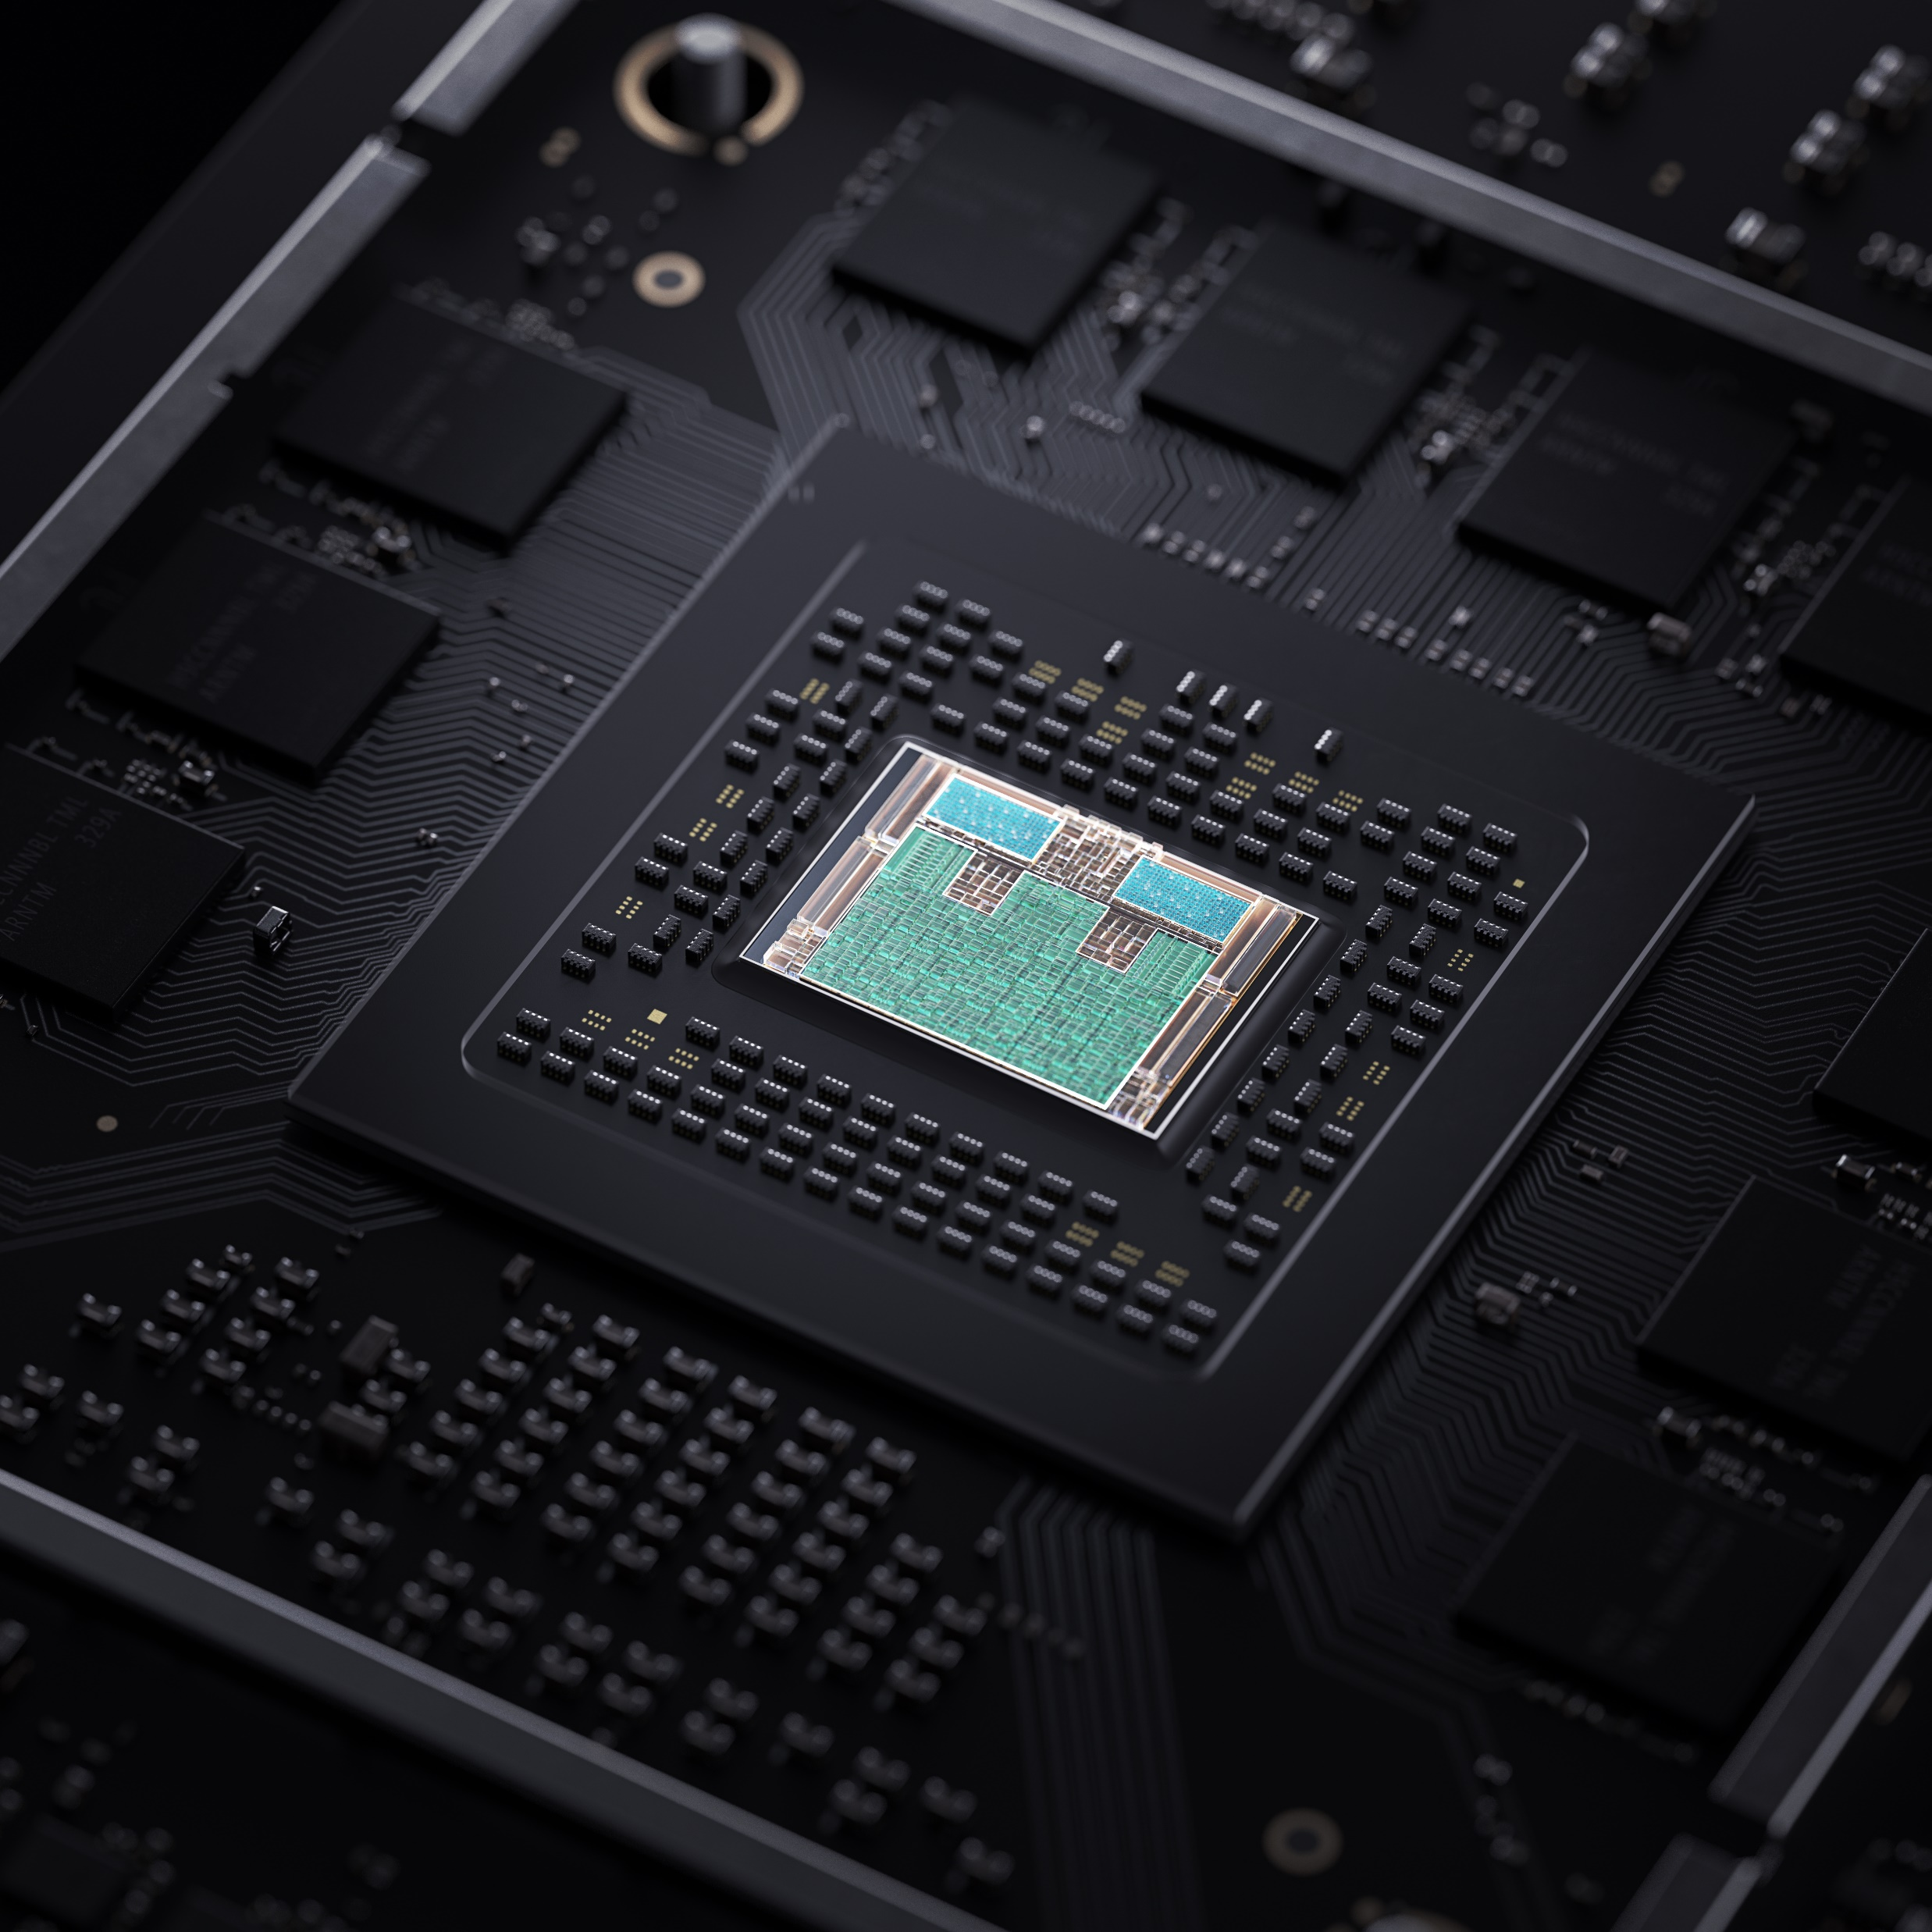
Xbox Series X
“Zen 2” provides a significant advancement in CPU performance delivering more than 4 times the performance of an Xbox One X.

Slide 9
Microarchitecture

Slide 10
What is Simultaneous Multi-Threading?
High performance cores have gaps in utilization which may be filled by additional hardware threads—this is Simultaneous Multi-Threading (SMT)
Although each hardware thread has its own program counter and architectural register set, they share core resources
Consequently, there may be architecture specific bandwidth and latency trade-offs
Skilled developers may apply knowledge of these trade-offs while optimizing for performance
Program Threads
A
B
“Zen” Core
Program Counter #1
Program Counter #2
Thread #1
Thread #2
Architectural Register Set #1
Architectural Register Set #2
Scheduler
Register Files, Execution Units

Slide 11
“Zen 2” microarchitecture
“Zen 2” supports 2-way SMT and may run in either single-thread or dual-thread mode
Program thread select occurs during branch prediction and is typically done using round robin scheduling
Some resources within the core may be shared while in dual-thread mode
32K ICACHE
8 way
BRANCH PREDICTION
DECODE
OP CACHE
4 instructions/cycle
Micro-op Queue
8 ops/cycle
6 ops dispatched
INTEGER
FLOATING
POINT
Integer Rename
Floating Point Rename
Scheduler
Scheduler
Scheduler
Scheduler
Scheduler
Scheduler
Scheduler
Scheduler
Integer Physical Register File
FP Register File
ALU
ALU
ALU
ALU
AGU
AGU
AGU
MUL
ADD
MUL
ADD
2 loads + 1 store per cycle
LOAD/STORE
QUEUES
32K DCACHE
8 way
512K L2 (I+D)CACHE
8 way

Slide 12
Resource sharing definitions
Competitively shared: Resource entries are assigned on demand. A thread may use all resource entries
Watermarked: Resource entries are assigned on demand. When in two‑threaded mode a thread may not use more resource entries than are specified by a watermark threshold
Statically partitioned: Resource entries are partitioned when entering two‑threaded mode. A thread may not use more resource entries than are available in its partition

Slide 13
“Zen 2” resource sharing…
Resource | Competitively Shared | Watermarked | Statically Partitioned
L1 Instruction Cache | X
ITLB | X
Op Cache | X
Dispatch Interface | X
L1 Data Cache | X
DTLB | X
L2 Cache | X
L3 Cache | X
Integer Scheduler | X
Integer Register File | X
Load Queue | X
Floating Point Physical Register | X
Floating Point Scheduler |  | X
Memory Request Buffers |  | X
Op Queue |  |  | X
Store Queue |  |  | X
Retire Queue |  |  | X

Slide 14
Instruction set evolution
YEAR | FAMILY | PRODUCT FAMILY | ARCHITECTURE | EXAMPLE PRODUCT | VAES | VPCLMUL | CLWB | ADX | CLFLUSHOPT | RDSEED | SHA | SMAP | XGETBV | XSAVEC | XSAVES | AVX2 | BMI2 | MOVBE | RDRND | SMEP | FSGSBASE | XSAVEOPT | BMI | FMA | F16C | AES | AVX | OSXSAVE | PCLMUL | SSE4.1 | SSE4.2 | XSAVE | SSSE3 | MONITORX | CLZERO | WBNOINVD
2019 | 17h | “Matisse” | “Zen 2” | Ryzen™ 9 3950X | 0 | 0 | 1 | 1 | 1 | 1 | 1 | 1 | 1 | 1 | 1 | 1 | 1 | 1 | 1 | 1 | 1 | 1 | 1 | 1 | 1 | 1 | 1 | 1 | 1 | 1 | 1 | 1 | 1 | 1 | 1 | 1
2018 | 17h | ”Pinnacle Ridge” | “Zen+” | Ryzen™ 7 2700X | 0 | 0 | 0 | 1 | 1 | 1 | 1 | 1 | 1 | 1 | 1 | 1 | 1 | 1 | 1 | 1 | 1 | 1 | 1 | 1 | 1 | 1 | 1 | 1 | 1 | 1 | 1 | 1 | 1 | 1 | 1 | 0
2017 | 17h | “Summit Ridge” | “Zen” | Ryzen™ 7 1800X | 0 | 0 | 0 | 1 | 1 | 1 | 1 | 1 | 1 | 1 | 1 | 1 | 1 | 1 | 1 | 1 | 1 | 1 | 1 | 1 | 1 | 1 | 1 | 1 | 1 | 1 | 1 | 1 | 1 | 1 | 1 | 0
2013 | 16h | “Kabini” | “Jaguar” | A6-1450 | 0 | 0 | 0 | 0 | 0 | 0 | 0 | 0 | 0 | 0 | 0 | 0 | 0 | 1 | 0 | 0 | 0 | 1 | 1 | 0 | 1 | 1 | 1 | 1 | 1 | 1 | 1 | 1 | 1 | 0 | 0 | 0
“Zen 2” added CLWB and WBNOINVD instructions.
Vectorized instructions use floating-point schedulers and execution units within a core.
AMD “Jaguar” and “Zen” are binary equivalent for RCPPS/SS and RSQRTPS/SS instructions.

Slide 15
Software Prefetch instructions…
Load a cache line from the specified memory address into the data-cache level specified by the locality reference hint T0, T1, T2, or NTA
This instruction is implementation dependent. Prefetch fill & evict policies may differ for other processors. Policies for “Zen 1-3” are shown
Prefetch levels T0/T1/T2 are implemented identically
Prefetch level NTA lines are evicted aggressively from the L2, and when eventually evicted from the L2 are not inserted into the L3
Prefetch T0|T1|T2|NTA
Fill lines
L1
32 KB
Aggressively Evict Prefetch NTA
lines
L2
512 KB
L3
4096 KB
Memory
Gigabytes

Slide 16
Software Prefetch instructions
Use Software Prefetch instructions on linked data structures experiencing cache misses. Use NTA on use once data. While in dual-thread mode, beware too many software prefetches may evict the working set of the other thread from their shared caches
Remove ineffective Software Prefetches found by PMCx052
Prefetch T0|T1|T2|NTA
Fill lines
L1
32 KB
Aggressively Evict Prefetch NTA
lines
L2
512 KB
L3
4096 KB
Memory
Gigabytes

Slide 17
Data flow

Slide 18

“Renoir” 8-core processor
Data Fabric
Unified Memory Controller
DRAM
Channel
32B fetch
32K
I-Cache
8-way
32B/cycle
512K L2
I+D Cache
8-way
32B/cycle
16B/cycle
4M L3
I+D Cache 16-way
¸uclk
¸memclk
32B/cycle
32B/cycle
2*32B load
32K
D-Cache 8-way
32B/cycle
32B/cycle
GFX9
¸
1*32B store
32B/cycle
¸cclk
¸l3clk
Media
¸
32B/cycle
IO Hub
Controller
¸fclk
¸lclk
AMD Ryzen™ 7 4800U, 15W TDP, 8 Cores, 16 Threads, up to 4.2 GHz max boost clock, 1.8 GHz base clock, integrated GPU.
Monolithic Die. Each 4M L3 Cache has its own 32B/cycle link to the data fabric. 64b DDR4 Channel Shown

Slide 19
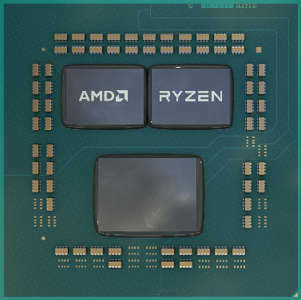
“Matisse” 16-core processor
CCD
CCD
IOD
16M L3
I+D Cache 16-way
Data Fabric
Unified Memory Controller
DRAM
Channel
32B fetch
32K
I-Cache
8-way
32B/cycle
512K L2
I+D Cache
8-way
32B/cycle
16B/cycle
¸uclk
¸memclk
32B/cycle
32B/cycle R
2*32B load
32K
D-Cache 8-way
32B/cycle
16B/cycle W
1*32B store
¸cclk
IO Hub
Controller
64B/cycle
¸l3clk
¸fclk
¸lclk
AMD Ryzen™ 9 3950X, 105W TDP, 16 Cores, 32 Threads, up to 4.7 GHz max boost clock, 3.5 GHz base clock.
Two Core Complex Die (CCD). Each CCD has two 16M L3 Cache Clusters
The L3 Cache Complexes within a CCD share a single link to the Data Fabric

Slide 20
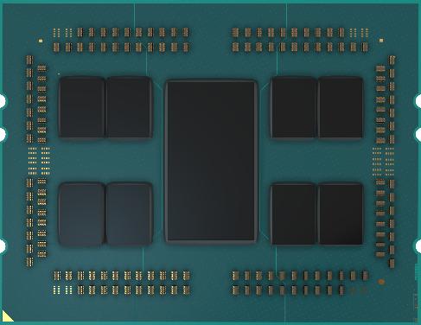
“Castle Peak” 64-core processor
0
1
IOD
4
5
2
3
6
7
16M L3
I+D Cache 16-way
Data Fabric
Quadrant
Unified Memory Controller
DRAM
Channel
32B fetch
32K
I-Cache
8-way
32B/cycle
512K L2
I+D Cache
8-way
32B/cycle
16B/cycle
¸uclk
¸memclk
32B/cycle
32B/cycle R
2*32B load
32K
D-Cache 8-way
32B/cycle
16B/cycle W
1*32B store
¸cclk
IO Hub
Controller
64B/cycle
¸l3clk
¸fclk
¸lclk
AMD Ryzen™ Threadripper™ 3990X, 280W TDP, 64 Cores, 128 Threads, up to 4.3 GHz max boost clock, 2.9 GHz base clock.
Two CCDs per Data Fabric Quadrant shown
Two Data Fabric Quadrants have Unified Memory Controllers and two have IO Hubs

Slide 21
Bandwidth and latency
As program threads are added to the system, both bandwidth and latency may increase
  Each logical processor may have memory demand, software prefetch, and hardware prefetch requests
  These requests to shared resources may cause cache evictions and misses
  These misses may increase Data Fabric usage and add queuing delays
  DRAM page conflicts may become more common
  False Sharing may become more harmful
  Software Prefetch instructions may become more beneficial
SMT dual-thread mode may further increase both bandwidth and latency

Slide 22
“Zen 3” architecture processors

Slide 23
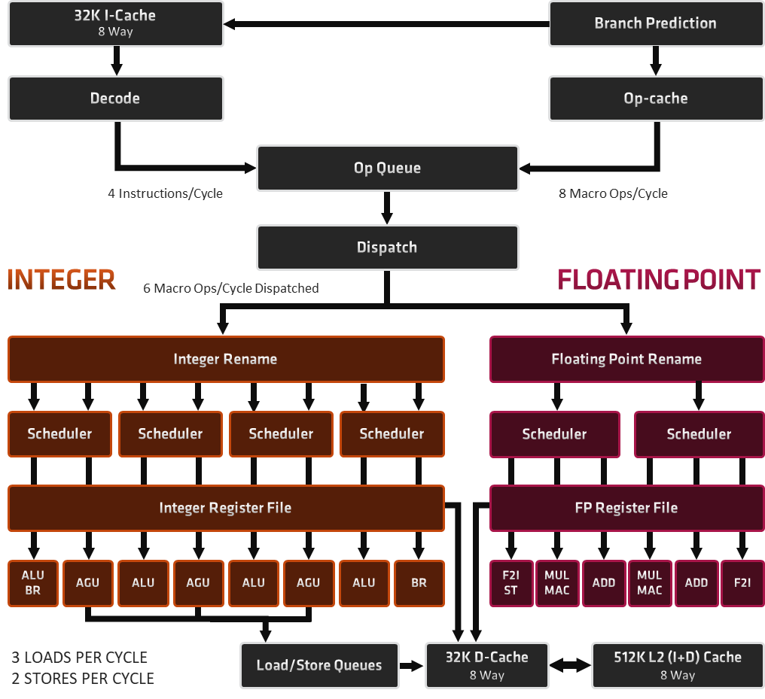
Advances in “Zen 3” microarchitecture
+19% Desktop IPC Improvement from “Zen 2” to “Zen 3”
Unified 8-Core Cluster
2x Direct Access L3 Cache Per Core
Improved Load Store Unit supports up to 3 operations/cycle
  Up to 3 loads/cycle
  Up to 2 stores/cycle
Wider issue in Float and Int Engines
  +2 FP pipes for F2I/STore
  +1 int pipe for BRanch
Improved SMT fairness
New Cryptography Instructions

Slide 24
“Zen 3” resource sharing…
Resource | Competitively Shared | Watermarked | Statically Partitioned
L1 Instruction Cache | X
ITLB | X
Op Cache | X
Dispatch Interface | X
L1 Data Cache | X
DTLB | X
L2 Cache | X
L3 Cache | X
Integer Scheduler |  | X
Integer Register File |  | X
Load Queue |  | X
Floating Point Physical Register | X
Floating Point Scheduler |  | X
Memory Request Buffers |  | X
Op Queue |  |  | X
Store Queue |  |  | X
Write Combining Buffer |  | X
Retire Queue |  |  | X

Slide 25
Instruction set evolution
YEAR | FAMILY | PRODUCT FAMILY | ARCHITECTURE | EXAMPLE PRODUCT | VAES | VPCLMUL | CLWB | ADX | CLFLUSHOPT | RDSEED | SHA | SMAP | XGETBV | XSAVEC | XSAVES | AVX2 | BMI2 | MOVBE | RDRND | SMEP | FSGSBASE | XSAVEOPT | BMI | FMA | F16C | AES | AVX | OSXSAVE | PCLMUL | SSE4.1 | SSE4.2 | XSAVE | SSSE3 | MONITORX | CLZERO | WBNOINVD
2020 | 19h | “Vermeer” | “Zen 3” | Ryzen™ 9 5950X | 1 | 1 | 1 | 1 | 1 | 1 | 1 | 1 | 1 | 1 | 1 | 1 | 1 | 1 | 1 | 1 | 1 | 1 | 1 | 1 | 1 | 1 | 1 | 1 | 1 | 1 | 1 | 1 | 1 | 1 | 1 | 1
2019 | 17h | “Matisse” | “Zen 2” | Ryzen™ 9 3950X | 0 | 0 | 1 | 1 | 1 | 1 | 1 | 1 | 1 | 1 | 1 | 1 | 1 | 1 | 1 | 1 | 1 | 1 | 1 | 1 | 1 | 1 | 1 | 1 | 1 | 1 | 1 | 1 | 1 | 1 | 1 | 1
2018 | 17h | ”Pinnacle Ridge” | “Zen+” | Ryzen™ 7 2700X | 0 | 0 | 0 | 1 | 1 | 1 | 1 | 1 | 1 | 1 | 1 | 1 | 1 | 1 | 1 | 1 | 1 | 1 | 1 | 1 | 1 | 1 | 1 | 1 | 1 | 1 | 1 | 1 | 1 | 1 | 1 | 0
2017 | 17h | “Summit Ridge” | “Zen” | Ryzen™ 7 1800X | 0 | 0 | 0 | 1 | 1 | 1 | 1 | 1 | 1 | 1 | 1 | 1 | 1 | 1 | 1 | 1 | 1 | 1 | 1 | 1 | 1 | 1 | 1 | 1 | 1 | 1 | 1 | 1 | 1 | 1 | 1 | 0
2013 | 16h | “Kabini” | “Jaguar” | A6-1450 | 0 | 0 | 0 | 0 | 0 | 0 | 0 | 0 | 0 | 0 | 0 | 0 | 0 | 1 | 0 | 0 | 0 | 1 | 1 | 0 | 1 | 1 | 1 | 1 | 1 | 1 | 1 | 1 | 1 | 0 | 0 | 0
“Zen 3” added VAES and VPCLMUL instructions.
“Zen 3” reduced the latency of PEXT and PDEP instructions to only 3 cycles.

Slide 26
“Vermeer” 16-core processor
CCD
CCD
IOD
32M L3
I+D Cache 16-way
Data Fabric
Unified Memory Controller
DRAM
Channel
32B fetch
32K
I-Cache
8-way
32B/cycle
512K L2
I+D Cache
8-way
32B/cycle
16B/cycle
¸uclk
¸memclk
32B/cycle
16B/cycle W
3*32B load
32K
D-Cache 8-way
32B/cycle
32B/cycle R
2*32B store
¸cclk
IO Hub
Controller
64B/cycle
¸l3clk
¸fclk
¸lclk
AMD Ryzen™ 9 5950X, 105W TDP, 16 Cores, 32 Threads, up to 4.9 GHz max boost clock, 3.4 GHz base clock.
Two Core Complex Die (CCD). Each CCD has one 32M L3 Cache Cluster

Slide 27
Hardware prefetchers
L1 Stream: Uses history of memory access patterns to fetch additional sequential lines in ascending or descending order
L1 Stride: Uses memory access history of individual instructions to fetch additional lines when each access is a constant distance from the previous
L1 Region: Uses memory access history to fetch additional lines when the data access for a given instruction tends to be followed by a consistent pattern of other accesses within a localized region
L2 Stream: Uses history of memory access patterns to fetch additional sequential lines in ascending or descending order
L2 Up/Down: Uses memory access history to determine whether to fetch the next or previous line for all memory accesses
For workloads that miss in the L1 or L2 caches, software may get improved performance if data structures are designed such that data access patterns match one of the above listed behaviors

Slide 28
Best practices

Slide 29
Best practices
Audit content
Use modern sync APIs
Avoid false sharing
Prefer data access patterns matching hardware prefetcher behaviors
Use Software Prefetch instructions for linked data structures experiencing cache misses
Test application scalability from 1 to %NUMBER_OF_PROCESSORS%

Slide 30
Audit content
Ask artists to recommend profiling scenes of interest!
  For example, an indoor dungeon, an outdoor city, an outdoor forest, large crowds, or a specific time of day
Run UE4Editor MapCheck!
  It may find some performance issues
  https://docs.unrealengine.com/en-US/BuildingWorlds/LevelEditor/MapErrors/index.html
Use Unity AssetPostprocessor!
  Enforce minimum standards
  https://docs.unity3d.com/Manual/BestPracticeUnderstandingPerformanceInUnity4.html
Check stats before CPU profiling!
  If the scene far exceeds its draw budget or has many duplicate objects, consider reporting the issue to its artists and profiling a different scene. Otherwise, you may risk profiling hot spots which may not be hot after the art issues are resolved

Slide 31
Use Modern Sync APIs
Over 10% faster after optimization!
Performance of binaries compiled with Microsoft Visual Studio 2019 v16.8.3
Testing done by AMD technology labs, January 13, 2021 on the following system. Test configuration: AMD Ryzen™ 7 4700G, AMD Wraith Spire Cooler, 16GB (2 x 8GB DDR4-3200 at 22-22-22-52) memory, AMD Radeon™ RX 6900 XT GPU with driver 20.12.2 (December 17, 2020), 512GB M.2 NVME SSD, AMD Ryzen™ Reference Motherboard, Windows® 10 x64 build 20H2, 1920x1080 resolution. Actual results may vary

Slide 32
Example: shared code
#define LEN 512
alignas(64) float b[LEN][4][4];
alignas(64) float c[LEN][4][4];
int main(int argc, char* argv[]) {
using namespace std::chrono;
float b0 = (argc > 1)?strtof(argv[1], NULL):1.0f;
float c0 = (argc > 2)?strtof(argv[2], NULL):2.0f;
std::fill((float*)b, (float*)(b + LEN), b0);
std::fill((float*)c, (float*)(c + LEN), c0);
int num_threads = hardware_concurrency();
HANDLE* threads = new HANDLE[num_threads];
high_resolution_clock::time_point t0 = \
high_resolution_clock::now();
for (size_t i = 0; i < num_threads; ++i) {
threads[i] = CreateThread(NULL, \
0, ThreadProcCallback, NULL, 0, NULL);
}
WaitForMultipleObjects(num_threads, \
threads, TRUE, INFINITE);
high_resolution_clock::time_point t1 = \
high_resolution_clock::now();
duration<double> time_span = \
duration_cast<duration<double>>(t1 - t0);
printf("time (milliseconds): %lf\n", \
1000.0 * time_span.count());
delete[] threads;
return EXIT_SUCCESS;
}

Slide 33
Example: bad user spin lock
namespace MyLock {
typedef unsigned LOCK, * PLOCK;
enum { LOCK_IS_FREE = 0, LOCK_IS_TAKEN = 1 };
void Lock(PLOCK pl) {
while (LOCK_IS_TAKEN == \
_InterlockedCompareExchange(\
pl, LOCK_IS_TAKEN, LOCK_IS_FREE)) {
}
}
void Unlock(PLOCK pl) {
_InterlockedExchange(pl, LOCK_IS_FREE);
}
}
alignas(64) MyLock::LOCK gLock;
DWORD WINAPI ThreadProcCallback(LPVOID data) {
alignas(64) float a[LEN][4][4];
std::fill((float*)a, (float*)(a + LEN), 0.0f);
float r = 0.0;
for (size_t iter = 0; iter < 100000; iter++) {
MyLock::Lock(&gLock);
for (int m = 0; m < LEN; m++)
for (int i = 0; i < 4; i++)
for (int j = 0; j < 4; j++)
for (int k = 0; k < 4; k++)
a[m][i][j] += b[m][i][k] * c[m][k][j];
r += std::accumulate((float*)a, \
(float*)(a + LEN), 0.0f);
MyLock::Unlock(&gLock);
}
printf("result: %f\n", r);
return 0;
}

Slide 34
Example: WaitForSingleObject
// MyLock not required. Let the OS do the work!
HANDLE hMutex;
int main(int argc, char* argv[]) {
hMutex = CreateMutex(NULL,FALSE,NULL);
// otherwise main is the same as before.
// ...
}
DWORD WINAPI ThreadProcCallback(LPVOID data) {
alignas(64) float a[LEN][4][4];
std::fill((float*)a, (float*)(a + LEN), 0.0f);
float r = 0.0;
for (size_t iter = 0; iter < 100000; iter++) {
WaitForSingleObject(hMutex, INFINITE);
for (int m = 0; m < LEN; m++)
for (int i = 0; i < 4; i++)
for (int j = 0; j < 4; j++)
for (int k = 0; k < 4; k++)
a[m][i][j] += b[m][i][k] * c[m][k][j];
r += std::accumulate((float*)a, \
(float*)(a + LEN), 0.0f);
ReleaseMutex(hMutex);
}
printf("result: %f\n", r);
return 0;
}

Slide 35
Example: std::mutex
// MyLock not required. Let the OS do the work!
std::mutex mutex;
DWORD WINAPI ThreadProcCallback(LPVOID data) {
alignas(64) float a[LEN][4][4];
std::fill((float*)a, (float*)(a + LEN), 0.0f);
float r = 0.0;
for (size_t iter = 0; iter < 100000; iter++) {
mutex.lock();
for (int m = 0; m < LEN; m++)
for (int i = 0; i < 4; i++)
for (int j = 0; j < 4; j++)
for (int k = 0; k < 4; k++)
a[m][i][j] += b[m][i][k] * c[m][k][j];
r += std::accumulate((float*)a, \
(float*)(a + LEN), 0.0f);
mutex.unlock();
}
printf("result: %f\n", r);
return 0;
}

Slide 36
Avoid false sharing
Over 500% faster after optimization!
Performance of binaries compiled with Microsoft Visual Studio 2019 v16.8.3
Testing done by AMD technology labs, January 13, 2021 on the following system. Test configuration: AMD Ryzen™ 7 4700G, AMD Wraith Spire Cooler, 16GB (2 x 8GB DDR4-3200 at 22-22-22-52) memory, AMD Radeon™ RX 6900 XT GPU with driver 20.12.2 (December 17, 2020), 512GB M.2 NVME SSD, AMD Ryzen™ Reference Motherboard, Windows® 10 x64 build 20H2, 1920x1080 resolution. Actual results may vary

Slide 37
Avoid false sharing…
#if defined(APPLY_OPTIMIZATION)
/* 64 bytes */
struct alignas(64) ThreadData { ULONG sum; };
#else
/* 4 bytes */
struct ThreadData { ULONG sum; };
#endif
#define NUM_ITER 2000000000
int seed;
DWORD WINAPI ThreadProc(void* param) {
ThreadData *p = (ThreadData*)param;
srand(seed);
p->sum = 0;
for (int i = 0; i < NUM_ITER; i++)
p->sum += rand() % 2; // had false sharing.
return 0;
}
int main(int argc, char* argv[]) {
seed = (argc > 1) ? atoi(argv[1]) : 3;
int num = std::thread::hardware_concurrency();
HANDLE* hThreads = new HANDLE[num];
ThreadData* a = new ThreadData[num];
high_resolution_clock::time_point t0 = \
high_resolution_clock::now();
for (size_t i = 0; i < num; ++i)
hThreads[i] = CreateThread(NULL, 0, ThreadProc, \
(void*)&a[i], 0, NULL);
WaitForMultipleObjects(num, hThreads, TRUE, INFINITE);
high_resolution_clock::time_point t1 = \
high_resolution_clock::now();
duration<double> time_span = \
duration_cast<duration<double>>(t1 - t0);
printf("time (ms): %lf\n", 1000.0 * time_span.count());
for (size_t i = 0; i < num; ++i)
printf("sum[%llu] = %lu\n", i, a[i].sum);
delete[] a;
delete[] hThreads;
return EXIT_SUCCESS;}

Slide 38
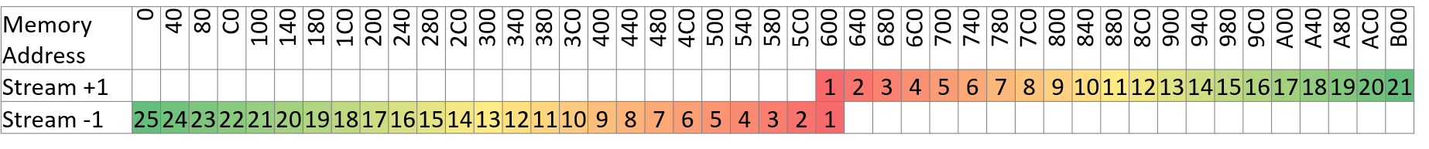
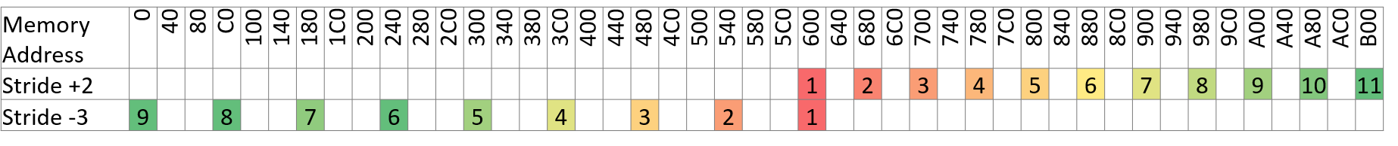
Prefer data access patterns matching hardware prefetcher behaviors
Streaming
Stride

Slide 39
Streaming hardware prefetcher
Uses history of memory access patterns to fetch additional sequential lines in ascending or descending order.
alignas(64) float a[LEN];
// …
float sum = 0.0f;
for (size_t i = 0; i < LEN; i++) {
sum += a[i]; // streaming prefetch
}

Slide 40
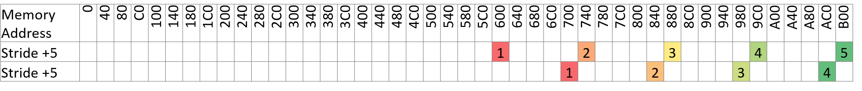
Stride hardware prefetcher
Uses memory access history of individual instructions to fetch additional lines when each access is a constant distance from the previous.
struct S { double x1, y1, z1, w1; char name[256]; double x2, y2, z2, w2; };
alignas(64) S a[LEN];
// …
double sumX1 = 0.0f, sumX2 = 0.0f;
for (size_t i = 0; i < LEN; i++) {
sumX1 += a[i].x1; // stride prefetch 0
sumX2 += a[i].x2; // stride prefetch 1
}

Slide 41
Use software prefetch instructions for linked data
Over 60% faster after optimization!
Performance of binaries compiled with Microsoft Visual Studio 2019 v16.8.3
Testing done by AMD technology labs, January 4, 2021 on the following system. Test configuration: AMD Ryzen™ 7 4700G, AMD Wraith Spire Cooler, 16GB (2 x 8GB DDR4-3200 at 22-22-22-52) memory, NVidia GeForce RTX™ 2080 GPU with driver 460.89 (December 15, 2020), 512GB M.2 NVME SSD, AMD Ryzen™ Reference Motherboard, Windows® 10 x64 build 20H2, 1920x1080 resolution. Actual results may vary

Slide 42
Use software prefetch instructions for linked data…
// Copyright (c) 2019 NVIDIA Corporation. All rights reserved
// ConvexRenderer.cpp from https://github.com/NVIDIAGameWorks/PhysX/tree/4.1/physx
void ConvexRenderer::updateTransformations()
{
for (int i = 0; i < (int)mGroups.size(); i++) {
ConvexGroup *g = mGroups[i];
if (g->texCoords.empty())
continue;
float* tt = &g->texCoords[0];
for (int j = 0; j < (int)g->convexes.size(); j++) {
const Convex* c = g->convexes[j];
#if defined(APPLY_OPTIMIZATION)
int distance = 4; // TODO find ideal number
size_t future = (j + distance) % g->convexes.size();
_mm_prefetch(0x0F8 + (char*)(g->convexes[future]), _MM_HINT_NTA); // mPxActor
_mm_prefetch(0x100 + (char*)(g->convexes[future]), _MM_HINT_NTA); // mLocalPose
_mm_prefetch(0x148 + (char*)(g->convexes[future]), _MM_HINT_NTA); // mMaterialOffset.x
_mm_prefetch(0x14C + (char*)(g->convexes[future]), _MM_HINT_NTA); // mMaterialOffset.y
_mm_prefetch(0x150 + (char*)(g->convexes[future]), _MM_HINT_NTA); // mMaterialOffset.z
_mm_prefetch(0x164 + (char*)(g->convexes[future]), _MM_HINT_NTA); //mSurfaceMaterialId
_mm_prefetch(0x160 + (char*)(g->convexes[future]), _MM_HINT_NTA); // mMaterialId
#endif
PxMat44 pose(c->getGlobalPose());
float* mp = (float*)pose.front();
float* ta = tt;
for (int k = 0; k < 16; k++) {
*(tt++) = *(mp++);
}
PxVec3 matOff = c->getMaterialOffset();
ta[3] = matOff.x;
ta[7] = matOff.y;
ta[11] = matOff.z;
int idFor2DTex = c->getSurfaceMaterialId();
int idFor3DTex = c->getMaterialId();
const int MAX_3D_TEX = 8;
ta[15] = (float)(idFor2DTex*MAX_3D_TEX + idFor3DTex);
}
glBindTexture(GL_TEXTURE_2D, g->matTex);
glTexSubImage2D(GL_TEXTURE_2D, 0, 0, 0, g->texSize, g->texSize,
GL_RGBA, GL_FLOAT, &g->texCoords[0]);
glBindTexture(GL_TEXTURE_2D, 0);
}
}

Slide 43
Test application scalability from 1 to N processors
Performance increased 28% with SMT
Microsoft Visual Studio 2019 v16.8.3
Testing done by AMD technology labs, January 13, 2021 on the following system. Test configuration: AMD Ryzen™ 7 4700G, AMD Wraith Spire Cooler, 16GB (2 x 8GB DDR4-3200 at 22-22-22-52) memory, AMD Radeon™ RX 6900 XT GPU with driver 20.12.2 (December 17, 2020), 512GB M.2 NVME SSD, AMD Ryzen™ Reference Motherboard, Windows® 10 x64 build 20H2, 1920x1080 resolution. Actual results may vary

Slide 44
UE4.26 Infiltrator Demo…
UE4.26 Infiltrator Demo, NoWindowsEditor, Shipping, By The Book, 1st 200s seconds
Testing done by AMD technology labs, January 13, 2021 on the following system. Test configuration: AMD Ryzen™ 7 4700G, AMD Wraith Spire Cooler, 16GB (2 x 8GB DDR4-3200 at 22-22-22-52) memory, AMD Radeon™ RX 6900 XT GPU with driver 20.12.2 (December 17, 2020), 512GB M.2 NVME SSD, AMD Ryzen™ Reference Motherboard, Windows® 10 x64 build 20H2, 1920x1080 resolution. Actual results may vary

Slide 45
UE4.26 Infiltrator Demo…
-corelimit | mean ms | 68% ms | 95% ms | 99.7% ms
1 | 14.10 | 13.05 | 24.99 | 54.02
2 | 6.42 | 5.85 | 14.23 | 25.08
3 | 6.44 | 5.88 | 14.16 | 24.82
4 | 5.81 | 5.23 | 13.45 | 23.54
5 | 5.86 | 5.32 | 13.62 | 23.90
6 | 5.88 | 5.39 | 13.71 | 23.99
7 | 5.96 | 5.44 | 14.00 | 24.33
8 | 5.95 | 5.43 | 14.06 | 24.48
9 | 5.95 | 5.43 | 14.05 | 24.62
10 | 6.01 | 5.52 | 14.03 | 23.98
11 | 5.96 | 5.45 | 14.04 | 24.82
12 | 6.04 | 5.54 | 14.24 | 24.64
13 | 5.97 | 5.48 | 14.00 | 23.88
14 | 5.98 | 5.50 | 14.11 | 24.23
15 | 5.95 | 5.47 | 14.02 | 24.18
16 | 6.05 | 5.56 | 14.15 | 24.73
Percentiles of frame times may reveal performance issues unnoticed by averages
Be sure you have sufficient samples—especially for 3 sigma and higher
  See https://en.wikipedia.org/wiki/68-95-99.7_rule
Performance is lost at high corelimit values
  The default value is effectively logical processors-2
Compare corelimit=14 %difference from 4
  Mean = 3% slower
  68% percentile = 5% slower
  95% percentile = 5% slower
  99.7% percentile = 3% slower

Slide 46
UE4.26 Infiltrator Demo

Slide 47
AMD general guidance for games
This advice is specific to AMD processors and is not general guidance for all processor vendors
Generally, applications show SMT benefits and use of all logical processors is recommended
However, games often suffer from SMT contention on the main or render threads during gameplay
  One strategy to reduce this contention is to create threads based on physical core count rather than logical processor count
  Profile your application/game to determine the ideal thread count
    Game initialization—including decompressing assets and compiling/warming shaders—may benefit from logical processors using SMT dual-thread mode
    Game play may prefer physical core count using SMT single-thread mode
  Recommend game options to:
    Set Max Thread Pool Size
    Force Thread Pool Size
    Force SMT
    Force Single NUMA Node (implicitly Group)
  Avoid setting thread pool size as a constant

Slide 48
AMD general guidance
DWORD getRecommendedThreadCountForGameplay() {
DWORD cores, logical;
getProcessorCount(cores, logical);
DWORD count = logical;
char vendor[13];
getCpuidVendor(vendor);
if (0 == strcmp(vendor, "AuthenticAMD")) {
if (0x15 == getCpuidFamily()) {
// AMD "Bulldozer" family microarchitecture
count = logical;
}
else {
count = (cores>=8)?cores:logical;
}
}
return count;
}
DWORD getRecommendedThreadCountForGameInit() {
// recommended for compiling shaders, etc.
DWORD cores, logical;
getProcessorCount(cores, logical);
return logical;
}
// Pseudocode shown.
// Actual code subject to change.
// see https://gpuopen.com/cpu-core-count-detection-windows/

Slide 49
Losing performance at high thread counts?…
Reduce logging verbosity
  Logging is often serial execution and may cause cache pollution
  Minimize logging within parallel worker threads
  One log event is faster than N log events!
  Consider disabling logging by default
Tune the minimum batch size
  The “batch” is the partition of parallel work executed by a thread
  Try minimizing page contention by setting the minimum batch size such that its data is at least 1 page
  Pages are typically 4 KB

Slide 50
Losing performance at high thread counts?
Reduce the worker thread count
  More ready threads than logical processors may result in unnecessary context switching
  Less threads may indirectly increase the batch size
  Less threads may result in less resources sharing—especially of SMT cores and caches

Slide 51
Do you want to know more?

Slide 52
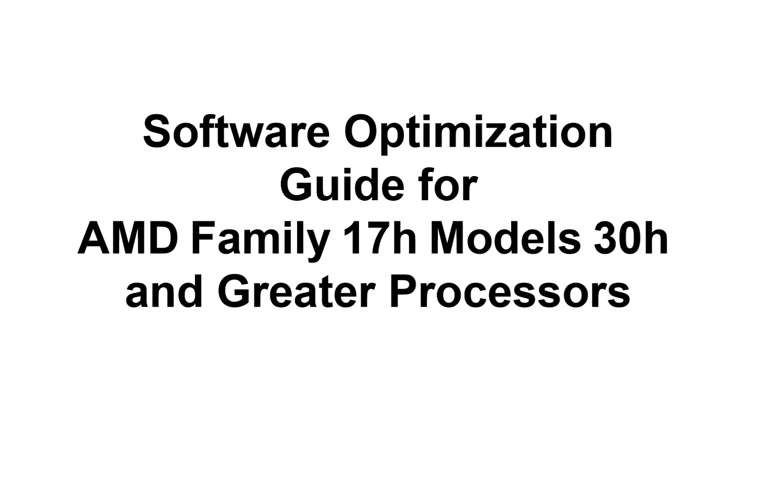
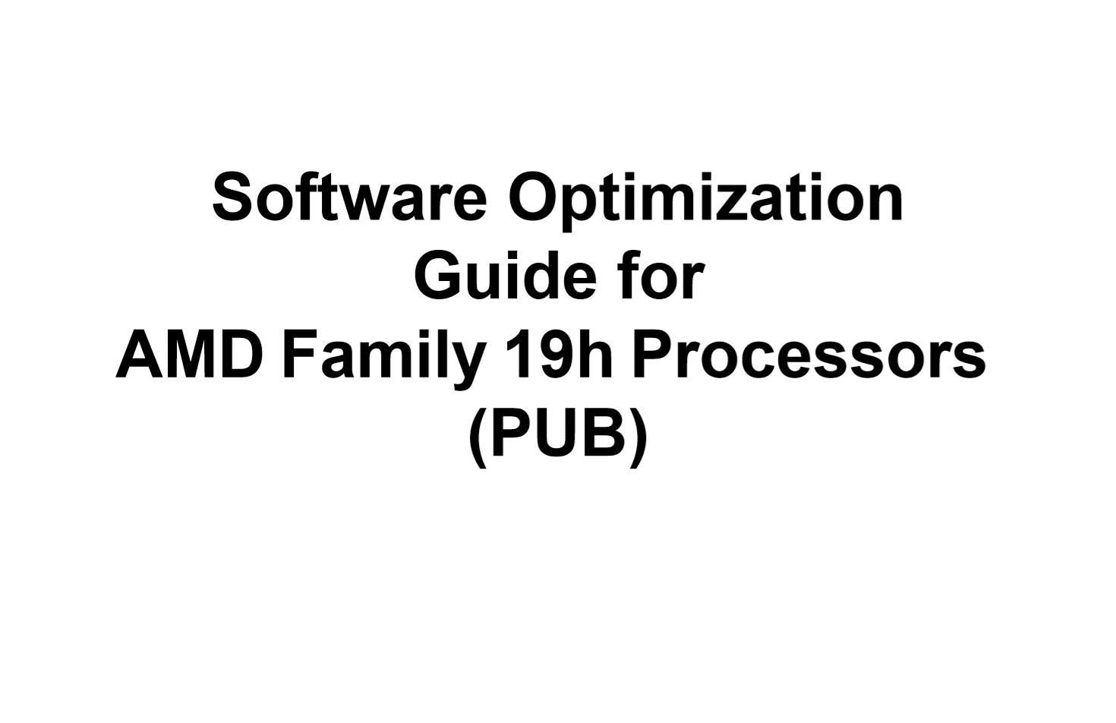
https://developer.amd.com/resources/developer-guides-manuals/
“Zen 2” Optimization Guide
“Zen 3” Optimization Guide

Slide 53


Slide 54
Design faster. Render faster. Iterate faster.

Slide 55
Disclaimer and attribution
The information presented in this document is for informational purposes only and may contain technical inaccuracies, omissions and typographical errors.
The information contained herein is subject to change and may be rendered inaccurate for many reasons, including but not limited to product and roadmap changes, component and motherboard version changes, new model and/or product releases, product differences between differing manufacturers, software changes, BIOS flashes, firmware upgrades, or the like. AMD assumes no obligation to update or otherwise correct or revise this information. However, AMD reserves the right to revise this information and to make changes from time to time to the content hereof without obligation of AMD to notify any person of such revisions or changes.
AMD MAKES NO REPRESENTATIONS OR WARRANTIES WITH RESPECT TO THE CONTENTS HEREOF AND ASSUMES NO RESPONSIBILITY FOR ANY INACCURACIES, ERRORS OR OMISSIONS THAT MAY APPEAR IN THIS INFORMATION.
AMD SPECIFICALLY DISCLAIMS ANY IMPLIED WARRANTIES OF MERCHANTABILITY OR FITNESS FOR ANY PARTICULAR PURPOSE. IN NO EVENT WILL AMD BE LIABLE TO ANY PERSON FOR ANY DIRECT, INDIRECT, SPECIAL OR OTHER CONSEQUENTIAL DAMAGES ARISING FROM THE USE OF ANY INFORMATION CONTAINED HEREIN, EVEN IF AMD IS EXPRESSLY ADVISED OF THE POSSIBILITY OF SUCH DAMAGES.
ATTRIBUTION
© 2021 Advanced Micro Devices, Inc. All rights reserved. AMD, Ryzen™, and the AMD Arrow logo and combinations thereof are trademarks of Advanced Micro Devices, Inc. in the United States and/or other jurisdictions. Microsoft and Windows are registered trademarks of Microsoft Corporation. PCIe is a registered trademark of PCI-SIG. Other names are for informational purposes only and may be trademarks of their respective owners.

Slide 56
Disclaimer and attribution…
Code sample on slide 44 is modified.
Copyright (c) 2019 NVIDIA Corporation. All rights reserved. Code Sample is licensed subject to the following: “Redistribution and use in source and binary forms, with or without modification, are permitted provided that the following conditions are met: Redistributions of source code must retain the above copyright notice, this list of conditions and the following disclaimer. Redistributions in binary form must reproduce the above copyright notice, this list of conditions and the following disclaimer in the documentation and/or other materials provided with the distribution. Neither the name of NVIDIA CORPORATION nor the names of its contributors may be used to endorse or promote products derived from this software without specific prior written permission. THIS SOFTWARE IS PROVIDED BY THE COPYRIGHT HOLDERS “AS IS” AND ANY EXPRESS OR IMPLIED WARRANTIES, INCLUDING, BUT NOT LIMITED TO, THE IMPLIED WARRANTIES OF MERCHANTABILITY AND FITNESS FOR A PARTICULAR PURPOSE ARE DISCLAIMED. IN NO EVENT SHALL THE COPYRIGHT OWNER OR CONTRIBUTORS BE LIABLE FOR ANY DIRECT, INDIRECT, INCIDENTAL, SPECIAL, EXEMPLARY, OR CONSEQUENTIAL DAMAGES (INCLUDING, BUT NOT LIMITED TO, PROCUREMENT OF SUBSTITUTE GOODS OR SERVICES; LOSS OF USE, DATA, OR PROFITS; OR BUSINESS INTERRUPTION) HOWEVER CAUSED AND ON ANY THEORY OF LIABILITY, WHETHER IN CONTRACT, STRICT LIABILITY, OR TORT (INCLUDING NEGLIGENCE OR OTHERWISE) ARISING IN ANY WAY OUT OF THE USE OF THIS SOFTWARE, EVEN IF ADVISED OF THE POSSIBILITY OF SUCH DAMAGE.”

Slide 57
Disclaimer and attribution…
Claim “Zen 2” +15% IPC uplift
  AMD “Zen 2” CPU-based system scored an estimated 15% higher than previous generation AMD “Zen” based system using estimated SPECInt®_base2006 results. SPEC and SPECint are registered trademarks of the Standard Performance Evaluation Corporation. See www.spec.org. GD-141
Claim “Zen 3” +19% IPC uplift
  Testing by AMD performance labs as of 09/01/2020. IPC evaluated with a selection of 25 workloads running at a locked 4GHz frequency on 8-core "Zen 2" Ryzen 7 3800XT and "Zen 3" Ryzen 7 5800X desktop processors configured with Windows® 10, NVIDIA GeForce RTX 2080 Ti (451.77), Samsung 860 Pro SSD, and 2x8GB DDR4-3600. Results may vary. R5K-003
Design faster. Render faster. Iterate faster. Create more, faster with AMD Ryzen™ processors
  Testing by AMD Performance Labs as of September 23, 2020 using a Ryzen 9 5950X and Intel Core i9-10900K configured with DDR4-3600C16 and NVIDIA GeForce RTX 2080 Ti. Results may vary. R5K-039

