Slide 1
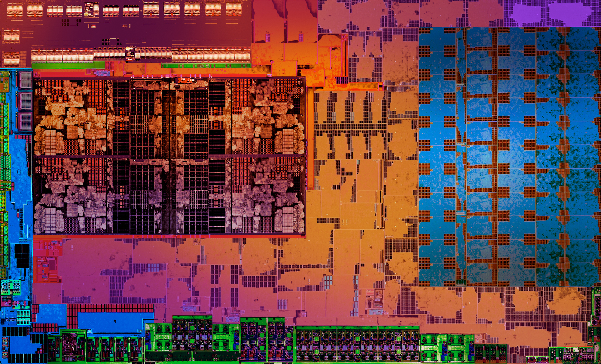
Timothy Lottes | gdc 2018
ENGINE OPTIMIZATION HOT LAP

Slide 2
Goals of this talk
Teach you more about how the GPU works closer to the hardware level
To help you reason about your own GPU workloads and engine design
Present results of various optimizations
And ultimately help you better realize your visual and performance goals as GPUs continue to scale

Slide 3

GCN review
This talk is a follow-up to ADVANCED SHADER PROGRAMMING ON GCN from gdc 2017
SIMD (VALU) = 16-wide vector ALU executes a 64-wide wave across 4 clocks
  Maximum occupancy 8 waves/SIMD (Polaris) or typically 10 waves/SIMD (non-Polaris)
CU = Compute Unit includes 4 SIMDs (peak VALU execution throughput of 1 wave/clock)
SALU = Scalar ALU
LDS = Local Data Store
V$ = Vector L1 Cache (VMEM)
I$ = Instruction L1 Cache
K$ = Scalar L1 Cache (SMEM)
Example Cluster of 4 CUs
I$
K$
CU
SIMD16
SIMD16
SALU
LDS
V$
SIMD16
SIMD16
CU
SIMD16
SIMD16
SALU
LDS
V$
SIMD16
SIMD16
CU
SIMD16
SIMD16
SALU
LDS
V$
SIMD16
SIMD16
CU
SIMD16
SIMD16
SALU
LDS
V$
SIMD16
SIMD16

Slide 4
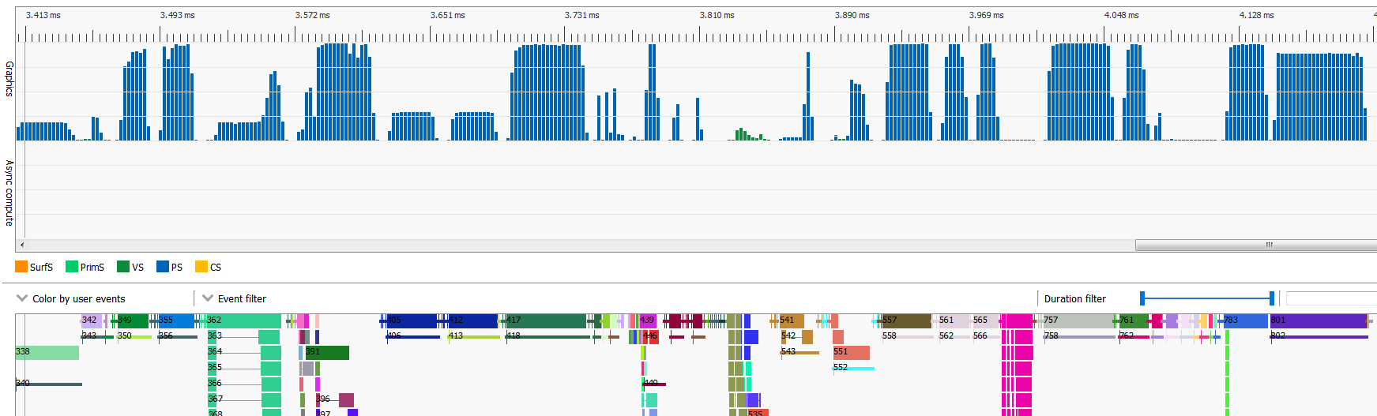
Thinking outside the draw
Often optimization efforts are narrowly focused on just optimizing the most expensive shaders
This talk takes a holistic view: focusing on full-frame runtime inside and outside of all draws/dispatches
Occupancy
Outside Draw
Fill
Drain
Inside Draw

Slide 5
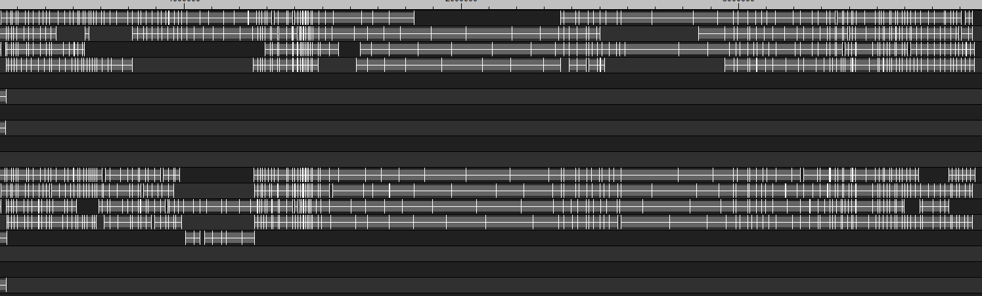
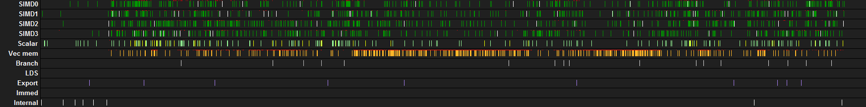
Introduction to the tools used inside amd for analysis
Transparency – With this talk you see what we see
Wave Execution Detail
External Tools
  Radeon GPU Profiler (RGP)
AMD Internal Tools
  VK_GPA_interface
  Driver modifications
  Instruction Trace Report
Lifetime of Waves
CU Instruction Summary
Green = VALU Issue Per SIMD
Orange = VMEM Issue

Slide 6
Core Principles
Optimization Theory for Parallel Machines

Slide 7
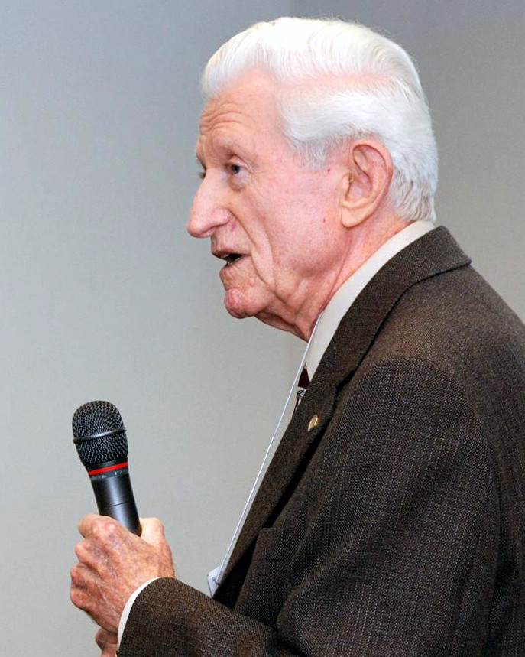
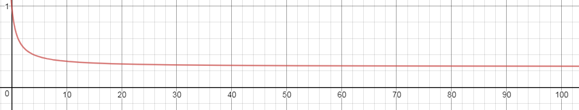
Amdahl’s law
presented at the AFIPS Spring Joint Computer Conference in 1967
Performance improvement possible as a machine scales in parallel capacity
is proportional to the amount of parallel work
At the GHz wall for example if only 75% of the work runs in parallel
best case runtime will drop to 25% of a non-parallel machine
Takeaway: Keep GPU filled with pipelined parallel work!
Runtime
More Parallel Machine
Creative Commons Photo by Pkivolowitz at English Wikipedia

Slide 8
understanding GcN vector memory access
Optimization is often about keeping the GPU memory system filled pipelined parallel work
Average latency can vary by GPU/workload/etc
Can estimate performance cliffs from synthetic shader latency testing results
  ~114 clock L1 hit (peak 16 clock/VMEM return rate for image ops) (1 clock/VALU)
  ~190 clock L2 hit (average ~76 clock extra latency compared to L1 hit ……………….. 76/16 = 4.75 image L1$ hits)
  ~350 clock L2 miss (average ~236 clock extra latency compared to L1 hit …………. 236/16 = 14.75 image L1$ hits)
Things which reduce memory throughput
  Not sustaining VMEM ops fast enough to keep request queue from draining
    Try to sustain a regular flow of memory requests (look for wave occupancy irregularities, etc)
  Memory bubbles caused by L1$ misses or L2$ misses
    Try to improve data locality spatially and temporally, increase ratio of L1 hits
Estimate of Perf Cliffs

Slide 9
Idle Bound
Failure to Keep GPU Fed With Pipelined Work

Slide 10
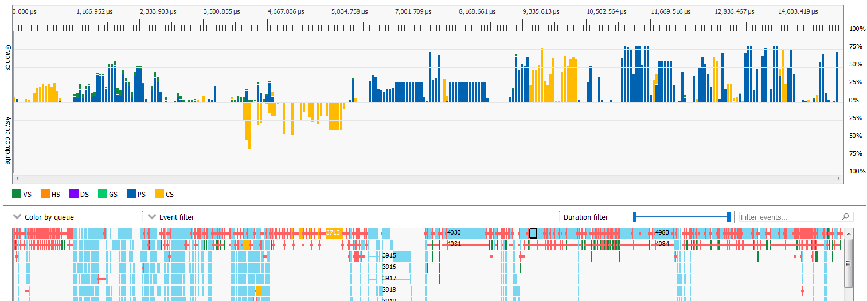
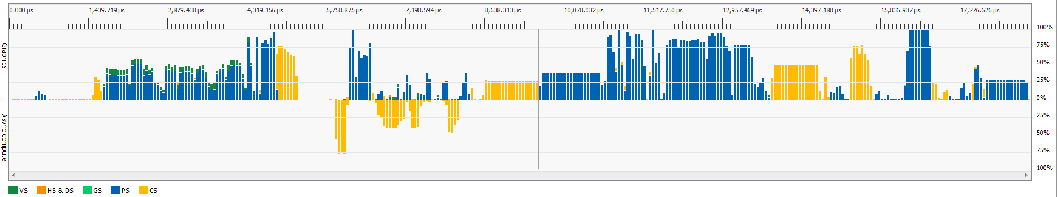
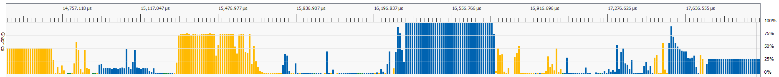
examples of being idle bound – Slide 1
GPU Draining
Barrier Induced Idle
Serial Dependencies + Small Jobs

Slide 11
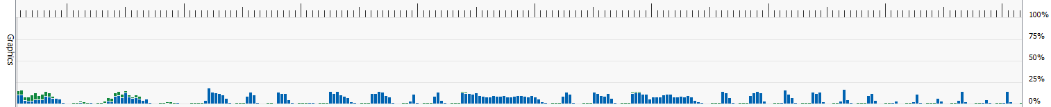
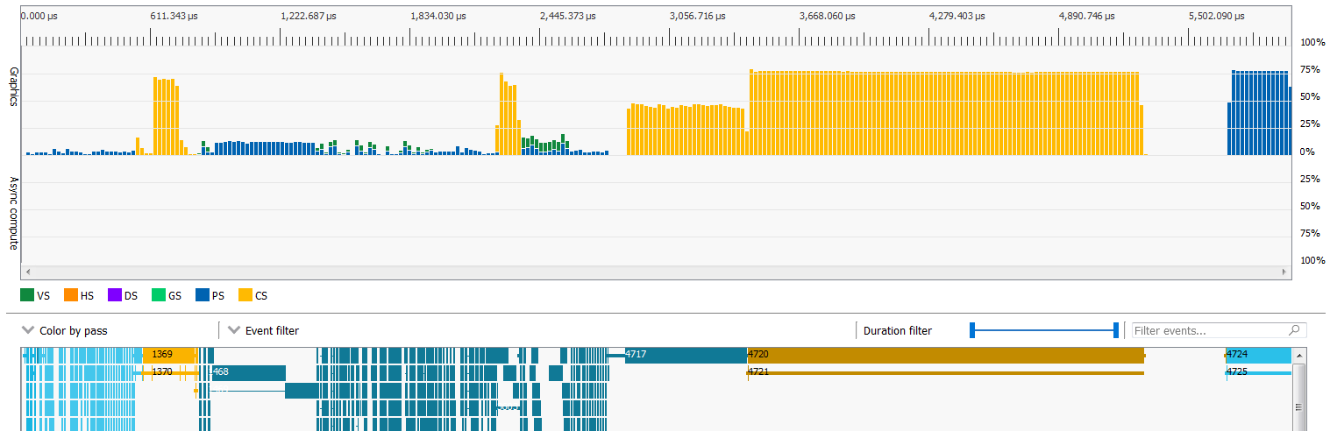
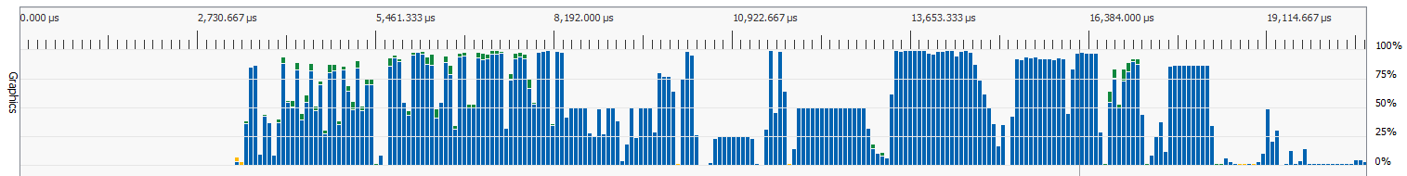
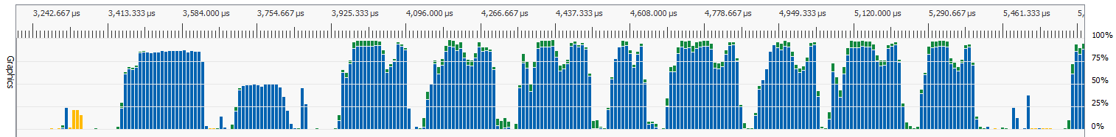
examples of being idle bound – Slide 2
Simple Geometry Not Saturating GPU
GPU Draining
SIMULTANEOUS_USE_BIT Command Buffer Prevents Parallelism

Slide 12
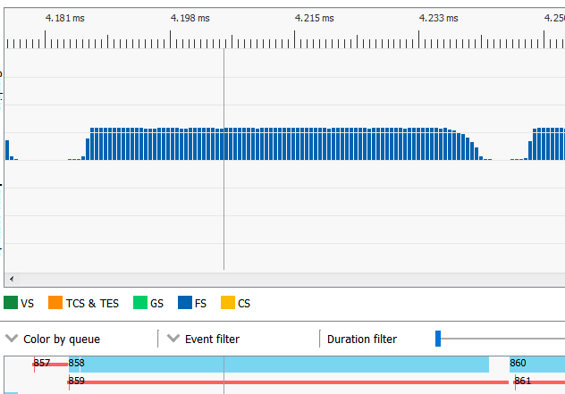
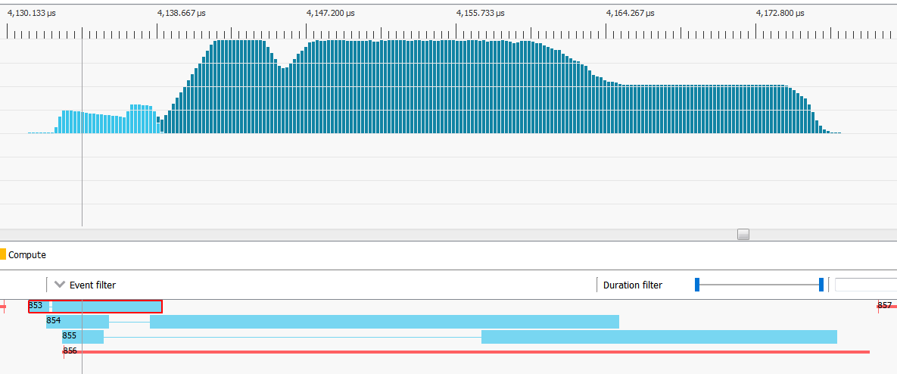
Numbers for drain and fill of 1/4 resolution passes
PS clear in parallel with independent 2nd and 3rd PS draws (35 us VALU work for 48 us time)
2.2 us in front-end timestamp to first PS wave (VS to PS delay included in here)
1.2 us PS fill time (<50% active)
5.9 us PS drain time (~50% active)
2.6 barrier (including cache flush)
counted as 100% (won’t get near that in practice)
vkCmdClearAttachments generating VS+PS clear, note VS-to-PS delay
51.5 us active for 59.9 us time total
minimal overlap, bandwidth bound PS clear (no VALU) delays 2nd PS launch
GPU at Least 14% VALU Idle in this Post Pass
GPU at Least 26% VALU Idle in this Post Pass + Clear

Slide 13
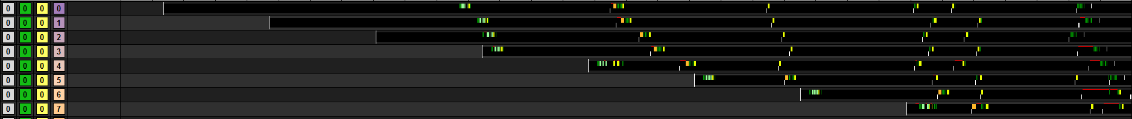
Filling the gpu – a story of cold caches
Looking at wave launch from amd-internal instruction trace
64 CUs (Vega) = capacity to launch 2560 waves (~160 Ki work items if at peak occupancy)
“First-Fill Waves” = waves starting in cold cache conditions
  Up to 4.4% of a 2560x1440 full-screen pass is first-fill waves
  Up to 17% of a 1/4 area post pass is first-fill waves (common with DOF/MB/etc)
  Up to 71% of a 1/16 area post pass is first-fill waves (common with reduction passes)
Significant amount of GPU time can be spent with cold caches
  CS dispatch: wave launch rate, I$ missing, K$ miss and dependent fetches
  = long latency chain which cannot be hidden on idle machine
Miss
Miss
I$ Miss
K$ Miss
SIMD 0
Launch
Increasing Time Since Dispatch

Slide 14
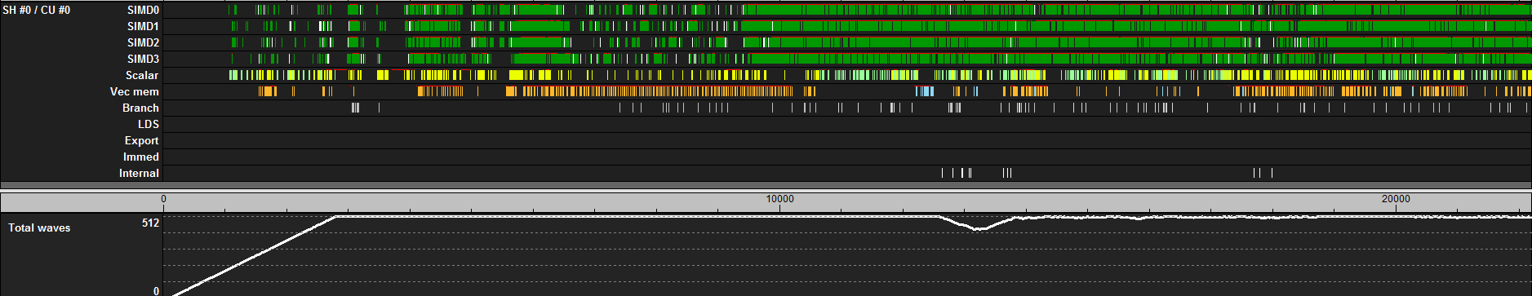
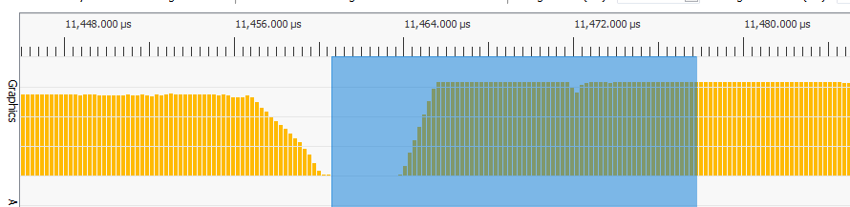
Story of cold caches related back to rgp
Wave occupancy != a measure of execution efficiency
AMD-Internal Instruction Trace
View From RGP
I$ Miss
Mostly Idle
Hit Efficient Execution Only a Bit After GPU Filled
GPU Filled
GPU Filled
Barrier Idle Time
Hit Efficient Execution Only a Bit After GPU Filled

Slide 15

Idle bound – takeaway
Amdahl’s law in practice
Time outside the draw matters
Serializing draws = performance stopped scaling with GPU size
Time to pipeline

Slide 16
DCC & CS VS PS
Tradeoffs

Slide 17
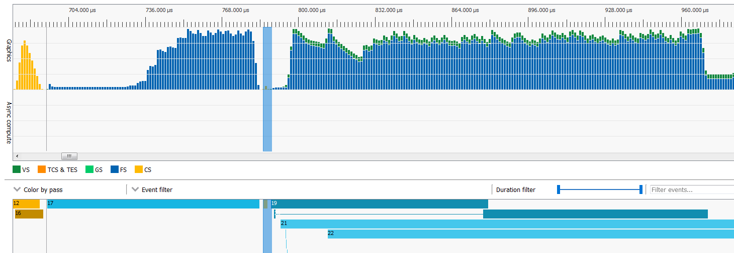
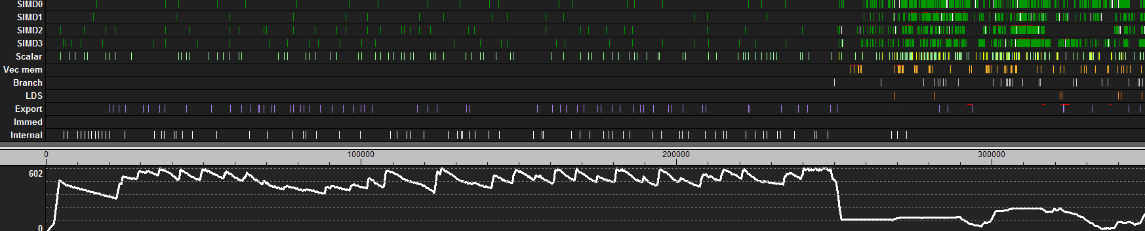
Avoid Slow clears
One major motivation for compression
Avoid clears to images written in CS passes
Avoid clears to images getting full-screen triangles (aka overwrite majority of image)
For compressed surfaces advantage via clearing to all 0.0 or 1.0
VS Work Can Run in Parallel With Clear, But PS is Blocked Until Clear Ends
Slow Clear
Slow Clear
Compressed Clear
End Of Clear
Mostly Idle on VALU

Slide 18
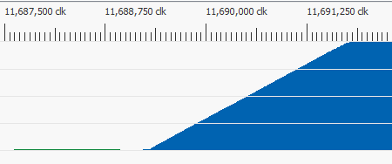
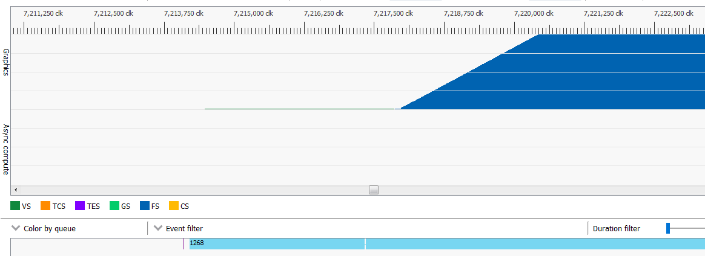
PS and cS on gcn
Comparing pros and cons
PS – Launches typically between 1-4 waves/V$ before moving to next V$ – Ordered export
  Supports DCC|Z compressed output (note compression can increase latency of loads)
  Cache flush to read render targets written in prior pass
  VS to PS delay can be substantial when VS has long latency chain and cold caches
CS – Launches workgroup/V$ before moving to next V$ – No export (unordered)
  Can read compressed image written in PS pass, but cannot store to DCC|Z compressed images
  Does not need a cache flush on shader read to shader write transition
  Easy to run pipelined in graphics queue or async in CS queue
VS
PS
VS
PS
Less Cache Missing = Lower VS to PS Delay
Almost 4000 Clocks Between CP Marker (Draw Start) and 1st PS Wave Launch

Slide 19
Delta color compression (Dcc) on/off
DCC on PC GPUs has possible advantages and disadvantages
  Possible reduction in bandwidth for an increase in latency (need to fetch meta-data)
Best to profile to choose when to use and not use DCC
  Can disable DCC on a render target by using STORAGE or UAV usage flags
  Better to try individual render targets instead of just all on vs all off
Example performance delta with DCC enabled for some game passes (Vega numbers)
  -5.0% for deferred shading (slower)
  -3.1% for screen space reflections
  1.8% for screen space occlusion
  2.2% for compositing pass
  3.8% for post processing (faster)

Slide 20
Pipelining With Events
Keeping the Machine Busy

Slide 21
Author’s opinion of ideal triangle-based engine
When to use cs and VS+ps
VS+PS only when rendering geometry, CS for everything else
CS maximizes ability to easily pipeline
VS+PS Geometry
Pipelined CS For Everything Else
VS+PS Geometry
Async-CS
Async-CS

Slide 22
pipelining
Hide the latency of cold caches during fill in the drain of the prior work
Going to explore an API-illegal technique to pipeline first: remove the barrier and test for data race
  Useful for understanding hardware
  Useful to try and estimate performance upper bound to test against for API-legal solution
  Useful to prove some kind of execution dependency is required
Following up with an API-legal solution in later slides
A
B
A
B

Slide 23
Simple data race tester
Two 32-bit/pixel images, three compute dispatches
Step #1
Step #2
Step #3
Start With
Black
Store
White
Load
Load
Barrier
No
Barrier
Store
Store
Data
Race
OR
No
Race

Slide 24
Simple data race tester : results validate data race is possible
Two 32-bit/pixel images, three compute dispatches
Results running various image sizes on an RX 580
  No Race : 256x256 and Larger
  Data Race : 128x128 and Smaller – Validation that some form of execution dependency is actually required
Combination of factors make data race not probable in some cases
  Non-coherent (GLC=0) stores still write-through to coherent L2$
  Step #2 waves need to launch before Step #3 waves (API submission-order launch, out-of-order completion)
  GPU’s loose workgroup launch order for dispatch (roughly right to left, then top to bottom)
Cannot Depend On This Behavior
GPU Size and Workload
Can Adjust Probability
Of Getting Data Race!
Stores Visible Before Loads Start
Step #2
Step #3

Slide 25
Leveraging coherent memory qualifier in glsl
Tool to remove the necessity to flush caches for buffer/image store to load transition
Coherent translates to GLC=1 store on GCN which bypasses L1$ and stores to a coherent L2$
  Example: layout(set=0, binding=5, rgba8) uniform coherent image2D imgA;
ARB_shader_image_load_store – “Buffer object or texture image memory accessed through such [coherent] variables may be cached only if caches are automatically updated due to stores issued by any other shader invocation”
  Explicitly states that coherent stores need to bypass non-coherent caches
Crucial observation
Loads need not use coherent qualifier and can thus be cached under the following usage model
  Beginning/end of frame cache flush to guarantee fresh caches
  Write cachelines only once with coherent stores before any read (only need execution dependency, aka vkEvent)
  Read cachelines via non-coherent caches (aka highest performance) any number of times
The Perfect Tool For Pipelining In Vulkan®

Slide 26
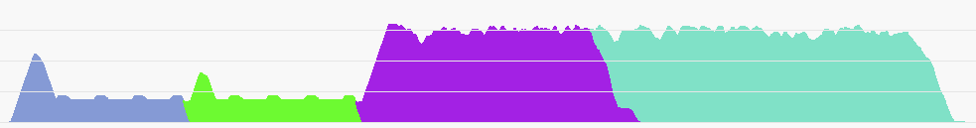
Mechanics of pipelining With events
Even serially dependent passes can often leverage explicit spatial independence
A
A0
Manually split dispatch into two dispatches
  Splits will have to vary based on maximum filter kernel window size, etc
A1
Doesn’t Wait, Event Already Signaled
Dispatch A0
Set Event X
Dispatch A1
Set Event Y
Wait Event X
Dispatch B0
Wait Event Y
Dispatch B1
B0
B1
A0
A1
Event X
Signaled
Event Y
Signaled

Slide 27
Write once coherent before any read, then read cached
Considerations for safe usage
API does not expose GPU cacheline size and hardware is free to change cacheline size
As of March 2018, there is no API interface to report “safe” split line granularity
  To make sure split does not straddle a cacheline boundry
Current workaround is to greatly overestimate required alignment
  Split offset should be a large powers of two
  32-bit/texel mixed with one hardware swizzle pattern on 64-byte cacheline might require 4 texel alignment
  Another image with 16-bit/texel on a machine with 128-byte cacheline might require 8 texel alignment
  Better to pad to say 64 texel alignment – leaves flexibility for change in cacheline size and swizzle patterns
A
A0
A1

Slide 28
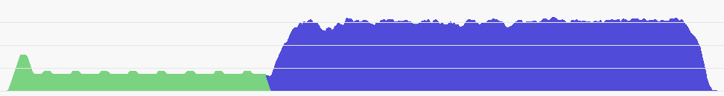
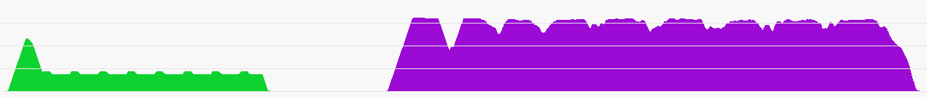
Simple data race tester : variations at 1152 x 1152 on Vega
Measured Normalized time (first wave to end of last wave)
Store Result Fits in L2$
No Barrier = Hit in L2$
1.00 time : Data Race Tester (Not API-Legal)
  Possible upper bound on limit of manual pipelining
1.31 time : Re-Introduce The Barrier
  API-legal common practice (time includes barrier)
  Overly conservative driver flushed L2$
    Or maybe barrier with usage requiring L2$ flush
1.03 time : Manually Split Pipeline Via Events
  Use “coherent” GLC=1 stores instead of image barrier
  Suggested “safe” and API-legal solution
Barrier, Flush Cache = Slower = Miss in L2$
GLC=1 Stores, No Cache Flush = Hit in L2$
Execution Dependency Managed by Events

Slide 29
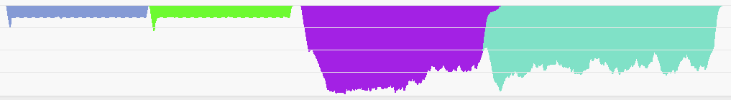
Differences between cs and gfx queue
Looking at same operations in different queues
Graphics queue is better at pipelining front-end operations (often see 40+ draws in parallel)
  Often better to pipeline small jobs in the graphics queue
Compute queue needs longer running waves to hide front-end overheads
Waiting on Signaled vkEvent Needs to Fetch Memory (Need Longer Waves to Hide)
Launch Limited Waves Depipelines GPU
Long Running Waves Are Good (Hides Wait Fetch Fine)

Slide 30
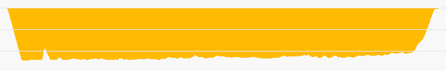
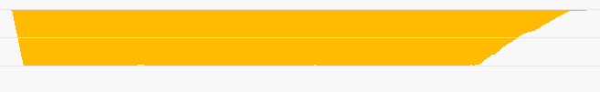
Measuring isolated timing in a pipelined world
The challenges of short dispatches, long running waves, and large gpus
Old non-pipelined world focuses on minimizing first wave launch to last wave exit time
  Which implies minimizing fill and drain time, which implies avoiding long running waves (due to long drain)!
New pipelined world focuses on minimizing average “wave run-time / wave occupancy”
  Changes what to optimize for (not interested in minimizing drain time)
  Changes what to measure for shader timed in isolation (take drain and fill into account)
Which shader is faster? (depends on if dispatch is to be pipelined or not)
61447 clk (non-pipelined timing)
62643 clk (non-pipelined timing)
58254 clk (pipelined timing)
54264 clk (pipelined timing)

Slide 31
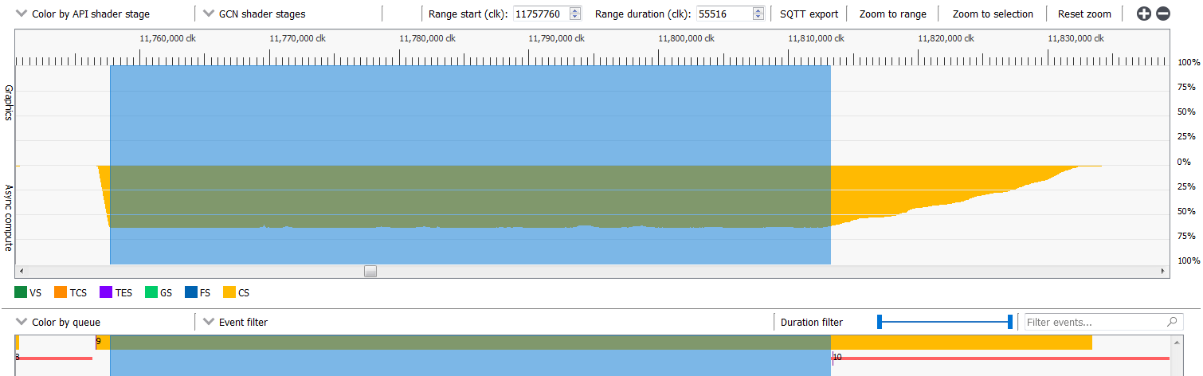
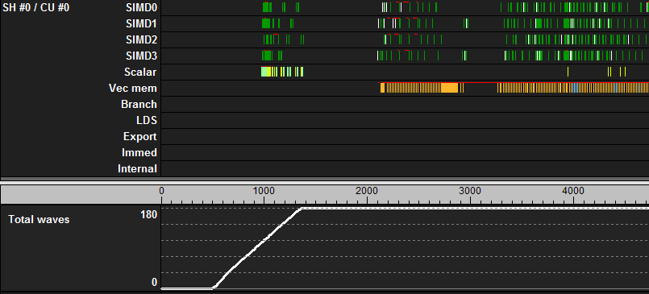
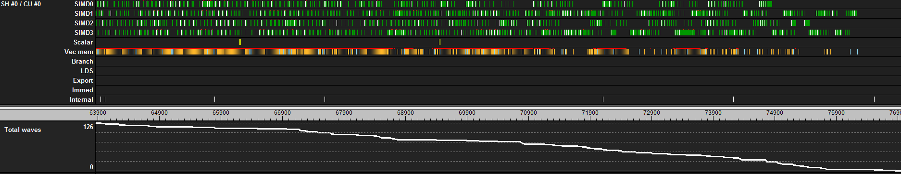
Estimating PipelineD timing in RGP – Rough but useful
Using ballpark estimate of 50% utilization in drain and fill regions
Motivation of 50% utilization estimate in drain and fill from ramp of utilization see in instruction traces
0.5 * Duration For Selected (Blue) Filled Region +
0.5 * Duration of The Full Draw

Slide 32

Pipelining With Events – takeaway
Vulkan®
  Pipelined CS works great now via vkEvents and “coherent” keyword
  Good gains possible from avoiding cache flushes
  Good gains possible from avoiding draining the GPU
  As of this talk (March 2018)
    Barriers : Possibly overly conservative cache flushes in the driver, we are looking to improve
Direct3D® 12
  Pair independent work to avoid barriers and leverage Async-CS to fill graphics drains
  The HLSL version of “coherent” is “globallycoherent”
  As of this talk (March 2018)
    Split Barriers : Possibly overly conservative, we are looking at options to improve

Slide 33
GPU Utilization
Visual Review of Instruction Traces

Slide 34
Collection of instruction traces from various workloads
One important trend – none of these are fully valu bound, most have a lot of valu idle time
Down Sample
4 Almost Empty Green SIMD Rows
Approaching VALU Idle
Motion Blur
Draw GUI
Light Occlusion
Horz Blur
Red Arrows
Fully Memory Bound
SSR
G-Buffer Fill
SSAO
Deferred Shading
TAA
Tonemap & More
4 Almost Solid Green SIMD Rows
Approaching VALU Bound

Slide 35
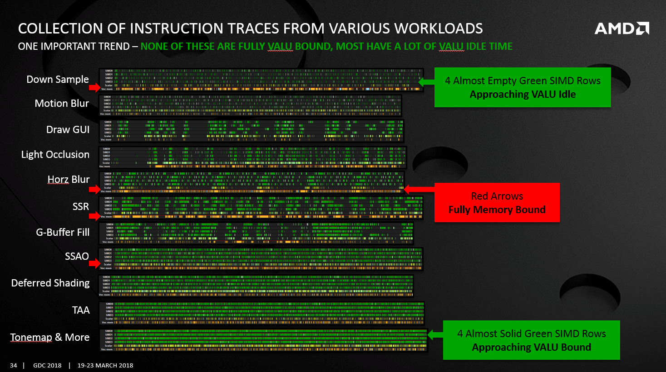
Utilization trends from “inside the draw/dispatch”
And basic theory on how to optimize
The GPU is often VALU idle = Huge untapped capacity to do work!
  Engineer to avoid being bottlenecked by fixed function limits
  Merge passes to avoid being memory bound (for instance down-sample in one pass)
  Leverage async-compute
  . . .
Some passes are fully saturating the VMEM request queue
  Yet can still be optimized
  Focus on improving cache locality
  By improving work to V$ mapping
  By improving scheduling of work
  By improving access patterns
  . . .

Slide 36
Wave Launch Rate
Larger GPUs Prefer Longer PS Waves

Slide 37
Gcn wave launch rate varies across Gpus
One of the core differences between large pc GPUs and consoles
SE = Shader Engines – Each SE can launch 1 wave every 4 clocks
CU = Compute Units – Number of CUs determines the size of the GPU
SE:CU ratio determines how fast the machine can fill itself
  1:16 – Fury X, Nano, Vega 64
  1:14 – Fury, Vega 56
  1:11 – R9 390X
  1:10 – XBox 1X
  1:9 – PS4, PS4 Pro, RX 480, RX 580
  1:8 – R9 380X, RX 470, RX 560, RX 570
  1:7 – RX 460
  1:6 – XBox 1
Larger GPUs Take Longer to Fill, Prefer Longer Running Waves
Smaller GPUs Fill Faster

Slide 38
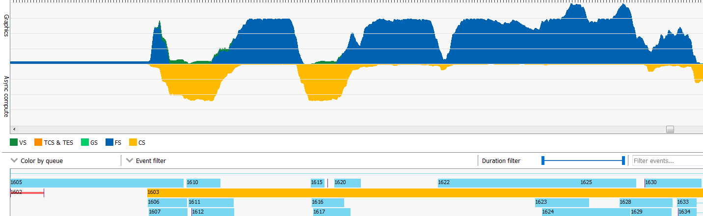
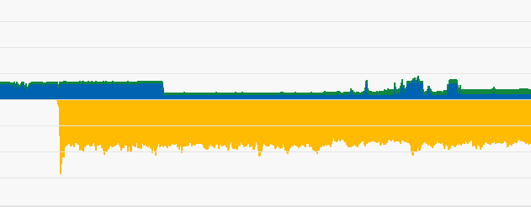
Short running waves can bottleneck larger gpus
example of wave launch for async-compute getting blocked by wave-launch-limited ps drawS
Mostly Launch Limited Z+Triangle-Normal Fill
Wave Launch Limited Stencil Fill
Async CS Wave Can Only Launch When PS Waves Don’t
Vega 64 (SE:CU ratio = 1:16)
CS Dispatch Starts Here
First CS Wave Launch Blocked Until Here
Z+Triangle-Normal Fill Less Launch Limited
RX 580 (SE:CU ratio = 1:9)
A Few VALU ops
Export Z+Tri Norm
PS Wave Instruction Trace : Nearly Empty and No Loads
Async-CS Launches Well + Set PSO Wave Limits

Slide 39
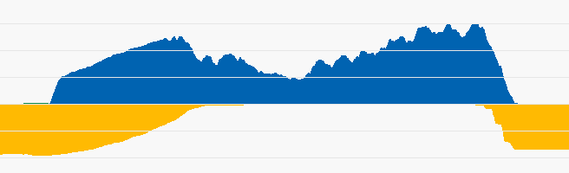
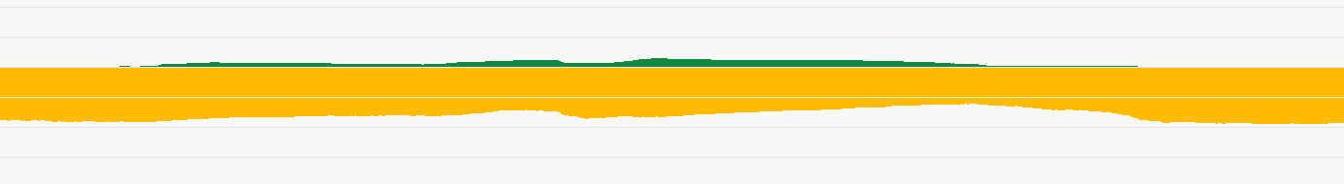
Another example of short running PS stalling async-compute
Best to have long running ps or no Ps (like z-only rendering for z-pre-pass or shadows)
Simple PS With One Fetch
Wait on Fetch, Some Math, Export
Instruction Trace Shows Single Fetch
Vega 64
PS Stalls 4-Wave Workgroup Async-CS (Watch Out For Workgroup Sizing Issues)
Same Async-CS Dispatch Overlaps Good With Shadow Rendering (No PS To Stall Async-CS)
Vega 64

Slide 40
Workgroup Optimization
2D Locality vs Workgroup Launch Rate

Slide 41
Typical practice of PS to CS conversion
Move PS to a {8,8,1} workgroup in CS
  1 wave/V$ for locality (can be worse than PS)
  GCN launches one workgroup per CU (one V$/CU)
  Before moving to the next CU
Lane to 8x8 tile mapping is “linear block”
  Possible poor {4x1} pattern for texture fetch quad
  Possible V$ bank conflicts
  GCN sampling works in groups of 4 lanes
0
00 | 01 | 02 | 03 | 04 | 05 | 06 | 07
08 | 09 | 0a | 0b | 0c | 0d | 0e | 0f
10 | 11 | 12 | 13 | 14 | 15 | 16 | 17
18 | 19 | 1a | 1b | 1c | 1d | 1e | 1f
20 | 21 | 22 | 23 | 24 | 25 | 26 | 27
28 | 29 | 2a | 2b | 2c | 2d | 2e | 2f
30 | 31 | 32 | 33 | 34 | 35 | 36 | 37
38 | 39 | 3a | 3b | 3c | 3d | 3e | 3f

Slide 42
Example “optimized”*** configuration
{512,1,1} workgroup configured to {32,16,1}
  8 wave/V$ for locality
  Each wave is a 8x8 tile
  8 waves organized into 4x2 collection of 8x8 tiles
Lane to 8x8 tile mapping is “swizzled block linear”
  Good {2x2} pattern for texture fetch quad
*** Optimized for a specific shader
  Which is highly dependent on 2D locality for cache hits
  And less dependent on wave launch issues
0 | 2 | 4 | 6
1 | 3 | 5 | 7
00 | 02 | 04 | 06 | 08 | 0a | 0c | 0e
01 | 03 | 05 | 07 | 09 | 0b | 0d | 0f
10 | 12 | 14 | 16 | 18 | 1a | 1c | 1e
11 | 13 | 15 | 17 | 19 | 1b | 1d | 1f
20 | 22 | 24 | 26 | 28 | 2a | 2c | 2e
21 | 23 | 25 | 27 | 29 | 2b | 2d | 2f
30 | 32 | 34 | 36 | 38 | 3a | 3c | 3e
31 | 33 | 35 | 37 | 39 | 3b | 3d | 3f

Slide 43
{512,1,1} to {32,16,1} reconfiguration CODE for prior slide
Glsl code
// 5 ops on GCN of extra VALU overhead (minimal)
uvec2 Remap(uint a) {
uint y = bitfieldExtract(a,3,4); // v_bfe_u32 ---> {...0,y3,y2,y1,x2}
y = bitfieldInsert(y,a,0,1); // v_bfi_b32 ---> {...0,y3,y2,y1,y0}
uint x = bitfieldExtract(a,1,3); // v_bfe_u32 ---> {...0,x2,x1,x0}
a = bitfieldExtract(a,4,5); // v_bfe_u32 ---> {...0,x4,x3,y3,y2,y1}
x = bitfieldInsert(a,x,0,3); // v_bfi_b32 ---> {...0,x4,x3,x2,x1,x0}
return uvec2(x, y); }
// usage in shader
uvec2 xy = Remap(gl_LocalInvocationID.x);
// 2 ops on Vega
xy.x += gl_WorkGroupID.x << 5; // v_lshl_add_u32
xy.y += gl_WorkGroupID.y << 4; // v_lshl_add_u32
REMAP
876543210 <- input bits
---------
yyy y <- output bits
321 0
xx xxx
43 210

Slide 44
Cs Ssao Measured performance for different configurations
3440x1440 resolution
Optimized drops 43% off runtime (yellow cases)
  {64 ,1 ,1} remap to {8, 8, 1} : 1.93 ms (base but with swizzled block)
  {128 ,1 ,1} remap to {8, 16, 1} : 1.69 ms
  {8 ,32,1} no-remap : 1.57 ms (linear block)
  {256 ,1 ,1} remap to {8, 32, 1} : 1.36 ms
  {512 ,1 ,1} remap to {16, 32, 1} : 1.24 ms
  {1024,1 ,1} remap to {8, 128, 1} : 1.22 ms (workgroup too big for non-pinned workload)
  {512 ,1 ,1} remap to {8, 64, 1} : 1.15 ms (easier VALU conversion, but worse L1$ perf)
  {512 ,1 ,1} remap to {32, 16, 1} : 1.09 ms (using transform from prior slide)
But large workgroups don’t always yield these kinds of gains
  Especially with async-CS work
  Diving deeper into the challenges in the next slide . . .

Slide 45
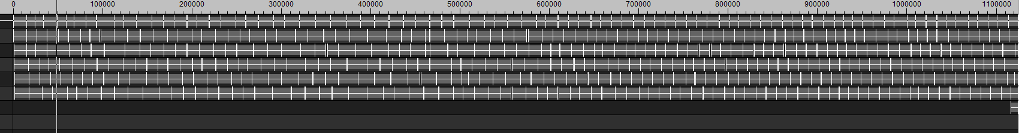
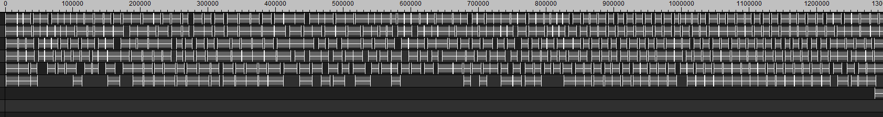
Dynamics Gcn workgroup launch
Two competing factors – getting good cache locality vs keeping machine filled OR NOt
Workgroups launched one per V$ (one per CU), round robin across CUs which can dispatch work
  Thus two primary options for V$ cache locality: larger workgroups or more work in a wave
For each SE, a wave can launch every 4 clocks, but waves can exit much faster than that
  Not always possible re-fill the machine fast
Workgroups need a contiguous block of LDS and waves need contiguous block of VGPRs/SGPRs to launch
  Smaller workgroups = easier to launch, irregularity in {size, wave run-time, etc} can yield run-time gaps
Apply Light Probes – 1 Wave / Workgroup Is Faster
Extra Runtime
Apply Light Probes – 8 Wave / Workgroup But Only 6 Waves / SIMD Fit

Slide 46
Semi-Persistent Waves
Keeping GPU Filled With Good Data Locality

Slide 47
Semi-persistent wave goals
Another interesting optimization tool
Often using larger CS workgroups results in launch issues (especially with async compute)
Would like another way to gain memory locality and keep with single wave workgroup
  Will use wave-sized {64,1,1} to 8x8 remap for good 2x2 quads from prior section
Current PC graphics APIs lack a function to dispatch to fill machine only once
So fully persistent workgroups is not yet practical
However semi-persistent waves can be an interesting middle ground

Slide 48
Anatomy of a short shader at semi-steady-state run-time
View from instruction trace
Wave relaunch
  Breaks ability to factor work (for instance would like to reuse instead of reload constants)
  Breaks ability to hide latency at end of shader
  Relaunch can be a significant amount of time where wave resources are not used
Semi-persistent wave – can instead loop through N instances of the shader in one wave . . .
  Amortize overheads of wave start/end/relaunch
Load Batch 1
Load Batch 2
Wait For Stores To Finish
Load Constants
Wave Relaunch Gap

Slide 49
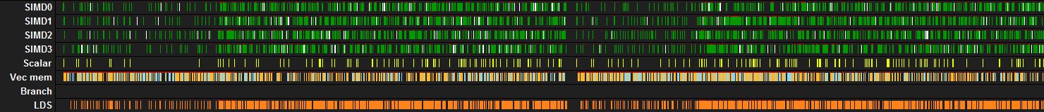
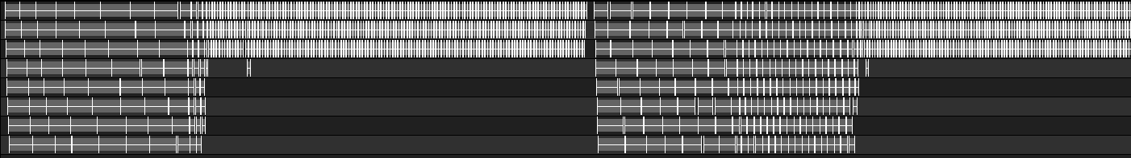
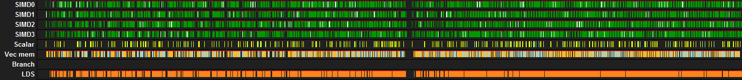
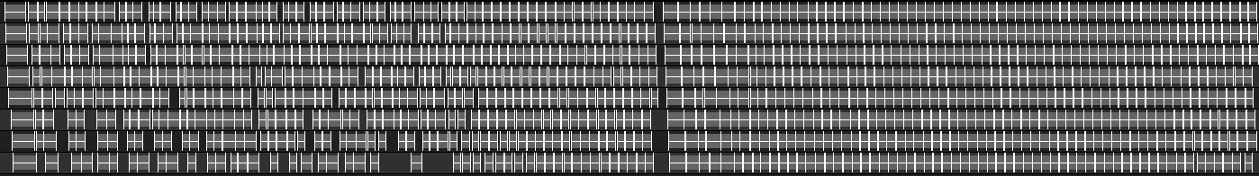
Not leaving data locality and launch regularity up to chance
Want to avoid depending on accidental data locality due to effect of how gpu launches workgroups
{8,8,1} workgroup, horizontal then vertical kernel, later execution happens to hit more in cache
{64,1,1} remap to 8x8, same kernels same occupancy slightly different execution, better cache rate
Hitting Cache
Missing Cache
Similar Store Rate Different Launch Effect
Better VALU
Utilization
More Regularly Hitting Cache = Fastest

Slide 50
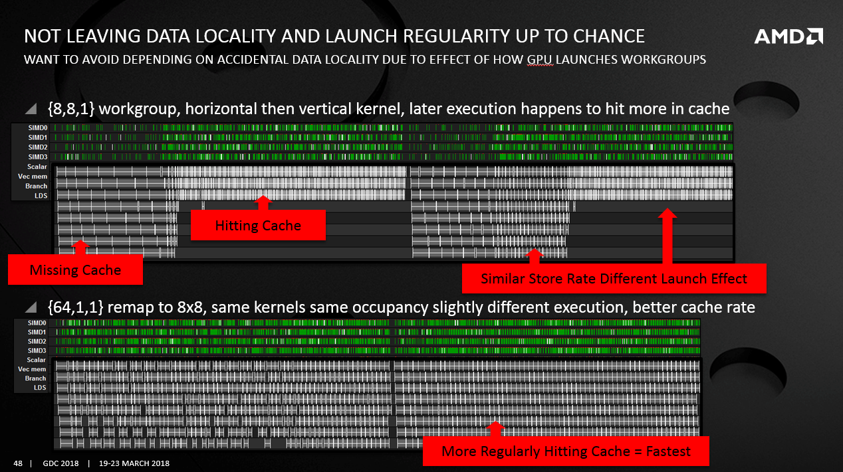
Semi-persistent wave launch
Using Wave-sized workgroup to best keep machine filled
Convert multi-wave workgroup into single wave-sized workgroup via loop unrolling
  Group dimension setup to maximize data locality (ie use vertical grouping for vertical blur)
  Reduce dispatch size
Example for a horizontal blur shader
Do The Work Of These Waves
In This Wave
Less Random
Data Locality
Explicit Data Locality
By Unrolling

Slide 51
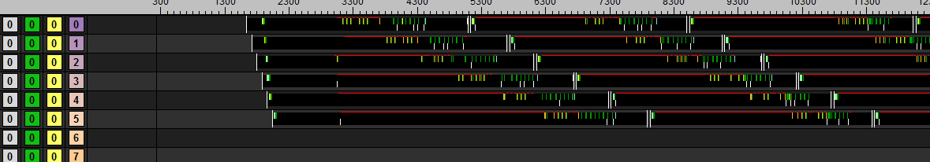
Understanding wave execution and scheduling
Via instruction trace of simple shader at launch (looking at one SIMD)
Showing effects of oldest wave first scheduling priority
Highlighting wave launch ordering and when the majority of texture fetches happen
Oldest wave first scheduling priority attempts to maximize opportunity for a wave to get cache reuse
  Good pairing for the unrolling for semi-persistent workgroups
0
0
0
0
6
6
1
1
7
7
2
2
8
8
3
3
9
4
4
5
5

Slide 52
Simple horizontal blur example
Testing basic theory on amortizing work by unrolling
8x8 tile doing a simple 9 tap box blur + 1 store
Semi-persistent waves unrolling share filter tap – compiler optimized this avoiding refetching
Can estimate initial scaling by the number of VMEM ops (ignoring possible cache hit rate changes)
  1.00 ops : 8x8 unroll 8 times = 10 VMEM ops + 9 VMEM ops * 7 times = 73 VMEM ops / 8 tiles = 9.125 ops/tile
  1.01 ops : 8x8 unroll 4 times = 10 VMEM ops + 9 VMEM ops * 3 times = 37 VMEM ops / 4 tiles = 9.250 ops/tile
  1.04 ops : 8x8 unroll 2 times = 10 VMEM ops + 9 VMEM ops * 1 times = 19 VMEM ops / 2 tiles = 9.500 ops/tile
  1.10 ops : 8x8 no unroll . . . . = 10 VMEM ops . . . . . . . . . . . . . . . . . . . . . = 10 VMEM ops / 1 tiles = 10.000 ops/tile
8 texel stride during unroll

Slide 53
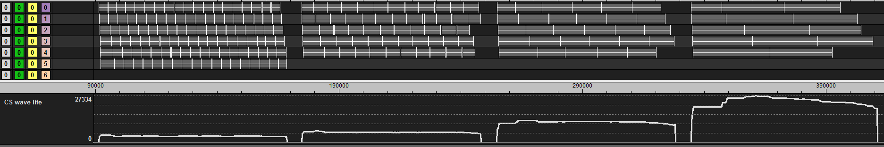
Simple horizontal blur example – measured runtime
Normalized rx 580 measured PIPELINED timing along with predicted scaling based on VMEM ops
Semi-persistent is doing better than expected based on number of VMEM ops alone
  Suggests successful increase in cache hit rate
1.00 time : 1.00 ops : Semi-persistent 8x8 running 64x8 (aka unroll 8x)
1.04 time : 1.01 ops : Semi-persistent 8x8 running 32x8 (aka unroll 4x)
1.10 time : 1.04 ops : Semi-persistent 8x8 running 16x8 (aka unroll 2x)
1.22 time : 1.10 ops : Classic 8x8 linear
Significant Drain Effect – Make Sure To Pipeline

Slide 54
Simple horizontal blur example – wave limited results rx 580
Running SOME cache/wave options to find optimal configurations
CONFIG | WAVE/ SIMD | CLOCKS NON-PIPELINED | CLOCKS PIPELINED
8x8 unroll x8 | 3 | 74184 | 68483
8x8 unroll x4 | 3 | 72092 | 69520
8x8 unroll x2 | 3 | 73905 | 72272
8x8 linear | 3 | 83508 | 82850
8x8 unroll x8 | 4 | 74241 | 66600
8x8 unroll x4 | 4 | 71811 | 68222
8x8 unroll x2 | 4 | 73376 | 71525
8x8 linear | 4 | 82583 | 81491
8x8 unroll x8 | 5 | 75571 | 64628
8x8 unroll x4 | 5 | 73129 | 67426
8x8 unroll x2 | 5 | 73384 | 70679
8x8 linear | 5 | 82427 | 80571
8x8 linear | 6 | 80971 | 78527
Semi-persistent wave example
  Faster for either non-pipelined
  Or optimal pipelined execution
Fastest For
Non-Pipelined
Fastest For
Pipelined Execution
Unoptimized

Slide 55

Workgroup Optimization + SEMI-PERSISTENT WAVES – Takeaway
Two useful tools for optimization
Can provide gains even in fully memory bound situations!
Un-pinning the work-item to lane mapping via semi-persistent waves
has advantages beyond what we have time to dive into today . . .

Slide 56
The End
Coding [koh-ding]
n. the act of transmuting caffeine into sarcasm with binary side effects

Slide 57

XOR rax,rax; xor [rax],rax;
Post-talk follow-up: timothy.lottes@amd.com
Want to join this team: AMD’s Graphics Performance R&D Team is hiring
Special thanks to
  Guennadi along with the AMD Tools Team – For giving us eyes to see with
  AMD Vulkan Driver Team – For helping bypass the rev limiter
  Jordan Logan – For extra help with run-time testing
  Dustin Land – For proving it is not always hard to port to Vulkan
  Sebastian Aaltonen and many others – For realizing cool stuff on the GPU
  . . .

Slide 58
Disclaimer & Attribution
The information presented in this document is for informational purposes only and may contain technical inaccuracies, omissions and typographical errors.
The information contained herein is subject to change and may be rendered inaccurate for many reasons, including but not limited to product and roadmap changes, component and motherboard version changes, new model and/or product releases, product differences between differing manufacturers, software changes, BIOS flashes, firmware upgrades, or the like. AMD assumes no obligation to update or otherwise correct or revise this information. However, AMD reserves the right to revise this information and to make changes from time to time to the content hereof without obligation of AMD to notify any person of such revisions or changes.
AMD MAKES NO REPRESENTATIONS OR WARRANTIES WITH RESPECT TO THE CONTENTS HEREOF AND ASSUMES NO RESPONSIBILITY FOR ANY INACCURACIES, ERRORS OR OMISSIONS THAT MAY APPEAR IN THIS INFORMATION.
AMD SPECIFICALLY DISCLAIMS ANY IMPLIED WARRANTIES OF MERCHANTABILITY OR FITNESS FOR ANY PARTICULAR PURPOSE. IN NO EVENT WILL AMD BE LIABLE TO ANY PERSON FOR ANY DIRECT, INDIRECT, SPECIAL OR OTHER CONSEQUENTIAL DAMAGES ARISING FROM THE USE OF ANY INFORMATION CONTAINED HEREIN, EVEN IF AMD IS EXPRESSLY ADVISED OF THE POSSIBILITY OF SUCH DAMAGES.
ATTRIBUTION
© 2018 Advanced Micro Devices, Inc. All rights reserved. AMD, the AMD Arrow logo and combinations thereof are trademarks of Advanced Micro Devices, Inc. in the United States and/or other jurisdictions. Other names are for informational purposes only and may be trademarks of their respective owners.

