Slide 2
Gordon Selley . Baldur Karlsson Navin Patel . Herb Marselas Budi Purnomo . Matthaeus Chajdas 21 March 2018
The Art of Profiling
Download AMD tools
https://gpuopen.com

Slide 3
agenda
Radeon GPU Profiler (RGP) | Gordon Selley
RenderDoc V1.0 | Baldur Karlsson
RenderDoc RGP Interop | Baldur Karlsson
Compressonator | Navin Patel
AMD Support in PIX for Windows | Herb Marselas
GPUPerfAPI & Radeon GPU Analyzer | Herb Marselas

Slide 4
Radeon GPU Profiler
Gordon Selley

Slide 5
Radeon GPU Profiler (RGP)
Why did we make it?
DirectX® 12 and Vulkan™ are awesome because they
Allow the developer to get closer to the metal of the GPU
Provide a lower level of GPU programming than previous APIs
Offer higher performance
But, they are also not awesome, because they
Allow the developer to get closer to the metal of the GPU
Wavefronts, layout transitions, VGPRs, SGPRs, hardware state, context rolls
Provide a lower level of GPU programming than previous APIs
Barriers, queue synchronization, fences & semaphores, async compute, pipeline state
Offer higher performance
As long as you can master all the complex stuff in red (above)

Slide 6
Radeon GPU Profiler (RGP)
Why did we make it?
If we could visualize how DirectX12 and Vulkan events map to the complex stuff in red
We could ask simple questions such as:
Am I synchronizing work between queues effectively?
Am I feeding the GPU enough work?
Am I fully utilizing the GPU?
Which draws/dispatches are the best candidates for optimization?
How are my applications barrier’s affecting performance?
How are driver barriers affecting performance?
Am I using expensive layout transitions?
How is my driving? (Call 1-800-BAD-DRIVER)

Slide 7
Radeon GPU Profiler (RGP)
Why we made it
The Radeon GPU Profiler answers these questions, and more, because it:
Exposes how the DirectX 12 and Vulkan APIs work on the GPU
Maps the APIs directly to GPU concepts and activity
Uses custom GPU hardware for accurate low-level event and timing data
Allows you to understand how, and why, your changes affect performance
Someone once said: “A picture is worth a thousand DWORDS” (or something similar)
RGP visualizes profiler data using easy to understand UI’s
In doing so, RGP reveals patterns, allows you to make connections, and improves your understanding of the complex stuff in red

Slide 8
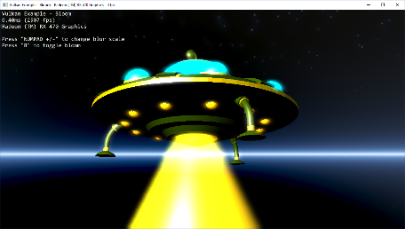
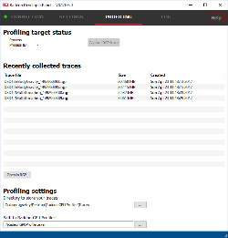
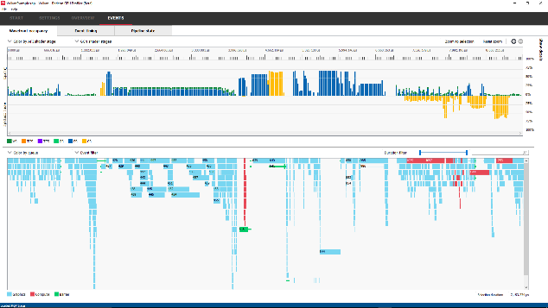
Radeon GPU Profiler (RGP) components
How it works
Radeon Developer Mode Driver (DMD)
Shipped in the public AMD Adrenalin driver package
Inactive by default
Available on Windows® & Linux®
Radeon Developer Service (RDS)
Tray application activates the developer mode driver to support:
Developer control of Driver Settings
RGP profile data collection
Radeon Developer Panel (RDP)
GUI for controlling services provided by RDS
Custom editing of settings for individual applications
Triggers RGP profiles from running applications
Connect to local or remote systems
Radeon GPU Profiler (RGP)
GUI for visualizing low level GPU data
Queue synchronization, command buffer submission timings, wavefront occupancy, barrier timings, context roll stalls, layout transitions, and hardware render state

Slide 9
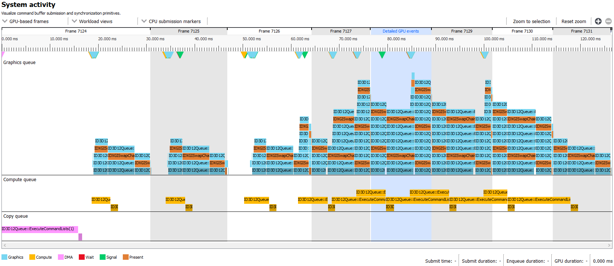
Radeon GPU Profiler
System ACTIVITY –command buffer timings
Graphics queue
Async compute
Copy queue
Notes:
When you load a profile in RGP the first UI you see is the System activity view
It is a timeline of your application’s command buffer CPU and GPU timings
Work submitted on the graphics queue is shown on the top row
If you are using the compute queue in your application, that will be shown below
And below that is any work you did using the copy queue
In this view you can instantly see that the GPU is continually being fed with work as there are no large gaps between frames or command buffers
You can also see where the async compute work is occurring within and across frame boundaries.

Slide 10
Radeon GPU Profiler
System ACTIVITY – multi-frame overview
Low-level GPU data
Notes:
The blue area highlighted here shows the frame that has been profiled using the low level RGP data
This is the data that is displayed in the rest of the tool

Slide 11
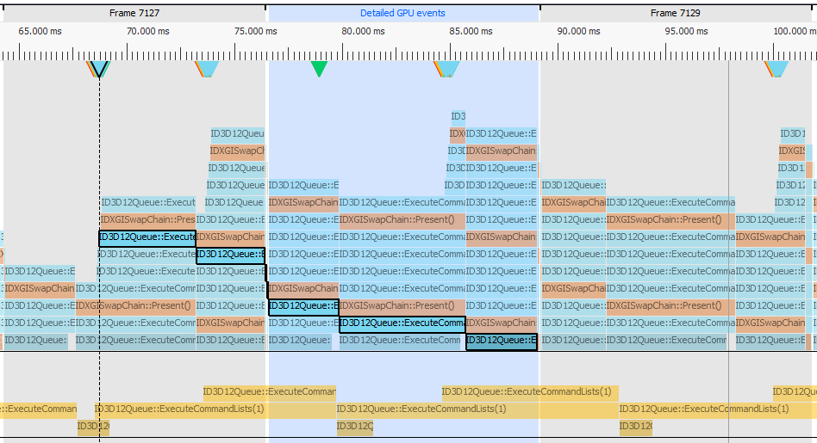
Radeon GPU Profiler
System ACTIVITY – CPU submission and GPU EXECUTION timings
CPU Submission
Queue clearing as work executes on GPU
GPU Execution
Work already in queue
Notes:
Zooming in a little bit we are able to select individual command buffers and see where they were submitted on the CPU
Below this is the existing work in the queue waiting to be processed
The bottom row shows the timings as the work gets executed on the GPU
We can clearly see where the selected command buffer gets executed on the GPU

Slide 12
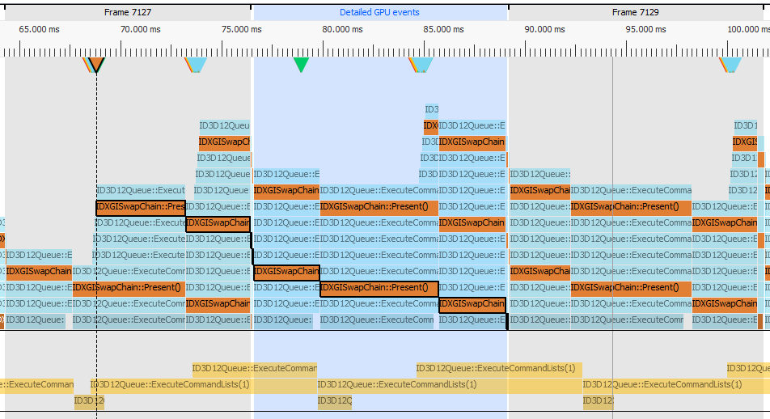
Radeon GPU Profiler
System ACTIVITY – present markers
Present submission
Present execution
Notes:
We can see clearly where our presents are submitted and executed

Slide 13
Radeon GPU Profiler
System ACTIVITY – visualize Queue synchronization
Graphics queue
Signal is submitted on the CPU
Signal is executed on the GPU
Compute queue is waiting
Compute work continues
Compute queue
Notes:
In this view we can visualize the use of signals and waits to synchronize work between the queues
The system activity view

Slide 14
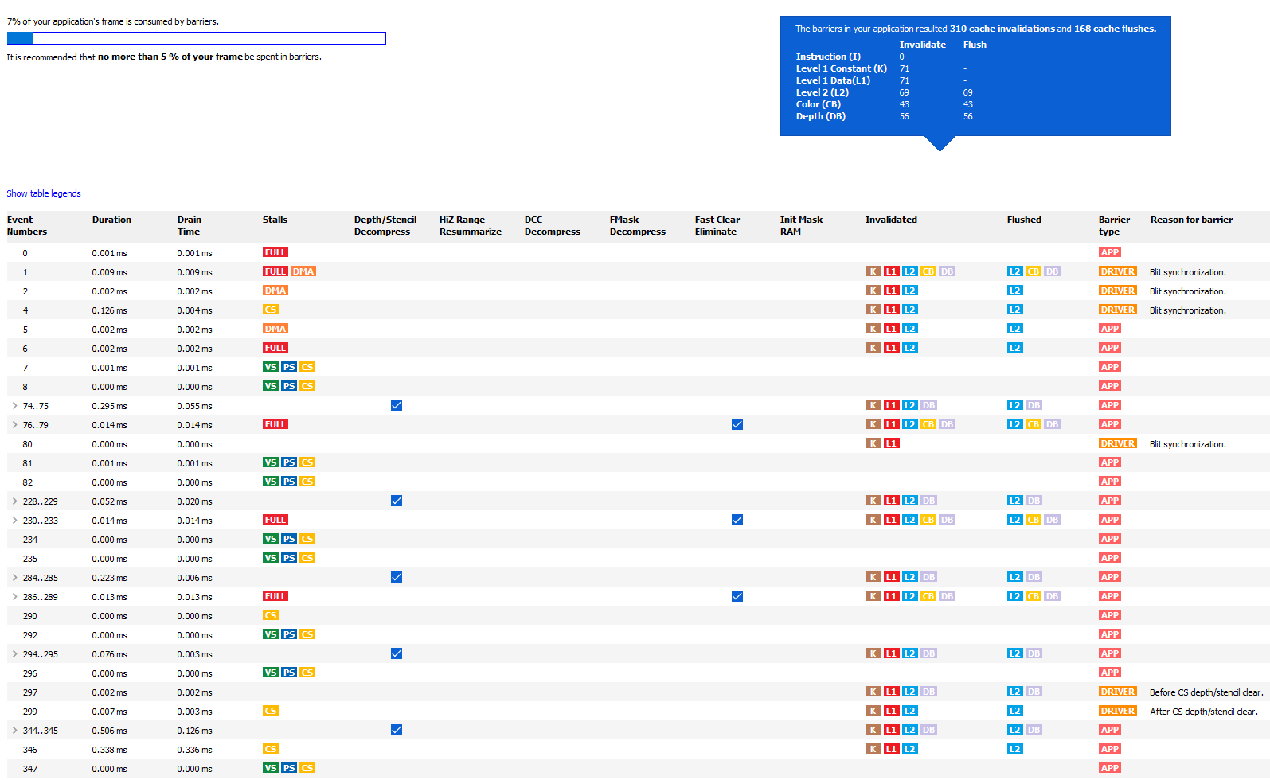
Radeon GPU Profiler
Barrier information
Barrier frame summary
Expected in optimal cases
Barrier type and reason
Barrier timing
Slow-path barriers
Caches
Notes:
Effective use of barriers is very important for good performance
RGP helps by summarizing how much of the frame time is consumed by barriers
As a guideline we suggest that 5% should be the upper limit.
In this case it is 7%, so we probably do not have too much work to do here, but if we did

Slide 15
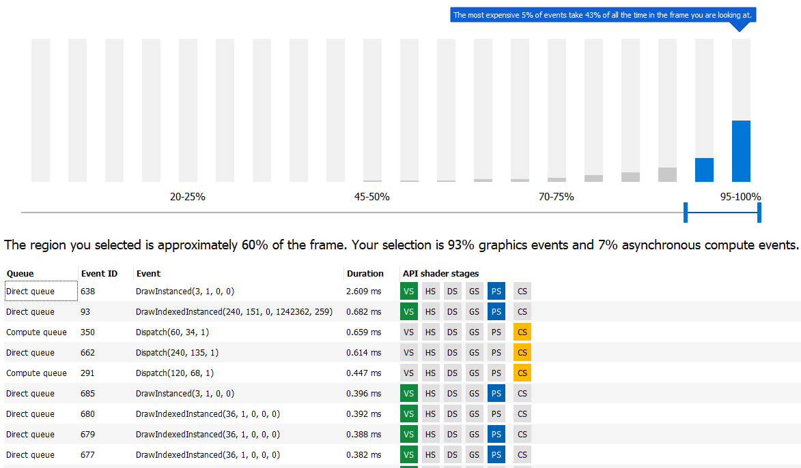
Radeon GPU Profiler
Most expensive events
Top 5% of events by duration
Configurable histogram
Most expensive event in selection
Notes:
The most expensive events UI automatically selects the most expensive events by duration
In this case the top 5% of events take 43% of the frame time
We will most likely have the most to gain by optimizing these events first

Slide 16
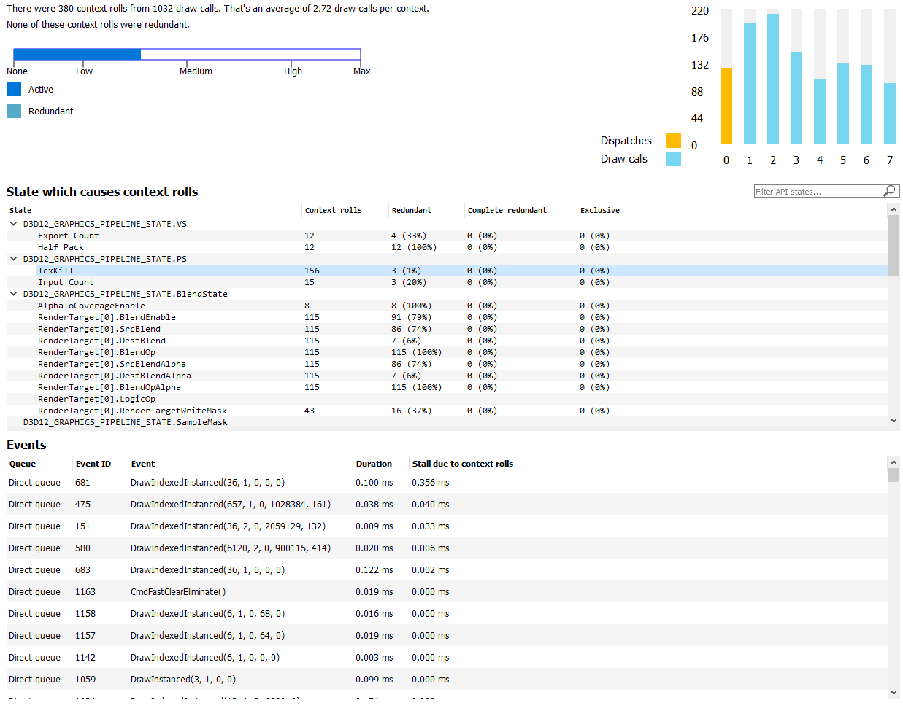
Radeon GPU Profiler
CONTEXT ROLLS
Context rolls summary
Context usage
Higher probability of context roll stalls
State that triggers a context roll
Context rolls data
Context roll stall times
Notes:
The context rolls UI introduces us to a hardware restriction of the GCN GPU architecture
There is a limit of 7 hardware contexts that are available for rendering
If a draw uses a different hardware state than the draw before it, it will require a new context
If you end up using all 7 contexts at the same time, then any new draws will stall while they wait for a context to free up
This is a called context roll stall
If you see that context 7 starts filling up in the chart on the top right, then your app is probably stalling in places
RGP displays a useful summary in the top left

Slide 17
Radeon GPU Profiler
Visualizing a CONTEXT ROLL stall
Select draw with stall 0.356ms
Notes:
In RGP we visualize context roll stalls
We can select a draw that has been stalled and view it in RGP’s Event timeline window

Slide 18
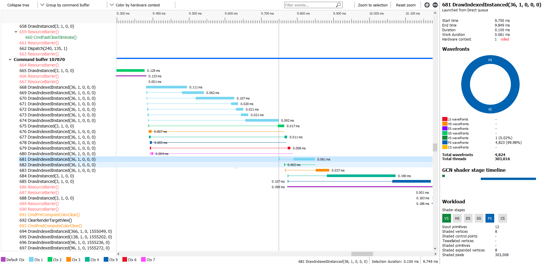
Radeon GPU Profiler
Event Timings – visualizing a context roll stall
Event tree
Event with longest stall time
All contexts are in use
Stall of 0.356 ms
All further work is stalled until contexts become available
Notes:
In this view you can see all of the events in a tree on the left hand side
The selected event is already highlighted in blue
Above this is a series of draw colored by the context that they are using
We can see that allow 7 colors, or contexts, are in use at he same time
Below these we can see a gap of 0.356ms as the following draw has to wait for a context to free up
Context rolls stalls form this distinctive staircase pattern in your profiles
The solution is to batch your draws together by state more effectively

Slide 19
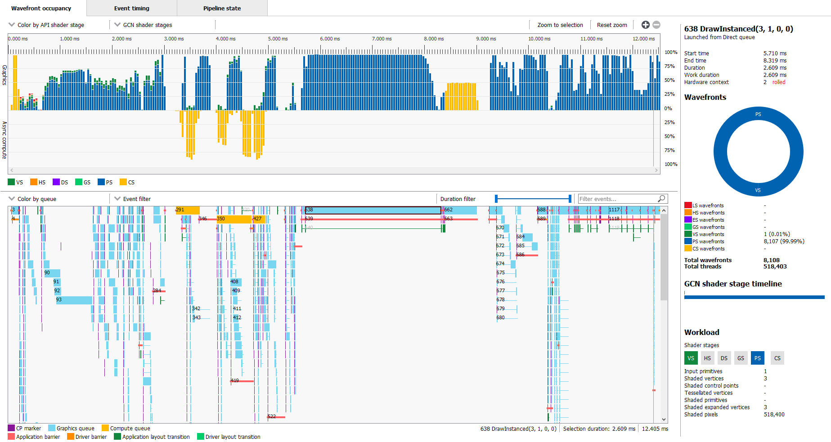
Radeon GPU Profiler
WAVEFRONT OCCUPANCY
Graphics wavefronts
Async compute wavefronts
Event timeline (draws, dispatches, barriers etc)
Wavefront occupancy
Event details
Selected event

Slide 20
Radeon GPU Profiler
WAVEFRONT OCCUPANCY
Color events by command buffer

Slide 21
Radeon GPU Profiler
WAVEFRONT OCCUPANCY
Useful color options

Slide 22
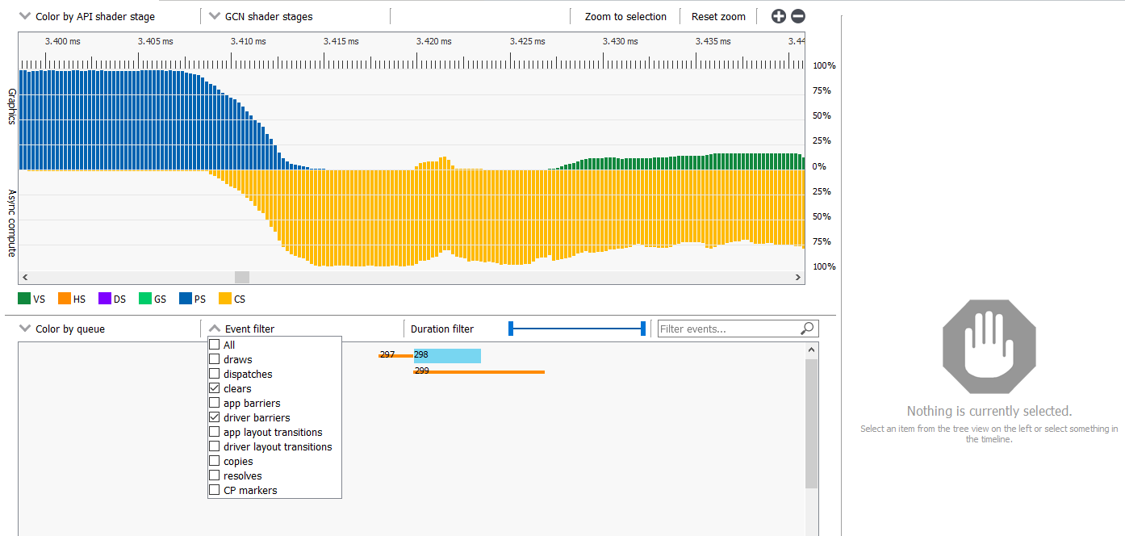
Radeon GPU Profiler
WAVEFRONT OCCUPANCY – Driver barrier example
Compute shader launched from Direct queue
Compute clear waves
Clear surrounded by two driver barriers
Dip in async wave occupancy due to graphics priority
Display clears and driver barriers
Display driver barriers
and clears
Selected clear

Slide 23
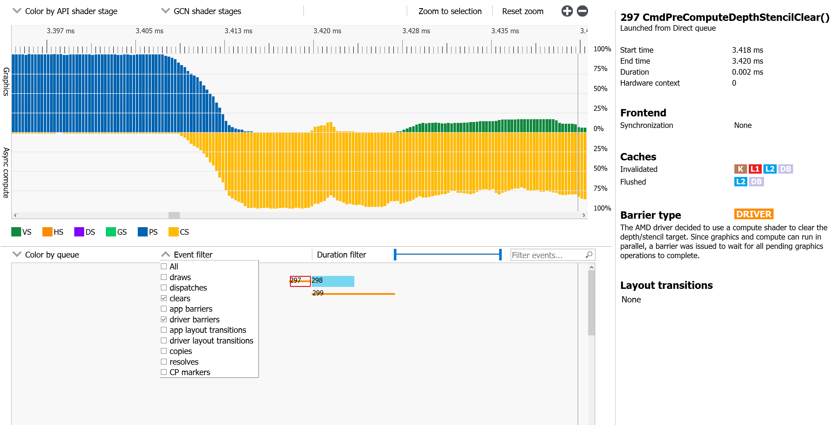
Radeon GPU Profiler
WAVEFRONT OCCUPANCY – Driver barrier example
Barrier reason
Select 1st barrier

Slide 24
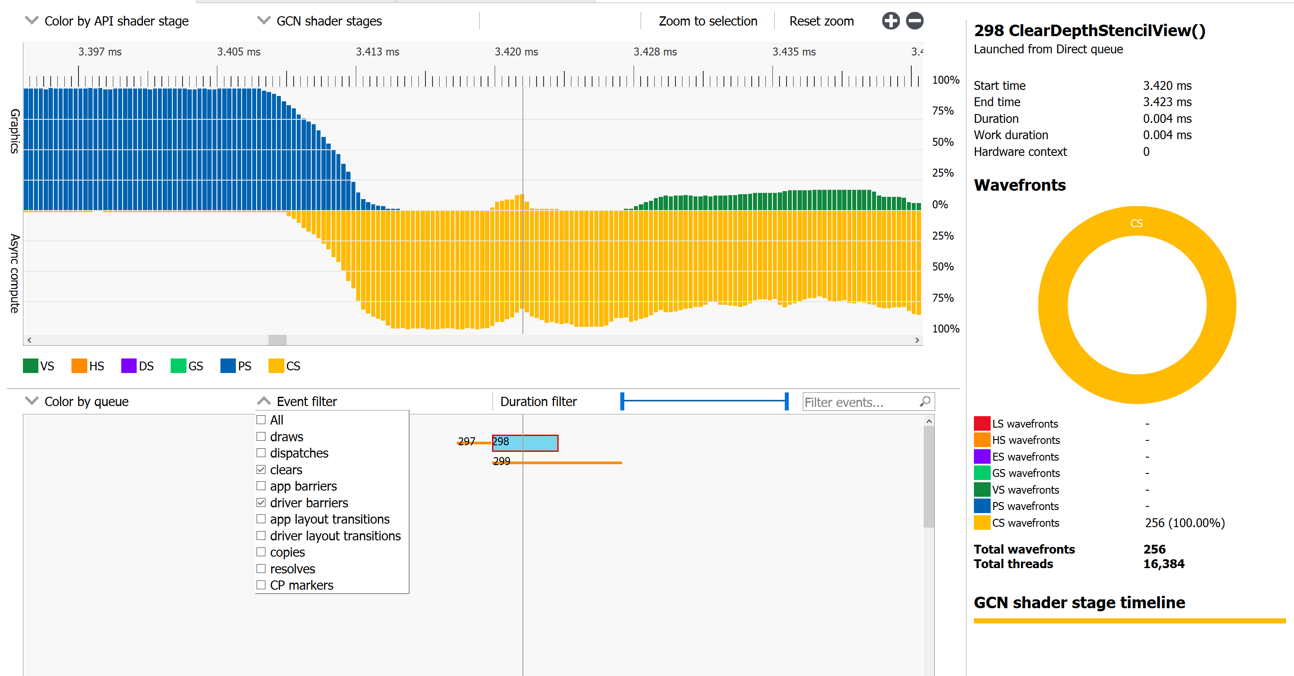
Radeon GPU Profiler
WAVEFRONT OCCUPANCY – Driver barrier example
Compute shader launched from Direct queue
Compute clear waves
Dip in async wave occupancy due to graphics priority
Select clear

Slide 25
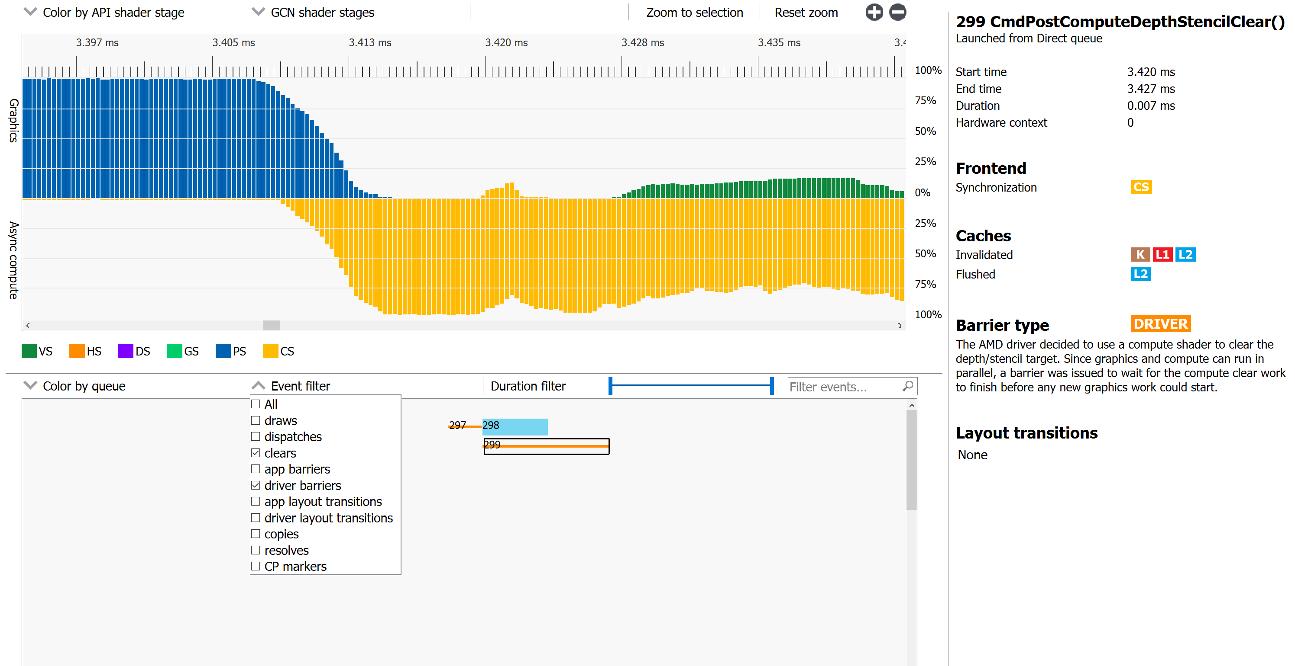
Radeon GPU Profiler
WAVEFRONT OCCUPANCY – Driver barrier example
Async compute keeps working
Barrier reason
Select 2nd barrier

Slide 26
Radeon GPU Profiler
WAVEFRONT OCCUPANCY – ALLOWS you to ask questions about your app
Does the app use Async compute?

Slide 27
Radeon GPU Profiler
WAVEFRONT OCCUPANCY – ALLOWS you to ask questions about your app
Does the async compute work overlap with graphics work?

Slide 28
Radeon GPU Profiler
WAVEFRONT OCCUPANCY – ALLOWS you to ask questions about your app
Is this full screen effect within my frame budget?

Slide 29
Radeon GPU Profiler
WAVEFRONT OCCUPANCY – ALLOWS you to ask questions about your app
Can I do this compute work on async compute?
Is there a scene dependency?
Do I have graphics work to overlap?

Slide 30
Radeon GPU Profiler
WAVEFRONT OCCUPANCY – ALLOWS you to ask questions about your app
What’s causing this gap?
Can I reduce it?

Slide 31
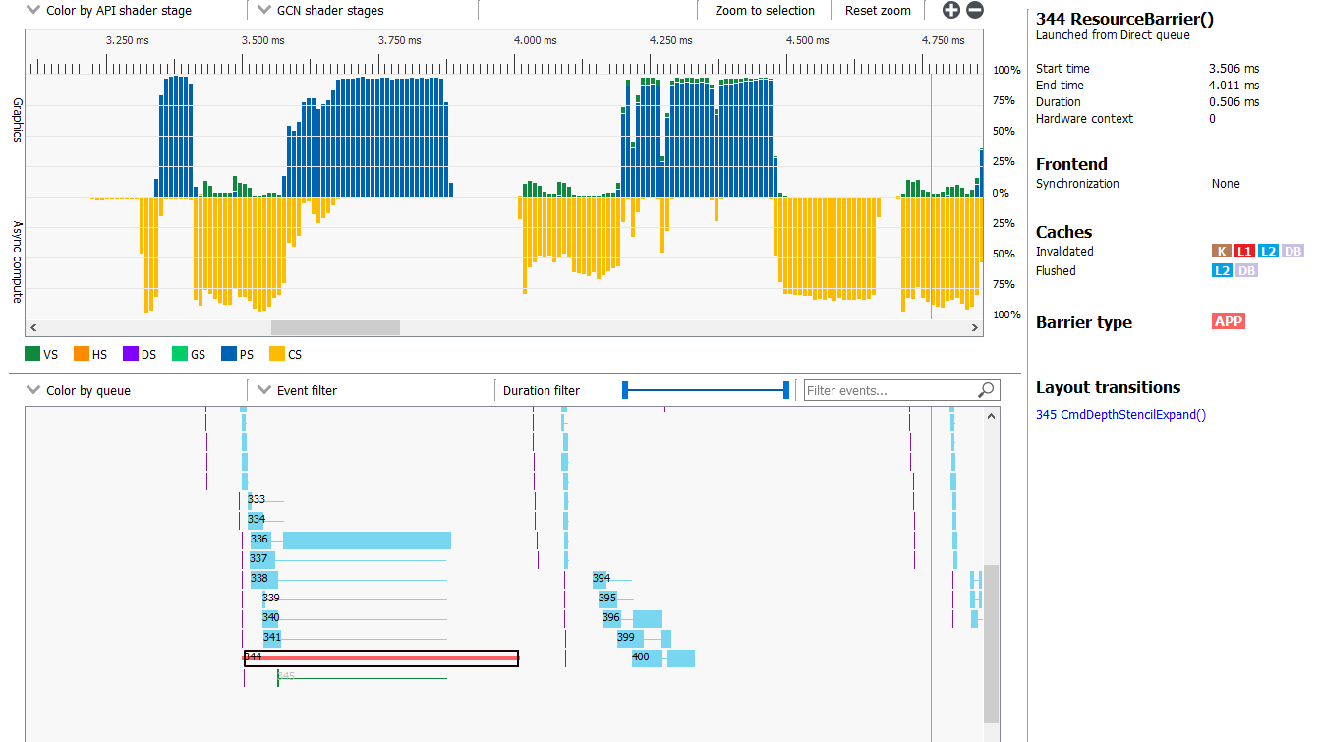
Radeon GPU Profiler
WAVEFRONT OCCUPANCY – ALLOWS you to ask questions about your app
Zoom in, take a deeper look Layout transition barrier

Slide 32
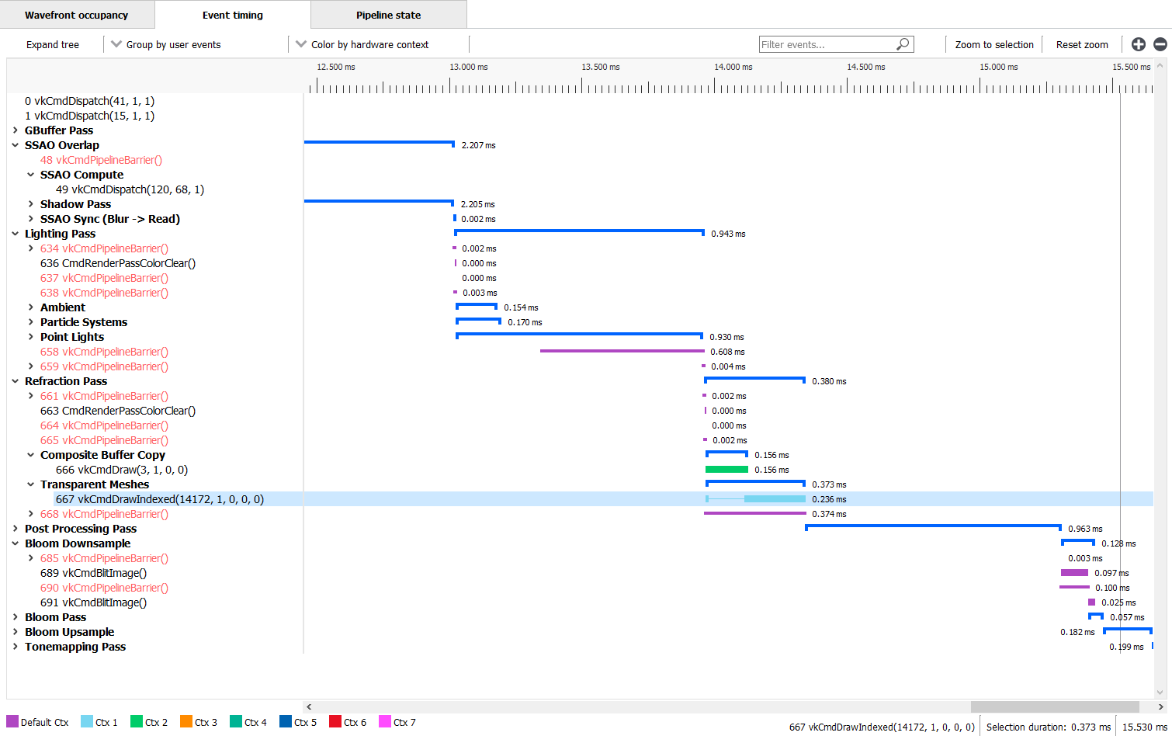
Radeon GPU Profiler
Event timings – don’t forget user markers
User markers are displayed in the Event tree

Slide 33
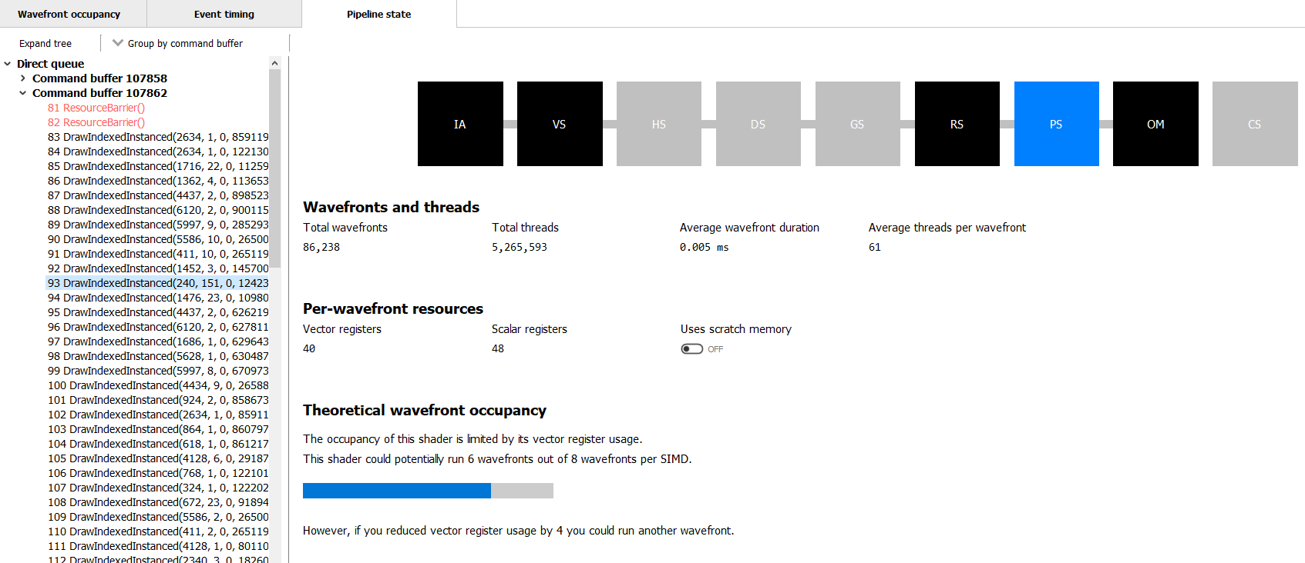
Radeon GPU Profiler
Pipeline STate
Selected stage
Wavefront stats
Selected event
Wavefront resources
Theoretical wavefront occupancy

Slide 34
RenderDoc v1.0
Baldur Karlsson

Slide 35
RenderDoc introduction
Released in 2014
Open source MIT licensed
Single frame capture-and-replay debugger
Vulkan™, Direct3D® 11&12, OpenGL & OpenGL ES
Windows®, Linux®, Android™

Slide 36
RenderDoc v1.0
Hot off the presses
Several new features and many smaller improvements
Integrations with AMD tools

Slide 37
Forwards compatible capture format
New capture format - breaking from v0.x series
Enables many advanced features, now and in the future
Conversion tool available

Slide 38
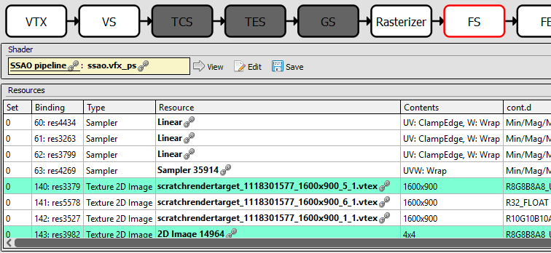
RESOURCE INSPECTOR

Slide 39
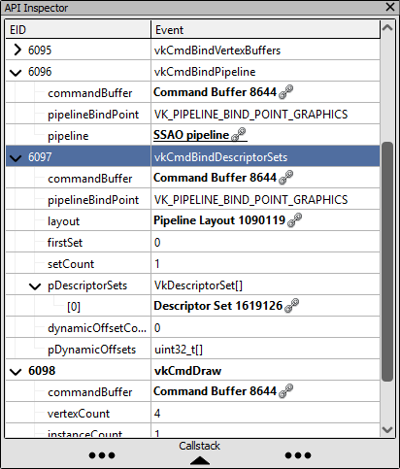
RESOURCE INSPECTOR

Slide 40
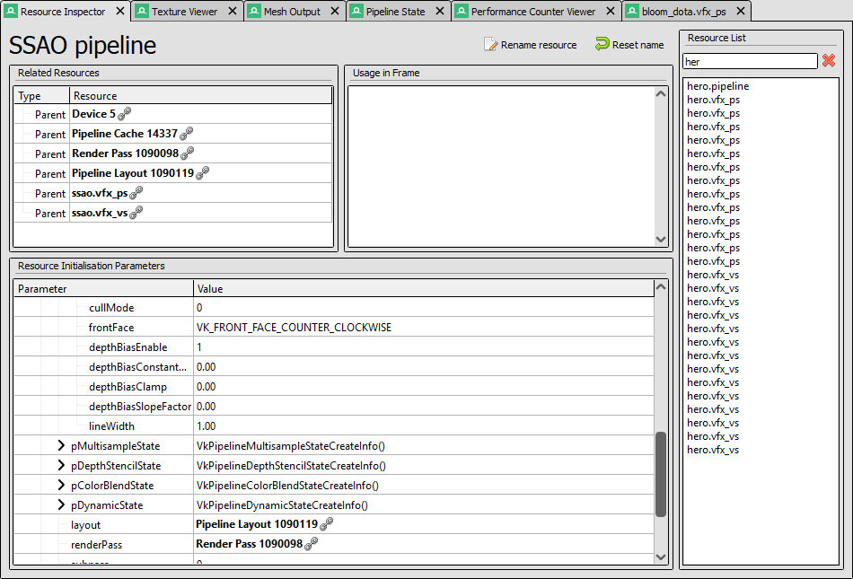
RESOURCE INSPECTOR

Slide 41
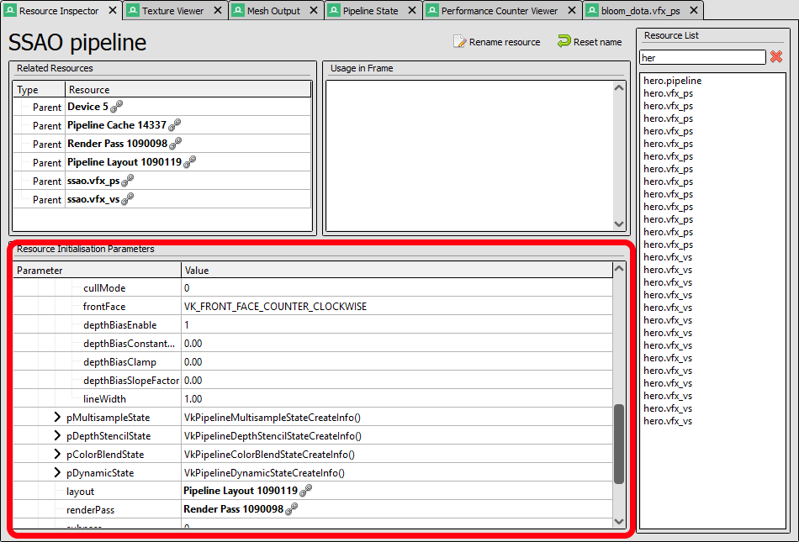
RESOURCE INSPECTOR

Slide 42
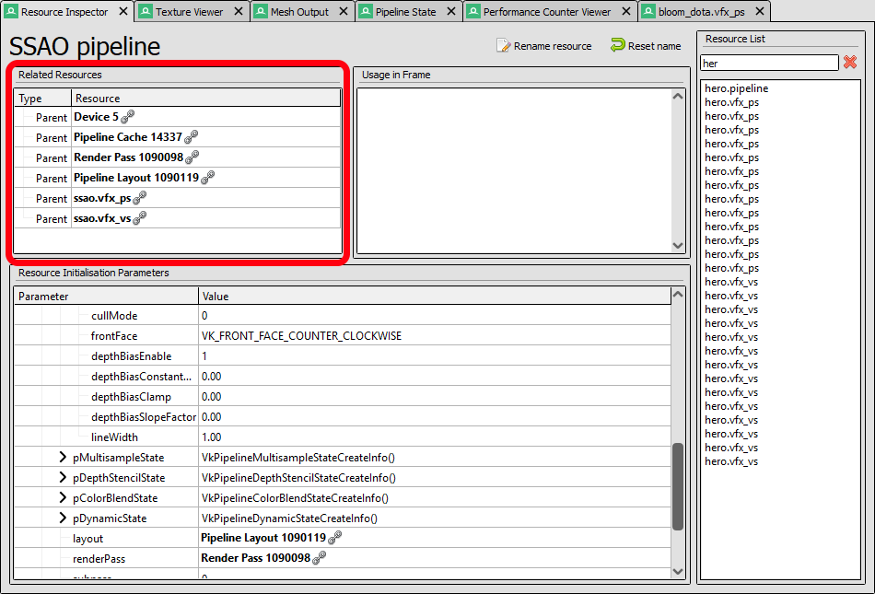
RESOURCE INSPECTOR

Slide 43
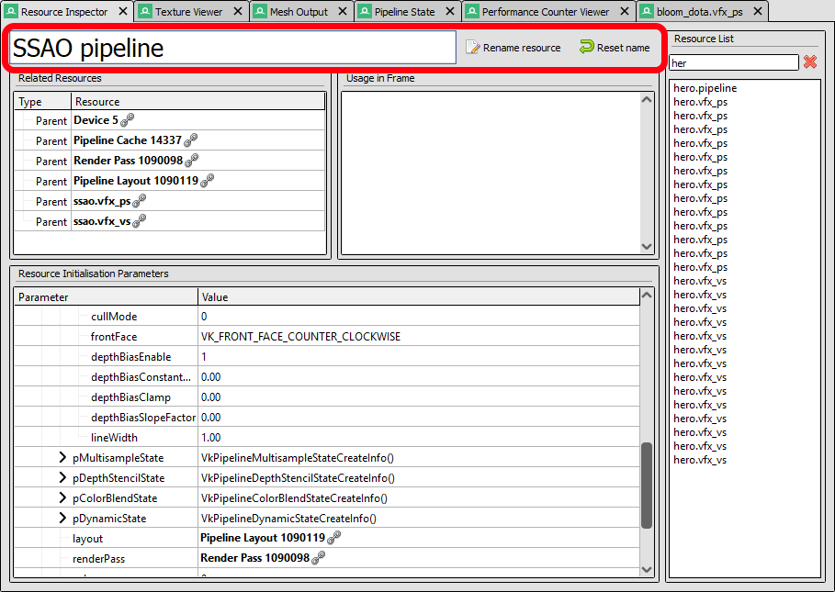
RESOURCE INSPECTOR

Slide 44
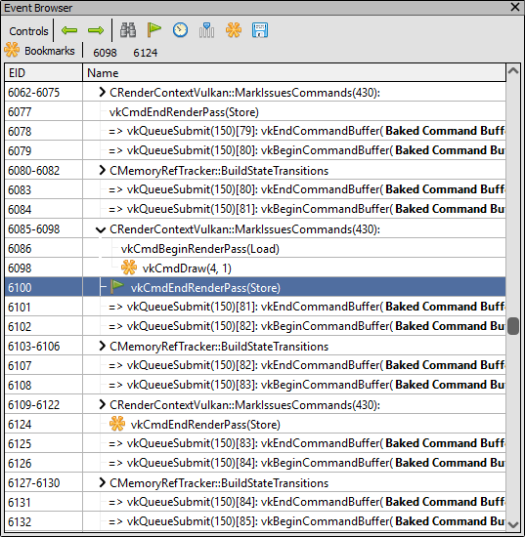
BOOKMARKS

Slide 45
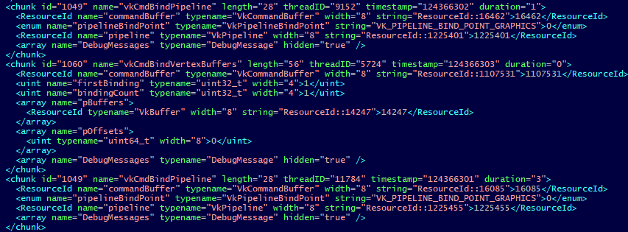
CAPTURE EXPORT & IMPORT
Captures now have 100% complete canonical representation, down to fundamental types
Allows export, modify, re-import
Out of the box support for import/export to XML (yes I know...)
Other formats possible - e.g. export to C++ to allow easy editing

Slide 46
ANDROID SUPPORT
Android support for OpenGL ES 2-3 & Vulkan™
Contributions from Samsung & Google
Streamlined familiar experience from desktop
0-step setup, choose device then run APK, everything else identical to desktop workflow

Slide 47
AMD PERFORMANCE COUNTERS
Native integration with AMD’s GPUPerfAPI
Support on all APIs & Platforms that RenderDoc runs on
Run consistent analysis offline on frame captures
Still not a profiler!

Slide 48
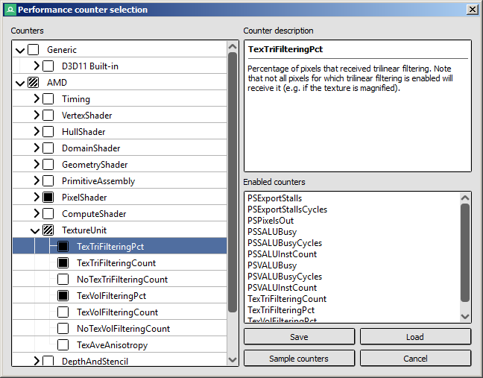
AMD PERFORMANCE COUNTERS

Slide 49
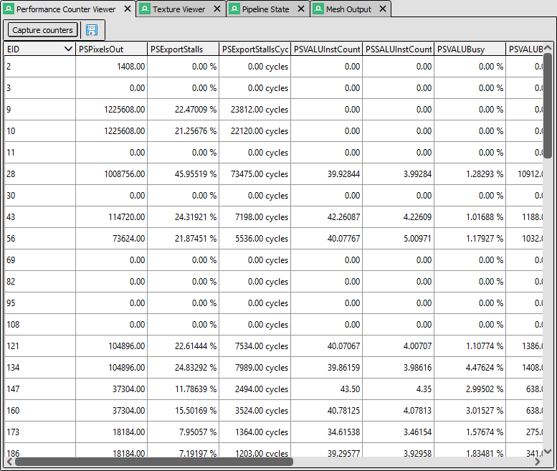
AMD PERFORMANCE COUNTERS

Slide 50
GCN SHADER ISA
Native integration with Radeon GPU Analyzer (RGA)
Fetch GCN ISA for shaders on any API
Support improving all the time: VK_AMD_shader_info

Slide 51
RenderDoc RGP Interop
Gordon Selley . Baldur Karlsson

Slide 52
RenderDOC RGP Interop
What does it do?
Work seamlessly between RenderDoc’s frame debugger and RGP’s profile data
Generate RGP profiles directly from inside RenderDoc
Profiles are opened in RGP
Cross-tool event synchronization
Select the same event in each tool
Investigate performance issues at the hardware and API levels
Build a richer understanding of your frame’s GPU performance

Slide 53
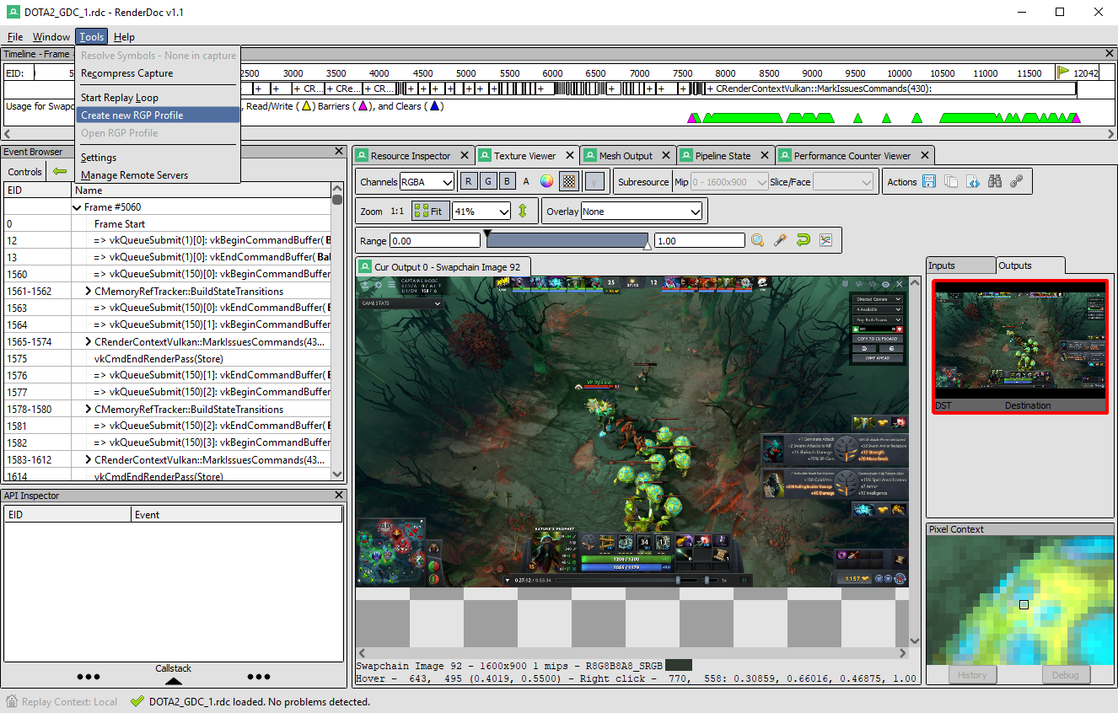
RENDERDOC RGP INTEROP
New menu item to create RGP profile

Slide 54
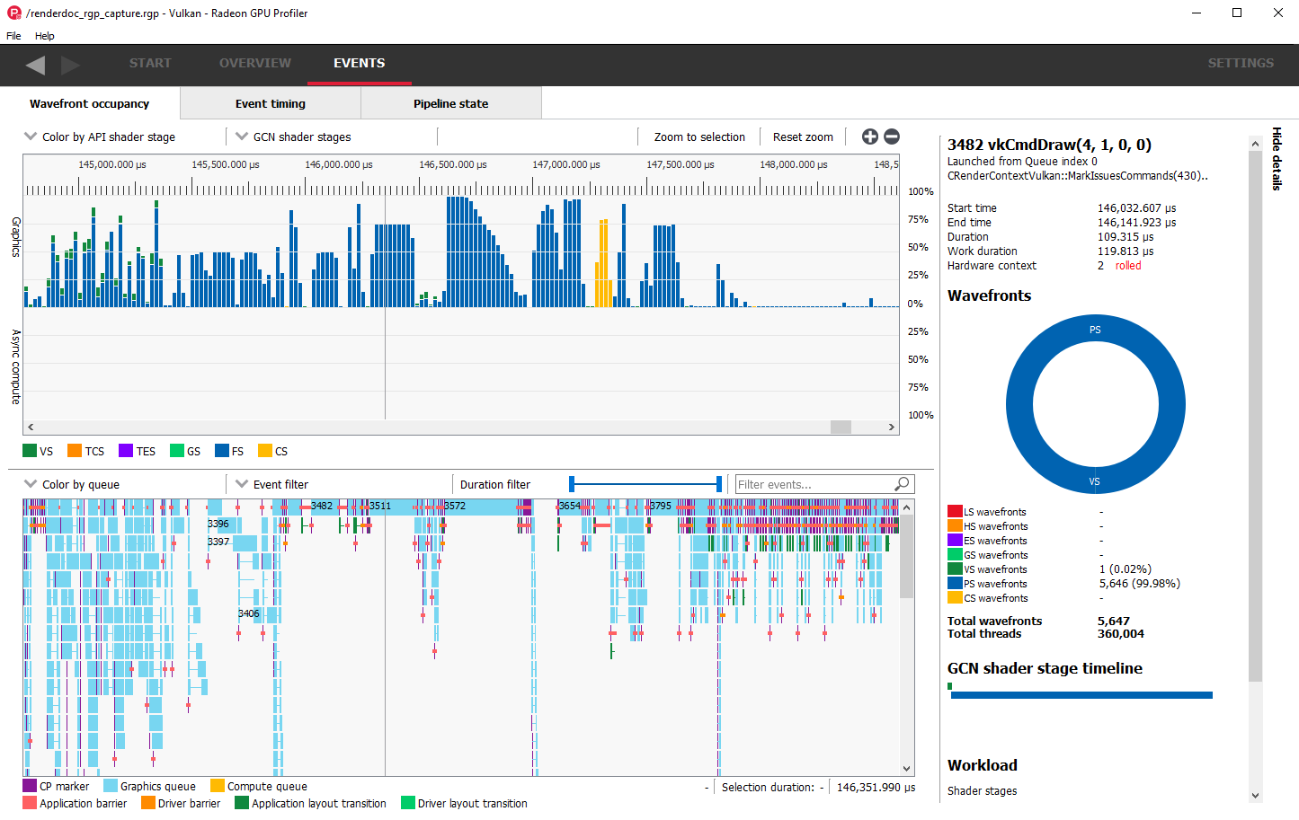
RENDERDOC RGP INTEROP
RGP profile is created and loads into new instance of RGP

Slide 55
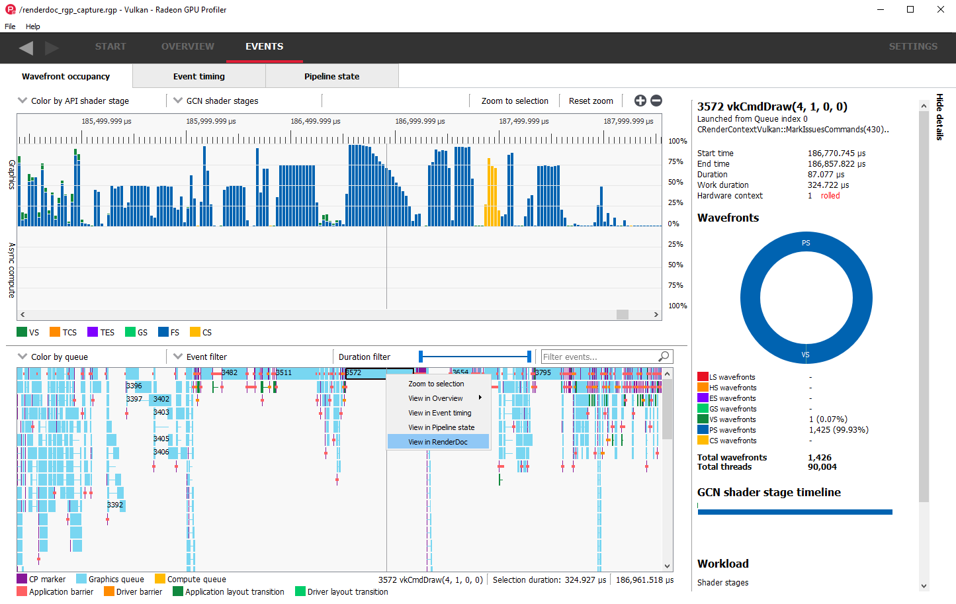
RENDERDOC RGP INTEROP
View selected event in RenderDoc

Slide 56
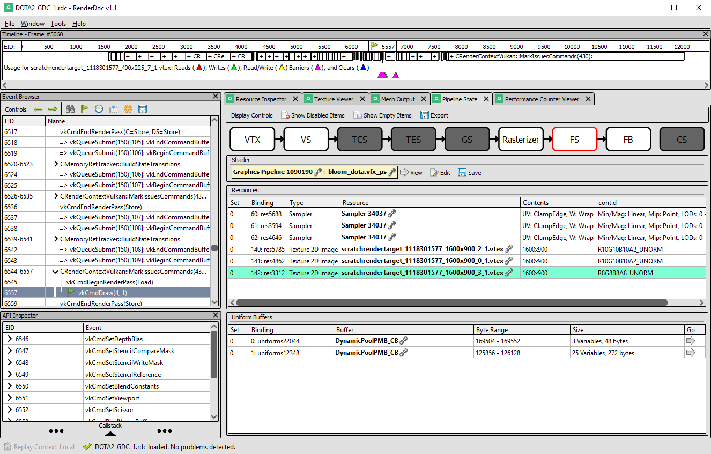
RENDERDOC RGP INTEROP
The same event is selected in RenderDoc

Slide 57
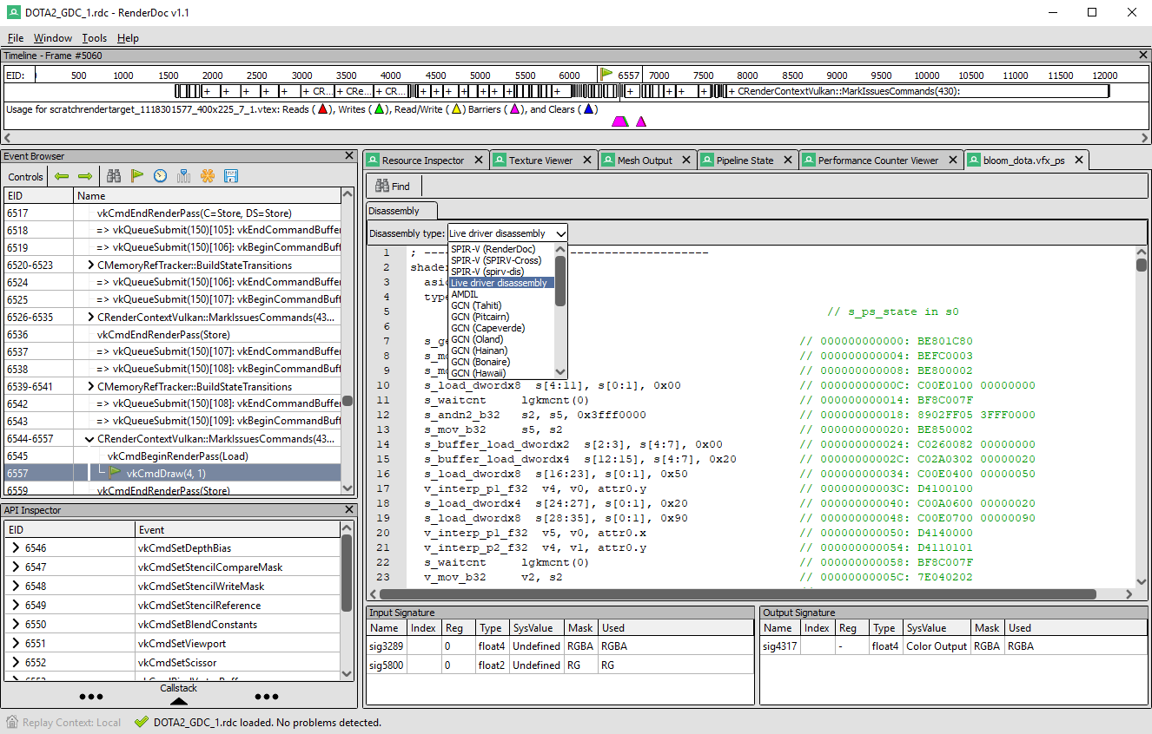
RENDERDOC RGP INTEROP
View shader code and disassembly using AMD’s shader analyzer plugin

Slide 58
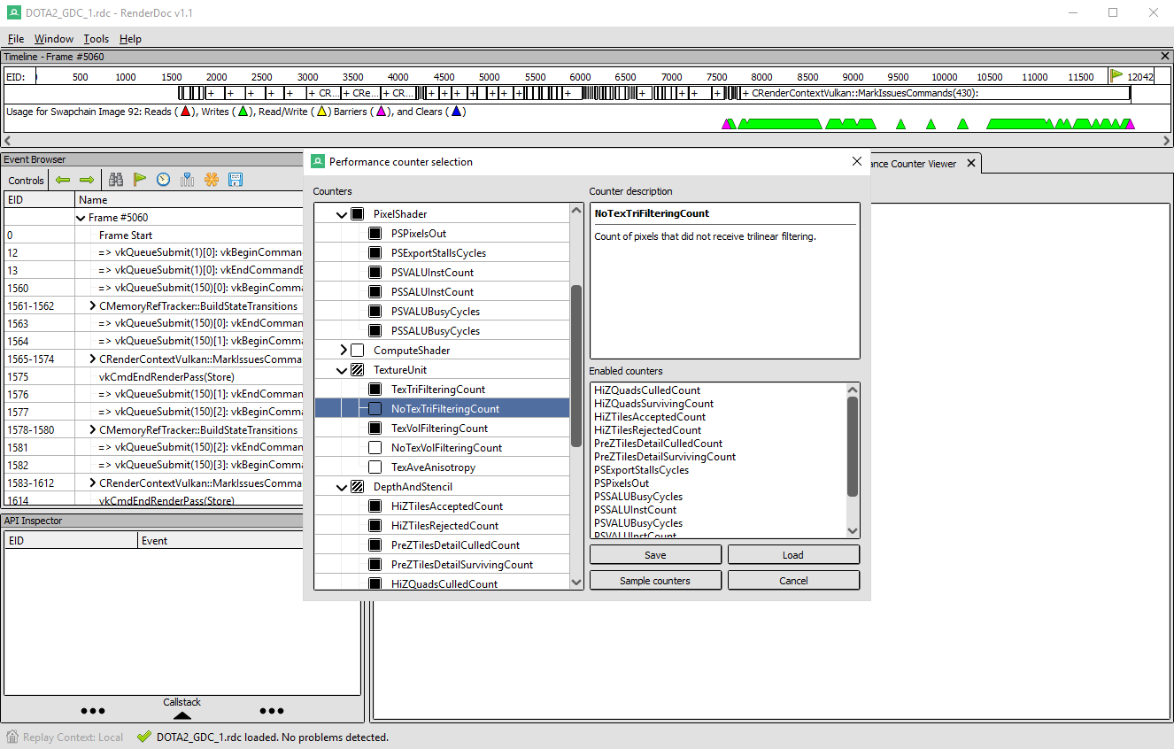
RENDERDOC RGP INTEROP
AMD’s GPUPerfAPI counters are now integrated into RenderDoc

Slide 59
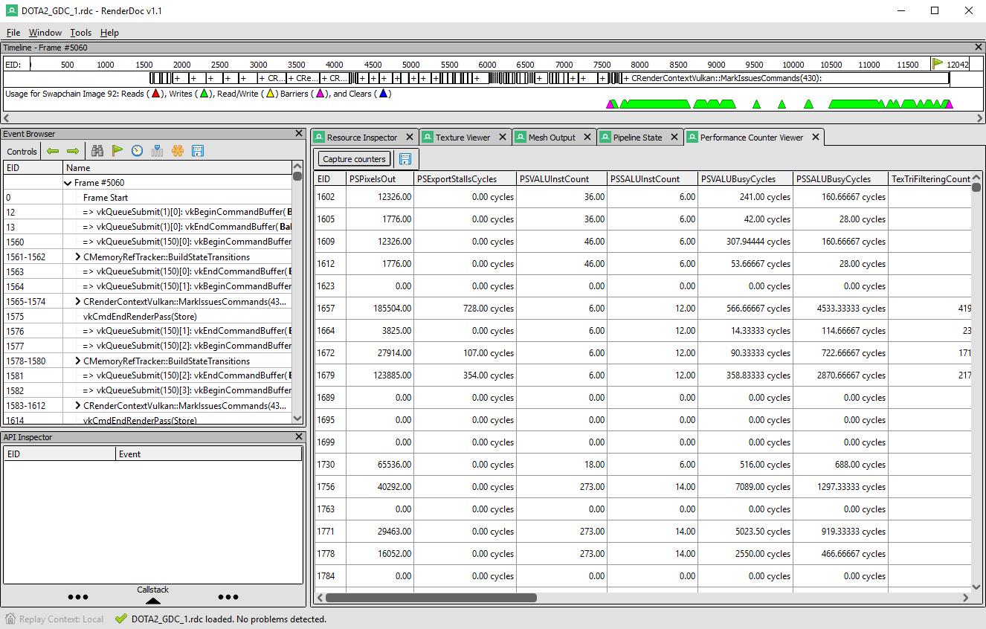
RENDERDOC RGP INTEROP
View counter results

Slide 60
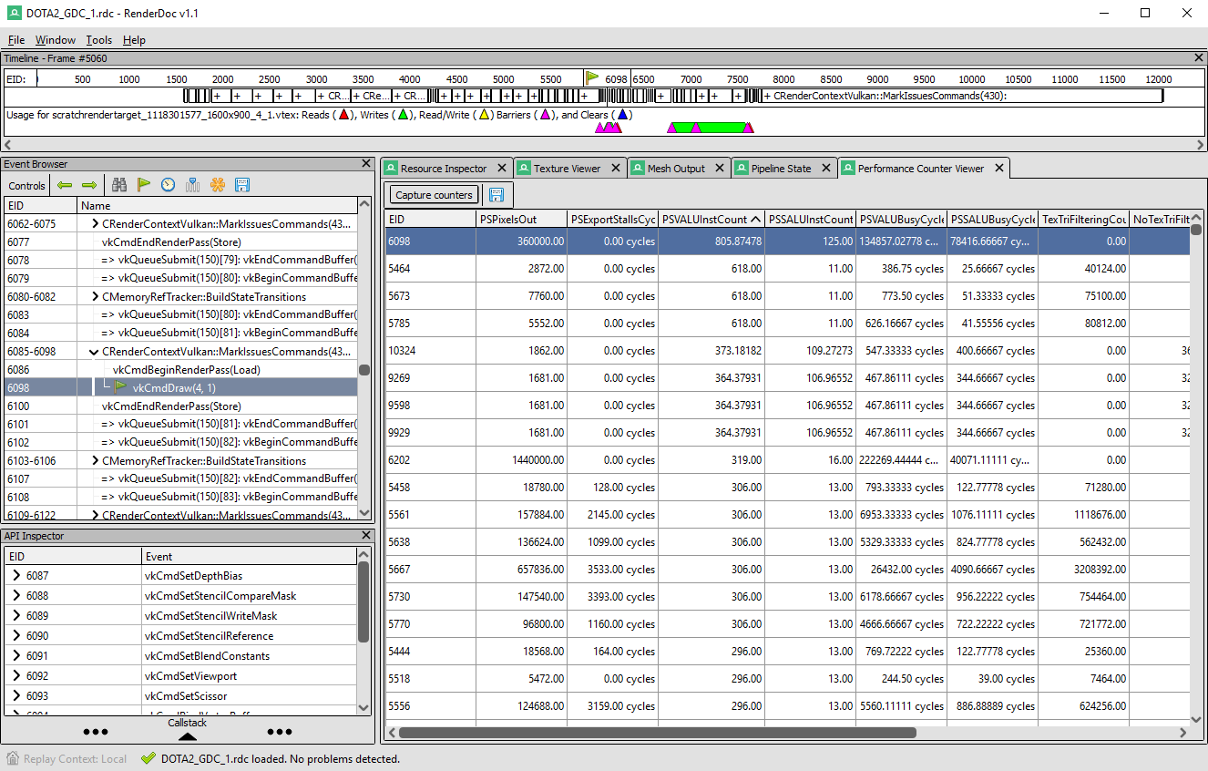
RENDERDOC RGP INTEROP
Select event of interest

Slide 61
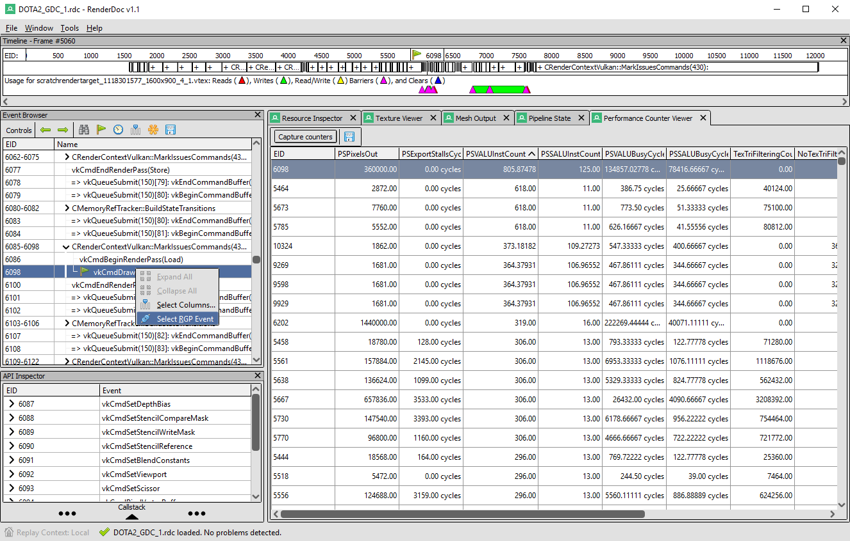
RENDERDOC RGP INTEROP
View selected event in RGP

Slide 62
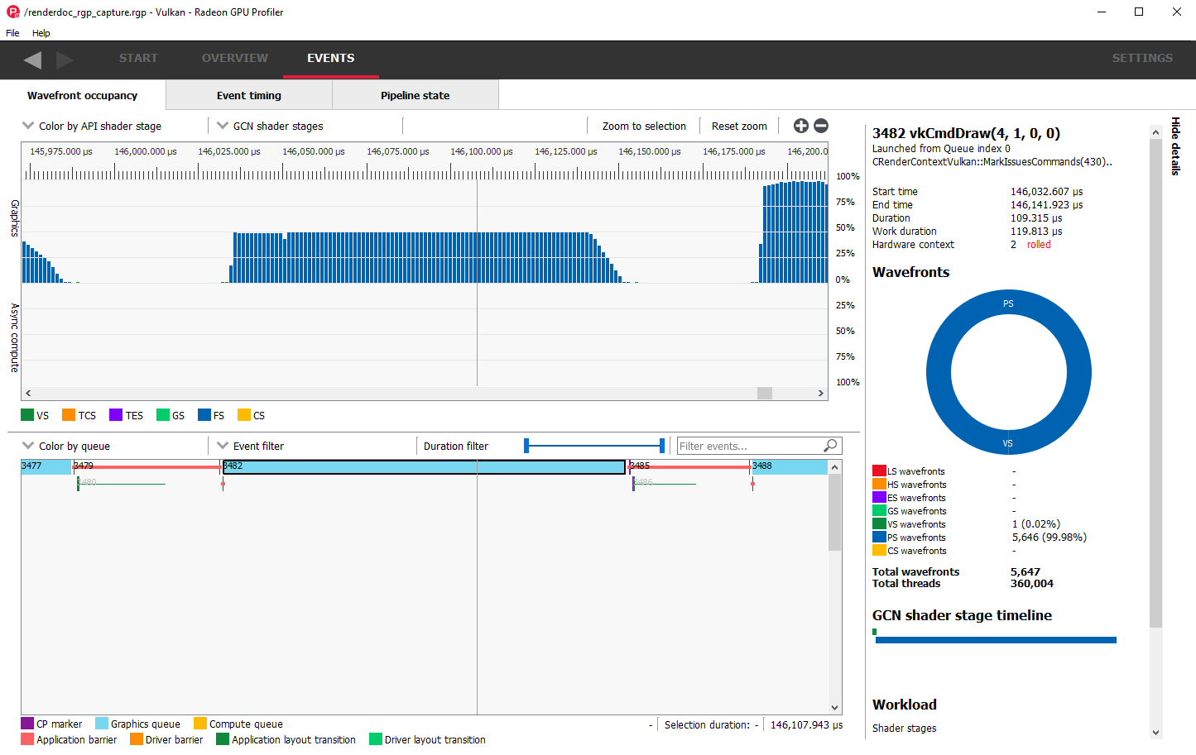
RENDERDOC RGP INTEROP
Event is selected in RGP

Slide 63
RENDERDOC RGP INTEROP
Release
Will be released with RGP 1.2
Information
https://github.com/baldurk/renderdoc
https://gpuopen.com/gaming-product/radeon-gpu-profiler-rgp/
Download RGP
Download: https://github.com/GPUOpen-Tools/Radeon-GPUProfiler/releases

Slide 64
Compressonator
Navin Patel

Slide 65
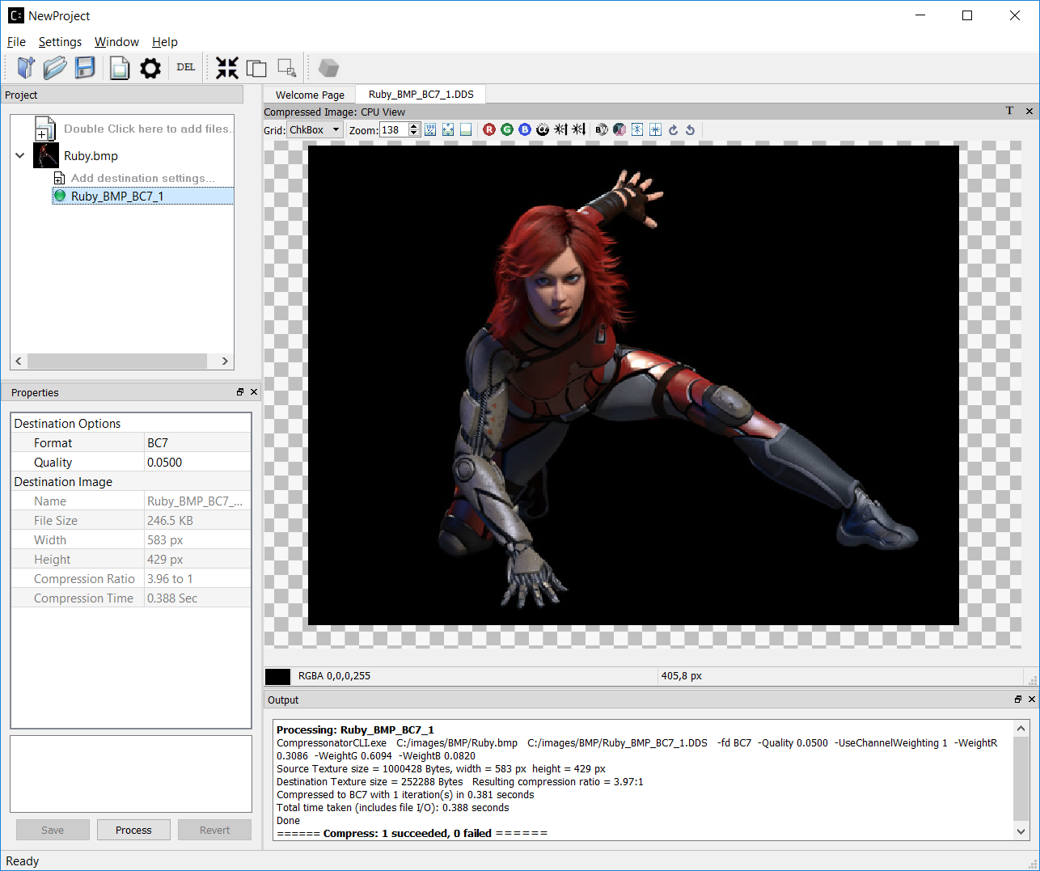
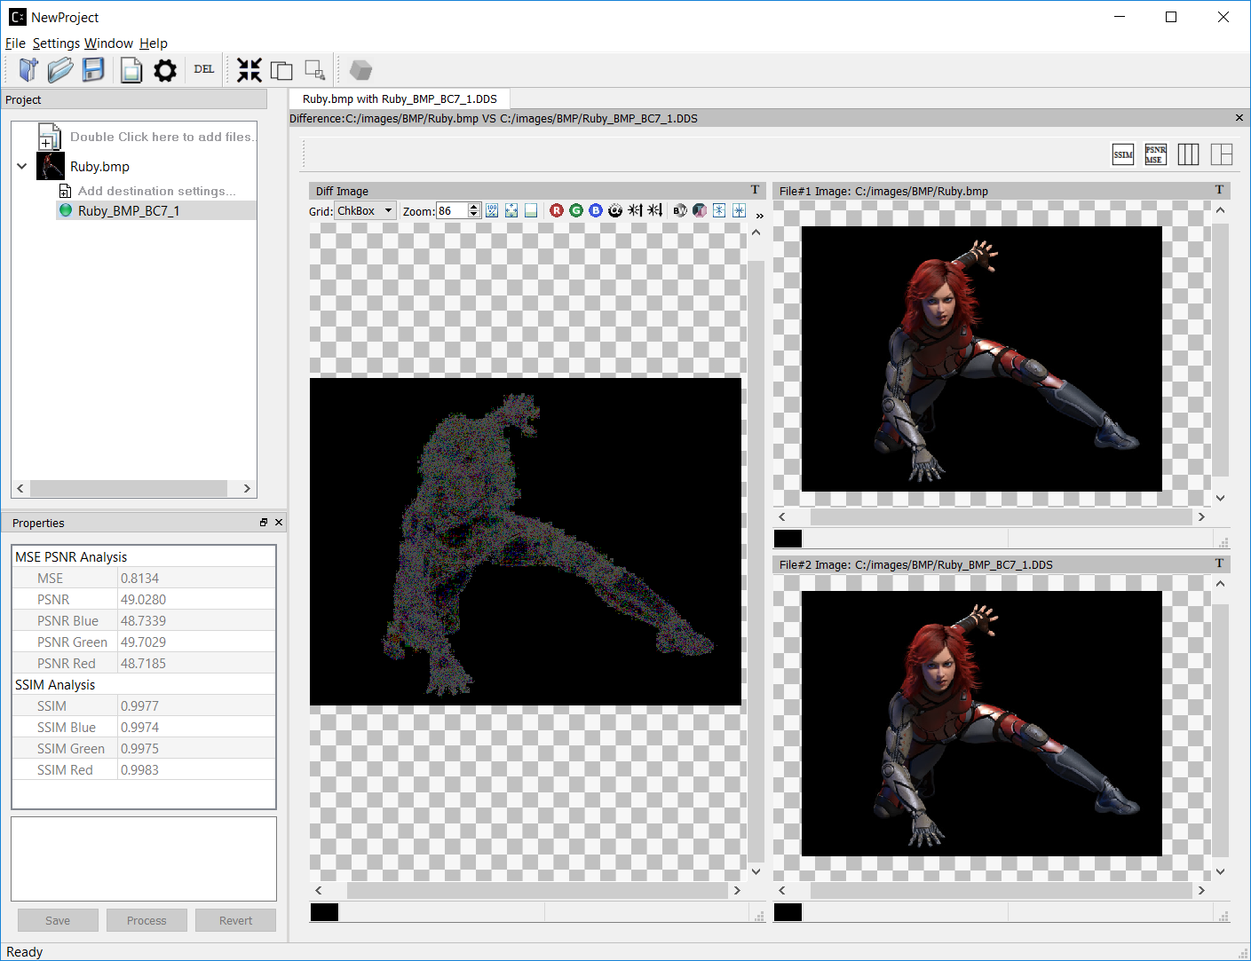
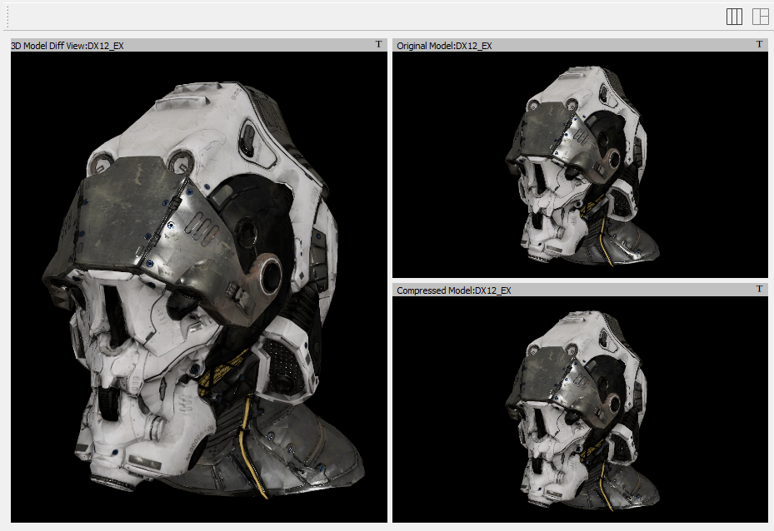
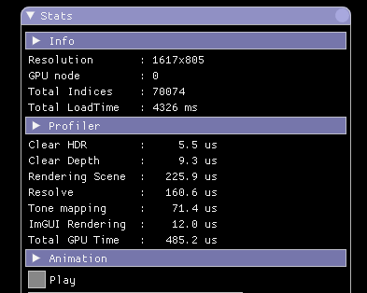
COMPRESSONATOR V3.0
Comprehensive tool for generating compressed 2D Textures and 3D Models
Leader in number of supported Codecs for 2D and 3D Assets
Considerable quality & performance advantages over other compression tools
Realtime 3D Model and 2D Image Analysis Features
.obj
.gltf
.drc
.bmp
.png
.dds
.tga
.hdr
.ppm
.crn
.tif
.jpg
.ktx
.exr
.pgm
.astc
…
BC1- BC7
ETC - ETC2
ASTC
ATC
Compressonator SDK is open sourced

Slide 66
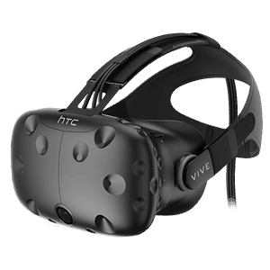
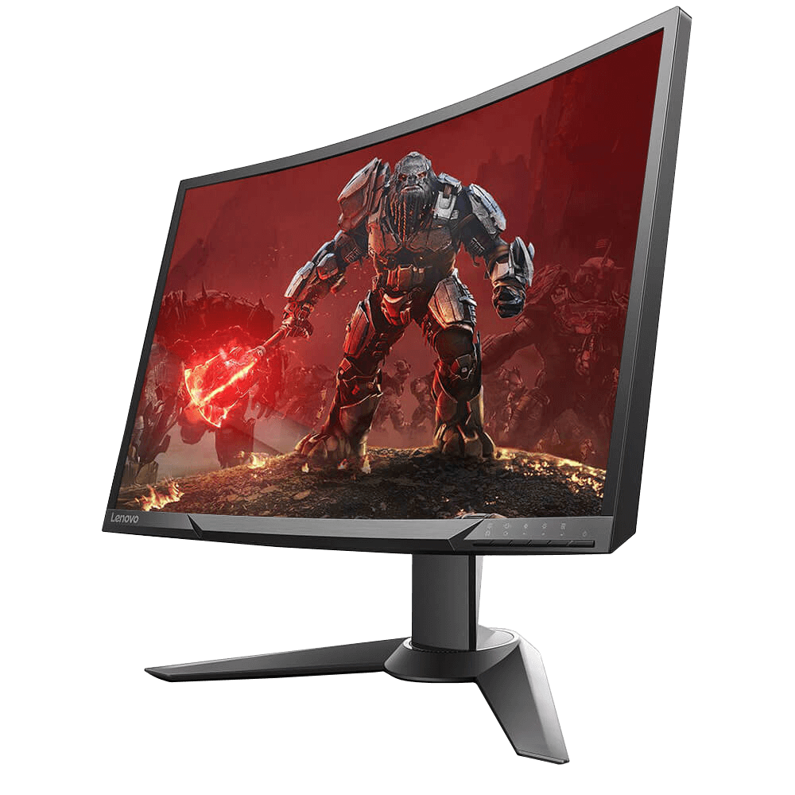
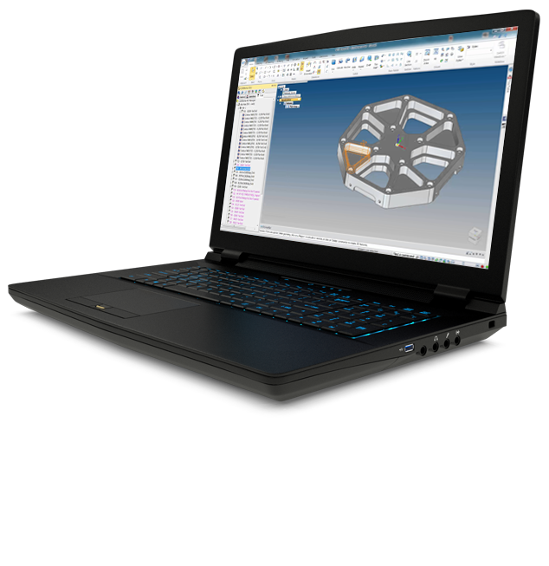
COMPRESSONATOR V3.0
The Compressonator Process
Compressonator apps and SDK Libs can be used for (1) (2) and (3)
Meshes
2. Optimization
Compressonator mesh decoder is used in Application
Textures
1. Compression
Storage
Application
3. Compression
Hard Drive
Cloud

Slide 67
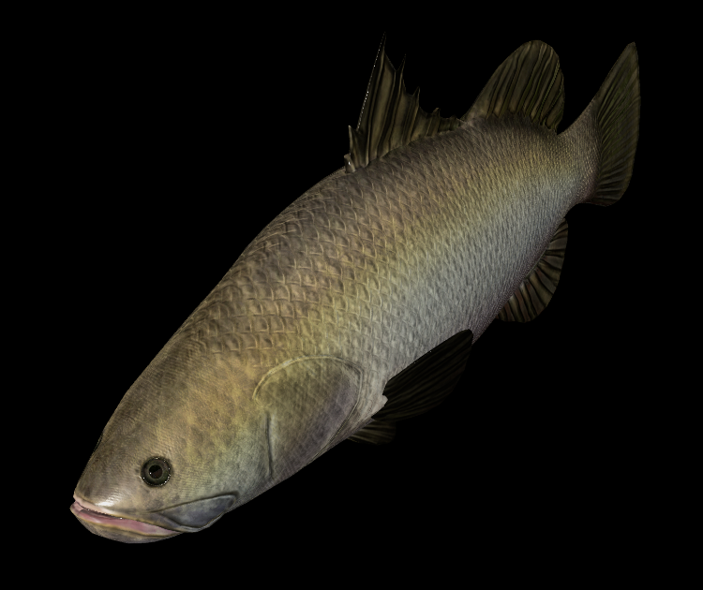
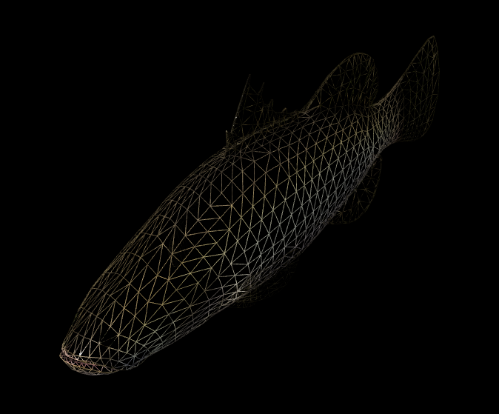
SAMPLE BENEFITS OF Compressonator gltf model
TEXTURE COMPRESSION
4x file size reduction using BC7
High Quality, 99% similar to original
Textures
Original bin file size
125 KB
2D
Compressed bin file size
21.8 KB
3D
Mesh Primitives
ORIGINAL MODEL
MESH OPTIMIZATION
Triangles reordering
FINAL MODEL
MESH COMPRESSION
5.7x file size reduction using Draco

Slide 68
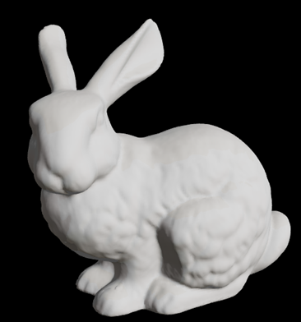
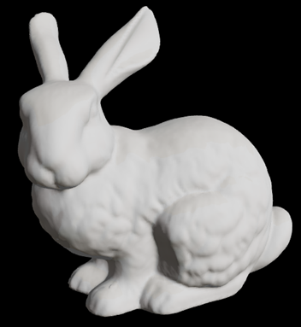
SAMPLE BENEFITS OF Compressonator - OBJ model
Bunny.obj (208890 indices)
MESH OPTIMIZATION
15% improvement
MESH COMPRESSION
42x file size reduction
Original file size
4745 KB
Compressed file size
114 KB
ORIGINAL MODEL
FINAL MODEL
GPU Render time 0.376 ms
GPU Render time 0.327 ms
Rendering time is based on AMD Radeon R9 290X & AMD FX-8350 8-core Processor
Notes:
2D Asset Compression
Model Textures can be compressed using a choice of any ETCn, BCn or ASTC Codecs
3D Model Optimization
Loading of vertices onto the GPU can be optimized for performance based on the size of the vertex caches which provides better frame rates. Vertices are reordered for faster uploads and none viewable redundancies are removed.
3D Geometric Mesh and Point Cloud Data Compression
While maintaining visual acuity, model data attributes are compressed using various quantization techniques and then saved into a binary format using lossless compression.
With a combination of a fast decoder, applications can now transmit data faster for rendering within a faction of the original bandwidth. Highly suitable for VR and AR based applications.

Slide 69
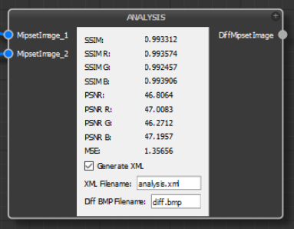
COMPRESSONATOR V3.0
- ArchitectMF
New programming application uses Compressonator codecs for modelling algorithms
SDK contains ready to use models
Links represent data flow between models
Model nodes represent plugin dynamic libraries of specific functions
Analysis
Image & Buffer Viewers
Transforms
Wavelet, LZ.., Huffman, BCn, ETCn, …
Code can be developed quickly and shared via json project file
Notes:
Support command line execution
Model UI using Qt
Model Property Editor
Dynamic Scripting Engine runs models in (Java Script, LUA, etc. …)
JIT Compile models (dynamic translation)
Dynamically use any text editor for JIT Model code

Slide 70
Microsoft PIX for Windows
Herb Marselas

Slide 71
Microsoft PIX for Windows
GPU Performance counters and Usage
Performance tuning and debugging for Windows® 10 + DirectX® 12 developers
Event list counters for Radeon Vega, Radeon RX, Intel Radeon Vega M
Dr. PIX AMD GPU cache and memory bandwidth analysis data
AMD GPU usage warnings and guidance

Slide 72
GPU Performance API (GPA) 3.0
GPA 3.0
GPA 3.0 Released March 19th
https://github.com/GPUOpen-Tools/GPA/
New Features
GPU counter support for Vulkan ™ and DirectX® 12 (plus OpenGL and DirectX® 11)
Multi-threading for Vulkan ™ and DirectX® 12
Bundles (DirectX® 12) and secondary command buffers (Vulkan ™)
Improved usability
New documentation (Sphinx)
New counters
Added cycle-based counters, Depth Buffer mem read/write counters, Color Buffer mem read/write counters. CS-specific memory counters are now generic.

Slide 73
Radeon gpu analyzer (Rga)
OFFLINE Compiler & Shader Code Analysis TOOL
Features
Command-line, Windows & Linux
GLSL, SPIR-V, OpenCL™, DirectX 11®, OpenGL, DirectX Bytecode, AMDIL
GCN ISA disassembly, IL disassembly
Evaluate the impact of different compilers and compiler settings
Inspect HW resource usage
VGPR and SGPR usage, LDS allocation, etc.
Static analysis of GCN ISA
Live VGPR analysis, CFG generation
Integrated into tools like RenderDoc and Pyramid
RGA 2.0 GUI for OpenCL
Now on GPUOpen github.com
Coming Soon!
GUI’s for other APIs

Slide 74
Disclaimer & Attribution
The information presented in this document is for informational purposes only and may contain technical inaccuracies, omissions and typographical errors.
The information contained herein is subject to change and may be rendered inaccurate for many reasons, including but not limited to product and roadmap changes, component and motherboard version changes, new model and/or product releases, product differences between differing manufacturers, software changes, BIOS flashes, firmware upgrades, or the like. AMD assumes no obligation to update or otherwise correct or revise this information. However, AMD reserves the right to revise this information and to make changes from time to time to the content hereof without obligation of AMD to notify any person of such revisions or changes.
AMD MAKES NO REPRESENTATIONS OR WARRANTIES WITH RESPECT TO THE CONTENTS HEREOF AND ASSUMES NO RESPONSIBILITY FOR ANY INACCURACIES, ERRORS OR OMISSIONS THAT MAY APPEAR IN THIS INFORMATION.
AMD SPECIFICALLY DISCLAIMS ANY IMPLIED WARRANTIES OF MERCHANTABILITY OR FITNESS FOR ANY PARTICULAR PURPOSE. IN NO EVENT WILL AMD BE LIABLE TO ANY PERSON FOR ANY DIRECT, INDIRECT, SPECIAL OR OTHER CONSEQUENTIAL DAMAGES ARISING FROM THE USE OF ANY INFORMATION CONTAINED HEREIN, EVEN IF AMD IS EXPRESSLY ADVISED OF THE POSSIBILITY OF SUCH DAMAGES.
ATTRIBUTION
© 2018 Advanced Micro Devices, Inc. All rights reserved. AMD, the AMD Arrow logo and combinations thereof are trademarks of Advanced Micro Devices, Inc. in the United States and/or other jurisdictions. Other names are for informational purposes only and may be trademarks of their respective owners.

