Slide 1

New Techniques for Accurate Real-Time Reflections
Maksim Aizenshtein
3DMark Team Lead

Slide 2
Intro
We were introduced to Ray Tracing API few months ago and started to think about applications
Not very hard really, because it’s so common in the movie industry
But we wanted to have something that can be realistically implemented for current or next gen GPUs
And still, wanted to solve a real problem
Notes:
We didn’t want to convert all our rendering pipeline into ray tracing based one, but instead fill the gaps

Slide 3
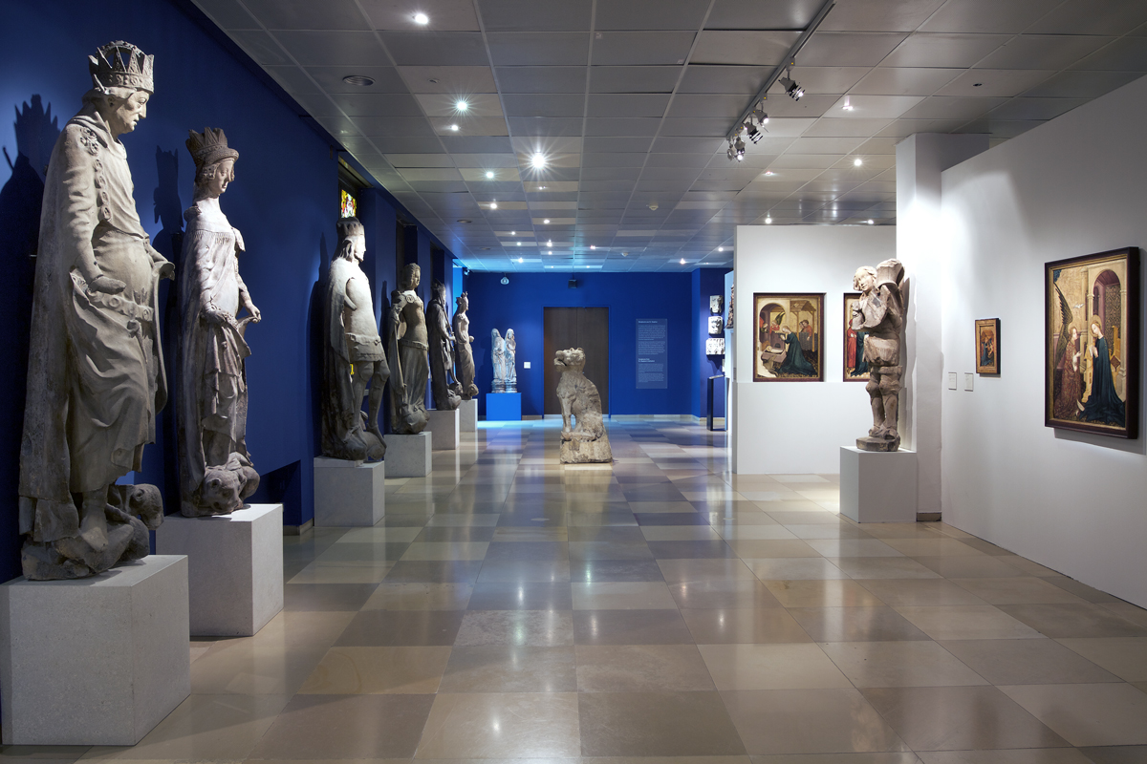
Notes:
SSR can handle this

Slide 4

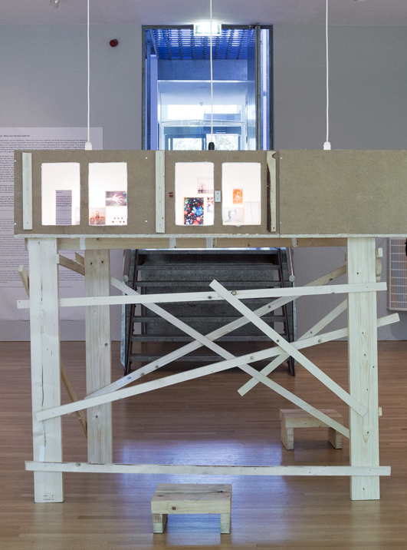
Notes:
These two have particularly tricky problems for SSR based methods because of both, taking information not on screen and tracing through geometry on screen to get there

Slide 5
Reflections
What do we want as game developers?
  Fast
  Robust
  Stable
  Complete (meaning can reflect things outside the viewport)
Notes:
Fast is relative, but we’re talking about things that run real-time at normal resolutions

Slide 6
 | Fast | Robust | Stable
Planar | ☺ | ☹ | ☺
SSR | ☺☺ | ☹ | 😐
Proxy spheres | ☺☺☺ | ☹ | ☺
Proxy cubes | ☺☺☺ | ☹~😐 | ☺
Single sample ray traced reflections | 😐 | 😐 | ☹
Multi sampled ray traced reflections | ☹☹☹☹ | ☺☺ | ☺
Notes:
Planar can reflect only for the selected plane. No real way of doing glossy reflections.
SSR has access only to things on the screen, while reflections are GI. So it can handle only the simple cases of tracing rays.
Intersecting rays against proxy geometry works well only when the reflected surfaces is near the proxy geometry, otherwise correctness is lost.
Single sampled ray traced reflections biggest issue is the inability to handle rough surfaces correctly.
Multi sampled ray traced reflections are not really practical due to their high cost.

Slide 7
What we’re showing today
How we used DirectX Ray Tracing to improve existing reflection techniques
  Supported on current hardware
  Real-time
  Perspective-correct reflections

Slide 8
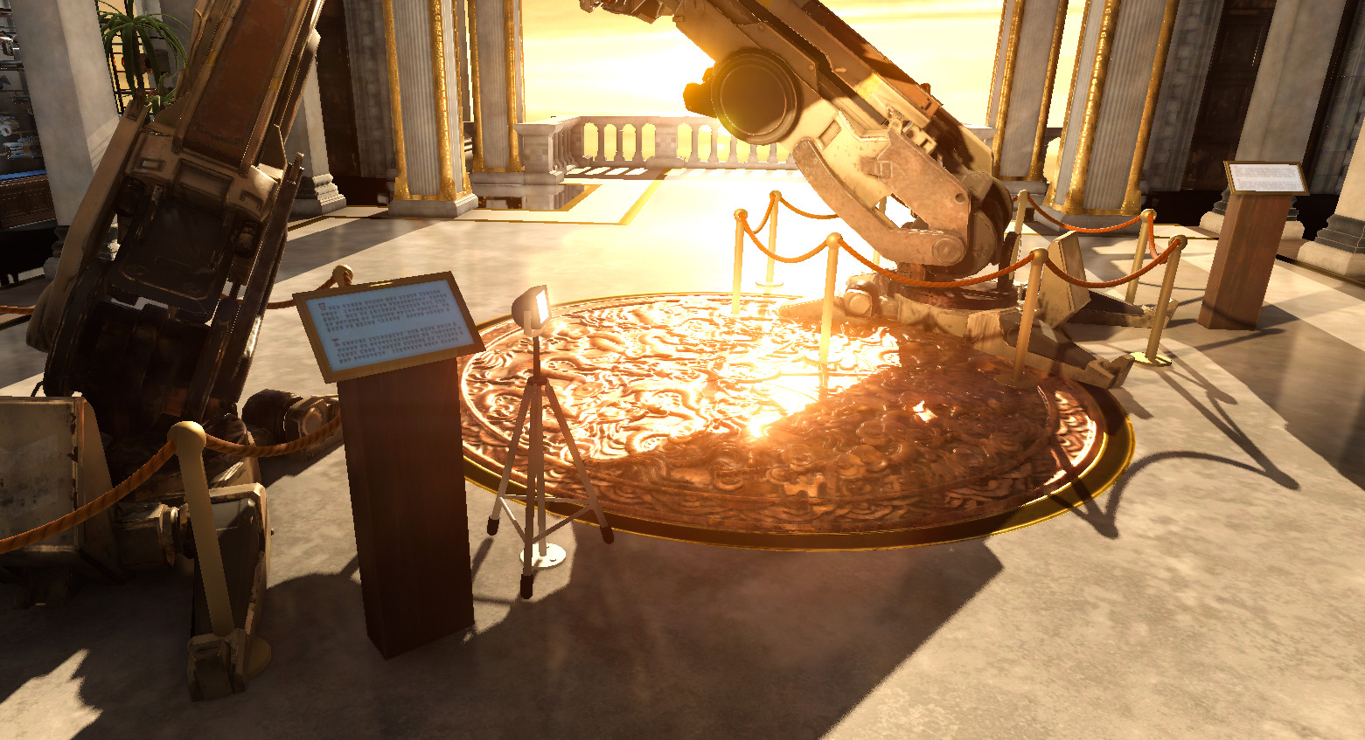
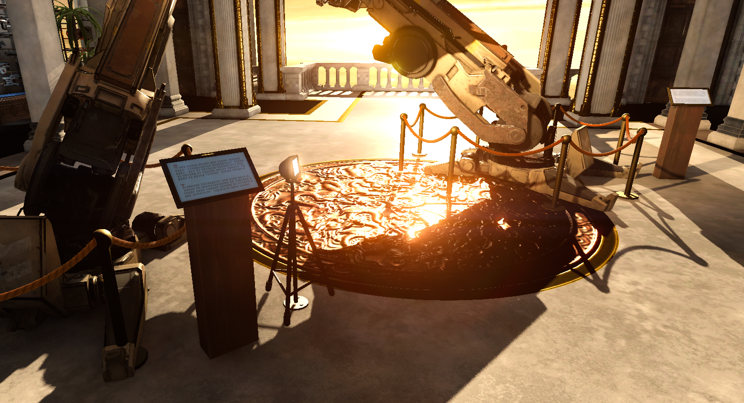
Reflections are not only for mirrors
Notes:
It makes metals more look more realistic
Also polished floors

Slide 9
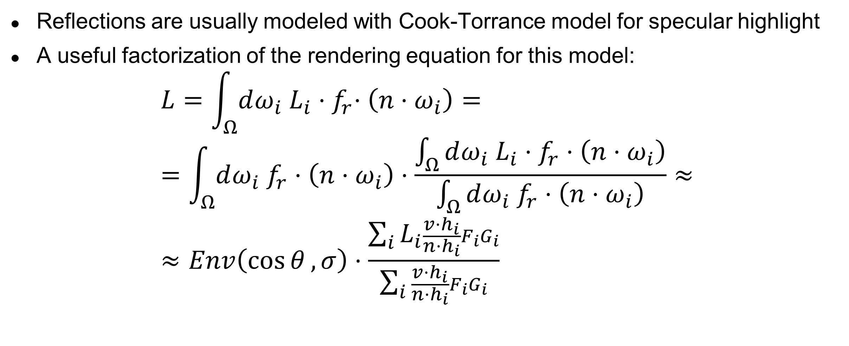
Rendering equation factorization
Reflections are usually modeled with Cook-Torrance model for specular highlight
A useful factorization of the rendering equation for this model:
$$L=\int_{Ω}{dω_{i} L_{i}{⋅f}_{r}⋅\left(n⋅ω_{i}\right)}= \\ =\int_{Ω}{dω_{i} f_{r}⋅\left(n⋅ω_{i}\right)}⋅\frac{\int_{Ω}{dω_{i} L_{i}⋅f_{r}⋅\left(n⋅ω_{i}\right)}}{\int_{Ω}{dω_{i} f_{r}⋅\left(n⋅ω_{i}\right)}}≈ \\ ≈Env\left(\cos{θ},σ\right)⋅\frac{\sum_{i}{L_{i}\frac{v⋅h_{i}}{n⋅h_{i}}F_{i}G_{i}}}{\sum_{i}{\frac{v⋅h_{i}}{n⋅h_{i}}F_{i}G_{i}}}$$
This is hard!
Supersampling
Notes:
$L_{i}$ is the incoming radiance and $f_{r}$ is the reflectance
For reflections, $L_{i}$ will be the incoming radiance from other objects rather than light sources
For sharp reflections $f_{r}$ will be with a strong and narrow peak
This is a fairly straightforward and well known factorization of the rendering equation.
On the left we’re left with $Env$ which is an approximation (fit or texture) to the integral on the left.
On the right is the importance sampling Monte Carlo integration of the fraction with samples taken from $D⋅\left(n⋅h\right)$.
Note that distribution normalization cancels out, so it’s ok to sample from clamped distribution without any modifications.
Slide in the back deck explains some missing math.

Slide 10
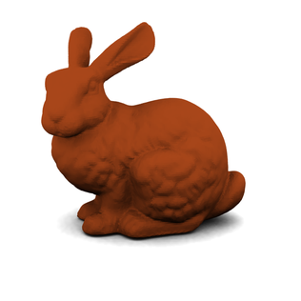

So what can we do?
If only we had a way to know that many $L_{i}$…
Maybe some other pixel already calculated it?

Slide 11
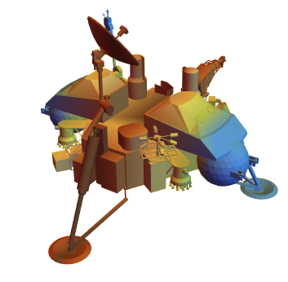

Pre-calculating reflection data
Pick a point and render around it
Notes:
Pick a point and render a cube map around it.
Other than separate resolution doesn’t seem like a huge win, but…

Slide 12
Sampling in cones
Now the benefit is more obvious, as we’re just resampling
Notes:
But really we need to sample the entire cones!

Slide 13
Why cube maps?
Integrates pretty well with available visibility culling solutions
Straightforward use of rendering hardware
No need to have highly tessellated geometry
But other forms are interesting too:
  Octahedron maps, tightly packed and can be sampled very efficiently
  Sphere mapping in stereographic coordinates
  Paraboloid mapping

Slide 14
Difficulties with environment shots
Intersection point
Mip level selection
Different background
Light data structure
Specular highlights
Missing information
TAA
BRDF for secondary reflections
Particles and volumetric effects

Slide 15
Intersection point
Notes:
How we can find the correct direction in the cube shot?

Slide 16
Intersection point
Can be easily identified with predefined bounding geometry
  For instance in case of box shaped room
  Or for bounding sphere around the point of capture
Tracing rays in environment shot texture space [McGuire]
  But requires re-rendering environment shots that are only passed through as well (not just the ones that are visible)

Slide 17
Intersection point
Or can use Ray Tracing pipeline to find intersections and later sample the environment shots
  Store the ray length for intersection in case of single reflection
  Further bounces can be handled by storing world position, or by approximations
Can do ray tracing on compute queue while relevant environment shots are re-rendered on direct queue
Glossy reflections require multiple samples

Slide 18
Pipeline overview
GBuffer
Shadow maps
Sample cubes

Slide 19
Pipeline overview
GBuffer
Cube depths
Shadow maps
Cube illumination
Sample cubes
Filter
Notes:
Adding dynamic update

Slide 20
Pipeline overview
GBuffer
Cube depths
Shadow maps
Cube illumination
Sample cubes
Filter
Ray tracing
Generate hole mask
Fill holes
Notes:
Adding ray tracing

Slide 21
Pipeline overview
GBuffer
Cube depths
Shadow maps
Cube illumination
Sample cubes
Filter
Ray tracing
Generate hole mask
Fill holes
Where is light culling?

Slide 22
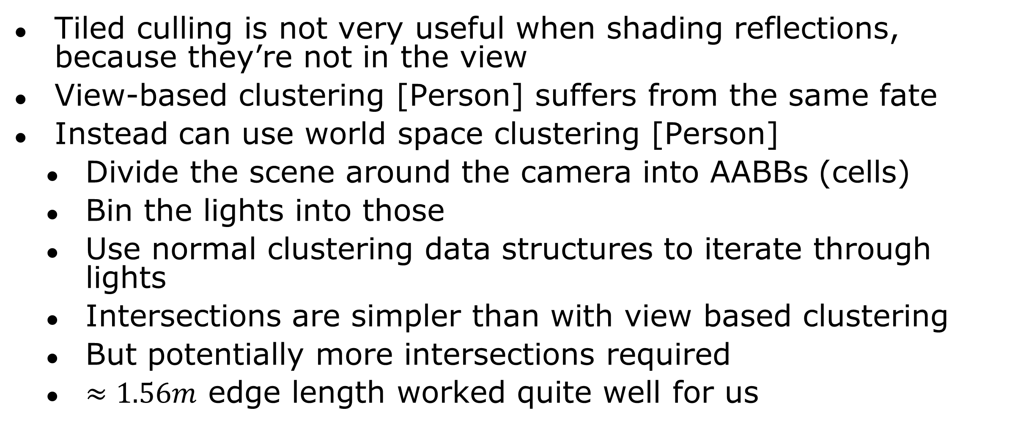
How to iterate through lights
Tiled culling is not very useful when shading reflections, because they’re not in the view
View-based clustering [Person] suffers from the same fate
Instead can use world space clustering [Person]
  Divide the scene around the camera into AABBs (cells)
  Bin the lights into those
  Use normal clustering data structures to iterate through lights
  Intersections are simpler than with view based clustering
  But potentially more intersections required
  $≈1.56m$ edge length worked quite well for us

Slide 23
Mip level selection
Notes:
The sampling solid angle is different

Slide 24
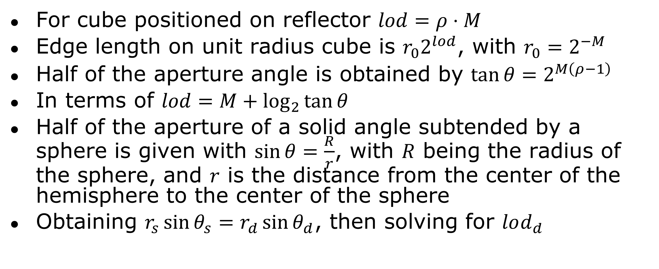
Mip selection math
For cube positioned on reflector $lod=ρ⋅M$
Edge length on unit radius cube is $r_{0}2^{lod}$, with $r_{0}=2^{−M}$
Half of the aperture angle is obtained by $\tan{θ}=2^{M\left(ρ−1\right)}$
In terms of $lod=M+\log_{2}{\tan{θ}}$
Half of the aperture of a solid angle subtended by a sphere is given with $\sin{θ}=\frac{R}{r}$, with $R$ being the radius of the sphere, and $r$ is the distance from the center of the hemisphere to the center of the sphere
Obtaining $r_{s}\sin{θ_{s}}=r_{d}\sin{θ_{d}}$, then solving for $lod_{d}$

Slide 25
Mip selection
Works correctly for high res mips
But going too high doesn’t always work because it starts gathering information from background which is not always correct

Slide 26
Improving glossy reflections
When sampling cubes, the reflected ray is re-casted to nearby points on the plane at the sample point
If it’s a miss can intersect with a new plane at the missed point
Notes:
Cube render outputs normal as well

Slide 27
Second intersection
Notes:
Cube render outputs normal as well

Slide 28
Very rough reflections
This is actually easy, just sample the cube in the old way

Slide 29
Specular highlights
Notes:
Different directions cause different specular highlights

Slide 30
Specular highlights
When illuminating the cubes some components depend on the view
The straightforward solution would be to store some SH coefficients for the radiance
  Costly
Alternatively, can make all cube-shots produce the same incorrect result
  Make all cube-shots agree on one view position for illumination purposes
  It’s consistent, and that’s what counts
  Can be made somewhat correct when there’s one main reflector

Slide 31
Missing information
Notes:
Teapot blocking the view

Slide 32
Filling missing information
The straightforward solution is to reshade with full Ray-Tracing approach
  Problems are: noise, glossy reflections
Cube-shots can be repositioned
  Should gravitate towards reflectors
In-painting algorithms
  Very good for closing smaller size holes, but ultimately unpredictable
  Temporal stability is an issue
Machine learning approach
  Can train for targeted scenes. Training set is simple to obtain.
  Temporal stability is an issue
Can just sample the cube in the direction, even if incorrect
  Will be visible for large holes

Slide 33
TAA
For static objects just reflect velocity
Dynamic objects can write out world space velocity
Can also be calculated during ray tracing, but requires some data fetching

Slide 34
BRDF for secondary reflections
Notes:
The color changes due to reflection from the teapot

Slide 35
Second and further bounces
Sharp multi-bounce reflections are best handled by the ray tracing pipeline
For cube sampling intersection position needs to be stored in world space coordinates
And BRDF information needs to be accumulated (multiplied)
Alternatively, cube render can write out normal
  Normal can be used to find intersection with bounding proxy geometry
  Illumination target can instead store the reflectance for these pixels
  Secondary reflections are harder to verify ☺
  Tertiary reflection will contain whatever we put on the reflectors when rendering the cubes
    Can be illumination from static pre-rendered cubes

Slide 36
Transparent surfaces (windows)
Can be handled relatively easily if there’s a dominant reflective layer
Implementation is based on approximated visibility [Salvi] with ROVs
  Render transparent layers and merge results into approximated visibility, also keep track of closest reflective pixel (dominated by Fresnel term)
  Ray trace from closest reflective pixel
  Render transparent layers with additive blending modulating by visibility function, if depth is equal to the reflective layer then also sample cubes

Slide 37

Volumetric effects
Notes:
No volumetric information is gathered from the cube shot

Slide 38
What to do with particles
The correct solution is to accumulate them when ray tracing, and then blend with the reflection result
  Requires extra proxy geometry for ray tracing
  Maybe even custom intersection shaders
  Need to shade particles and volumetrics in ray tracing
But can also approximate and render them in cubes
  This will work when they’re close to surfaces, but will have defects otherwise

Slide 39
Future work
Hole filling
Improving temporal stability

Slide 40
South Hall, Booth 1827

Slide 41
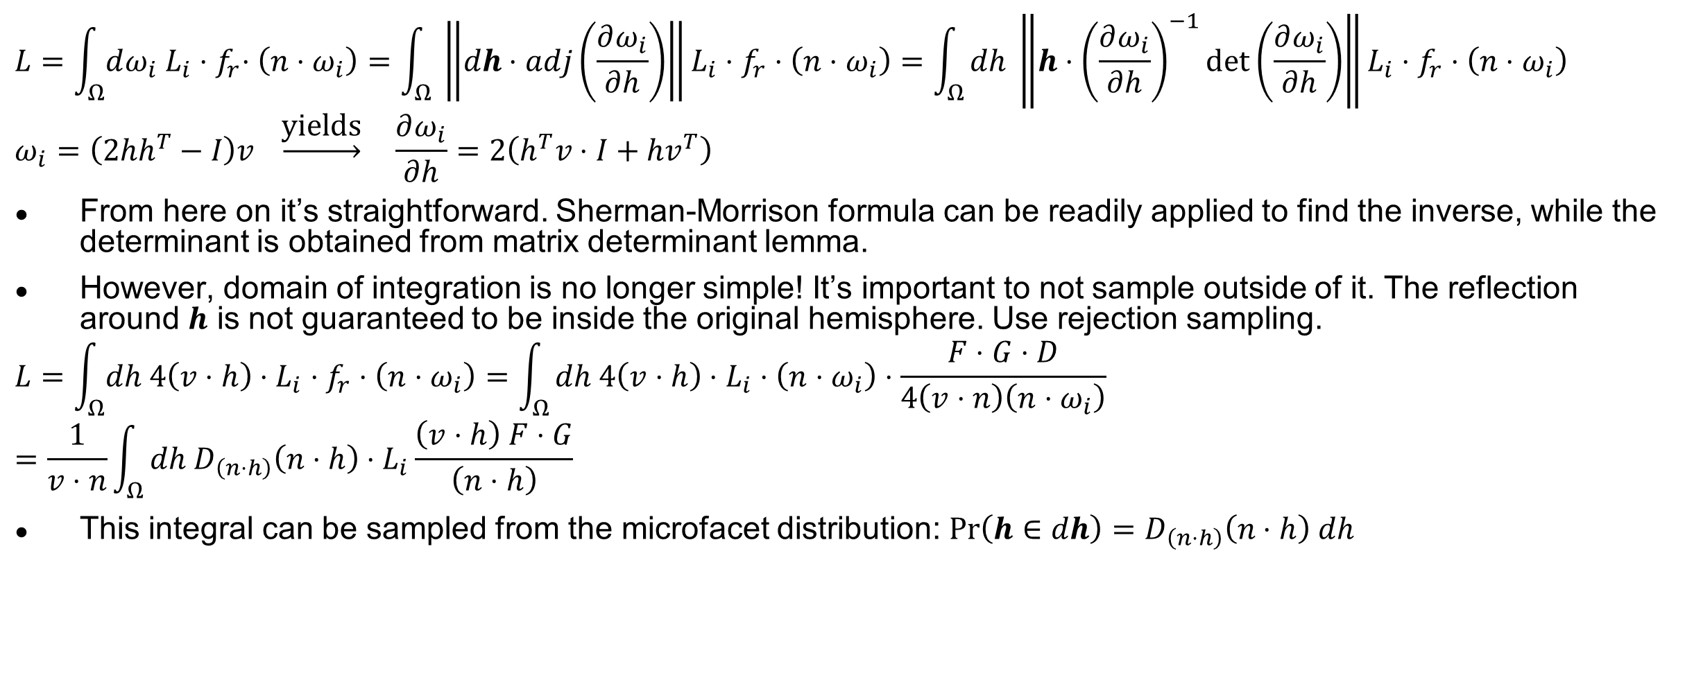
Cook-Torrance importance sampling
$$L=\int_{Ω}{dω_{i} L_{i}{⋅f}_{r}⋅\left(n⋅ω_{i}\right)}=\int_{Ω}{ \left\|dh⋅adj\left(\frac{∂ω_{i}}{∂h}\right)\right\|L_{i}⋅f_{r}⋅\left(n⋅ω_{i}\right)}=\int_{Ω}{dh \left\|h⋅{\left(\frac{∂ω_{i}}{∂h}\right)}^{−1}\det\left(\frac{∂ω_{i}}{∂h}\right)\right\|L_{i}⋅f_{r}⋅\left(n⋅ω_{i}\right)}$$
$$ω_{i}=\left(2hh^{T}−I\right)v \underset{→}{\text{yields}} \frac{∂ω_{i}}{∂h}=2\left(h^{T}v⋅I+hv^{T}\right)$$
From here on it’s straightforward. Sherman-Morrison formula can be readily applied to find the inverse, while the determinant is obtained from matrix determinant lemma.
However, domain of integration is no longer simple! It’s important to not sample outside of it. The reflection around $h$ is not guaranteed to be inside the original hemisphere. Use rejection sampling.
$$L=\int_{Ω}{dh 4\left(v⋅h\right)⋅L_{i}⋅f_{r}⋅\left(n⋅ω_{i}\right)}=\int_{Ω}{dh 4\left(v⋅h\right)⋅L_{i}⋅\left(n⋅ω_{i}\right)⋅\frac{F⋅G⋅D}{4\left(v⋅n\right)\left(n⋅ω_{i}\right)}}=\frac{1}{v⋅n}\int_{Ω}{dh D_{\left(n⋅h\right)}\left(n⋅h\right)⋅L_{i}\frac{\left(v⋅h\right) F⋅G}{\left(n⋅h\right)}}$$
This integral can be sampled from the microfacet distribution: $\operatorname{Pr}\left(h∈dh\right)=D_{\left(n⋅h\right)}\left(n⋅h\right) dh$
Notes:
$h$ is a linear form, because it’s a normal. So it’s treated like row vector.

Slide 42
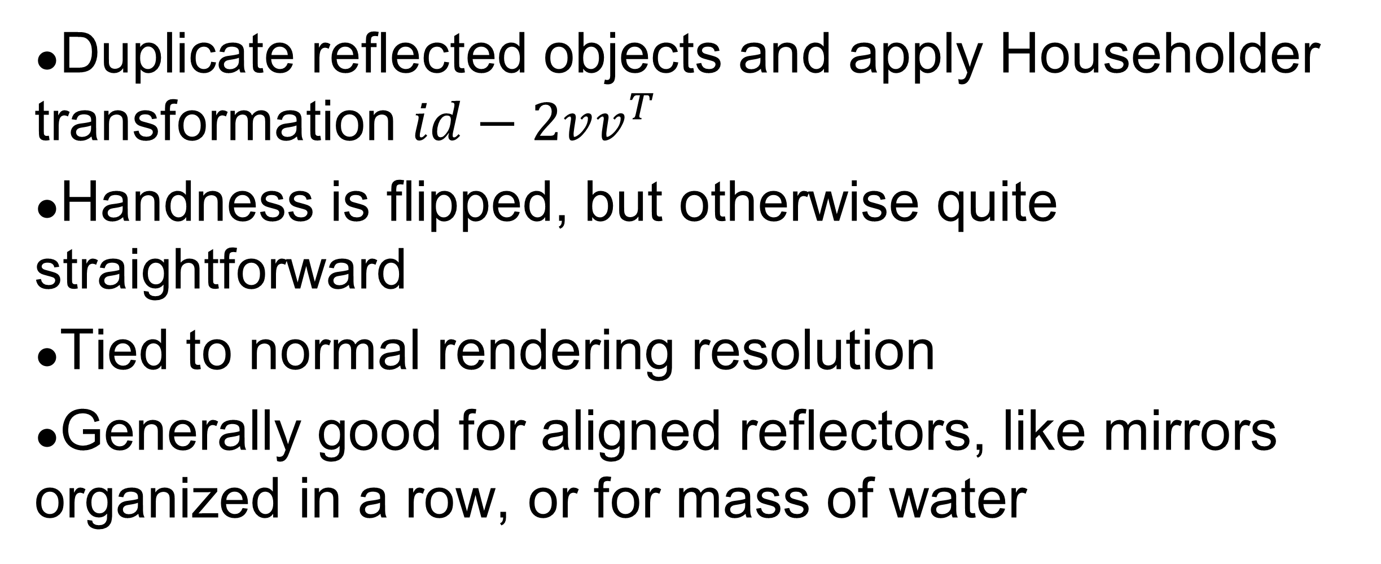
Planar reflections
Duplicate reflected objects and apply Householder transformation $id−2vv^{T}$
Handness is flipped, but otherwise quite straightforward
Tied to normal rendering resolution
Generally good for aligned reflectors, like mirrors organized in a row, or for mass of water

