Slide 1
GPU-based clay simulation and ray-tracing tech in Claybook Sebastian Aaltonen Co-founder of Second Order

Slide 2
Introduction
Sebastian Aaltonen
Ex-Ubisoft senior lead programmer
20 years of 3d programming experience
Second Order
Formed two years ago
Two employees (me and Sami)
We target PC and consoles
Claybook is our first game
@SebAaltonen

Slide 3
Topics
Claybook Overview
Signed Distance Fields (SDF)
Raytracing Signed Distance Fields
Clay and Fluid Simulation
Async Compute
Integration to Unreal Engine 4

Slide 4
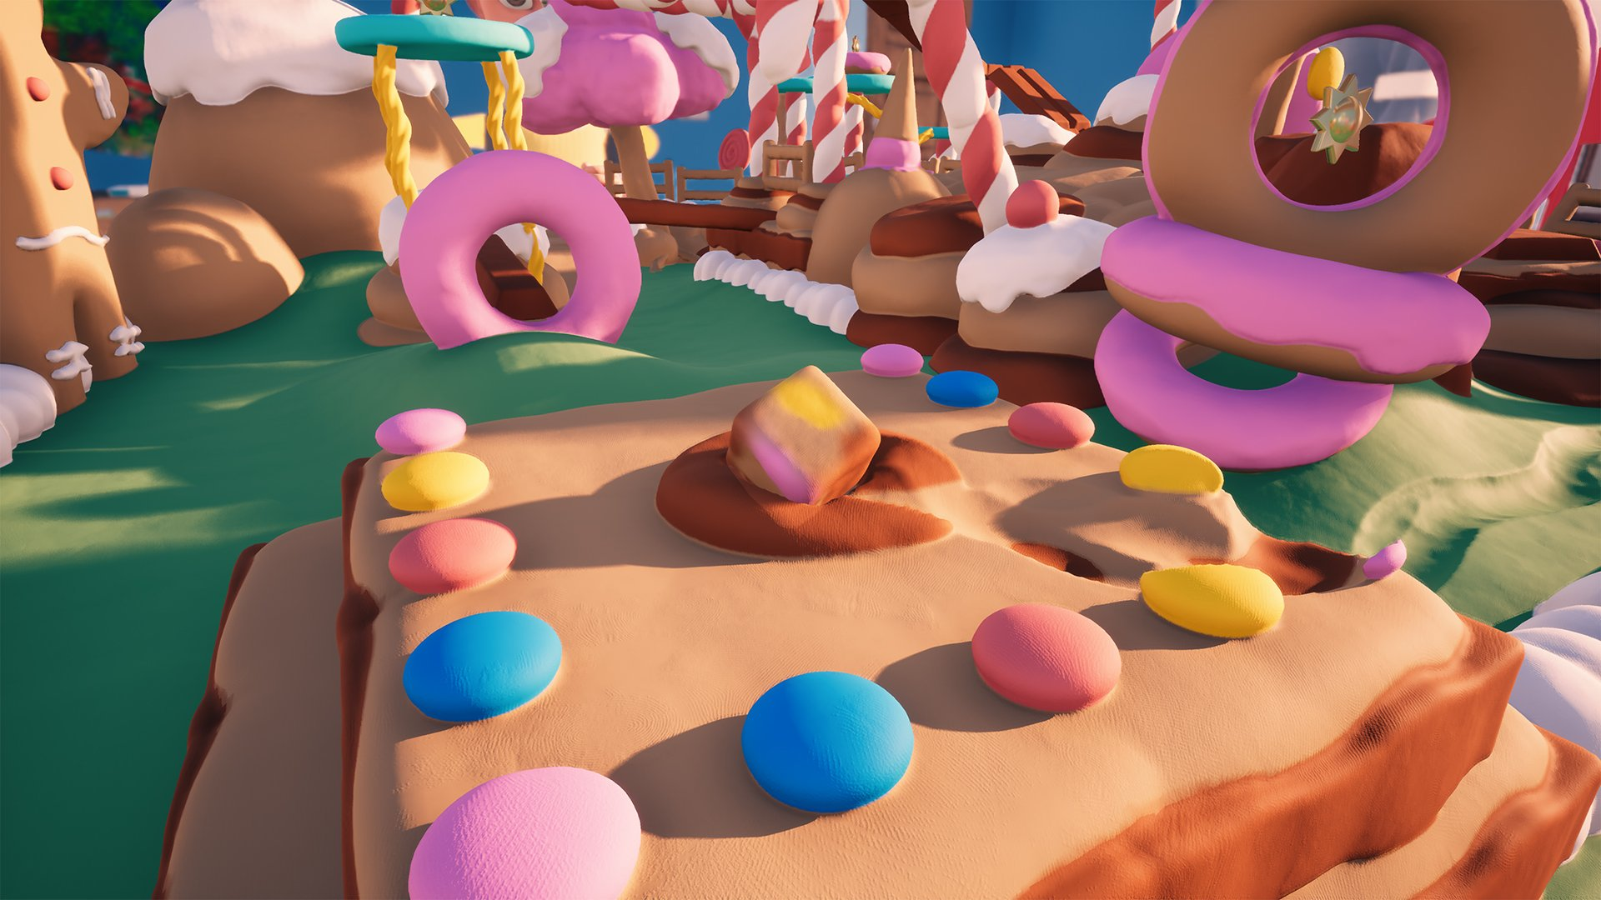
Claybook Overview
Clay simulation game
Fully destructible environment
User generated content
PC (Steam), Xbox One (X) and PS4 (Pro)
Steam Early Access & Xbox Game Preview

Slide 5
Claybook Overview, cont
Clay modeled as signed distance fields (SDF)
Both world and characters are SDF based
Physics & fluid simulation running on GPU
No baked lighting, AO or shadows
Everything must be real time

Slide 6
Claybook Trailer
https://www.youtube.com/watch?v=Q8quiLN7n04

Slide 7
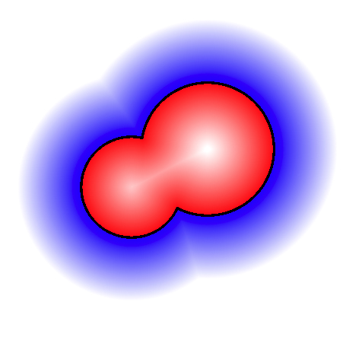
Signed Distance Fields (SDF)
SDF(P) = signed distance to nearest surface at P
Analytic distance functions
Popular in demoscene productions
Huge shader. Lots of math. No data
Volume texture
Store distance function. Trilinear filter
We use volume texture with mip maps

Slide 8
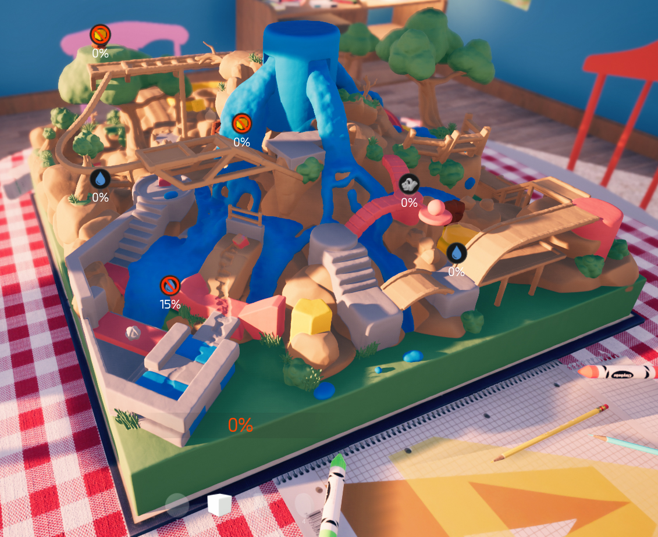
World SDF
Resolution = 1024x1024x512
Format = 8 bit signed
Size = 586 MB (5 mip levels)
Distance of [-4, +4] voxels
256 values / 8 voxels → 1/32 voxel precision
Max step distance (world space) doubled per mip level
Notes:
Separate 512 MB material volume. Out of scope.

Slide 9
SDF Brushes
Brush = Small offline baked volume texture
Resolution [32³, 128³] = [32 kB, 2 MB]
World SDF generated by combining N brushes
Each brush has translation, rotation and uniform scale
Smooth add/cut operations (exponential min/max)
Layering system (operation ordering)
Runtime performance not dependent on brush count

Slide 10
Compute Shader Intro
SPMD = single program, multiple data
My slides are written from perspective of one thread
Unless line starts with: “Group“
Thread groups
Compute dispatches are split to thread groups
Sync barrier + groupshared memory (GSM)

Slide 11
World SDF Generation on GPU
Generate SDF brush grid
Generate dispatch coordinates and mip masks
Generate level 0 in 8x8x8 tiles (sparse)
Generate mips (sparse)

Slide 12
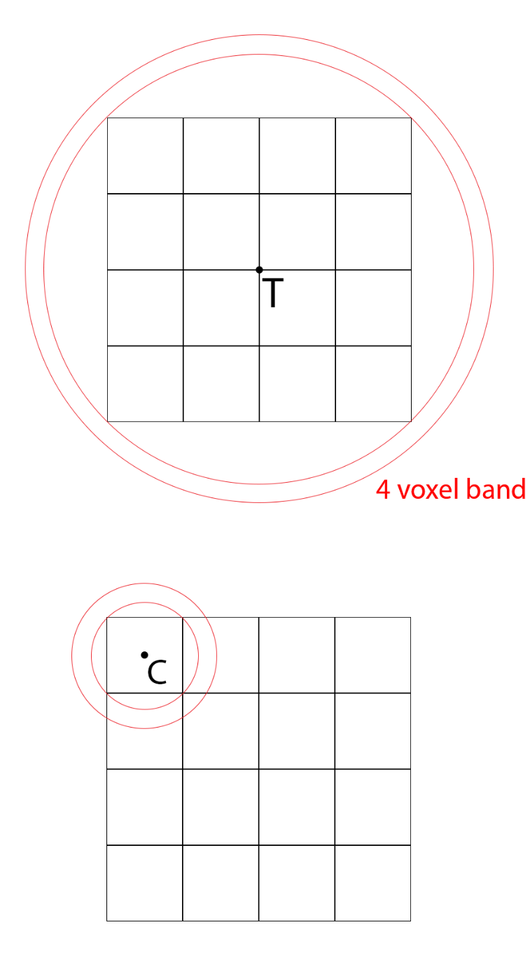
Generate SDF Brush Grid
64x64x32 dispatch. 4x4x4 groups
Sample a brush volume at tile center T
Cull if SDF > grid tile bounds + 4 voxels
Accepted? → atomic add + store to GSM
Loop through brushes in GSM
Sample brushGSM[i] at cell center C
Accepted? → store to grid (linear)
Local + global atomic for compaction
Notes:
We do first local groupshared atomics, and then one global atomic per group. This reduces the number of global atomics, and ensures that allocations for a group are adjacent to each other, improving cache efficiency when using the grid later.

Slide 13
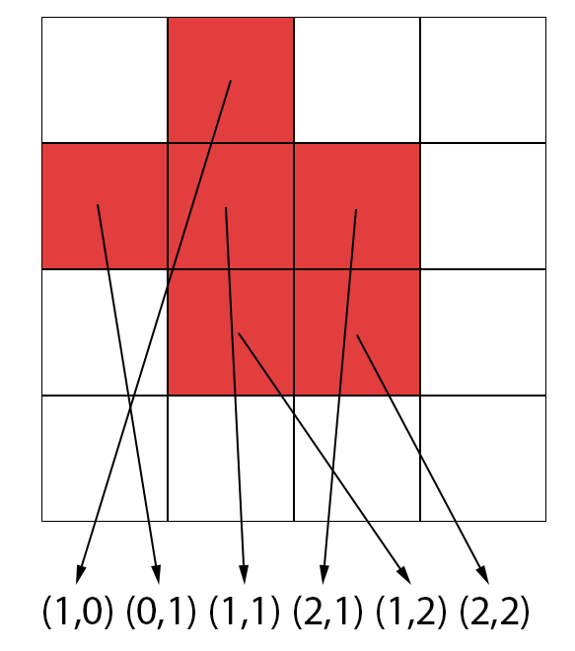
Generate Dispatch Coordinates
64x64x32 dispatch. 4x4x4 groups
Read a brush grid cell
If not empty:
Atomic add (L+G) to get write index
Write cell coordinate to buffer

Slide 14
Generate Mip Masks
4x Dispatch (mips). 4x4x4 groups
Group: Read 1 cell wider L₋₁ nbhood to GSM
Group: Dilate mask by 1 voxel in GSM
Write mip mask value
Mask!=0 → Write grid cell coords (prev slide)

Slide 15
Generate Level 0 (sparse)
Indirect Dispatch. 8x8x8 groups
Group: Read grid cell coordinate (SV_GroupId)
Read a brush from grid and store to GSM
Loop through brushes in GSM
Sample brushGSM[i]
Do exp smooth min/max operation
Write voxel to WorldSDF level 0

Slide 16
Generate Mips (sparse)
4x Indirect Dispatch (mips). 8x8x8 groups
Group: Load 4 voxel wider L₋₁ neighborhood
2x2 downsample (avg) and store as 12³ in GSM
+-4 voxel band becomes +-2 voxel band
Group: Run 3 steps of eikonal eq in GSM
Expands band: 2 voxels → 4 voxels
Store 8x8x8 center of the neighborhood

Slide 17
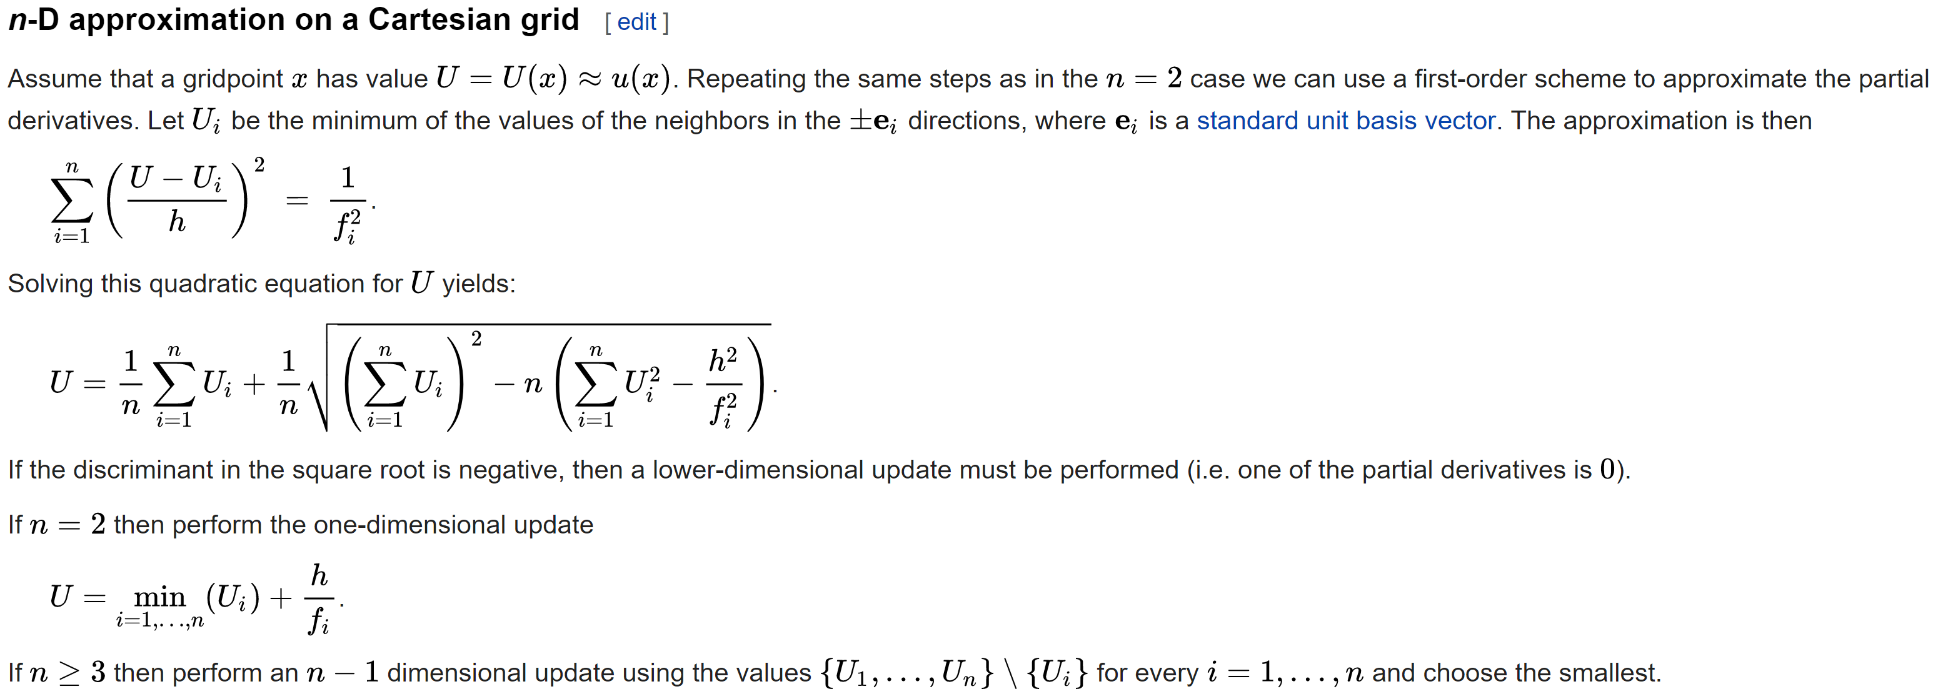
Eikonal Equation (Wikipedia)
Notes:
Source: https://en.wikipedia.org/wiki/Eikonal_equation
This equation takes the distance estimates of known neighborhood voxels and expands the band by one voxel at a time. The new distance estimate is sub-voxel precise.
We also tried jump flooding algorithm (JFA) inside groupshared memory, but it resulted in worse quality and was slower than simply running 3 passes of eikonal equation. Jump flooding doesn’t guarantee sub-voxel precise result. It works fine if you have binary (in/out) voxels, but we aren’t creating minecraft here, we need more precision.

Slide 18
Notes:
https://www.shadertoy.com/view/MtK3zD

Slide 19
World Modification
GPU simulated clay shapes
Up to 16k particles each
Smooth cut for each particle→world collision
Shapes can also stamp copies of themselves (add)
Fluid erosion
Up to 64k fluid particles
Smooth cut for each particle→world collision

Slide 20
World Modification, cont
SDF has infinite range
Local modifications are very expensive…
Our volume texture has limited range!
8-bit multilevel SDF
Mip 0: +-4 voxel band around modification
Mip 1+: Dilate, but size = 12.5%, 1.6%, 0.2%...
→ Efficient local modifications!

Slide 21
World Modification, cont
Same world generation algorithm, except:
Build grid with modifications only
Sample previous volume data at start…
Must output to temporary buffer on PC
DirectX 11.1 (Win7) doesn’t support typed UAV load
In-place update of R8_unorm data can’t be done!
Workaround: Indirect dispatch to copy 8x8x8 tiles

Slide 22
Future: Sparse Volume?
Only ~10% of mip0 8x8x8 tiles used
Software virtual texturing with 8x8x8 tiles
Low res 3d indirection texture + 3d tile atlas
Indirection texture read perf hit?
Our sphere tracing steps are fetch bound
Indirect = nearest (full rate) + trilinear (½ rate)
Measured cost = 13% slower
Notes:
Trilinear fetch with SampleLevel is less than ½ rate on some GPUs, if mip different inside a quad (4 consecutive threads). Virtual texturing tile atlas doesn’t have mip levels (indirection flattens mip), meaning that trilinear fetch is always ½ rate.

Slide 23
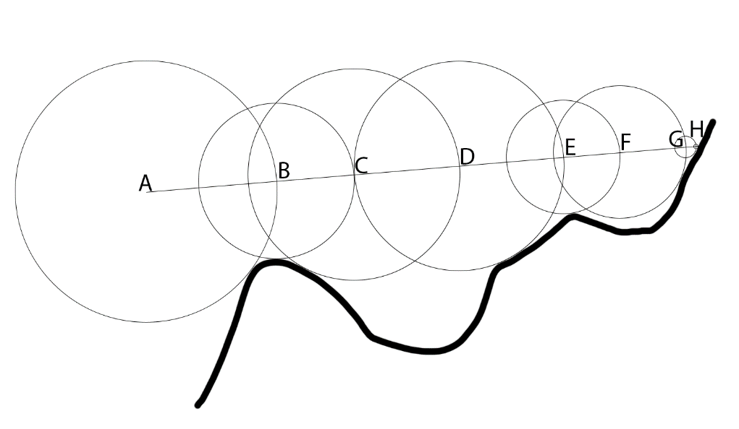
Ray-Tracing Distance Fields
SDF(P) = distance to the closest surface at P
Radius of sphere at P (filled with empty space)
Sphere tracing algorithm
D = SDF(P)
P += ray * D
D < epsilon → BREAK

Slide 24
Multilevel Volume Texture Tracing
Loop
D = volume.SampleLevel(origin + ray*t, mip)
t += worldDistance(D, mip)
D == 1.0 → mip += 2
IF D <= 0.25 → mip -= 2; D -= halfVoxel
D < pixelConeWidth * t → BREAK
Break if surface is inside pixel inner bounding cone
→ Perfect LOD!

Slide 25
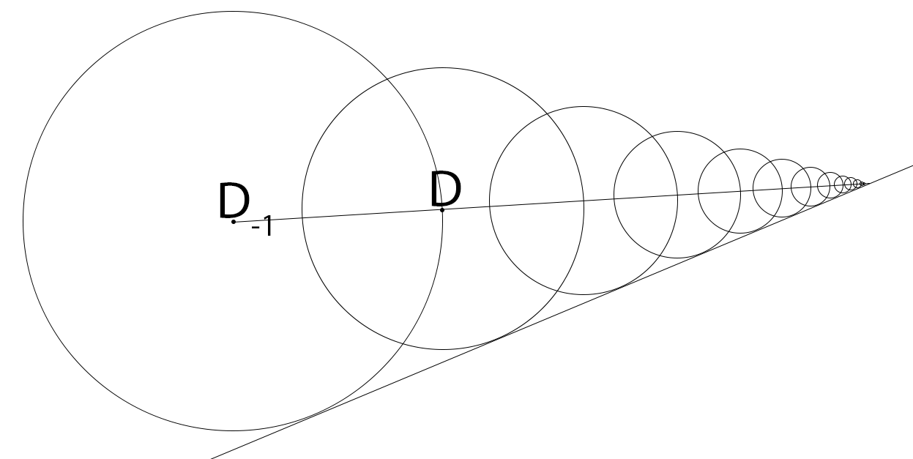
Last Step
Sphere trace takes infinite steps to converge
Assume we hit a planar surface
Trilinear filter = piecewise linear surface
Geometric series
Use last 2 samples
Step = D/(1-(D-D₋₁))

Slide 26
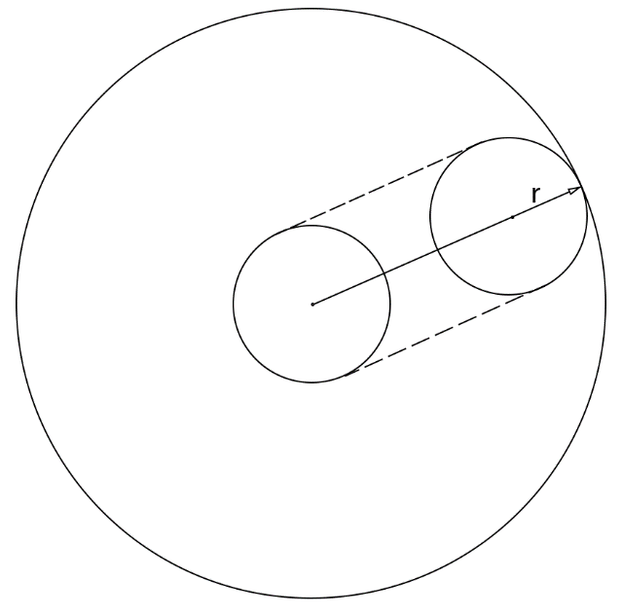
SDF Sweeps
SDF can be swept by any bounded shape
Point sweep (ray): step by D
Sphere sweep: step by D – radius
SDF cone trace (spherical cap)
Analytic solution exists
Only one extra instruction in shader!

Slide 27
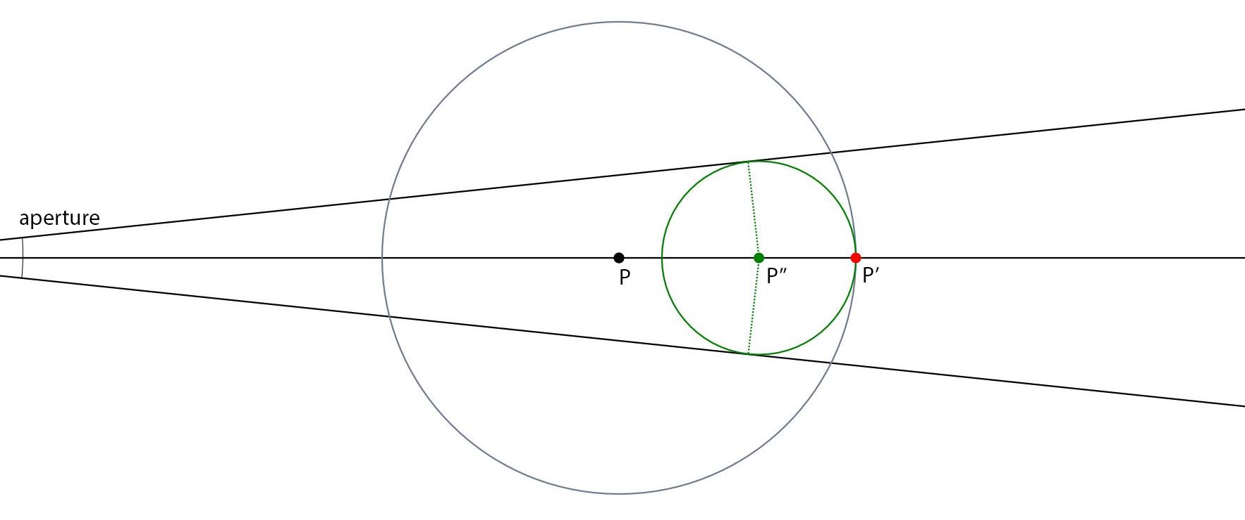
Cone-Tracing Analytic Solution
Pre-calculate (CPU):
C = sqrt(aperture^2 + 1)
A = C / (C - aperture)
In shader:
t = (t + D) * A
Notes:
P is the SDF sampling location. The large sphere around it represents the empty space. Green circle represents the maximum radius circular cone cap that can be safely fitted inside the large sphere.
When we are tracing a ray, we step to P’. Cone-trace needs to stop to P’’, because we must assume the worst case, which is that P’ lies on a surface.
Thanks to L. Ritter (@paniq) for the image.

Slide 28
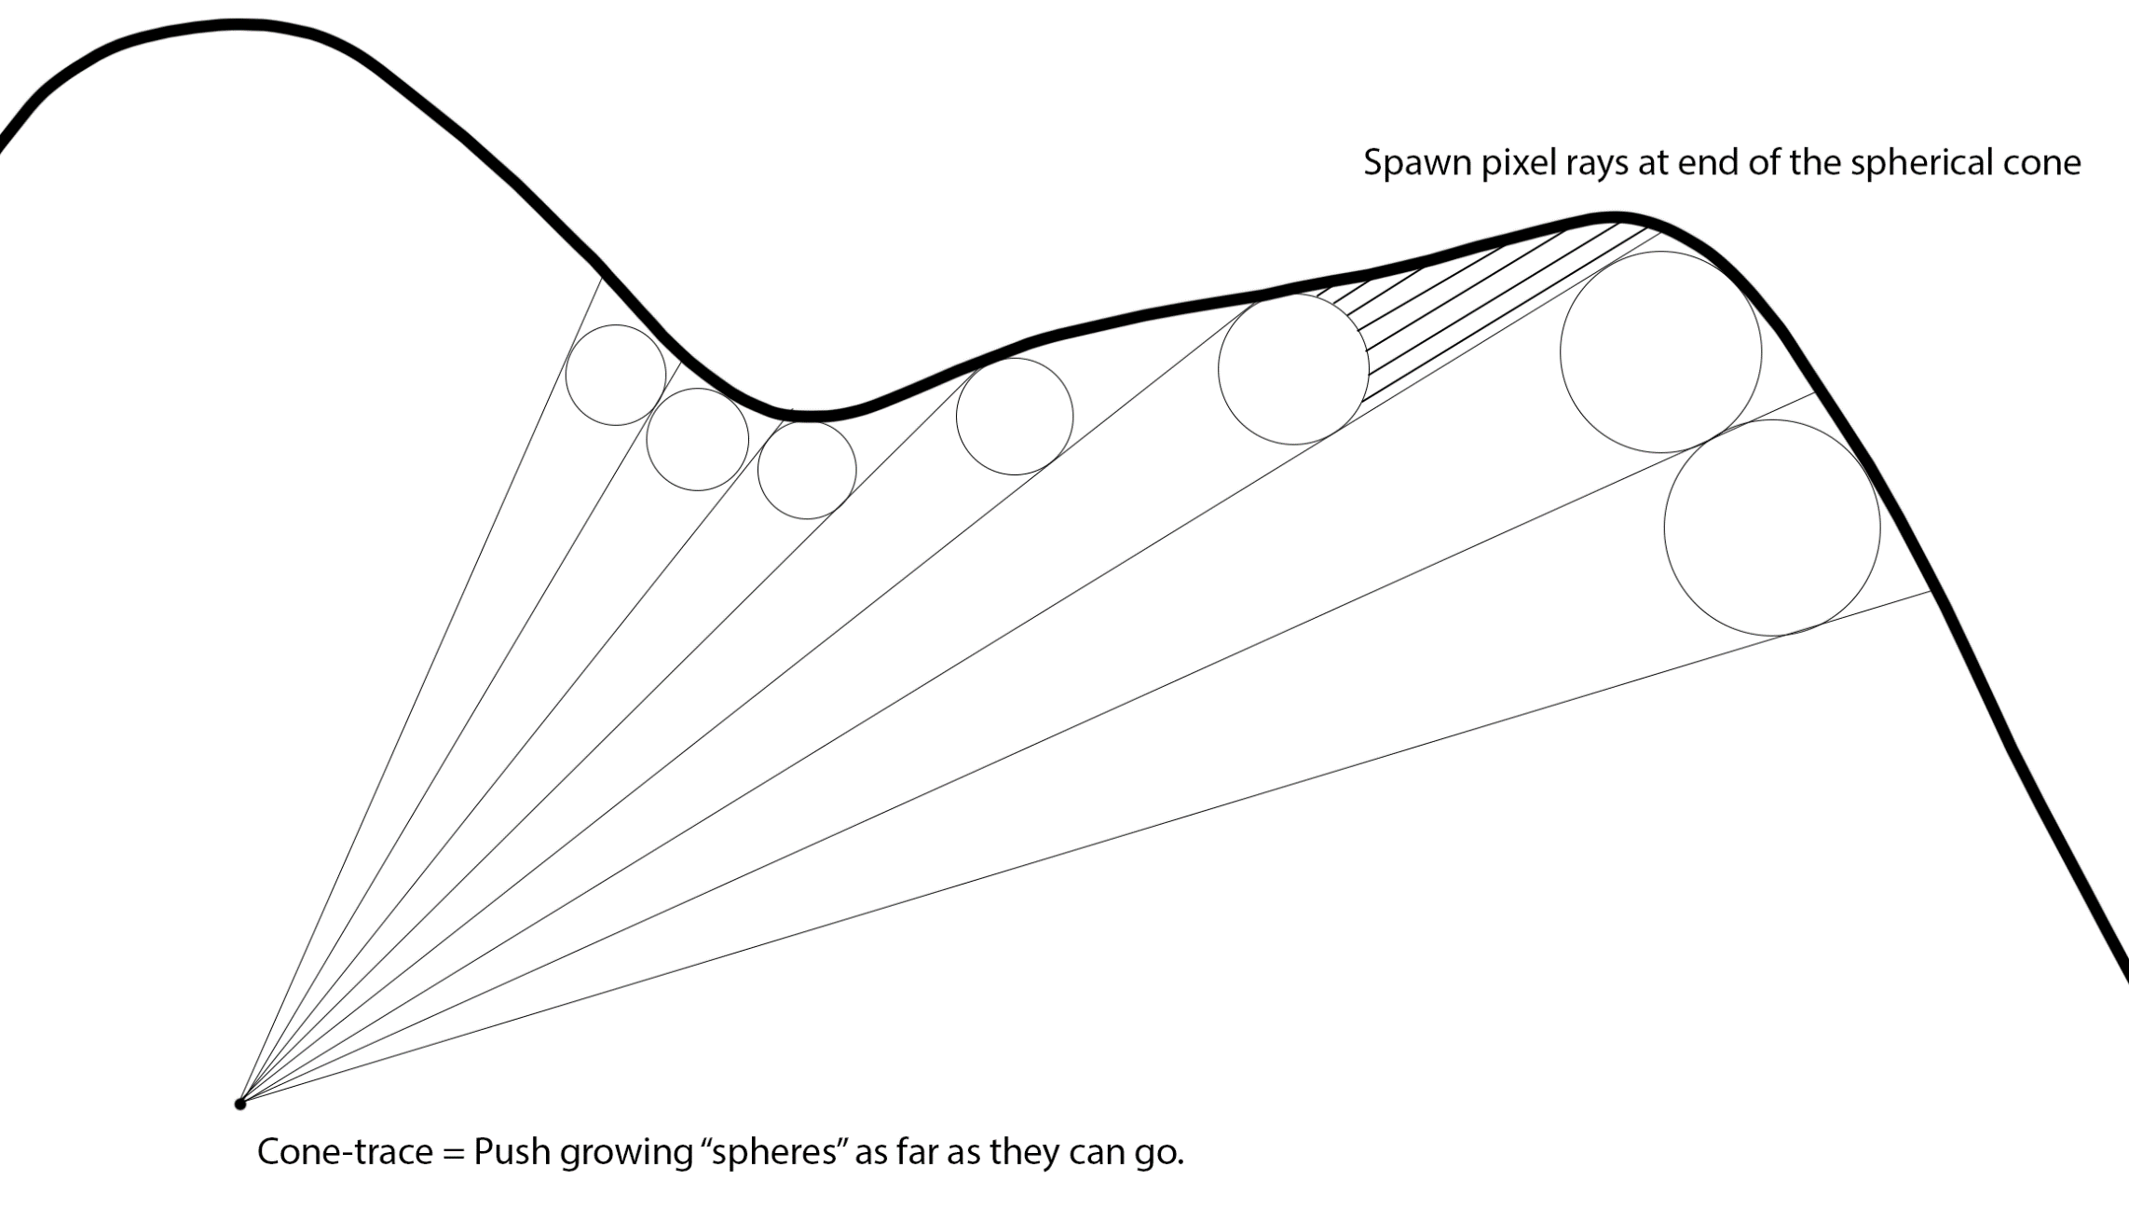
Coarse Cone-Trace Pre-Pass
8x8 pixel (outer) bounding cones

Slide 29
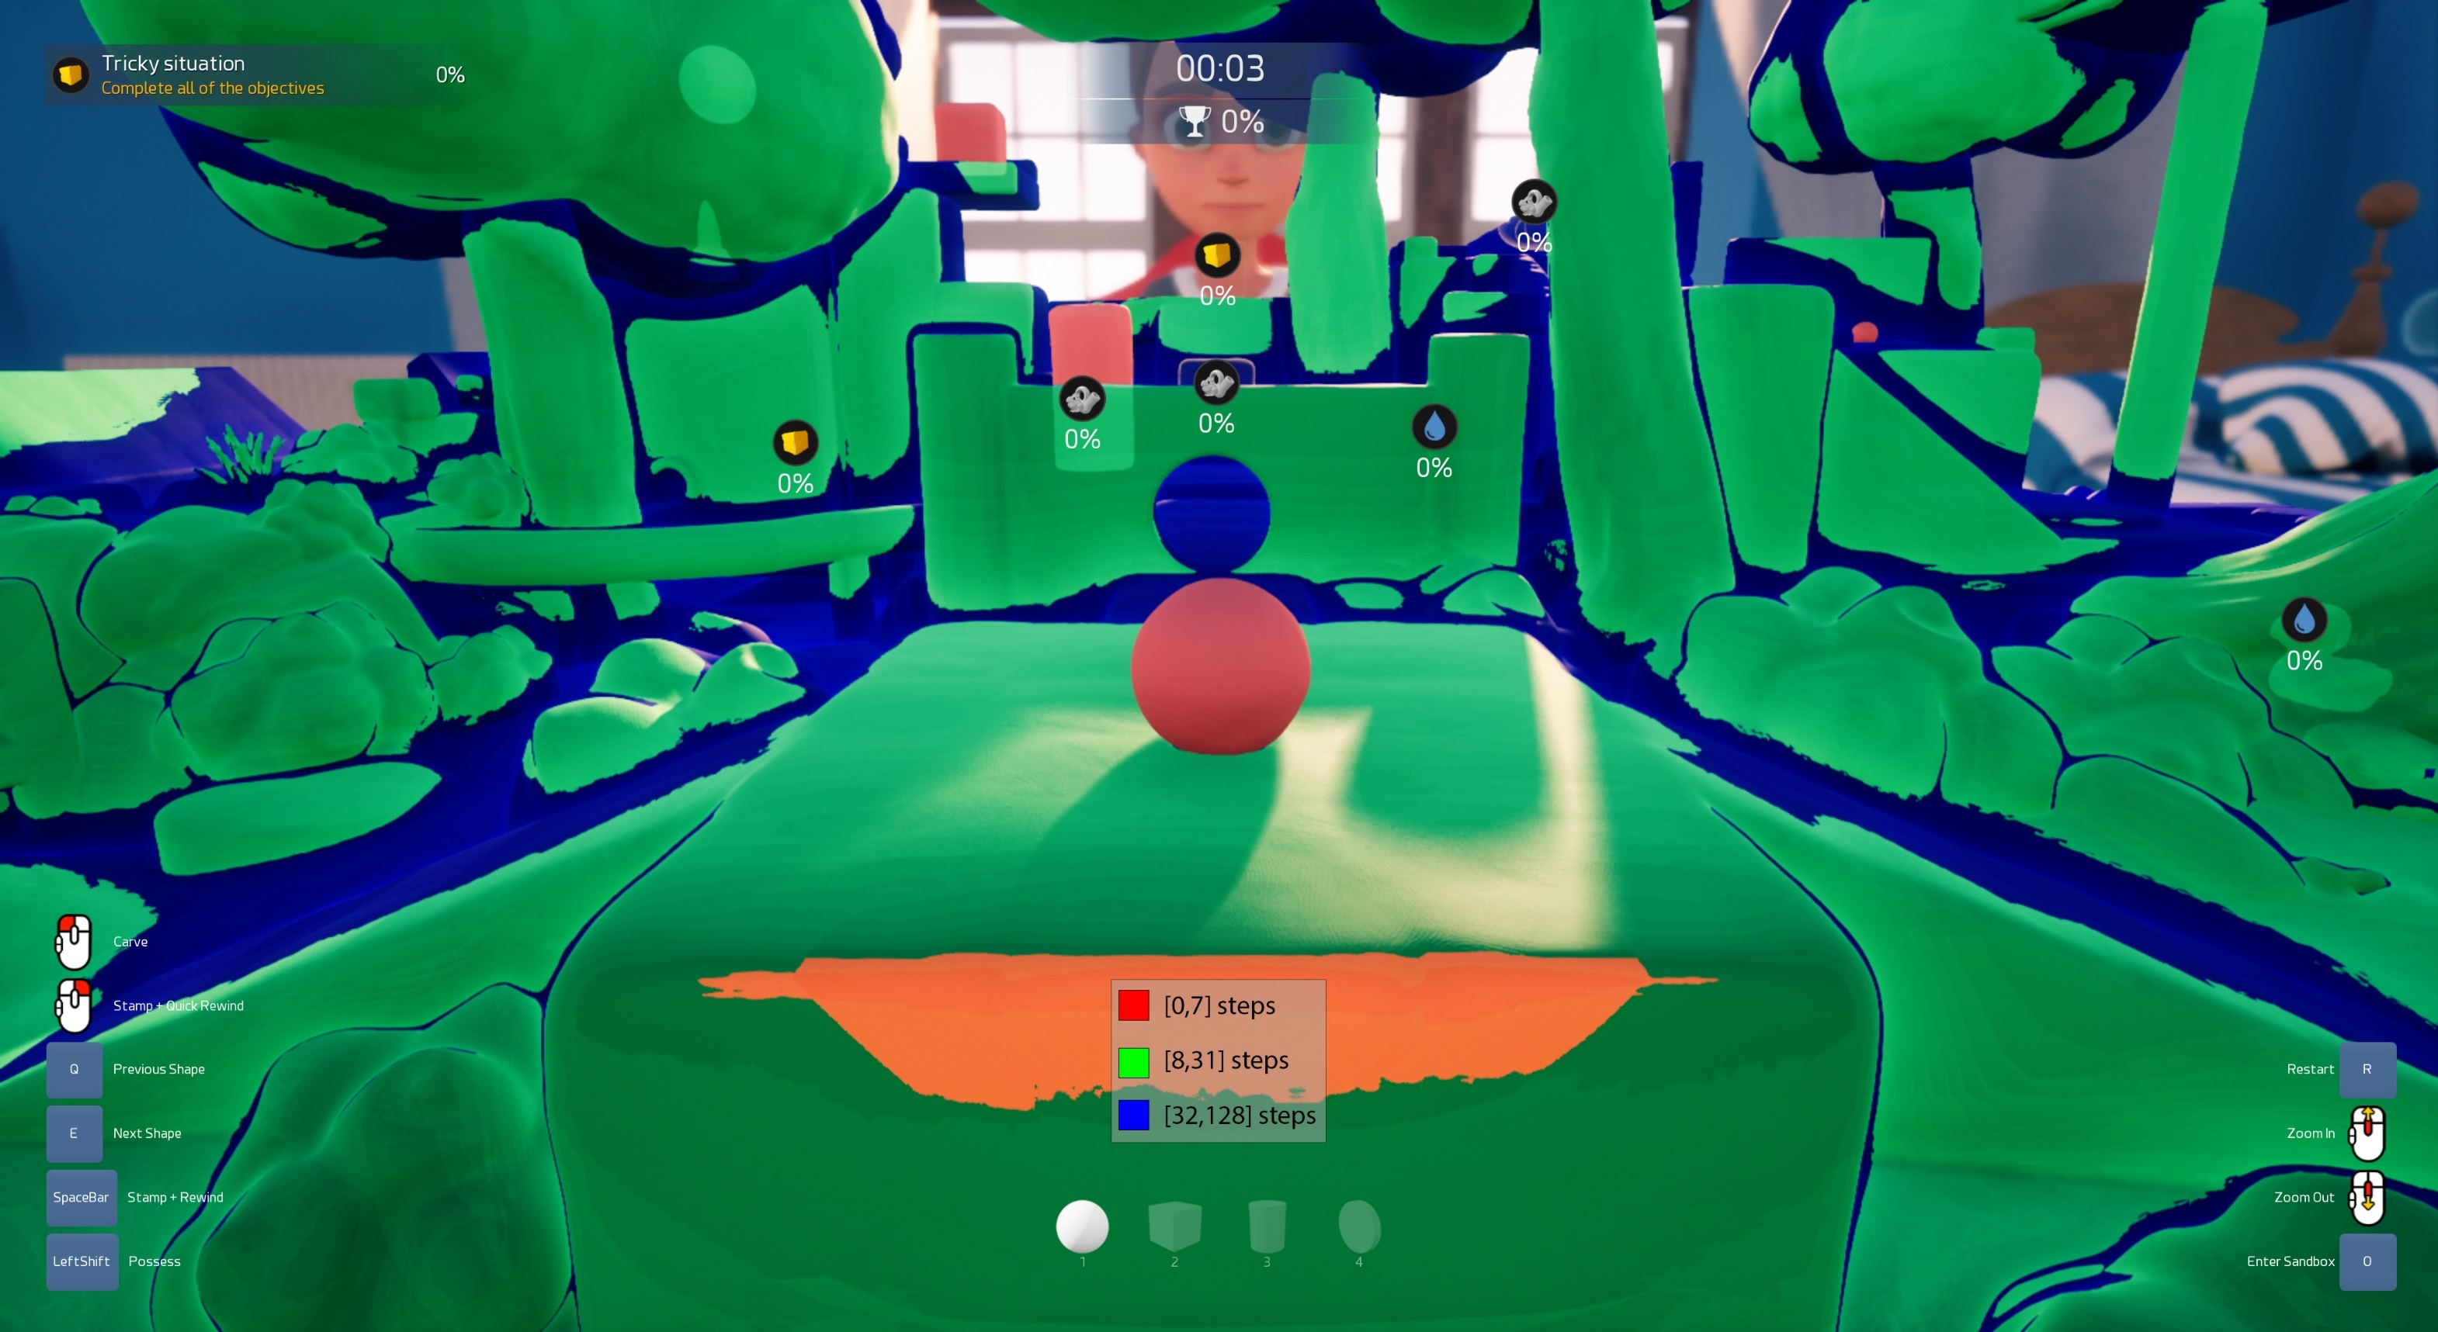

Slide 30
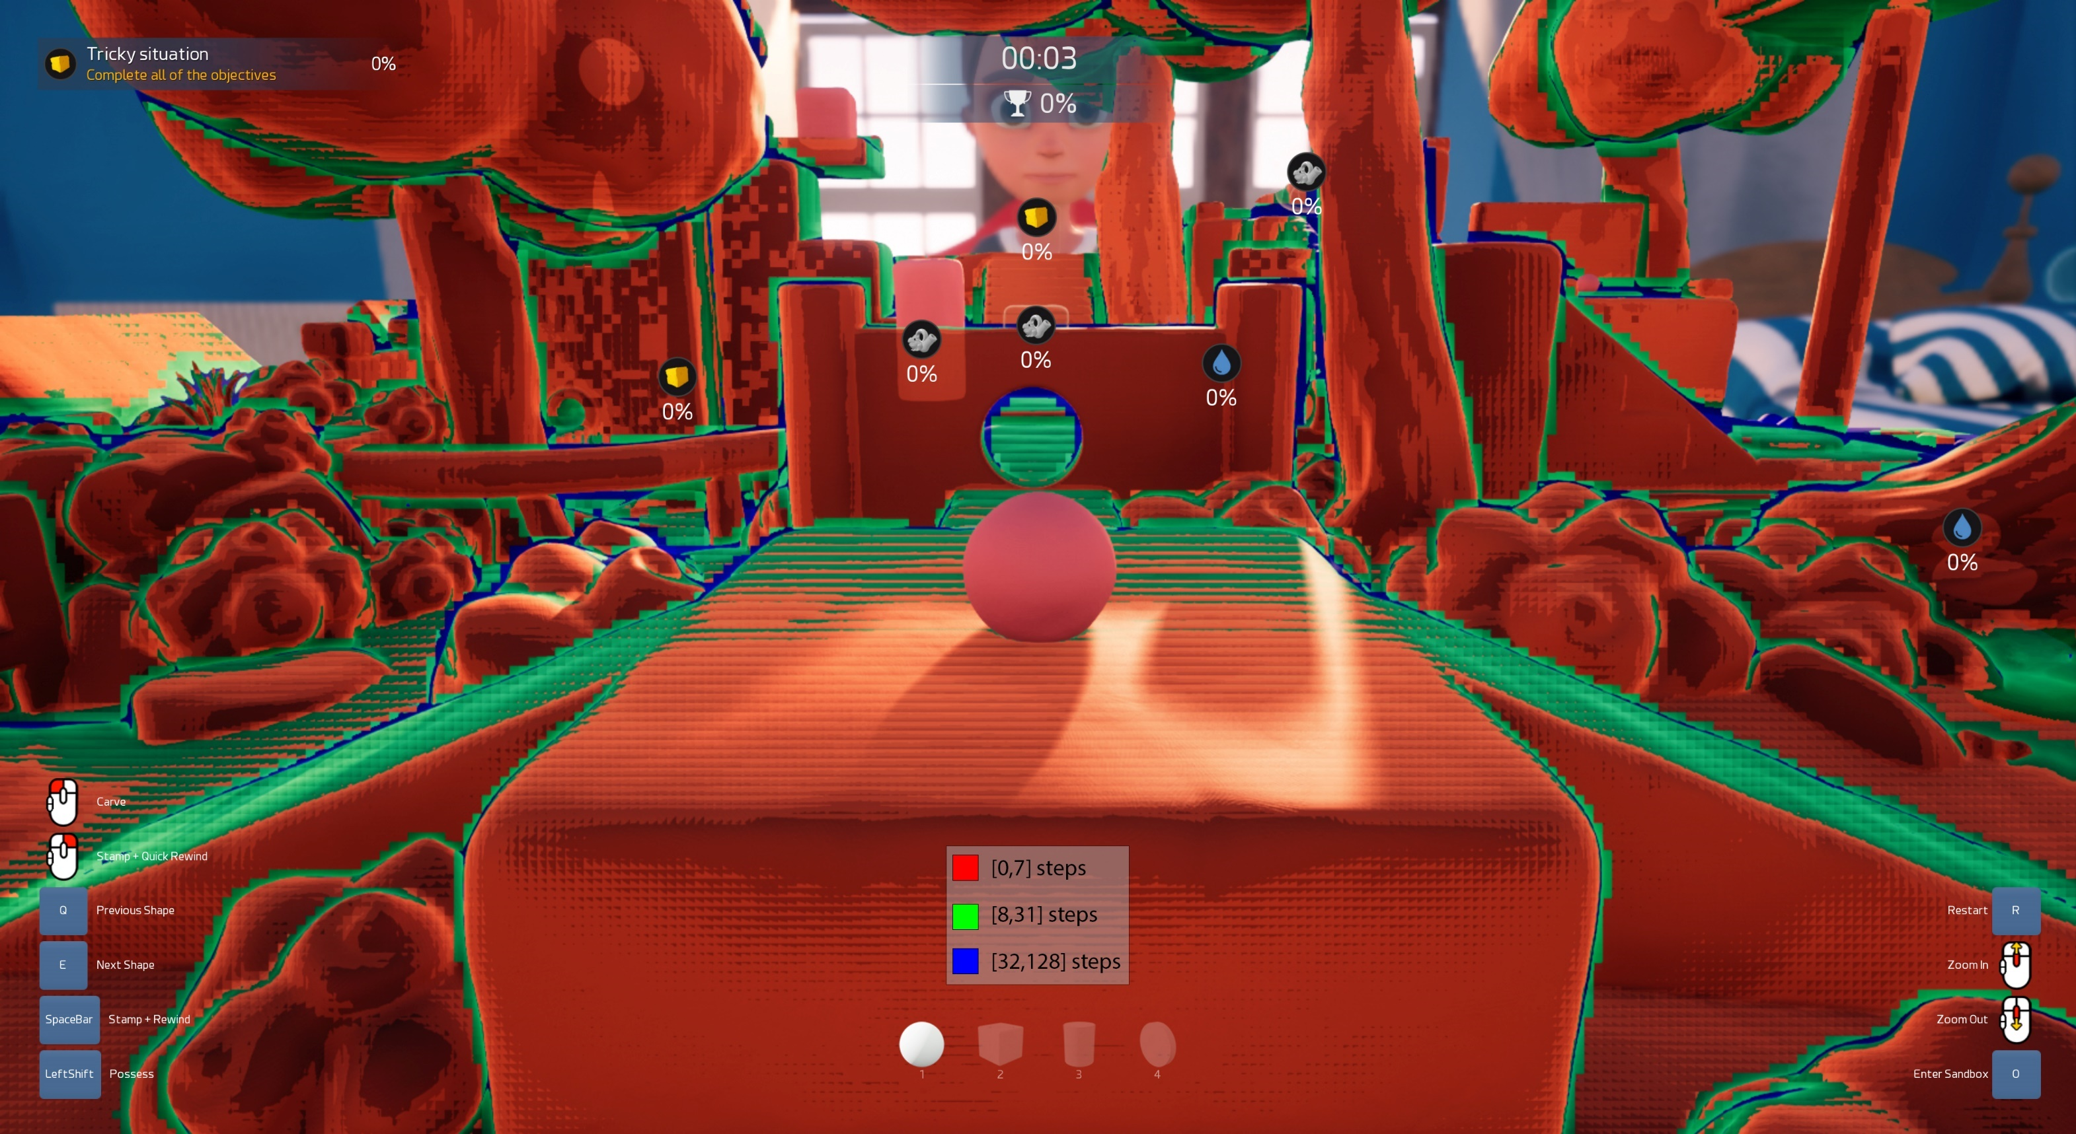

Slide 31
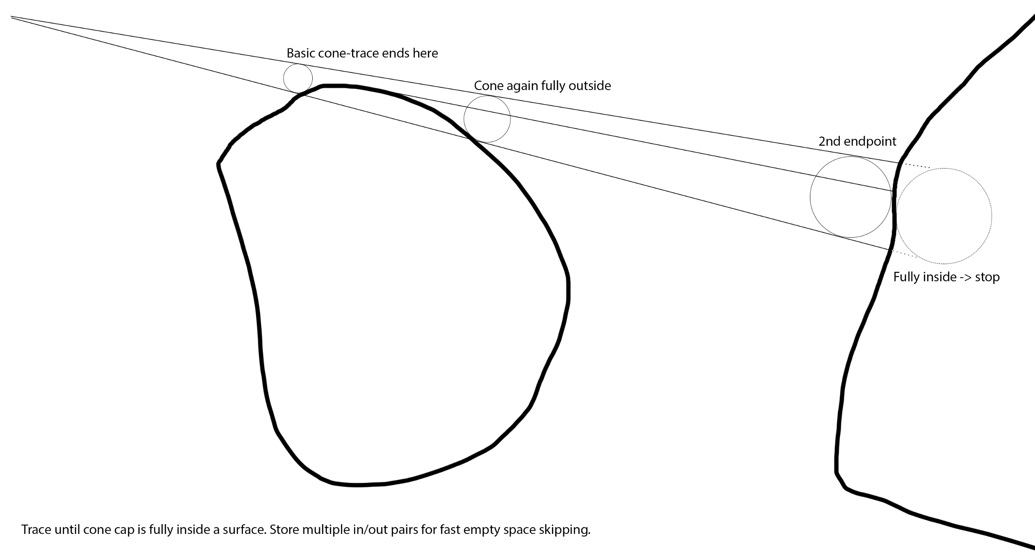
Future: Improving the ”Edge Case”

Slide 32
Ray Tracing Results
Cone trace skips large areas of empty space
Huge step length reduction
Volume sampling more cache local
Mip maps improve cache locality
Log8 scaling of data: 100%, 12.5%, 1.6%, 0.2%...
Measurement (1080p render)
8 MB data accessed (512 MB). 99.7% cache hit rate

Slide 33
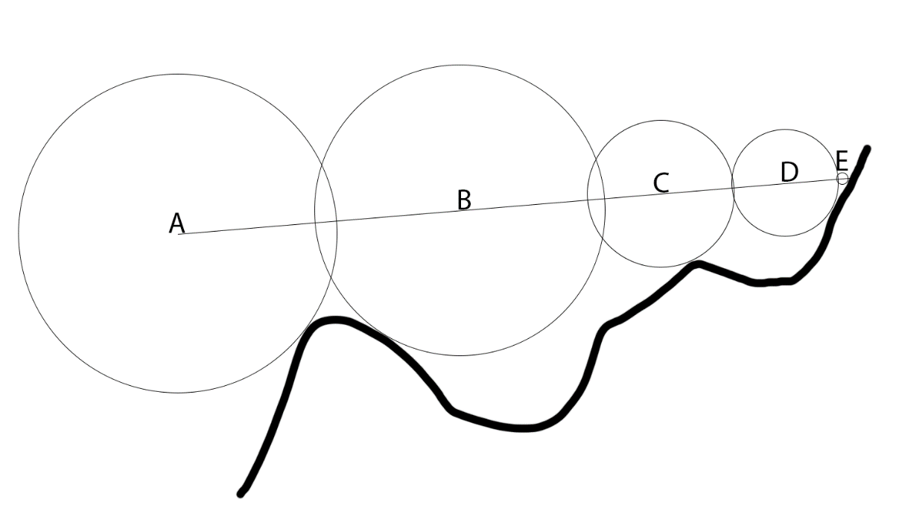
Failed Techniques: Overstepping
Idea: Take longer steps
dist(P₁,P₂) <= SDF(P₁)+SDF(P₂)
Fail → Rollback to previous sample
Problems:
Reduces sampling cache locality (random rollback)
SDF(P) more noisy with our mipmapped approach
Bloats VGPR count and adds ALU
Notes:
See: John C. Hart (1996). Sphere tracing: a geometric method for the antialiased ray tracing of implicit surfaces. Section 2.5.5.

Slide 34
Failed Techniques: Load Balancing
Loop continues until all threads in wave exit
Some rays need significantly more steps than others
Idea: Use wave ballot to exit loop early
50% rays finished → fill finished threads with new rays
Problems:
Ray setup code runs for unfinished rays (<50%)
Volume texture sampling is less cache local
Coarse cone-trace is simpler and does the job better
Notes:
Volume texture accesses are less cache local. This is because normally a wave is 8x8 pixel tile, which is a coherent beam of rays. With load balancing, threads come from a global pool. Rays are no longer screen local. SDF sampling trashes GPU L1 caches.
Load balancing was slightly faster without coarse cone trace, but slightly slower when it was used. Coarse cone trace was a huge win, so we didn’t need load balancing. It partially solves the same issue and significant other benefits as well.
Other issues:
8x8 tile scalar optimizations gone → VGPR bloat
DX11 (PC) doesn’t have wave ballot

Slide 35
Ambient Occlusion
Cast cone at surface normal direction
Add random variation + temporal accumulate
AO rays use low SDF mip
Better GPU cache locality and less bandwidth
Soft long distance AO
We also use UE4 SSAO
Small scale (near) ambient occlusion

Slide 36
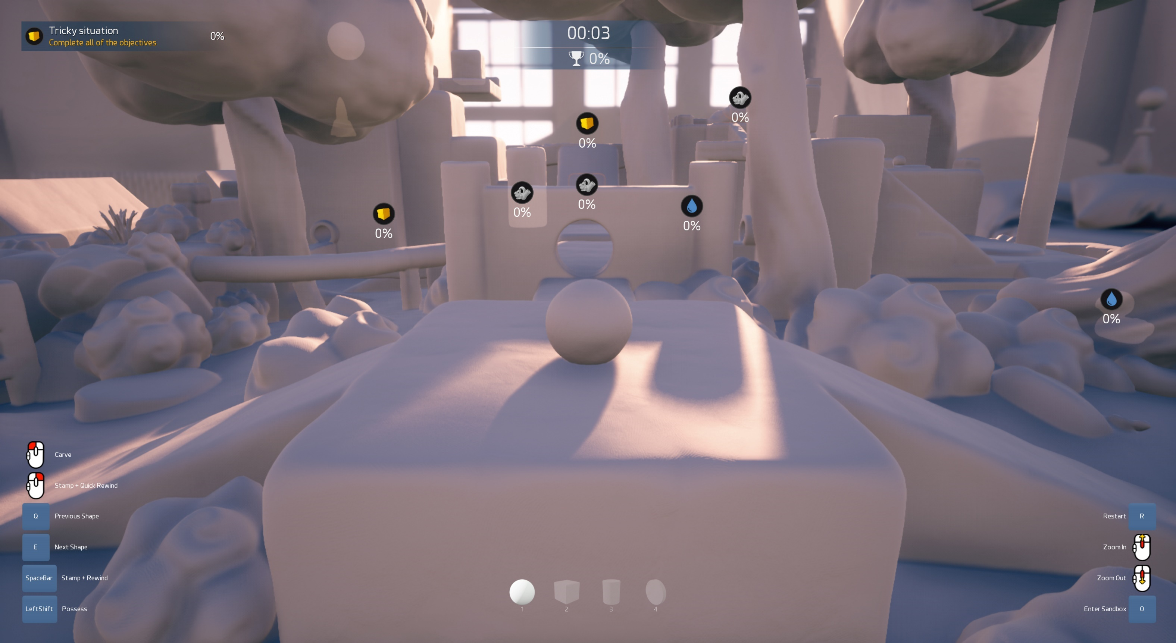
SSAO

Slide 37
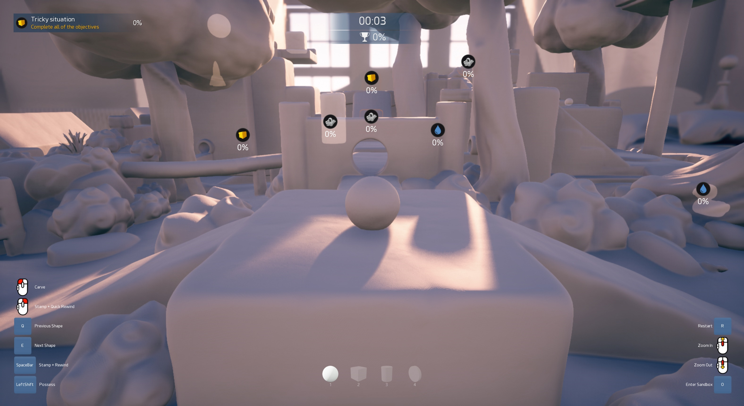
SSAO + RTAO

Slide 38
Soft Shadow Sphere-Tracing
Soft penumbra widening shadows
Approximate max cone coverage by stepping SDF
Demoscene cone coverage approximation [1]
c = min(c, light_size * SDF(P) / time)
[1] http://www.iquilezles.org/www/articles/rmshadows/rmshadows.htm

Slide 39
Soft Shadow: Our Improvements
Triangulate for better coverage estimate
Demoscene approach uses single SDF sample
We use previous + current sample
Triangulate position between them → less banding
Jitter shadow rays + temporal accumulate
Hides remaining banding artifacts
Allows wider inner penumbra without light leaks

Slide 40
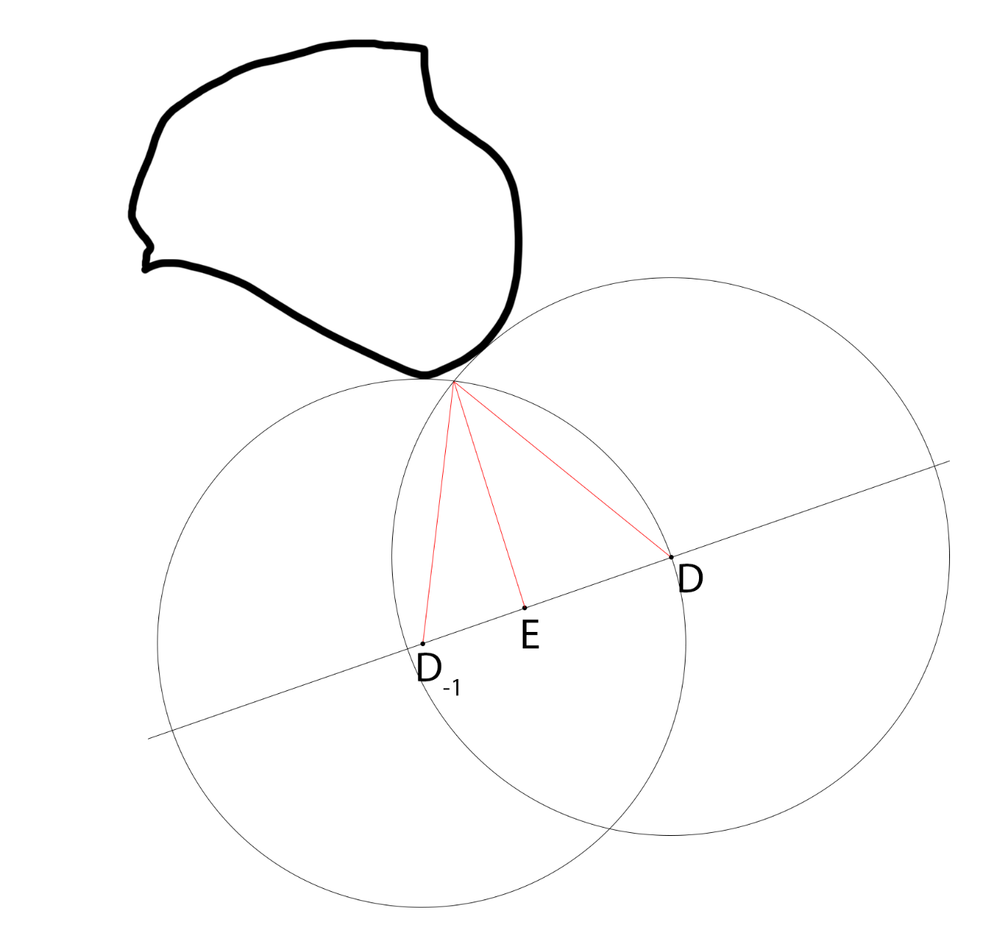
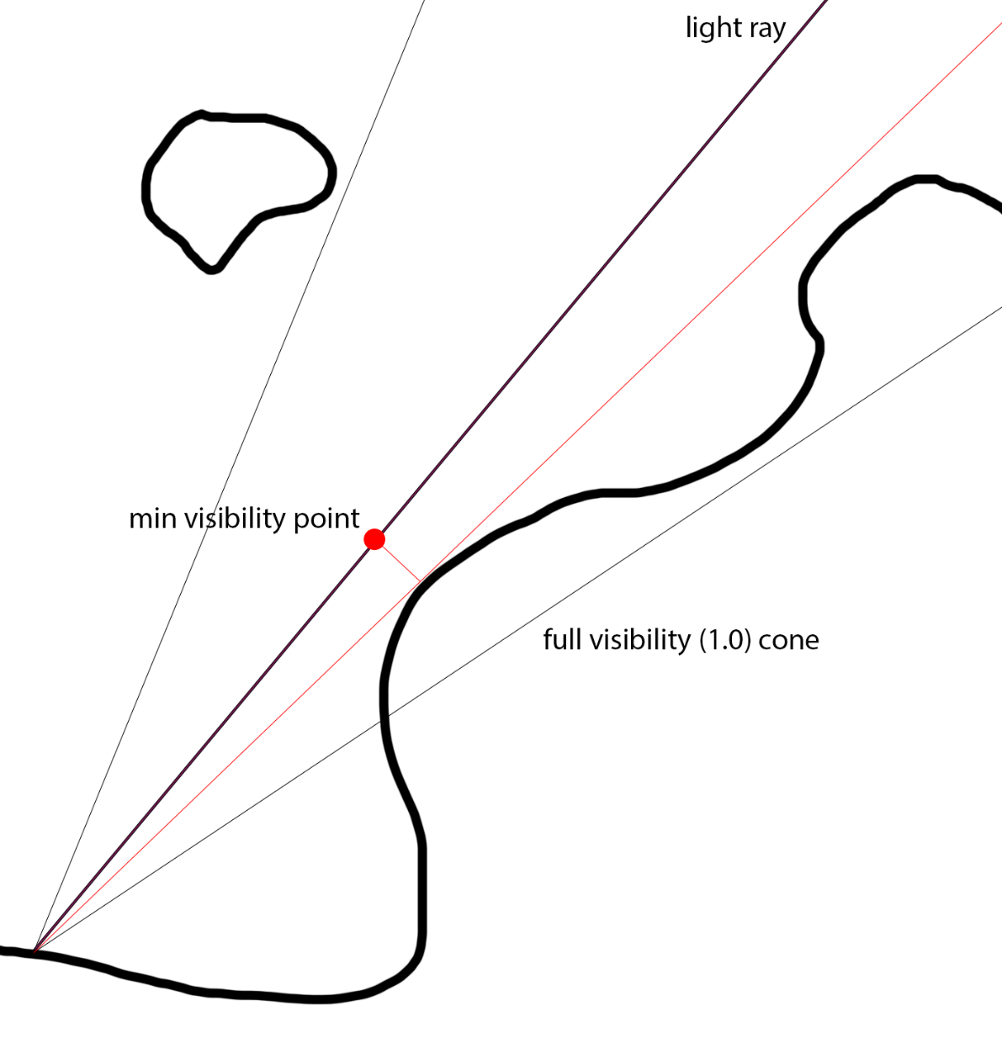
Notes:
Triangulation formula: res = min(res, (r2*sqrt(4*(r1*r1)-h*h))*rcp(2*hprev)/(t-h*h*rcp(2*hprev)))

Slide 41
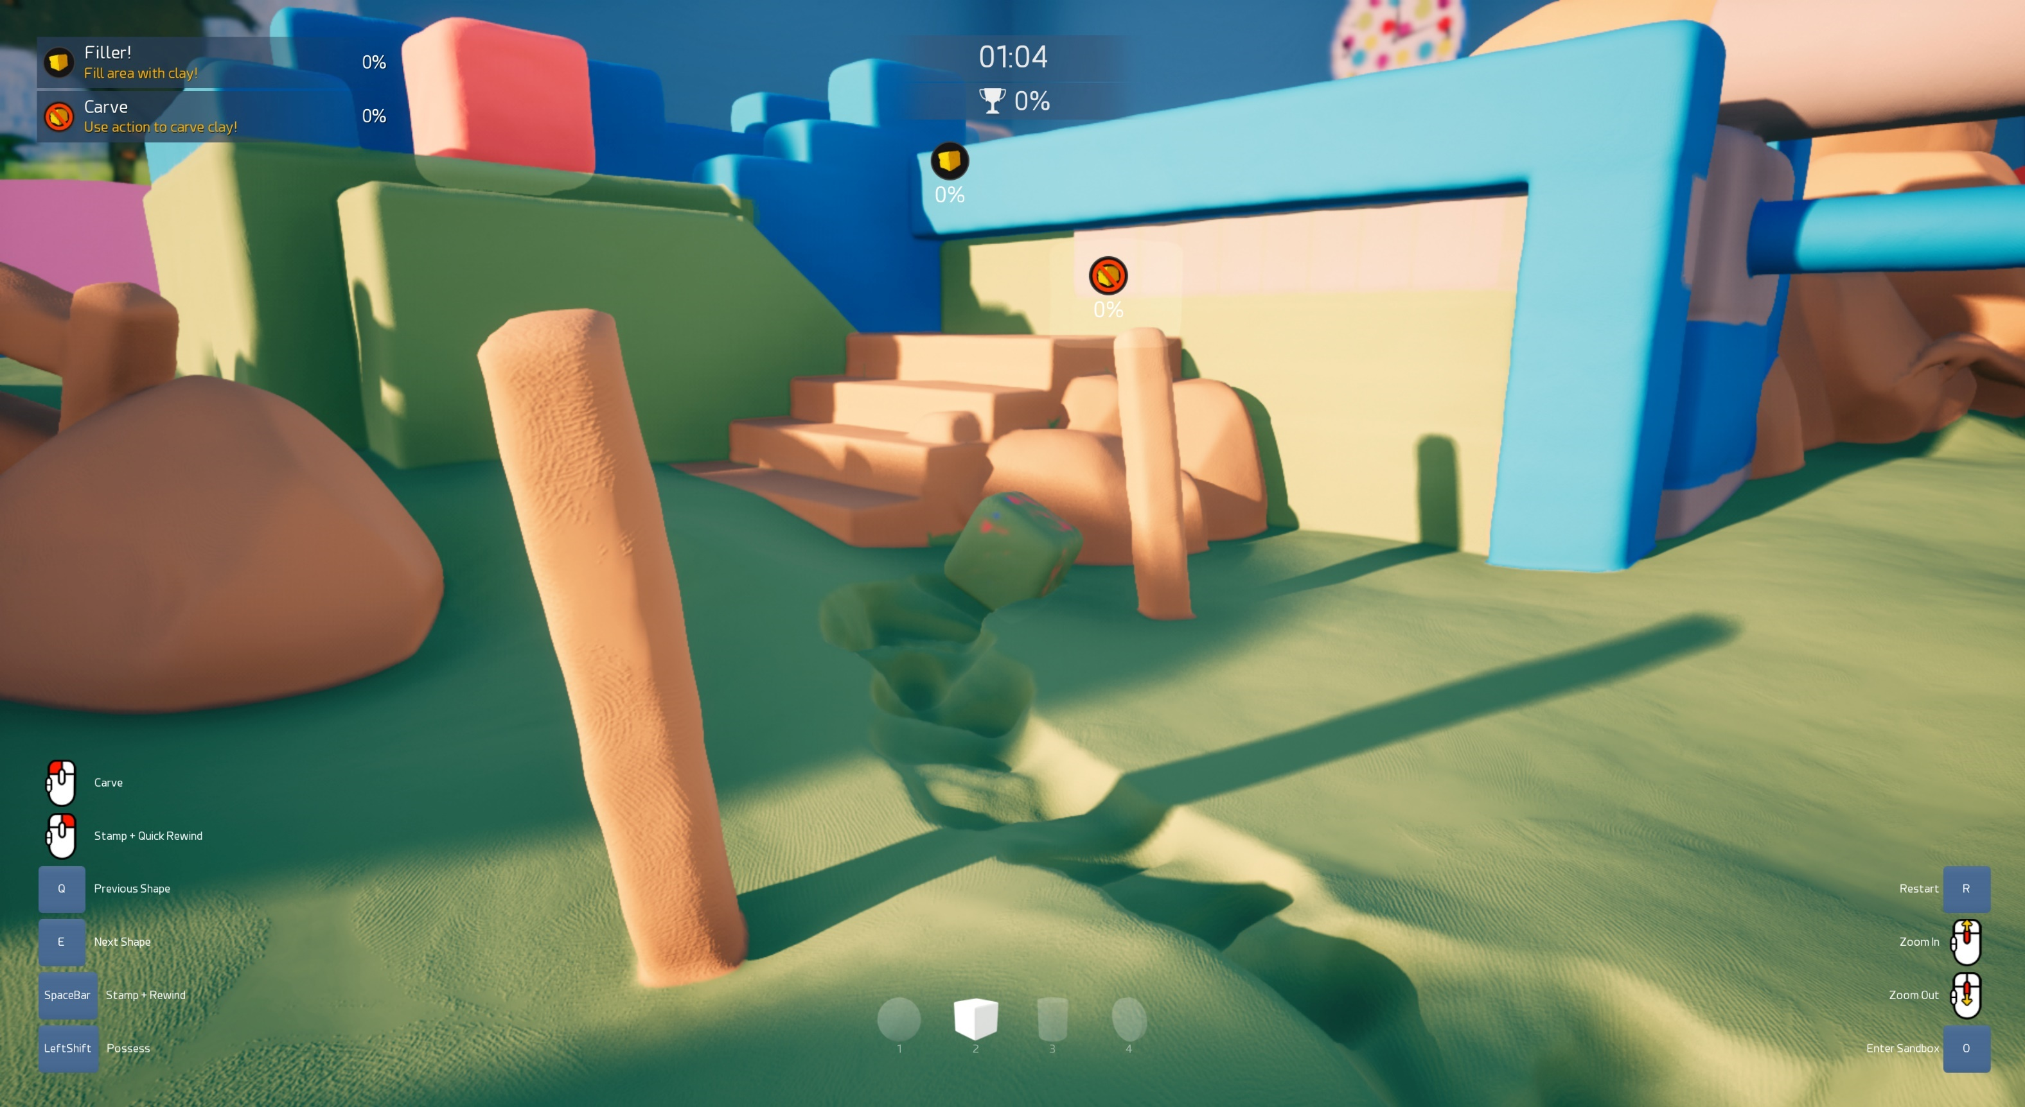

Slide 42
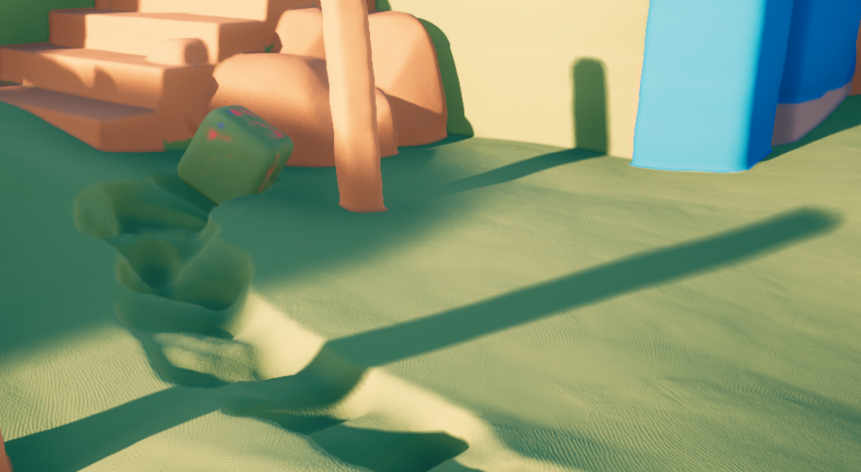
Notes:
You can see very wide penumbra cast from a distant object, ending roughly at the middle of the screen. This is combined perfectly with a sharper shadow cast from a object closer to the receiving surface.
Bottom part shows narrow shadow cast from a beam. Shadow is perfectly sharp at contact point, and gets gradually wider to the right side of the screen.

Slide 43
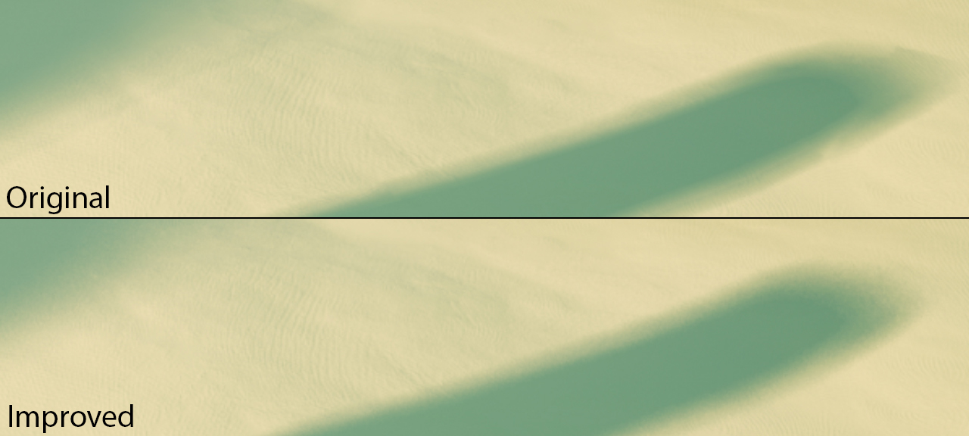
Notes:
Triangulation and shadow jittering reduce banding caused by the trivial approach.

Slide 44
Ray-Tracing Timings
 | Xbox One (base) @ 720p | AMD Vega @ 4K
Cone-trace pre-pass | 0.2 ms | 0.2 ms
Primary & AO rays | 1.5 ms | 1.6 ms
Shadow rays | 1.7 ms | 1.9 ms
Material & g-buffer | 0.8 ms | 1.0 ms
60 fps target on all consoles
Notes:
I haven’t yet implemented shadow beam-tracing optimization. Shadow rays are highly coherent, as they are all going to the same direction. Big performance improvement still coming to shadow rays.

Slide 45
Clay Simulation
Position based dynamics (PBD) on GPU
SDF based clay shapes
64³ SDF converted to point cloud for physics & render
Up to 16384 particles per clay shape (surface)
Collisions to world SDF and between shapes
O(1) particle<->SDF collision detection!
Plastic deformation

Slide 46
SDF→Mesh Conversion
Two pass approach
Multiple triangles refer to the same particle
→ Need to generate the particles first
Output
Linear array of particles (surface) for PBD simulator
Index buffer for triangle rendering
All meshes drawn with a single indirect draw call

Slide 47
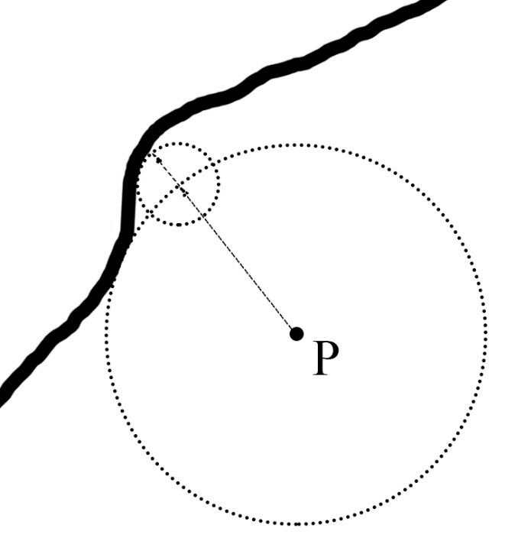
SDF→Mesh Conversion (Particles)
64x64x64 dispatch. 4x4x4 groups
Group: Load 6³ SDF neighborhood to GSM
Read 2³ GSM nbhood, if found in/out edge →
Move P to surface (gradient descent)
Allocate particle id (L+G atomic)
Write P to array[id]
Write particle id to 64³ grid

Slide 48
SDF→Mesh Conversion (Triangles)
64x64x64 dispatch. 4x4x4 groups
Group: Load 6³ SDF neighborhood to GSM
Read 2³ GSM nbhood, if found XYZ edge →
Allocate 2x triangle per XYZ edge (L+G atomic)
Read 3x particle ids from 64³ id grid
Write triangle to index buffer (3x particle id)
Notes:
We can use one store3 instruction to write three indices at once. DirectX supports raw views to typed buffers (including index buffer).

Slide 49
Shape Morphing
Linearly interpolate between two SDFs
Run SDF→mesh generation every frame

Slide 50
Ray-Traced SDF Meshes?
Render SDF mesh bounding box to g-buffer
Vertex shader outputs local ray start point and direction
Pixel shader sphere-traces mesh volume
Ray miss → discard pixel
Use conservative depth (SV_Depth_LessEqual)
Up to 6x faster than SV_Depth when high overdraw
Didn’t use this as our deform is particle based!
Notes:
So why do we not ray-trace the SDF meshes?
Our particle simulator plastic deformation modifies the particles directly.
There’s no feedback to the mesh SDF volume texture.
If we would ray-trace the SDF directly, we wouldn’t see any deform.
I would like to solve this issue eventually and ray-trace the meshes too.

Slide 51
Shape Matching Solver
60 Hz fixed step length (16.6 ms)
One constraint solve per physics tick
Reductions:
Group per body (1024): 16x loop load + reduce in GSM
Reduce 3x3 covariance matrix
Solve 3x3 SVD/PD → rotation matrix
Ported SVD/PD solver CUDA→HLSL (MIT license)
Notes:
Link: https://github.com/ericjang/svd3

Slide 52
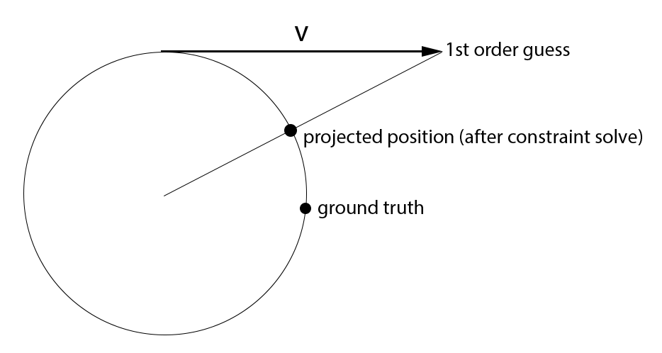
Failed Techniques: Verlet Integration
1st order technique
Only position data
Problem:
Linear estimate of P₊₁
Projection damps rotation
Solution:
Use 2nd order integrator (BDF2)

Slide 53
Failed Techniques: Gauss-Seidel
Graph colorization
Split constraints to 32 passes (independent)
Constraint passes solved in GSM
No memory traffic between passes
Performance and stability very good!
Problem: GSM limited to ~2000 particles/shape

Slide 54
Failed Techniques: Jakobi
Sum constraint projections, divide by joint count
Parallelizes perfectly
No limits for constraints
Successive over relaxation (SOR) = 2x speed up
Problem: Required 4x more sub-steps vs GS
Converges too slowly…

Slide 55
Fluid Simulation
Smoothed Particle Hydrodynamics (SPH)
Clay fluid = highly viscose + smooth surface
64k fluid particles (25cm radius)
Fluid rendering
Generate fluid SDF every frame
Resolution = 256³ + 1 mip
Ray-traced (prim, AO, shadow)

Slide 56
Recommended Physics Papers
Collections of GPU simulation papers:
http://matthias-mueller-fischer.ch
http://mmacklin.com
Notes:
Good tutorial: http://mmacklin.com/flex_eurographics_tutorial.pdf

Slide 57
Async Compute
Split frame to 3 async segments
Overlap UE4 g-buffer and shadow cascades
Overlap UE4 velocity render and depth decompress
Overlap UE4 lighting and post processing
Work submitted immediately
Compute queue waits for a fence to start (x3)
Main queue waits for fence to continue (x3)

Slide 58
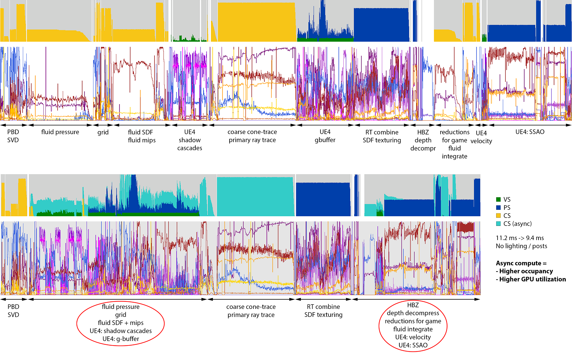
FPS increase = 19%+
Notes:
This is the Claybook GPU frame timeline. I cropped out UE4 lighting and post processing at the end of the frame, to make it more readable.
Above is with async compute disabled, below is with async compute enabled. Both have identical scale.
We overlap fluid simulation, grid building and fluid SDF generation with UE4 shadow cascade and g-buffer tasks. This works really well, because these rendering steps are mostly bound by fixed function units.
After g-buffer rendering there’s another overlap. This time we overlap GPU depth decompress step and UE4 velocity rendering with fluid simulation and physics reductions which are read back by the CPU and sent to game logic.

Slide 59
Integration to UE4 renderer
G-buffer combine
Full screen PS to combine ray-traced data
Samples material map (custom gather4 filter)
Writes to UE4 g-buffer + depth buffer (SV_Depth)
Shadow mask combine
Full screen PS to sphere trace shadows
Writes to UE4 shadow mask buffer (with alpha blend)

Slide 60
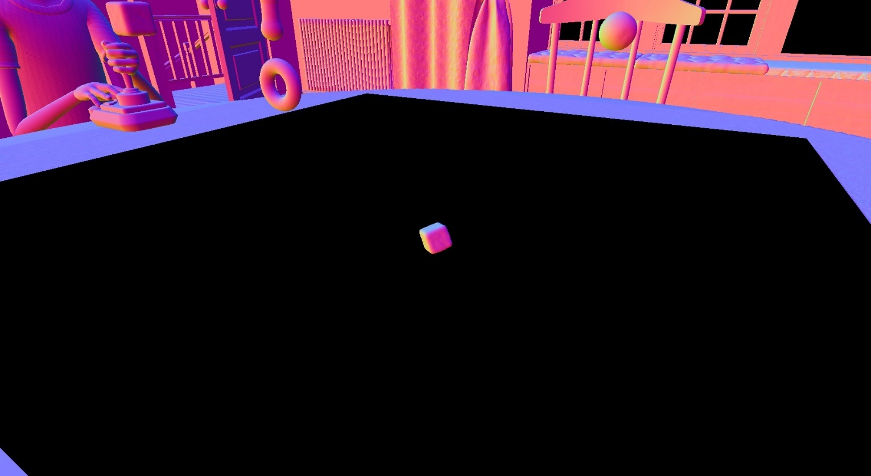
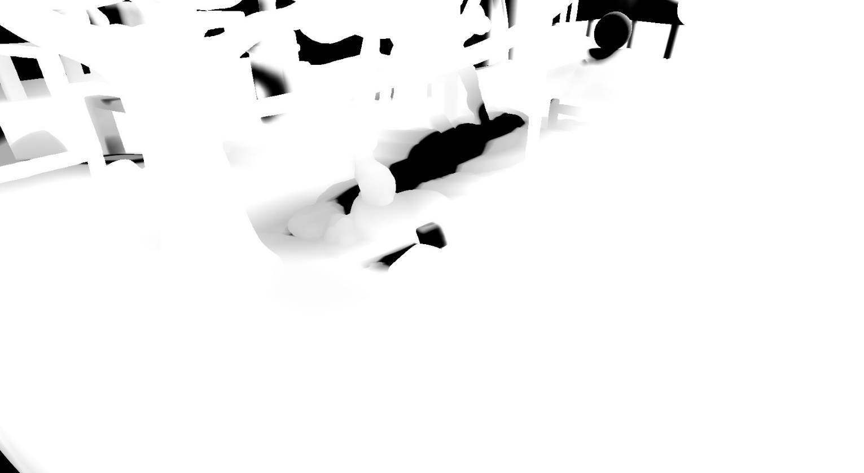
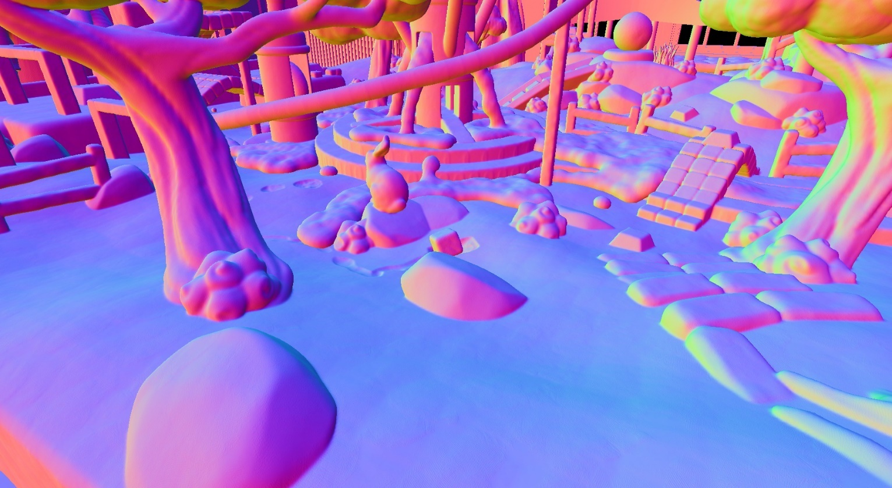
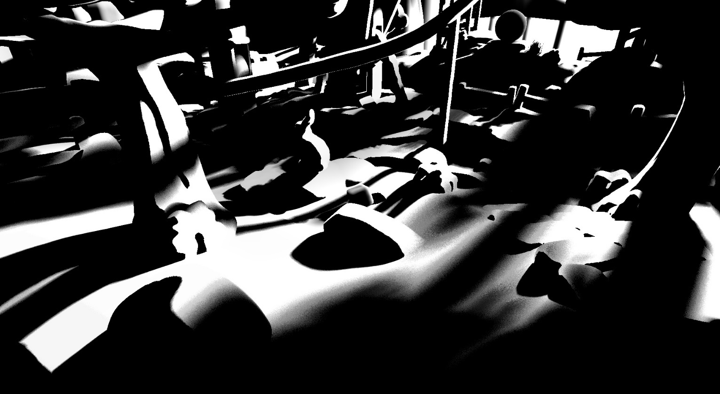
Notes:
Left = g-buffer buffer
Right = shadow mask
Before (UE4 output) = top
After combining our data = bottom

Slide 61
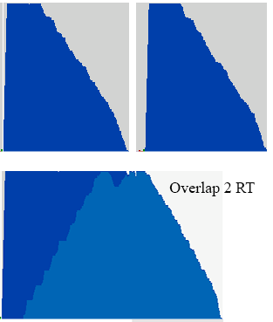
UE4 RHI Customizations
Set render target(s) without implicit sync
Can overlap depth/color decompress
Can overlap draws to multiple RTs (image)
Clear RT/buffer without implicit sync
Missing async compute features
Buffer/texture copy and clear
Compute shader index buffer write
Notes:
Most buffer clears are very small, for example clear a buffer containing an atomic counter. Overlapping these with other shaders removes unnecessary GPU stalls.

Slide 62
Thanks!
UE4 Rendering Team
Rys Sommefeldt (AMD)
Lou Kramer (AMD)
Adam Miles (Microsoft ATG)
More questions? We have ID@Xbox station in South Hall Lobby Bar (Thu/Fri)

Slide 63
Bonus Slides
UE4 Build Process
UE4 Merging
UE4 Customizations
UE4 Optimizations and Fixes
Implementation Notes

Slide 64
Built on Top of Unreal Engine 4
UE4 = huge code base + lots of shaders
Needs fast development hardware
16-core AMD Threadripper workstations
UE4 build system scales well to 32 threads
Around 3x faster build time vs 4 GHz i7 quad
Large SSDs for checkouts
Gigabytes of symbol and .obj files

Slide 65
Unreal Engine 4 Merging
Started with UE 4.8. Now UE 4.18
Merged most major UE4 versions
Created our own 3-way directory merge tool
UE4 console source code comes as zip package
Will merge UE 4.19 soon
New features = temporal upscaler + dynamic resolution

Slide 66
Unreal Engine 4 Customizations
Early decision: Fully separate our tech
Our own UE4 module
C-header with function entry points
1-line modifications around UE4 code to call our module
Separation not possible for all cases
UE4 RHI + low level changes (GPGPU features)
UE4 WorldCollision changes (SDF collision)

Slide 67
UE4 RHI Customizations (Extra)
GPU->CPU buffer readback
UE4 only supports 2d texture readback without stall
Other readback APIs stall the whole GPU
Buffer can have both raw and typed view
Wide raw writes = fill narrow typed buffers efficiently

Slide 68
UE4 optimizations
Allow overlap of indirect dispatches/draws
Allow overlap of clears and copy operations
Allow overlap of draws to different RTs
Reduced GPU cache flushes and stalls (image)
Optimized staging buffers
Fast clear improvements

Slide 69
UE4 optimizations
Optimized barriers and fences
Optimized texture array sub-resource barriers
Better GPU tile modes for 3d textures
Improved partial 2d/3d texture updates
5x faster histogram + eye adaptation shaders
4x faster offline CPU SDF generator (cooking)

Slide 70
UE4 optimizations & fixes
I send changes/fixes to UE4 rendering team
UE team implements/tests on all platforms
Remove my local fix once official fix is available
Helps with merging in the future
UE4 rendering team has been very helpful
Quick response time and friendly discussion
Big thanks for you!

Slide 71
Implementation Notes
Physics data stored in one big raw buffer
Wide Load4/Store4 instructions (16 byte), bit packed:
Particle positions: 16 bit norm
Particle velocities: fp16
Bitfield for particle flags (alive, collided, etc)
Benchmark tool: https://github.com/sebbbi/perftest
Groupshared mem was a big performance win
SDF generation, grid generation, physics
Use when doing repeated loads of same data

Slide 72
Implementation Notes (2)
Scalar loads were a big performance win on AMD
Use case: Constant index raw buffer loads
Use case: SV_GroupID based raw buffer loads
→ Load stored to SGPR → Better occupancy
More info: https://gpuopen.com/optimizing-gpu-occupancy-resource-usage-large-thread-groups/

