Slide 1
The Elusive Frame Timing
A Case for Smoothness Over Speed
Alen Ladavac
CTO
Croteam
Notes:
Thanks for coming to this super-esoteric talk.
Prototype methods -> actual methods now!

Slide 2
<taxonomy>
Notes:
Will first introduce taxonomy
Will assume 60 FPS, and assume people know 16ms and 33ms
Smoothness can be hard to “see”
Will repeat things if needed
Subjective: If it is not a problem for you, it is for the gamers, at least some!
Caveat: the video players’
Look at the contraption

Slide 3
“perfect”
Notes:
Setting up the baseline
(if it works at first :) )

Slide 4
[Talos] Smooth

Slide 5
“slow”
Notes:
What it’s supposed to look like when it can’t hit 60.

Slide 6
[Talos] Slow

Slide 7
“spikes”
Notes:
What one would expect when oscillating between 30 and 60 FPS
Namings are based on what the framerate graph looks like.

Slide 8
[Talos] Spikes

Slide 9
“jagged”
Notes:
something awful that happens often - we’ll see later what causes it

Slide 10
[Talos] Jagged

Slide 11
“heartbeat”
Notes:
And now for something that’s very significant. It started our journey in all this.
This beast is very hard to catch in the wild - we call it “the heartbeat”.

Slide 12
[Talos] Heartbeat

Slide 13
just a bug?
Notes:
At first we though we are doing something wrong
But then again...

Slide 14
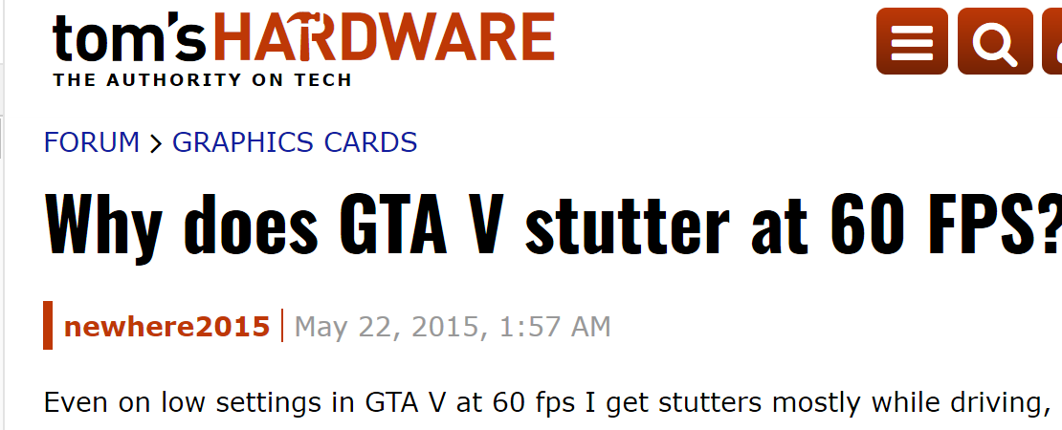
Notes:
You can find this for any game!
What most of these people are referring to is heartbeat.
I’ve seen in in several other games when I was playing, but it’s very elusive. Will see why later.

Slide 15
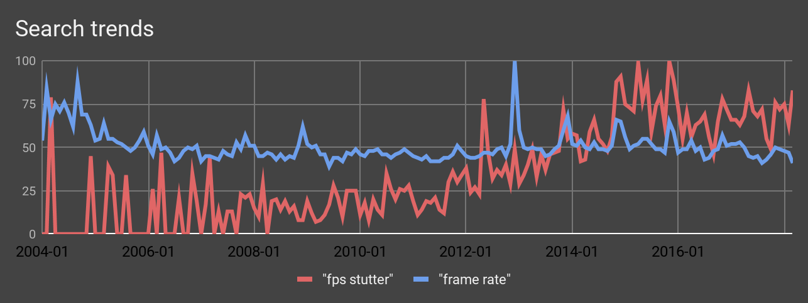
Smoothness vs Speed
In the past 5 years, stutter is a bigger problem than performance!
Notes:
We first noticed heartbeat around 2003 - Google stats don’t go that far back
But it’s obviously getting worse over time - and it’s become more of an issue than actual low framerate
Machines have gotten better, but - in relative terms - this has only gotten worse

Slide 16
Notes:
When you look at the discussion threads in detail you notice a common trait
each person has a different solution
and they all boil down to superstitious rituals
they are essentially placebos - you change _something_ and the problem disappears

Slide 17
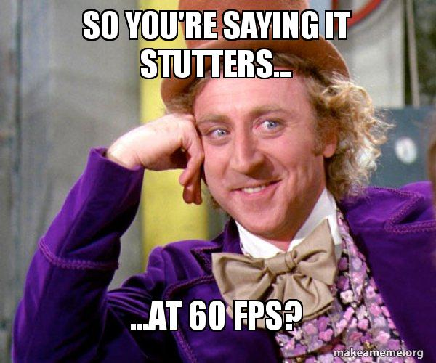
Notes:
People talking about it certainly do feel like weirdos sometimes…
Bad grammar doesn’t help
But they are not imagining things

Slide 18
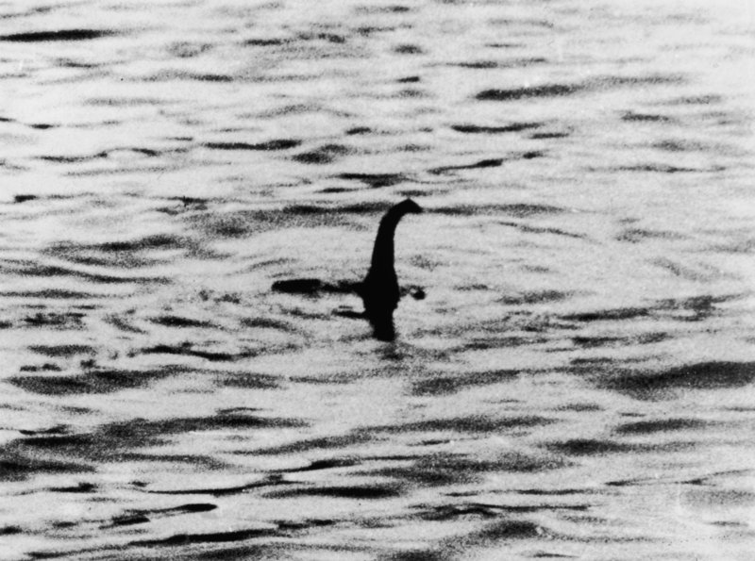
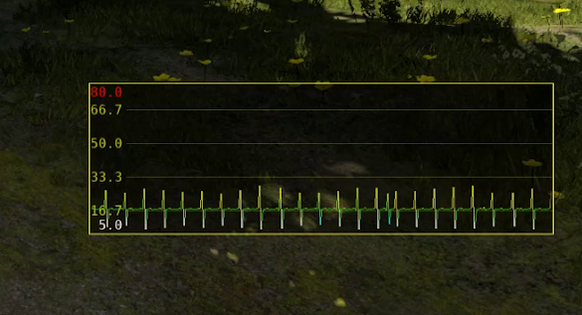
Notes:
Reminds of paranormal phenomena, doesn’t it?
Paranormal is “something that happens behind the edge of normal”
This indeed happens in edge cases that are very hard to reproduce.
a week to find exact settings to catch this video! Felt like a Sasquatch hunter.

Slide 19
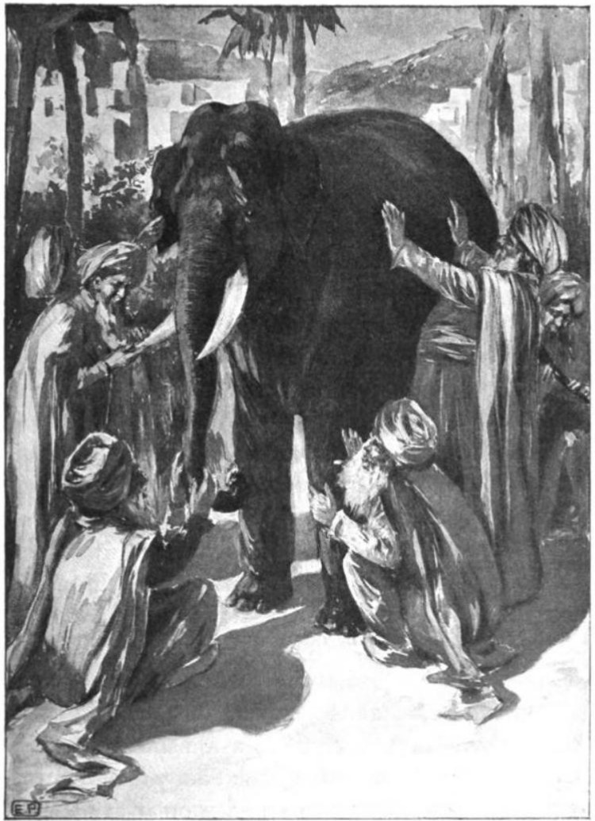
The Parable of Blind Men and an Elephant
Notes:
they are seeing a different instance of the problem (or none at all)
depends on CPU/GPU load balance
Influenced by driver versions, background tasks, reboots, game restarts… yes, probably even gamepad disconnecting
Being able to reproduce this reliably was of crucial importance
Once we were about to do that (back in 2012!) we were able to see what the elephant really looks like.

Slide 20
frameology
(n.) The scientific study of the behaviour, structure, physiology, classification, and distribution of frame stuttering.
Notes:
And we’ve studied the elephant in detail!
Let me show you our most important finding...

Slide 21
[Talos] Heartbeat to Perfect
Notes:
Here we see an untamed specimen of heartbeatus vulgaris in the wild…
… and here we are testing our hypothesis on the specimen.
Boom!

Slide 22
what’s the secret?
Notes:
What did I do there?
Nothing that changed the performance of the game in any way. I swear.
Let’s look those two side-by-side...

Slide 23
[Talos] Heartbeat vs Perfect - split
Notes:
Notice that they are both moving all the time
Contrary to the common belief - the sttutery part isn’t actually skipping frames

Slide 24
are you sure it’s
not skipping frames?
Notes:
How can I be sure it’s not skipping frames?
It might be easier to see it, if we align them like this...

Slide 25
[Talos] Heartbeat vs Perfect - split slow

Slide 26
what was that?
Notes:
There - did you see that one frame?
Let’s zoom further into this...

Slide 27
The stuttering case is “faster” than the perfect case?!?!
Notes:
The tree is actually moving to the right
The “heartbeat” version is going _ahead_
So the stutter is not actually slower - it is faster?!?!?

Slide 28
Actually, it’s the opposite!
Notes:
The frame time delta in stuttering case appears bigger than in perfect case (“slower frame”), thus the simulation is pushed a bit further ahead.
But the frame is actually still displayed after 16ms.
Thus stutter.

Slide 29
Stutter happens because the game doesn’t know how fast it is displaying!
Notes:
Let this sink. It’s not actually missing frames. It just doesn’t know it!

Slide 30
The Secret
“Dear game, pretend that this is 60 FPS.”
Magic!
Because it always was running perfectly anyway!
Notes:
What we typed in the console there was “let’s ignore all timings and pretend each frame is 16ms”
Let’s look at this again.

Slide 31
[Talos] Heartbeat to Perfect

Slide 32
Why does the game “think” it is running slower?
80’s/90’s - 8-bit/16-bit era
Fixed hardware, always same timing - no problems.
Remember the different NTSC/PAL versions?
‘90’s/00’s - software rendering/”graphics accelerators”
Started doing timing and interpolation
But no pipelining - no problem.
What’s going on today?
Don’t know exactly but...

Slide 33
Theory: “API’s/Driver’s fault”*
the real GPU load is “hidden” from the game
The “feature” possibly introduced by “driver benchmarking wars” in early 2000s
Indicative by Flush() and Finish() behavior changing at that time
Compositors are not helping either
Internal mechanisms that are trying to compensate for this?
That’s why this was so hard to find!
Inevitable anyway - to use pipelined hardware to its potential
It’s OK to “buffer the slack time” - but we need to know!
* Largely speculation. :)
Notes:
Take all of this with a large grain of salt…. But it doesn’t really matter
What matters is that the game doesn’t know what the frame timing is.

Slide 34
The two faces of wrong timing:
#1 - Wrong timing feedback
Major cause of “heartbeat” stutter (but also sometimes others).
#2 - Wrong frame scheduling
Major cause of stutter when recovering from “slow” to “perfect”
Notes:
#1 Game doesn’t know how long a particular frame was shown on screen.
#2 Frame being shown earlier/later than the game expected it to happen.

Slide 35
Proposal
Must know how long a past frame lasted.
Asynchronous.
Will need to use heuristics
Must accept that it is not perfect.
Ideally, know how long the next frame will last. But that’s not possible.
Or is it???
Must be able to schedule when the next frame is shown.
Faster is not always better!
Must know how much leeway we have left.
This is actually the most problematic part.

Slide 36
The old algorithm
frame_step = 16.67 ms // (assuming 60fps as initial baseline) current_time = 0 while(running) Simulate(frame_step) // calculate inputs/physics/animation... using this delta RenderFrame() current_time += frame_step PresentFrame()// scheduled by the driver/OS¹ frame_step = LengthOfThisFrame() // calculated by the game²
¹Who basically doesn’t have a clue. ²Who basically doesn’t have a clue.
Notes:
Will not talk much about this

Slide 37
The new algorithm
frame_step = 16.67 ms // (assuming 60fps as initial baseline) current_time = 0 pending_frames_queue = {} // (empty) frame_timing_history = {} while(running) Simulate(frame_step) // calculate inputs/physics/animation... using this delta RenderFrame() current_time += frame_step current_frame_id = PresentFrame(current_time) AddToList(pending_frames_queue, current_frame_id) QueryFrameInfos(pending_frames_queue,frame_timing_history) frame_step = FrameTimingHeuristics(pending_frames_queue, frame_timing_history)
legend: New APIs New App Algorithm
Notes:
Will not talk much about this

Slide 38
Internals of FrameTimingHeuristics()
Poll all in pending_frames_queue - for those that are already available
record their respective timings into the frame_timing_history.
If you see any single frame that missed its schedule,
Return its length to be used for frame_step
(this is how we drop into lower framerate!)
If you see recovery_count_threshold* successive frames that are both
Early and
Their margin < recovery_margin_threshold*
Return their length to be used for frame_step
(this is how we bump into higher framerate
*recovery_count_threshold and recovery_margin_threshold assure we don't start oscillating up/down

Slide 39
OpenGL + VDPAU prototype
Implemented in The Talos Principle as proof of concept in Aug 2015
Uses NV_present_video OpenGL extension
Originally intended for video playback - thus has timing features
Almost there:
Properly schedule future frames
Get timing info for past frames
But no margin info
Makes it very hard to recover
Only works on some NVIDIA boards, on Linux, under OpenGL
Not very wide coverage, but proved the point

Slide 40
Vulkan + VK_GOOGLE_display_timing
Implemented in The Talos Principle and Serious Sam Fusion…
.... just in time for this talk
Has everything:
schedule future frames
timing info for past frames
has margin info
ambiguity?

Slide 41
the results

Slide 42
remember the “spikes”?

Slide 43
[Talos] Spikes w/GDT
Notes:
They look much better now, don’t they?

Slide 44
“jagged”?

Slide 45
[Talos] Jagged w/GDT

Slide 46
“heartbeat”?

Slide 47
[Talos] Heartbeat w/GDT

Slide 48
“heartbeat”
has turned into
“perfect”!

Slide 49
20 FPS???
check this out...
”Acceptable frame-rates in GLQuake begin at 20 FPS, and 25 FPS for GLQuakeWorld” (from Comparison of Frame-rates in GLQuake Using Voodoo & Voodoo 2 3D Cards, by "Flying Penguin (Mercenary)" cca year 1999. )
In those days spirits were brave, the stakes were high, …. and framerates sucked???
Was the tolerance really that low?
Probably, but also - those 20 FPS were certainly smoother than “today’s” 20 FPS!

Slide 50
[Talos] 20 FPS w/GDT

Slide 51
Internals of FrameTimingHeuristics()
But don’t stick to this!
Poll all in pending_frames_queue - for those that are already available
record their respective timings into the frame_timing_history.
If you see any single frame that missed its schedule,
Return its length to be used for frame_step
(this is how we drop into lower framerate!)
If you see recovery_count_threshold* successive frames that are both
Early and
Their margin < recovery_margin_threshold*
Return their length to be used for frame_step
(this is how we bump into higher framerate
*recovery_count_threshold and recovery_margin_threshold assure we don't start oscillating up/down

Slide 52
Considerations
When to decide to recover from slow back to perfect?
How (and whether?) to correct for timing when dropping to slow?
Can we predict slow and make a perfect drop?
This would be the “Holy Grail” of smoothness - when possible.
Can probably do even better than this!
What about VRR displays? What if Vsync is off?
That’s both doable - but still no API for it yet!

Slide 53
Subjectivity
It is a matter of perception in the end
Perhaps some people see it differently
Different developers will have different approaches
Expose different options to users?

Slide 54
Platform support...
VK_GOOGLE_display_timing was defined Mar 2017 , but…
Only Android - only Shield TV and a handful others
As of last month, available on Linux in RADV driver as part of Mesa!
Everyone else - Please implement ASAP! 😊
DirectX 12?
Metal?

Slide 55
Does this always apply?
Only if FPS can fall below refresh rate
Consoles? Probably not.
Thinner drivers
Tighter control of the hardware
Known configurations
No (unpredictable) background tasks
PC? Mobile? Definitely!
Opaque drivers
Compositors
Varying configurations
Background tasks

Slide 56
Do we really need an API for this?
Perhaps could determine timing with GPU queries
But what about the compositor?
Cannot schedule frames later than GPU is done
Even if you manage - how to know when to recover?
Is someone already doing it without the API?
The anti-microstutter fix kludge
API should be available “for the greater good”!
API is not imposing an approach - heuristics are still up to the developer.
Not just for games!
Video players are in a sad condition today.

Slide 57
Is GOOGLE_display_timing perfect?
It is incomparably better than the next alternative.
Slight ambiguity of the “margin”
But this only matters in how soon you can recover
Not actually smoothness problem, but extra “bonus” performance problem
Might be worked on

Slide 58
Praise to the brave engineers who made this possible...
Dean Sekulić (Croteam)
Tracking down the first Sasquatch in the wild (~2012!)
James Jones (NVIDIA)
VDPAU idea
Karlo Jež (Croteam)
Implementing VDPAU prototype and the VK_GOOGLE_display_timing version
Aaron Leiby (Valve)
pointing out problems with our early ideas
Ian Elliot (Google)
defining the VK_GOOGLE_display_timing extension
Pierre-Loup A. Griffais and Keith Packard (Valve)
for the Mesa implementation
Everyone at Vulkan Advisory Panel
long and productive discussions about this
Andrei Tatarinov and Liam Byrne (Nvidia)
for making this talk happen

Slide 59
Thank you!
The Elusive Frame Timing
Questions?
(Wrap up room: Overlook 3022 & 3024)
Alen Ladavac
@AlenL
alenl@croteam.com
A Case for Smoothness Over Speed

